Slide 1
Europe PMC Section Tagger
Şenay Kafkas
EMBL-EBI
Literature Services
6-10-2014

Slide 2
Outline
Motivation
Implementation Details
Performance Analysis
Use Cases
Europe PMC Section Level Search Functionality
Section tagging in ContentMine (Demo by Richard)

Slide 3
Motivation: Why do we need for sectioning documents?
Aim: automatically classifying sequences of text-spans (e.g. segments/sections, sentences) within a document into predefined categories such as “Introduction”, “Methods” or “Results.”
Can aid curation tasks: better understanding and prioritisation of biomedical documents
Example: The section which a given search term appear can play role in determining the document priority: e.g. documents containing a given PDBe citation in Figure legends can be prioritised over the documents having the same citation only in the “Introduction” section
Can aid text mining tasks
Example: In information retrieval processes, document sectioning would help to reduce the noise: e.g. A search engine which operates based on a section tagger, would allow to ignoring those articles which contain a given PDBe citation only in the “References” section.

Slide 4
Implementation Details
A rule based Section Tagger:
Rules are formed from the top 150 most frequent section headers appearing in the Open Access PMC set (covers 85% of total no. of headers)
E.g. “Conclusion & Future Work” => (conclusion| key message|future|summary|recommendation|implications for clinical practice|concluding remark)
17 different section category types:
Introduction & Background, Materials & Methods, Discussion, Conclusion & Future Work, Case Study, Acknowledgement & Funding, Author Contribution, Competing Interest, Supplementary Data, Abbreviations, Key words, References, Appendix, Figures, Tables, Other

Slide 5
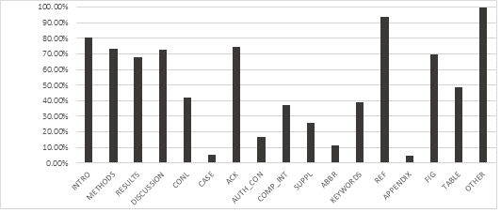
Performance Analysis
Estimated manually on a randomly selected set of 100 full-text articles
Precision= 99.84%
Recall=96.27%
F-score=98.02%
Analysis on the
Open Access
articles

Slide 6
Availability
http://europepmc.org/ftp/oa/SectionTagger/

Slide 7
A Use Case: Section Level Search Functionality in Europe PMC
A search engine which allows users to search particular parts of an article, would allow fine-tune searches and reducing noise
Provided in two ways:
1. In the default full text search, we can now exclude articles from search results that contain the search terms only in the “References” section
2. From the Advanced Search (http://europepmc.org/advancesearch)
Demo
http://europepmc.org/search?query=%22protein%20structure%22
http://europepmc.org/search?scope=fulltext&page=1&query=%28FIG%3A%22protein+structure%22%29
http://europepmc.org/search?query=%28ACK_FUND:%22Janet+Thornton%22%29&page=1

Slide 8
Another Use Case: Section tagging in ContentMine
Demo by Richard

