Slide 1

UCL - ContentMine Project
Systematic rapid evidence assessment
Meeting agenda and deliverables: (CG)
Software development progress (PMR)
Metrics (CHJH)
Use of GROBID (CHJH / PMR)
Training (all)
Issues (all)
Next steps (all)
CG Cesar Gomez
CHJH Chris Hartgerink
PMR Peter Murray-Rust
TA Tom Arrow
ContentMine. 16 Mill Ln, Cambridge CB2 1RX, Cambridge, United Kingdom. E-mail: info@contentmine.org. www.contentmine.org

Slide 2
Software development Strategy
GROBID promising approach to extracting table coordinates
Manual creation of development corpus (SVG tables)
Emphasis on APA-like tables (structured headers)
Develop schema for representing compound documents (“Norma”)
Standards for table output (HTML, CSV and “Tidy Data”)
Hand over to CHJH
ContentMine. 16 Mill Ln, Cambridge CB2 1RX, Cambridge, United Kingdom. E-mail: info@contentmine.org. www.contentmine.org

Slide 3
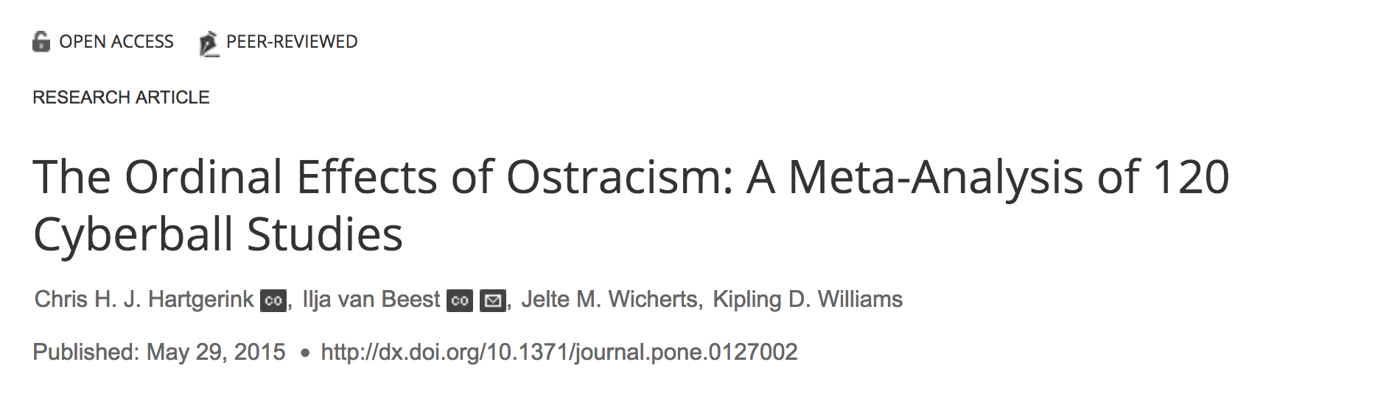

Slide 4
Software development
Software development process
Current status
Example?
ContentMine. 16 Mill Ln, Cambridge CB2 1RX, Cambridge, United Kingdom. E-mail: info@contentmine.org. www.contentmine.org

Slide 5
Software development
Software development process
Current status
Example?
ContentMine. 16 Mill Ln, Cambridge CB2 1RX, Cambridge, United Kingdom. E-mail: info@contentmine.org. www.contentmine.org

Slide 6
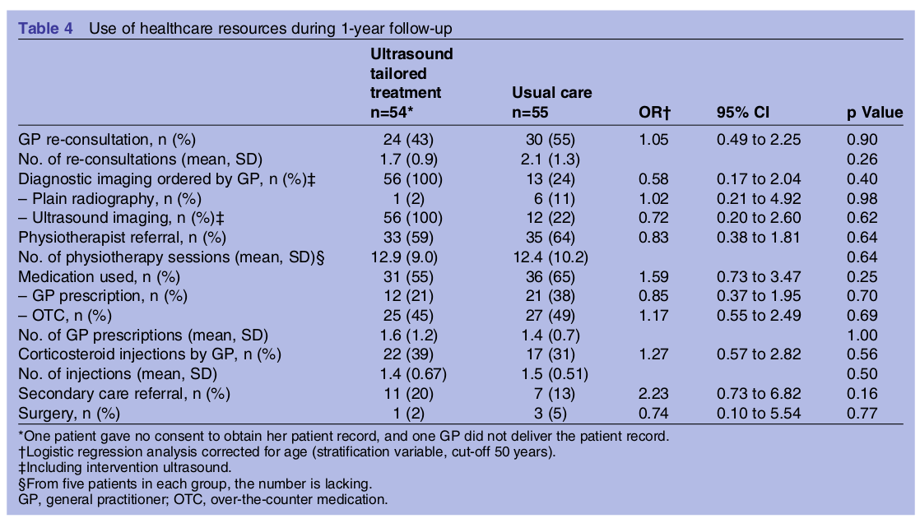
Software development
ContentMine. 16 Mill Ln, Cambridge CB2 1RX, Cambridge, United Kingdom. E-mail: info@contentmine.org. www.contentmine.org

Slide 7
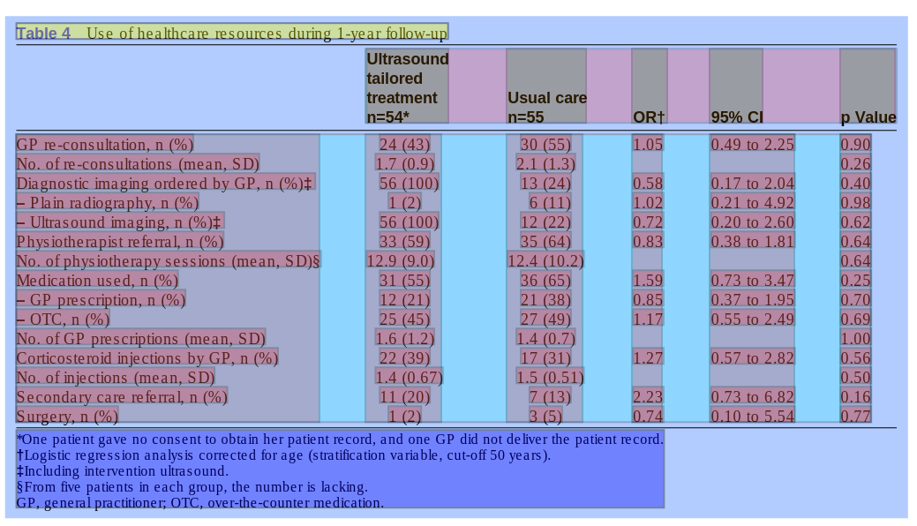
Software development
ContentMine. 16 Mill Ln, Cambridge CB2 1RX, Cambridge, United Kingdom. E-mail: info@contentmine.org. www.contentmine.org

Slide 8
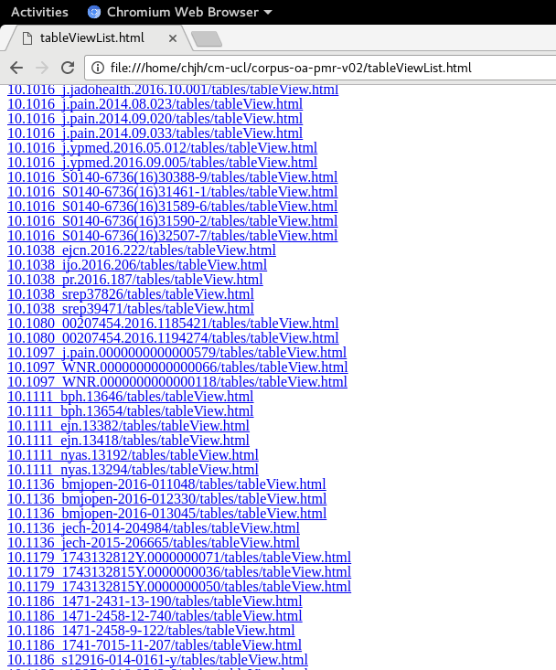
Software development
ContentMine. 16 Mill Ln, Cambridge CB2 1RX, Cambridge, United Kingdom. E-mail: info@contentmine.org. www.contentmine.org

Slide 9
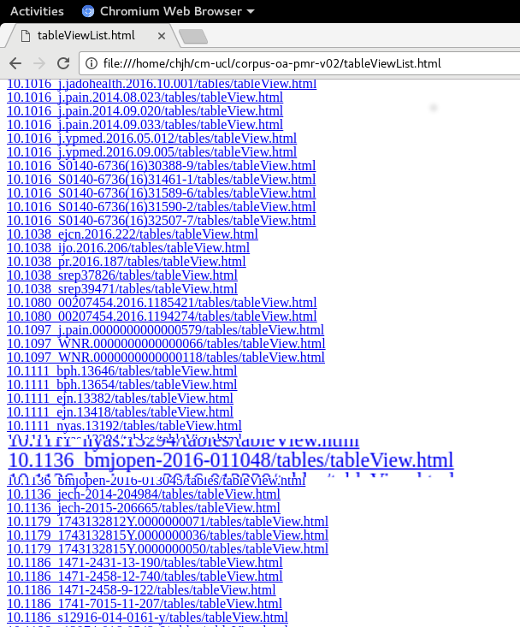
Software development
ContentMine. 16 Mill Ln, Cambridge CB2 1RX, Cambridge, United Kingdom. E-mail: info@contentmine.org. www.contentmine.org

Slide 10
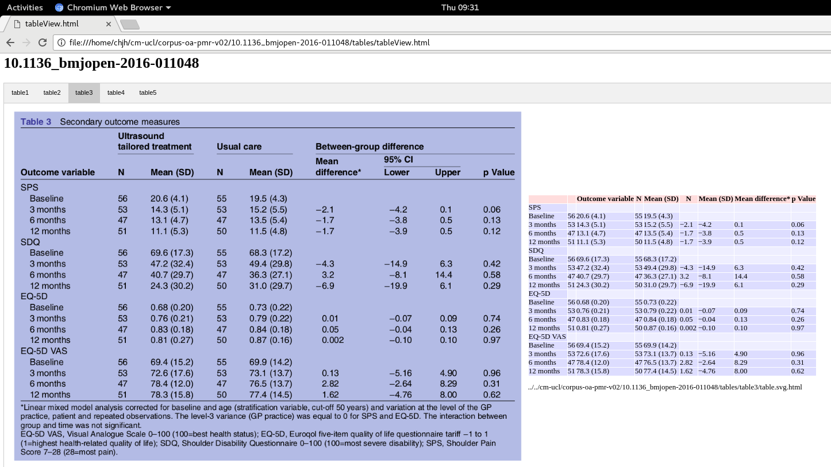
Software development
ContentMine. 16 Mill Ln, Cambridge CB2 1RX, Cambridge, United Kingdom. E-mail: info@contentmine.org. www.contentmine.org

Slide 11
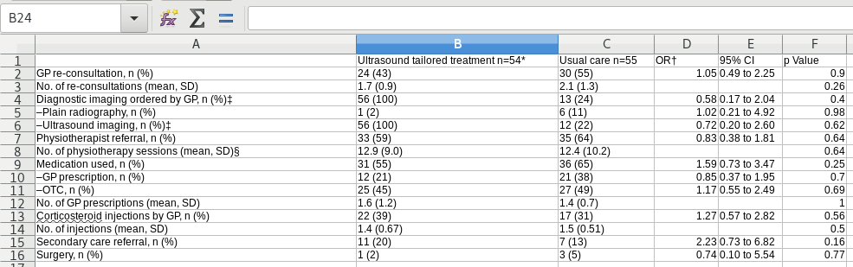
Software development
ContentMine. 16 Mill Ln, Cambridge CB2 1RX, Cambridge, United Kingdom. E-mail: info@contentmine.org. www.contentmine.org

Slide 12
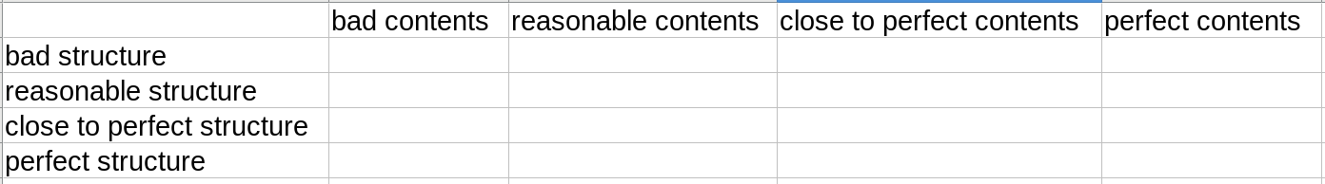
Metrics
ContentMine. 16 Mill Ln, Cambridge CB2 1RX, Cambridge, United Kingdom. E-mail: info@contentmine.org. www.contentmine.org

Slide 13
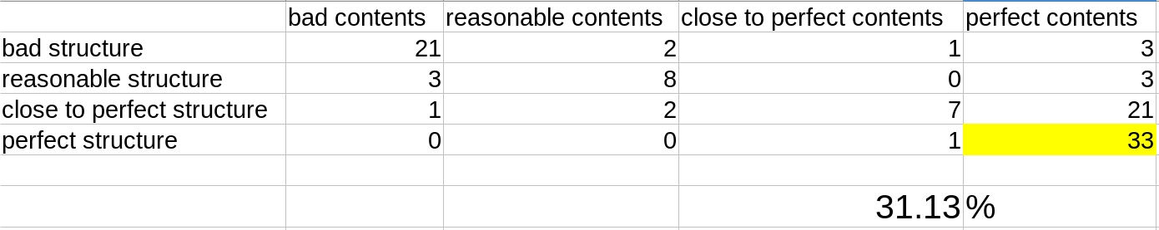
Metrics
ContentMine. 16 Mill Ln, Cambridge CB2 1RX, Cambridge, United Kingdom. E-mail: info@contentmine.org. www.contentmine.org

Slide 14
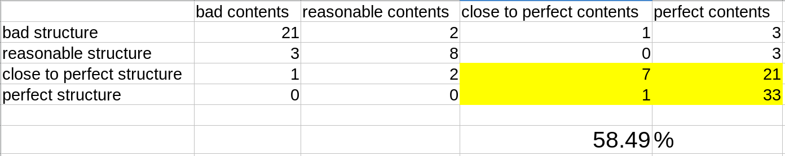
Metrics
ContentMine. 16 Mill Ln, Cambridge CB2 1RX, Cambridge, United Kingdom. E-mail: info@contentmine.org. www.contentmine.org

Slide 15
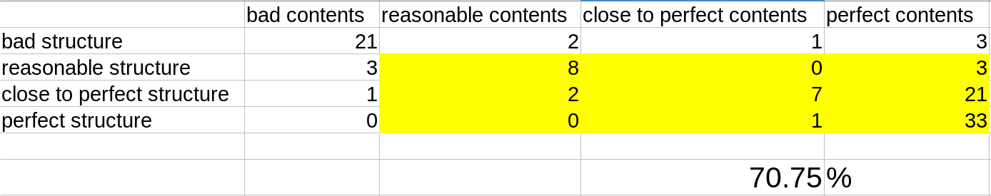
Metrics
ContentMine. 16 Mill Ln, Cambridge CB2 1RX, Cambridge, United Kingdom. E-mail: info@contentmine.org. www.contentmine.org

Slide 16
Training
Training Material
Scope
Dates
ContentMine. 16 Mill Ln, Cambridge CB2 1RX, Cambridge, United Kingdom. E-mail: info@contentmine.org. www.contentmine.org

Slide 17
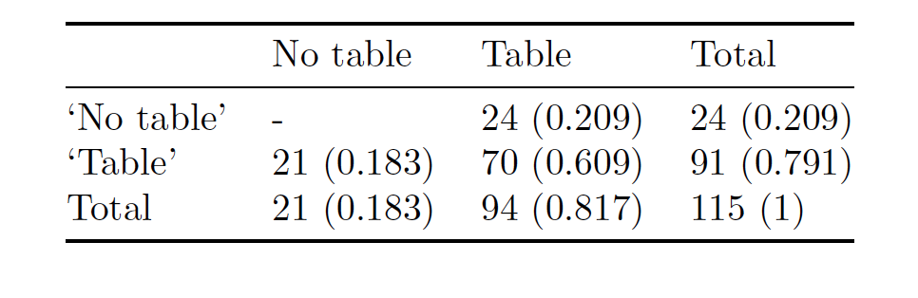
GROBID

Slide 18
Issues
Customisation “Templates” – OMITTED
Installing and Running
Integration
Use and training
UCL issues
ContentMine. 16 Mill Ln, Cambridge CB2 1RX, Cambridge, United Kingdom. E-mail: info@contentmine.org. www.contentmine.org

Slide 19
Next steps
Validation strategy
Training session
Metrics report presentation
Integration strategy
Project timeframe
AOB
ContentMine. 16 Mill Ln, Cambridge CB2 1RX, Cambridge, United Kingdom. E-mail: info@contentmine.org. www.contentmine.org

