Slide 1
About ContentMine
What do we do, and why?
How can this be useful to you?

Slide 2
The right to read is the right to mine.
The Hargreaves report (UK) allowing limitations and exceptions for non-commercial content mining research

Slide 3
OUR MISSION
“make 100,000,000 facts from the scholarly literature open, accessible and reusable”
*Ulrich’s database: http://ulrichsweb.serialssolutions.com/login

Slide 4
THE SCALE OF THE TASK
~ 27,000 peer reviewed journals*
> 5,000 publishers
~ 3,000 new papers per day
“costing” 15 Billion USD to publish
Representing 500 Billion USD of research
*Ulrich’s database: http://ulrichsweb.serialssolutions.com/login

Slide 5
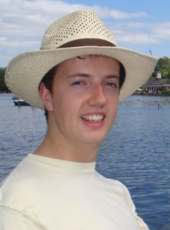
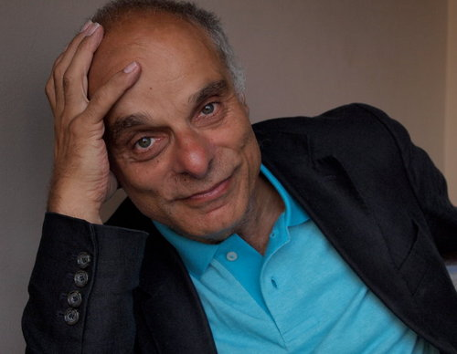
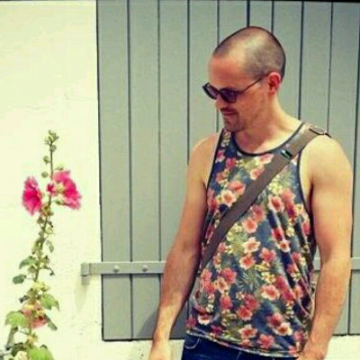
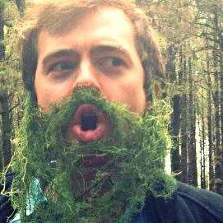

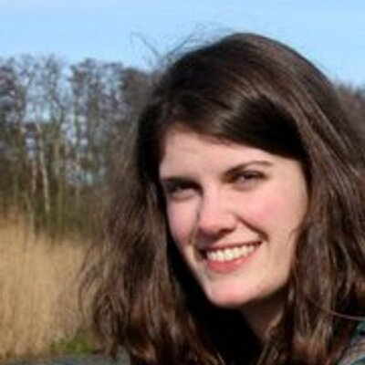
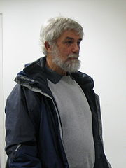
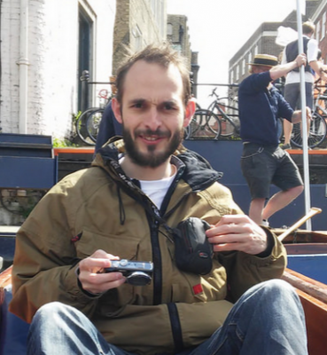
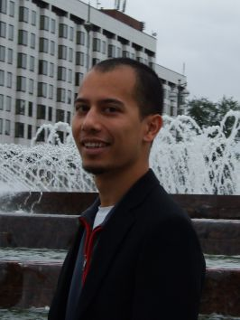
OUR TEAM
Ross Mounce
@rmounce
Mark MacGillivray
@cottagelabs
Charles Oppenheim
@CharlesOppenh
Richard Smith-Unna
@blahah404
Graham Steel
@McDawg
Jenny Molloy
@jenny_molloy
Stephanie Smith-Unna
@treblesteph
Peter Murray-Rust
@petermurrayrust
Christopher Kittel
@chris_kittel
Stefan Kasberger
@stefan
kasberger

Slide 6
COLLABORATIONS
University of Bath: PLUTo (Phyloinformatic Literature Unlocking Tools)
OpenKnowledge: FutureTDM (H2020)
OpenTrials: Clinical Trials

Slide 7
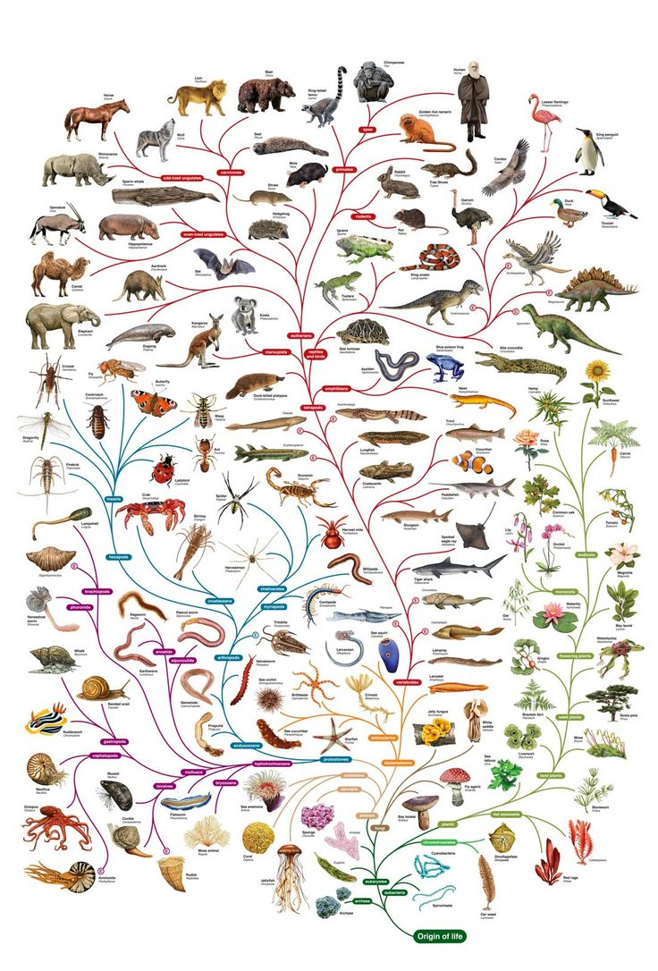
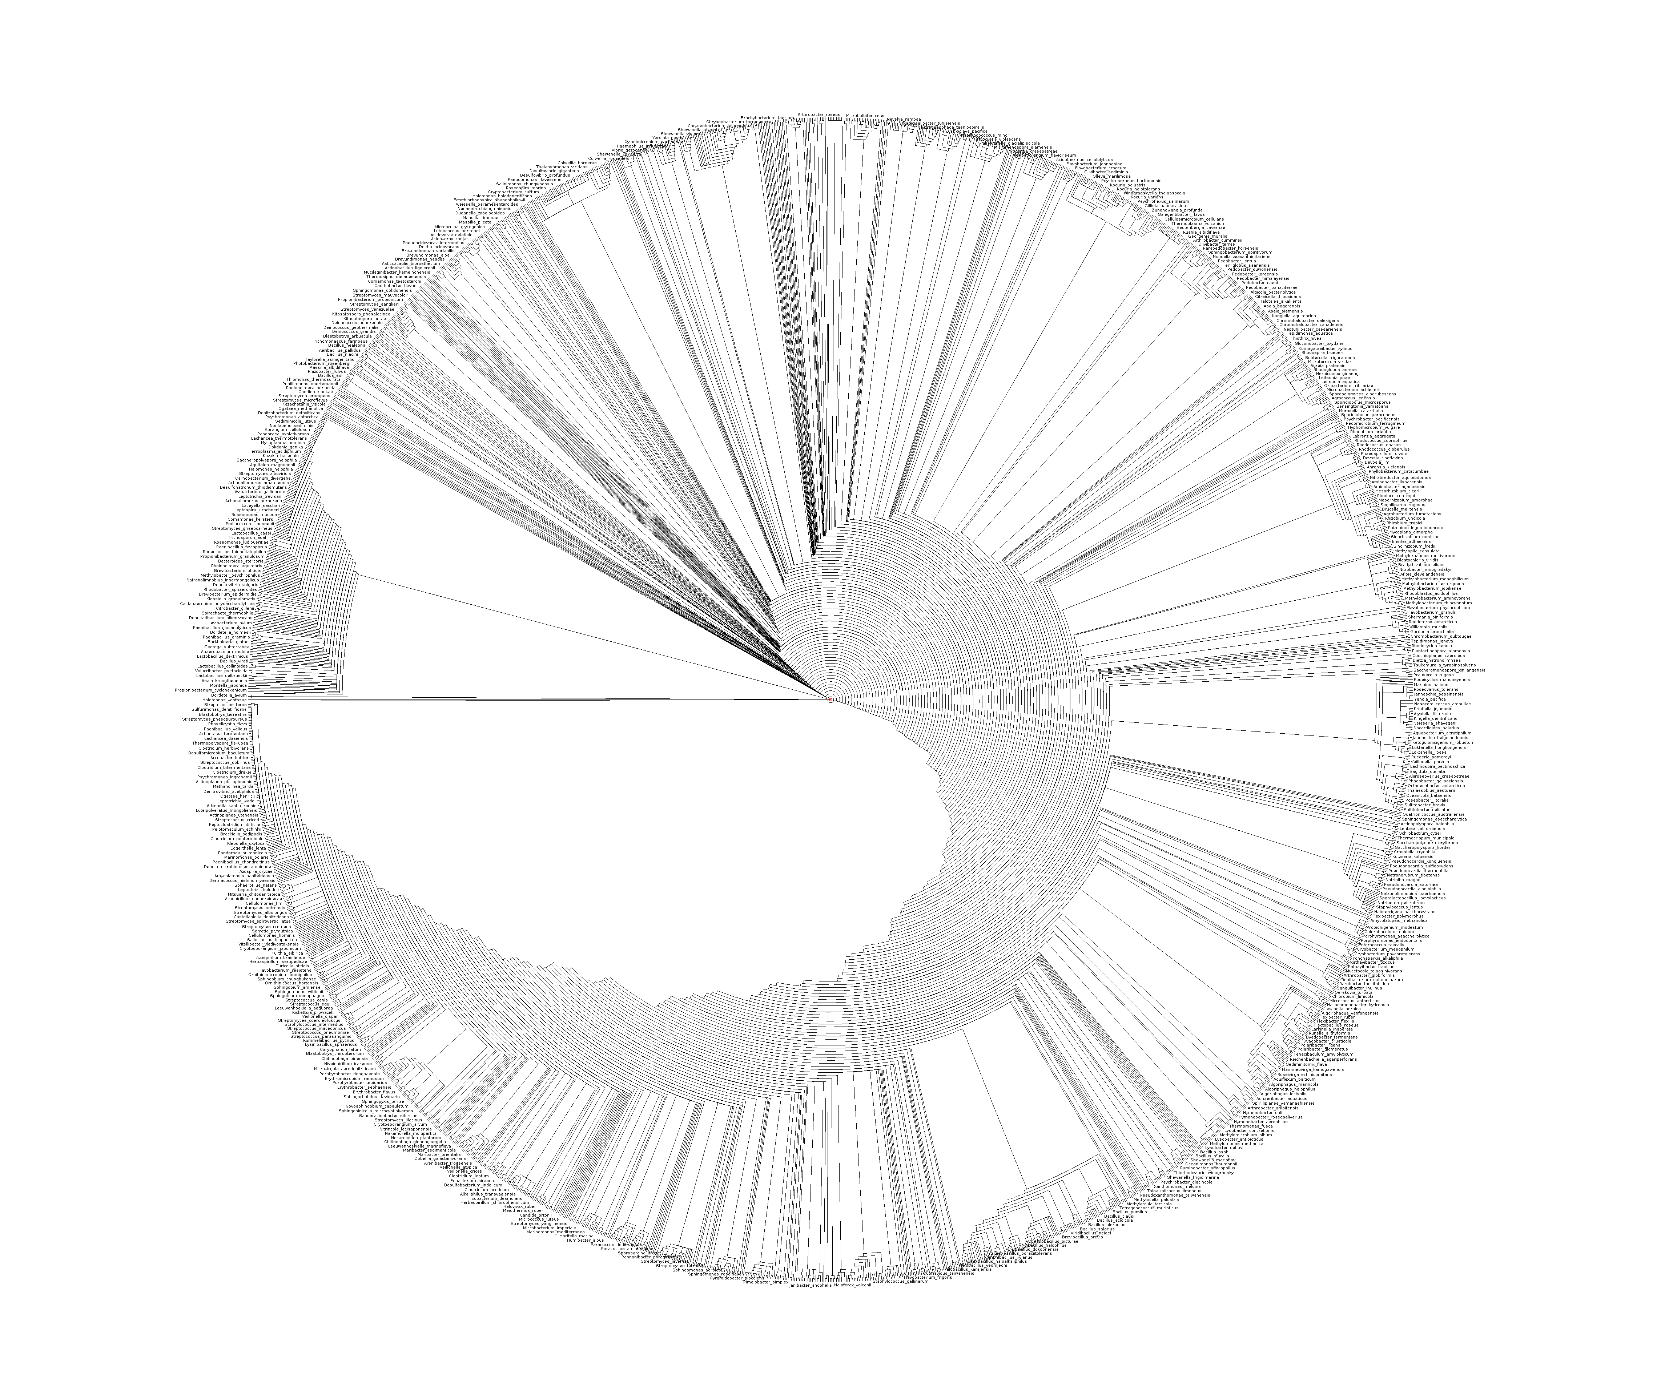
PLUTo
http://www.open.ac.uk/science/main/schools/tree-life-resources

Slide 8
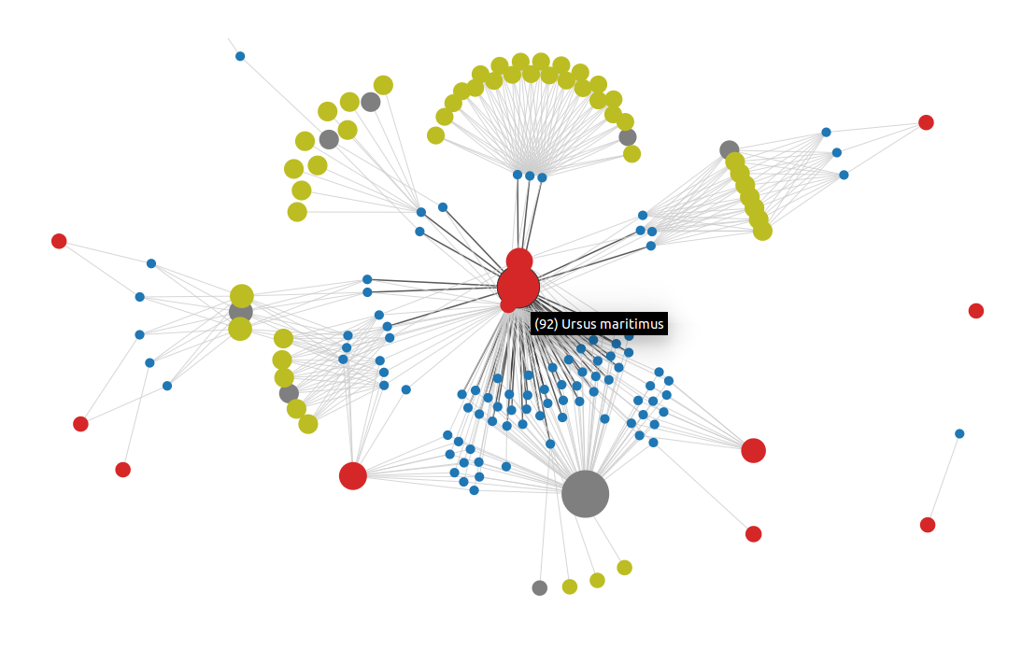
Bubbles

Slide 9
What can content mining do for you?
Describe your research question
How can the use of large text collections help?

