Slide 1
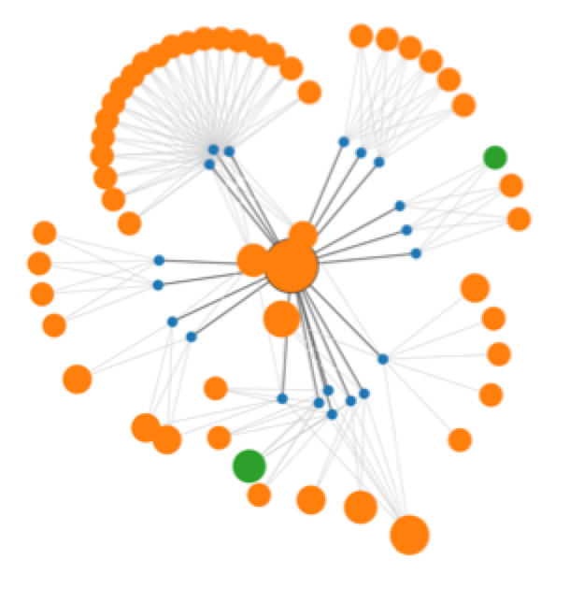
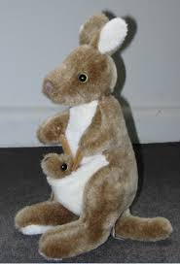

ContentMine tools:
What happens where?
EuPMC, arXiv
CORE , HAL,
(UNIV repos)
Publisher Sites
Figures
query
Data
PloSONE, BMC, peerJ… Nature, IEEE, Elsevier…
PNG
EPS
crawl
getpapers
CSV
XLS
URLs
DOIs
quickscrape
ToC
services
Daily
Crawl
PDF HTML
DOC ePUB
TeX XML
scrapers
Text
UNIV
Repos
COMMUNITY
Normalizer
Sectioner
Semantic
Tagger
norma
taggers
search
plugins
abstract
Captioned
Figures
Facts
methods
Fig. 1
catalogue
ami
HTML tables
references
CONTENT
MINING
Visualization
and Analysis
Lookup
Up to 30, 000 pages/day Semantic ScholarlyHTML

Slide 2
Finding, scraping and norma-lizing papers
Scientific literature
Scrapers
Per-Journal,
Community-maintained
Taggers
Per- Journal
PDFs
PDFs
XMLs
URLs
XMLs
getpapers
quickscrape
norma
sHTML
DOCs
search query
DOIs
CSVs
badHTML
Repositories
Green: possible user entry points
Red: possibilites for community contributions

Slide 3
Extracting Facts and working with them
select
ami2-genes
AMI
ami2-species
pyCProject
rCProject
sHTML
Index &
Transform
ami2-sequences
ami2-regex
CAT
index
Green: possible user entry points

Slide 4
And in practice?
We will now have a closer look at:
publisher APIs and scope of data sources
CProject/CTree
fulltext.xml / scholarly.html
Facts in context

