Slide 1
Scraping
quickscrape scrapes URLs with the help of
scraper definitions in order to find and retrieve metadata and additional material

Slide 2
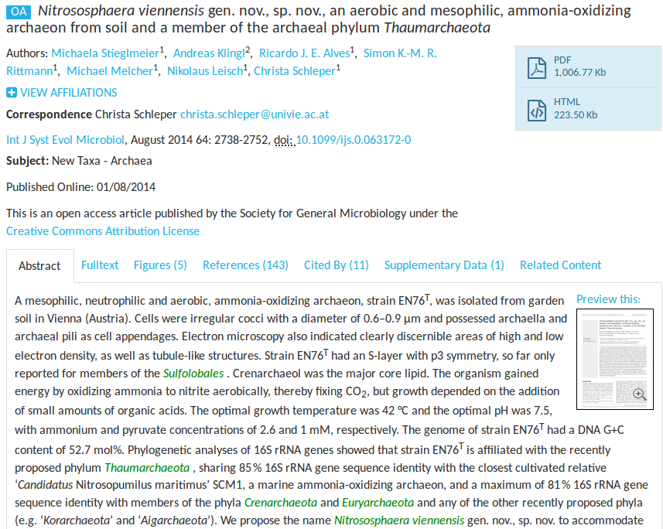

Slide 3
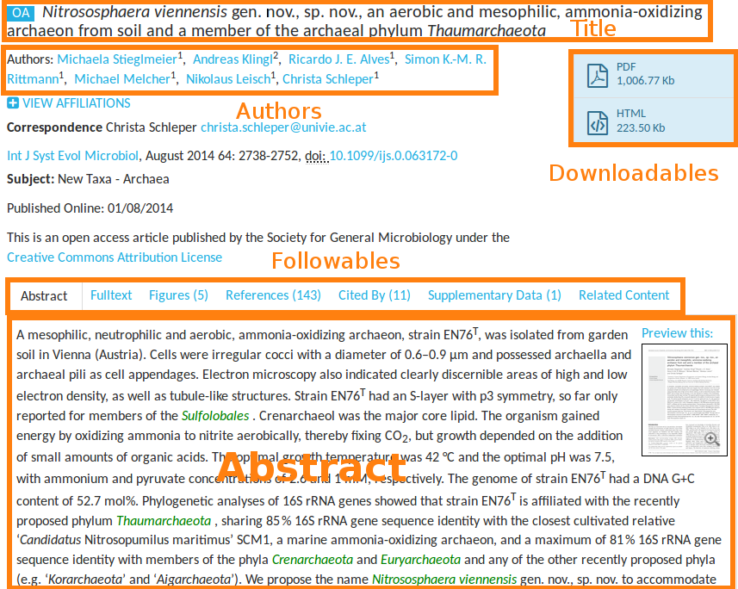

Slide 4
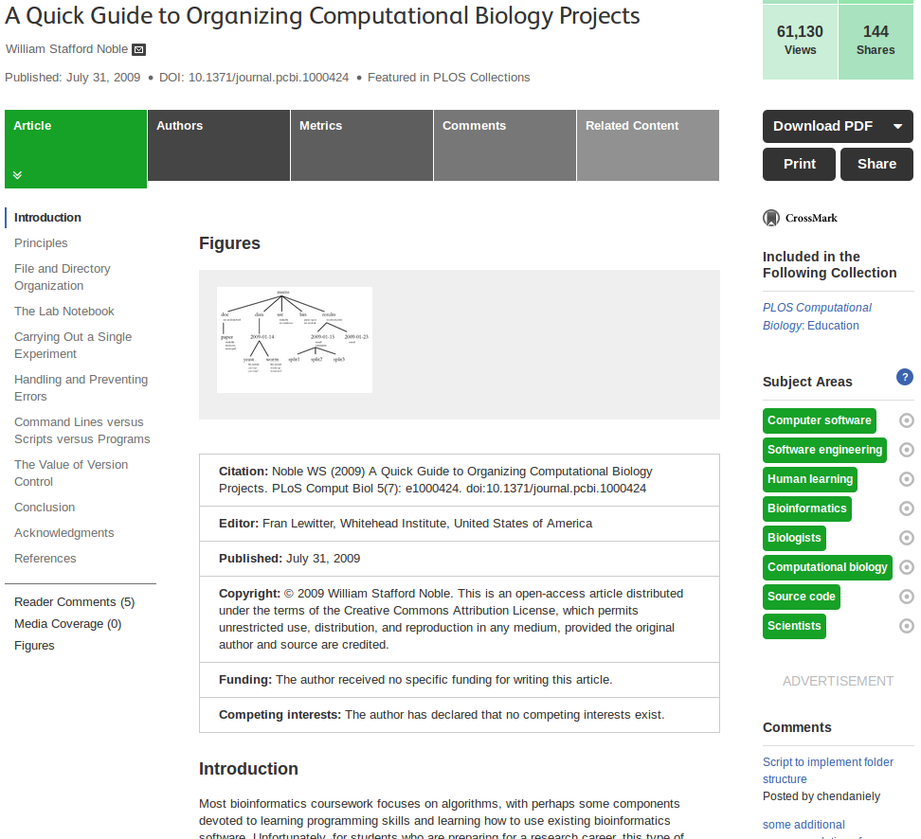

Slide 5
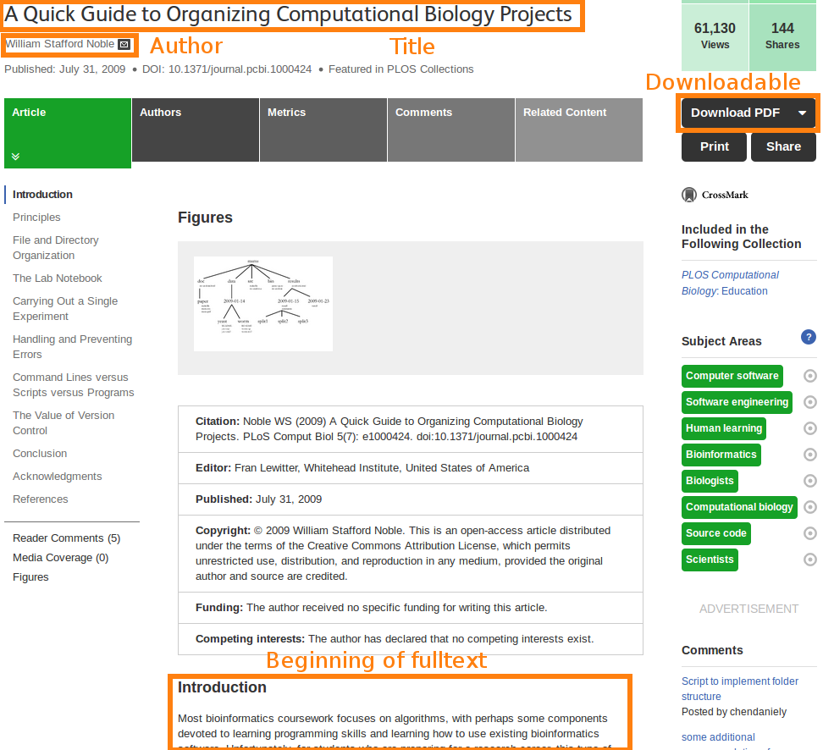

Slide 6
Scraping
scraper definitions,
per publisher
Paper_A
fulltext.html
Title
Authors
Other Metadata
Fulltext
possibly XML or PDF
Paper_B
fulltext.html
Title
Authors
Other Metadata
Fulltext
possibly XML or PDF

Slide 7
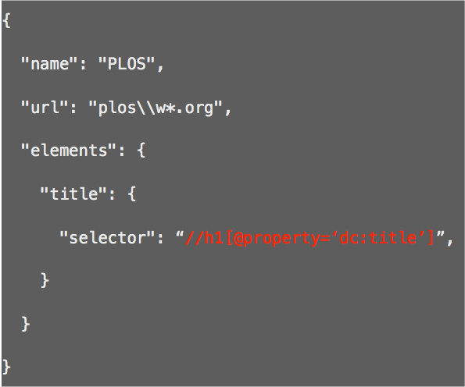
Basic scraper json
name of the scraper:
the URL(s) it applies to:
the elements to capture:
element name:
where to find it:
http://github.com/ContentMine/scraperJSON

Slide 8
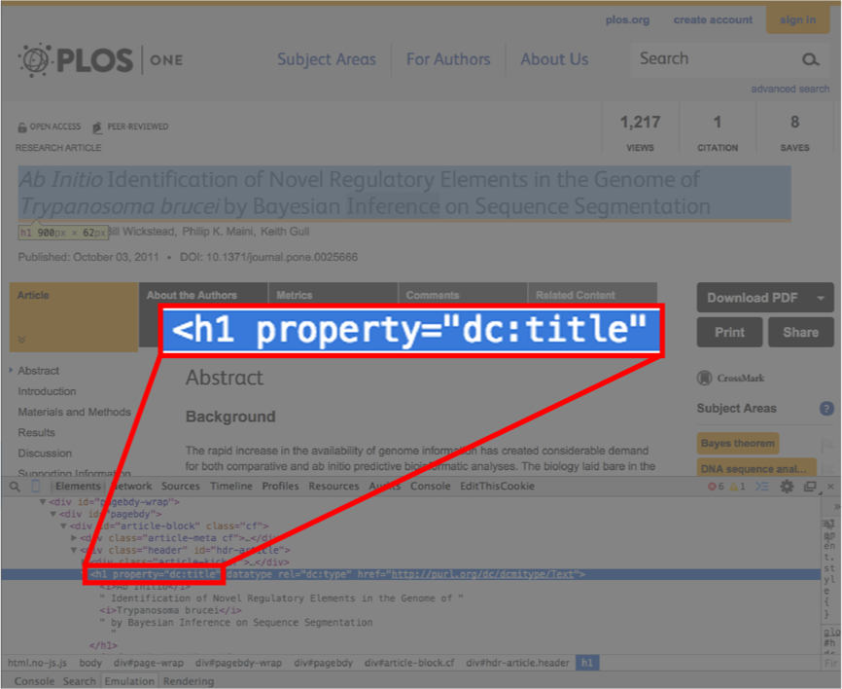

Scraper definitions

Slide 9
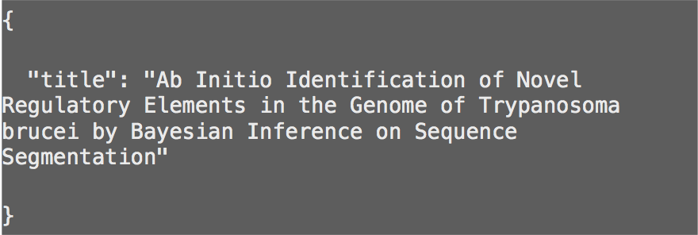
Output: bibjson

Slide 10
Let's get our hands dirty
We will:
Run quickscrape
Compare source-html with scraper output
Get some intuition about scraping

