Slide 1


Software overview
quickscrape & thresher
norma
AMI fact extraction
Notes:
This presentation will be a quick introduction to the ContentMine software for literature scraping, normalising, and fact extraction.

Slide 2
our mission
“make 100,000,000 facts from the scholarly literature open, accessible and reusable”

Slide 3
the scale of the task
~ 27,000 peer reviewed journals*
> 5,000 publishers
~ 3,000 new papers per day
*Ulrich’s database: http://ulrichsweb.serialssolutions.com/login

Slide 4
structured information
chemical names and structures
species
metabolism
phylogenetic trees
Notes:
Because information is structured (some examples listed), we can aggregate similar objects and mine using a modular systematic approach.

Slide 5
collaborations
Mint phylogeny working group
Phyloinformatic Literature Unlocking Tools (PLUTo)
EBI - MetaboLights
OpenFarm
OpenOil / OpenCorporates
Notes:
Can describe each collaboration, but keep this slide brief if the presentation is short.

Slide 6
Software pipeline
journals
(ISSNs)
metadata +
content +
files
product:
fulltext
URLs
facts
process:
crawl
scrape
extract

Slide 7
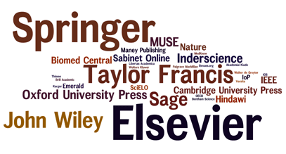
crawling
The latest journal tables of contents at Journal TOCs
http://www.journaltocs.hw.ac.uk/

Slide 8
scrapers
all have the same plumbing
scraping software (thresher) handles the plumbing
scraperJSON is a config file
supports large collections of scrapers
no programming required
not limited to one piece of software

Slide 9
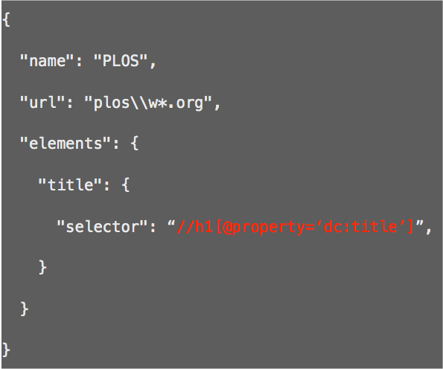
Basic scraper json
name of the scraper:
the URL(s) it applies to:
the elements to capture:
element name:
where to find it:
http://github.com/ContentMine/scraperJSON

Slide 10
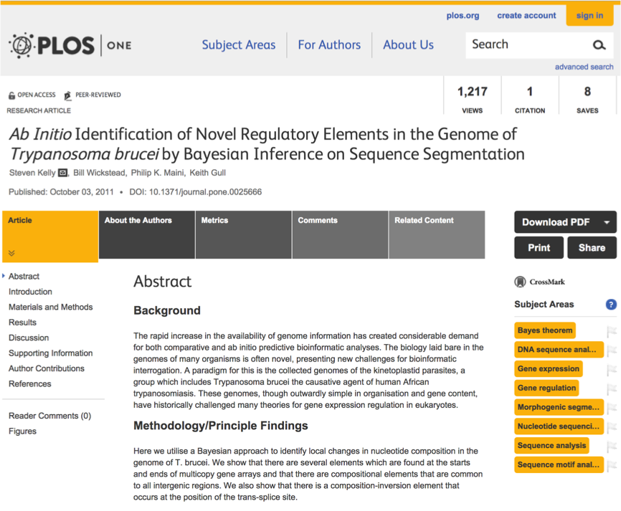
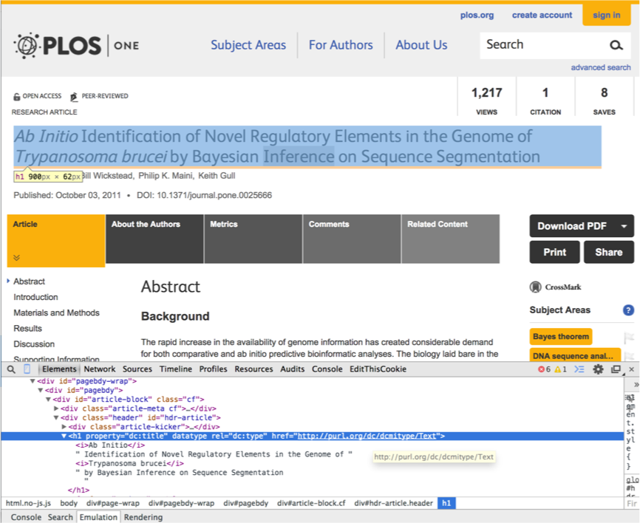
scrapers

Slide 11
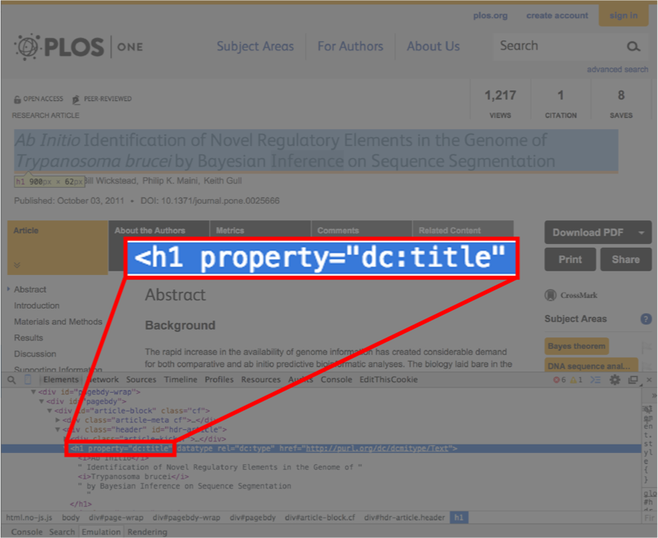

scrapers

Slide 12
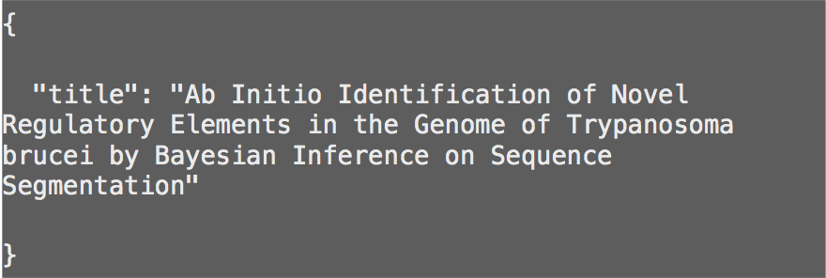
scrapers
bibJSON output

Slide 13

thresher & quickscrape
reference implementation of scraperJSON
thresher is the scraping library
http://github.com/ContentMine/thresher
quickscrape is the command-line tool
http://github.com/ContentMine/quickscrape
Node.js, MIT licensed

Slide 14

journal scrapers
http://github.com/ContentMine/journal-scrapers
a self-testing collection of scraperJSON scrapers for academic journals
PLOS MDPI
PeerJ Wiley
ScienceDirect Taylor & Francis
NPG, AAAS, RSC, ACS Springer

Slide 15
normalisation
quickscrape
HTML
PDF
sHTML
XML
Norma
AMI
fact
extraction
DOC
CSV
Notes:
The normalisation step takes the scraper outputs and transforms them into a processable HTML - scholarly HTML (sHTML)

Slide 16
normalisation
before
after
un-navigable
non-unicode
pixel glyphs
no structure
processable
sectioned
tagged
structured

Slide 17
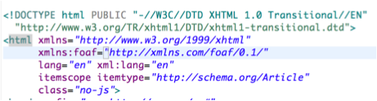

normalisation
mending on a journal-by-journal basis
invalid XHTML from PLOS ONE
invalid XHTML from BMC

Slide 18

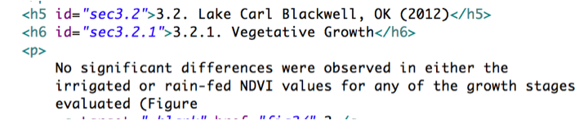
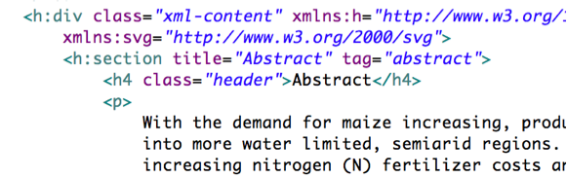


normalisation
document structure
before: un-sectioned HTML from Hindawi
after: sectioned and tagged HTML

Slide 19
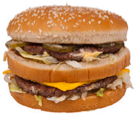
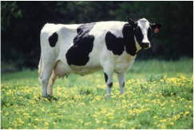
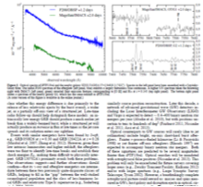
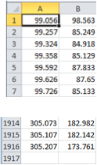
fact extraction
we can’t turn a hamburger into a cow
but we can turn PDFs into science

Slide 20
fact extraction
AMI software: https://bitbucket.org/petermr/ami-core
pixel path shape char word…
para document SCIENCE

Slide 21
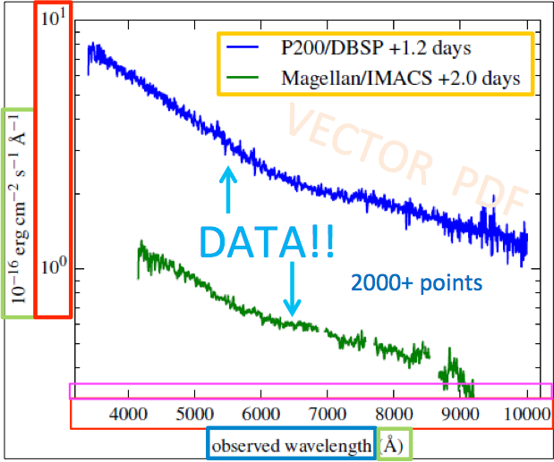
fact extraction
titles
scale
units
ticks
quantity
+ data

Slide 22
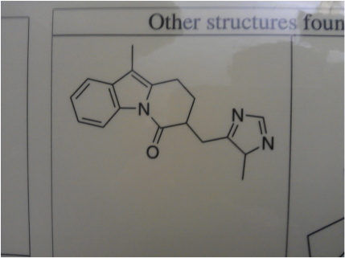
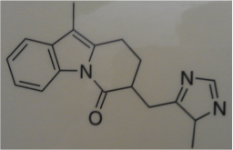
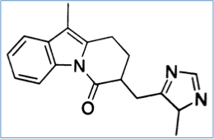
fact extraction
AMI-chem for extracting chemical formulae
raw mobile photo
shadows, contrast, noise, skew
clipping
binarization:
pixels 0 or 1

Slide 23
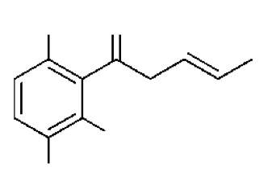
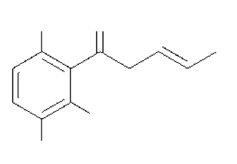
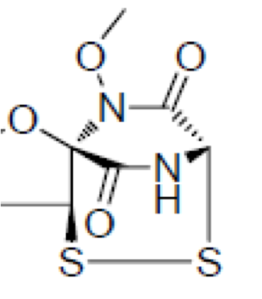
fact extraction
AMI-chem for extracting chemical formulae
thinning
down to 1- pixel
chemical optical character recognition

Slide 24
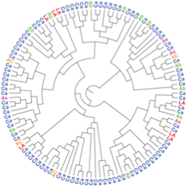
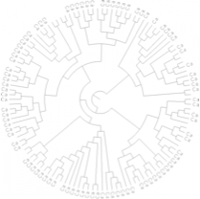
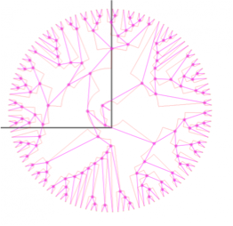
fact extraction
AMI-phylo for extracting phylogenetic trees
thinning
topology

Slide 25
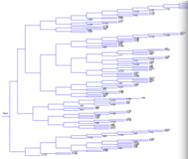
fact extraction
AMI-phylo for extracting phylogenetic trees
((n122,((n121,n205),((n39,(n84,((((n35,n98),n191),n22),n17))),((n10,n182),((((n232,n76),n68),(n109,n30)),(n73,(n106,n58))))))),((((((n103,n86),(n218,(n215,n157))),((n164,n143),((n190,((n108,n177),(n192,n220))),((n233,n187),n41)))),((((n59,n184),((n134,n200),(n137,(n212,((n92,n209),n29))))),(n88,(n102,n161))),((((n70,n140),(n18,n188)),(n49,((n123,n132),(n219,n198)))),(((n37,(n65,n46)),(n135,(n11,(n113,n142)))),(n210,((n69,(n216,n36)),(n231,n160))))))),(((n107,n43),((n149,n199),n74)),(((n101,(n19,n54)),n96),(n7,((n139,n5),((n170,(n25,n75)),(n146,(n154,(n194,(((n14,n116),n112),(n126,n222))))))))))),(((((n165,(n168,n128)),n129),((n114,n181),(n48,n118))),((n158,(n91,(n33,n213))),(n87,n235))),((n197,(n175,n117)),(n196,((n171,(n163,n227)),((n53,n131),n159)))))));
Newick format can be viewed at:
http://www.unc.edu/~bdmorris/treelib-js/demo.html
serialization

Slide 26
Acknowledgements
Richard Smith-Unna, Dept Plant Sci, Univ. Cambridge
Andy Howlett, Dept Chemistry, Univ. Cambridge
Mark Williamson, Dept Chemistry, Univ. Cambridge
Ross Mounce, Biology, Univ. Bath

