Slide 1
What is a “Fact“?
What is a Fact?
Where does it come from?
What can I do with it?

Slide 2
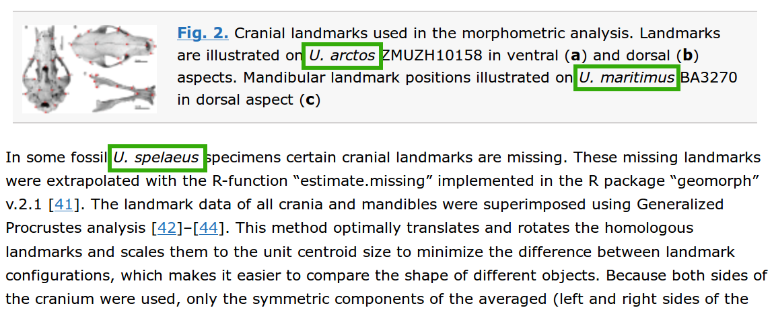
Where do Facts come from?
doi:10.1186/s12862-015-0521-z

Slide 3
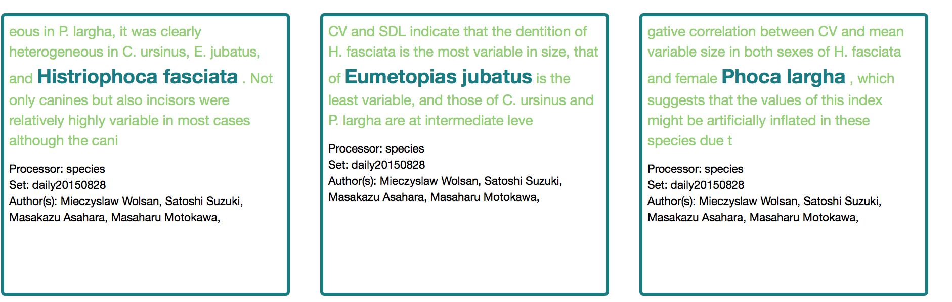
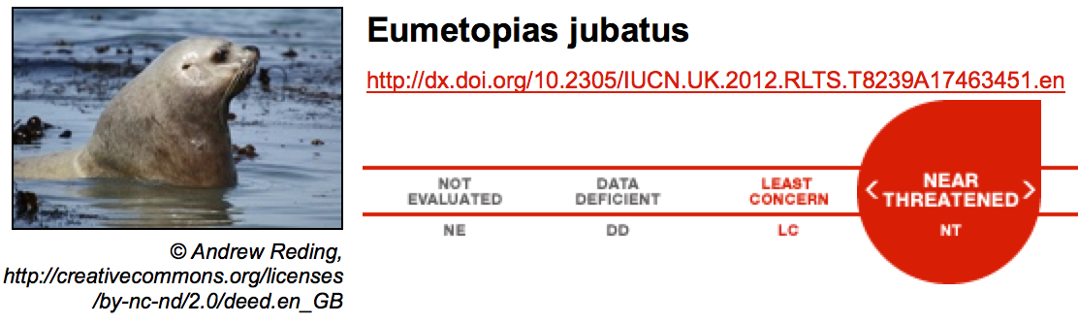
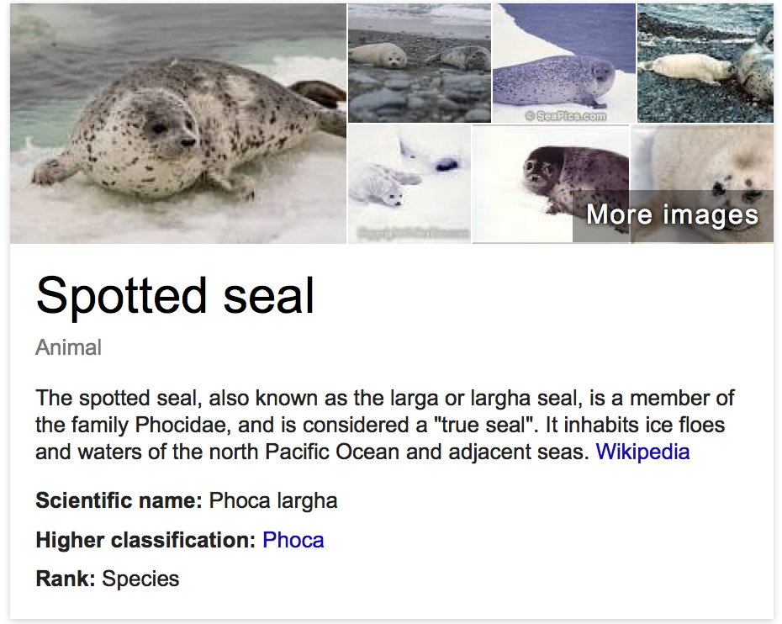
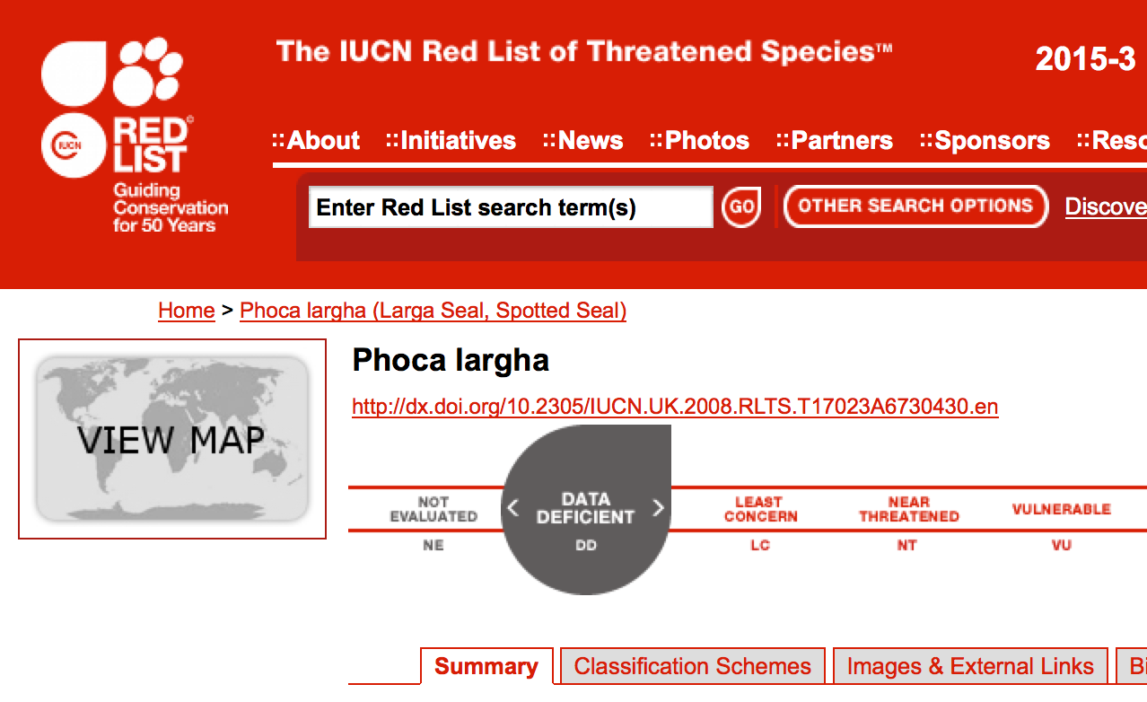
Fact notifications:
IUCN Red List
en.wikipedia.org CC By-SA

Slide 4
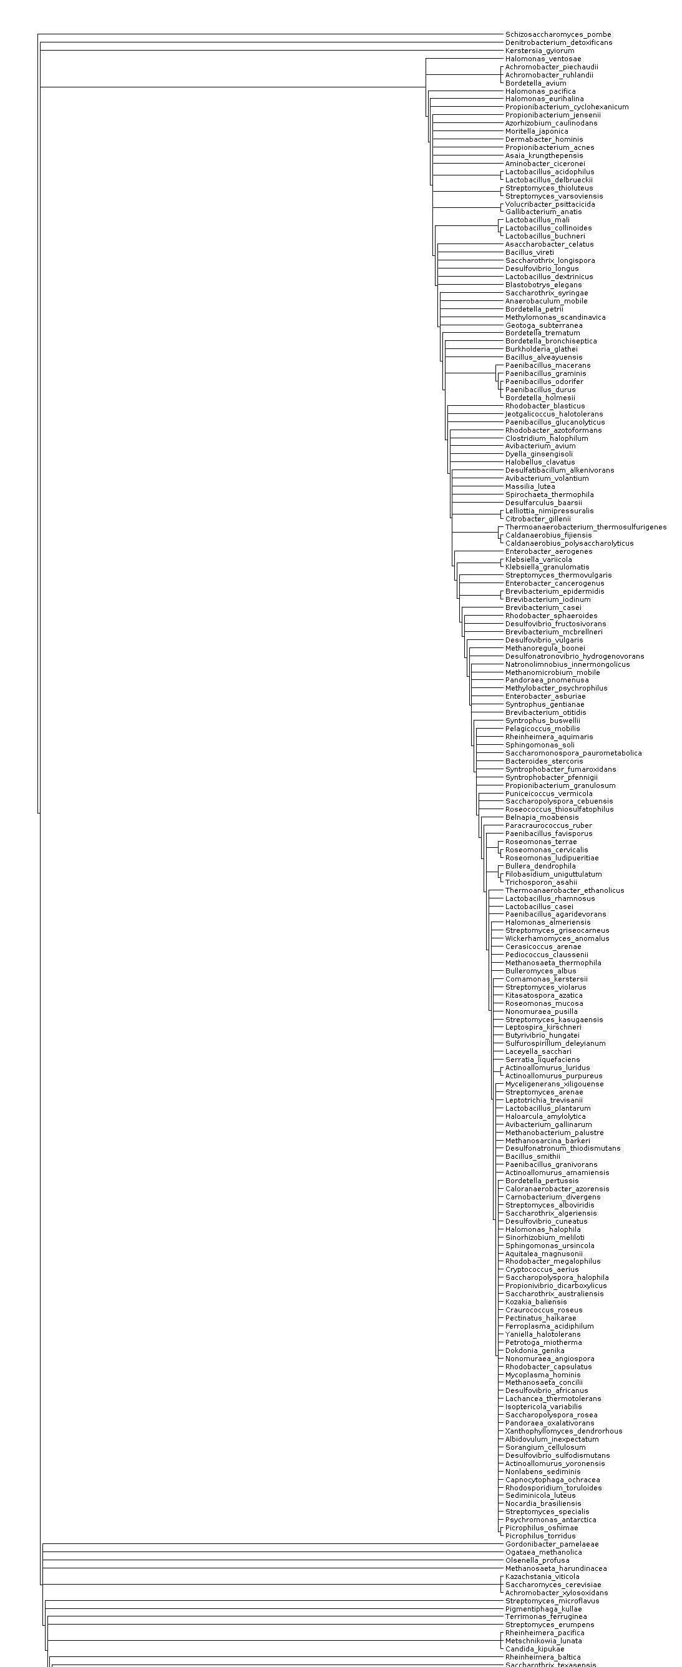
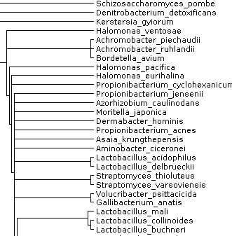
Fact aggregation:
Supertrees

Slide 5
Filtering: ARRIVE/CONSORT

Slide 6
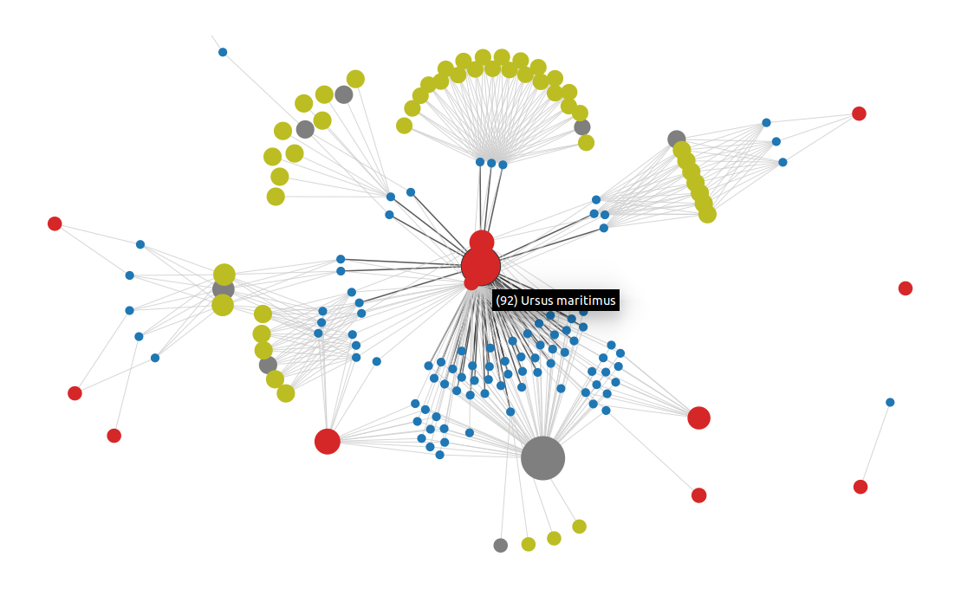
Bubbles

Slide 7
Other ideas?
Indexing/searching the literature
Current awareness; alerts and practices
Extraction and re-use of facts; re-computation
Multidisciplinary integration; co-occurrence
Compliance with funder/institution policies
Managing your Research Data!
Finding similar and complementary colleagues
Reproducibility, checking data and avoiding fraud

