Slide 1




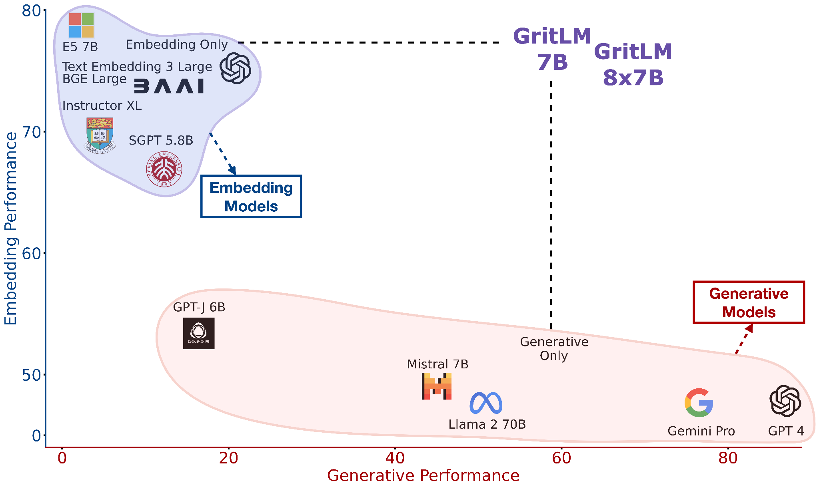
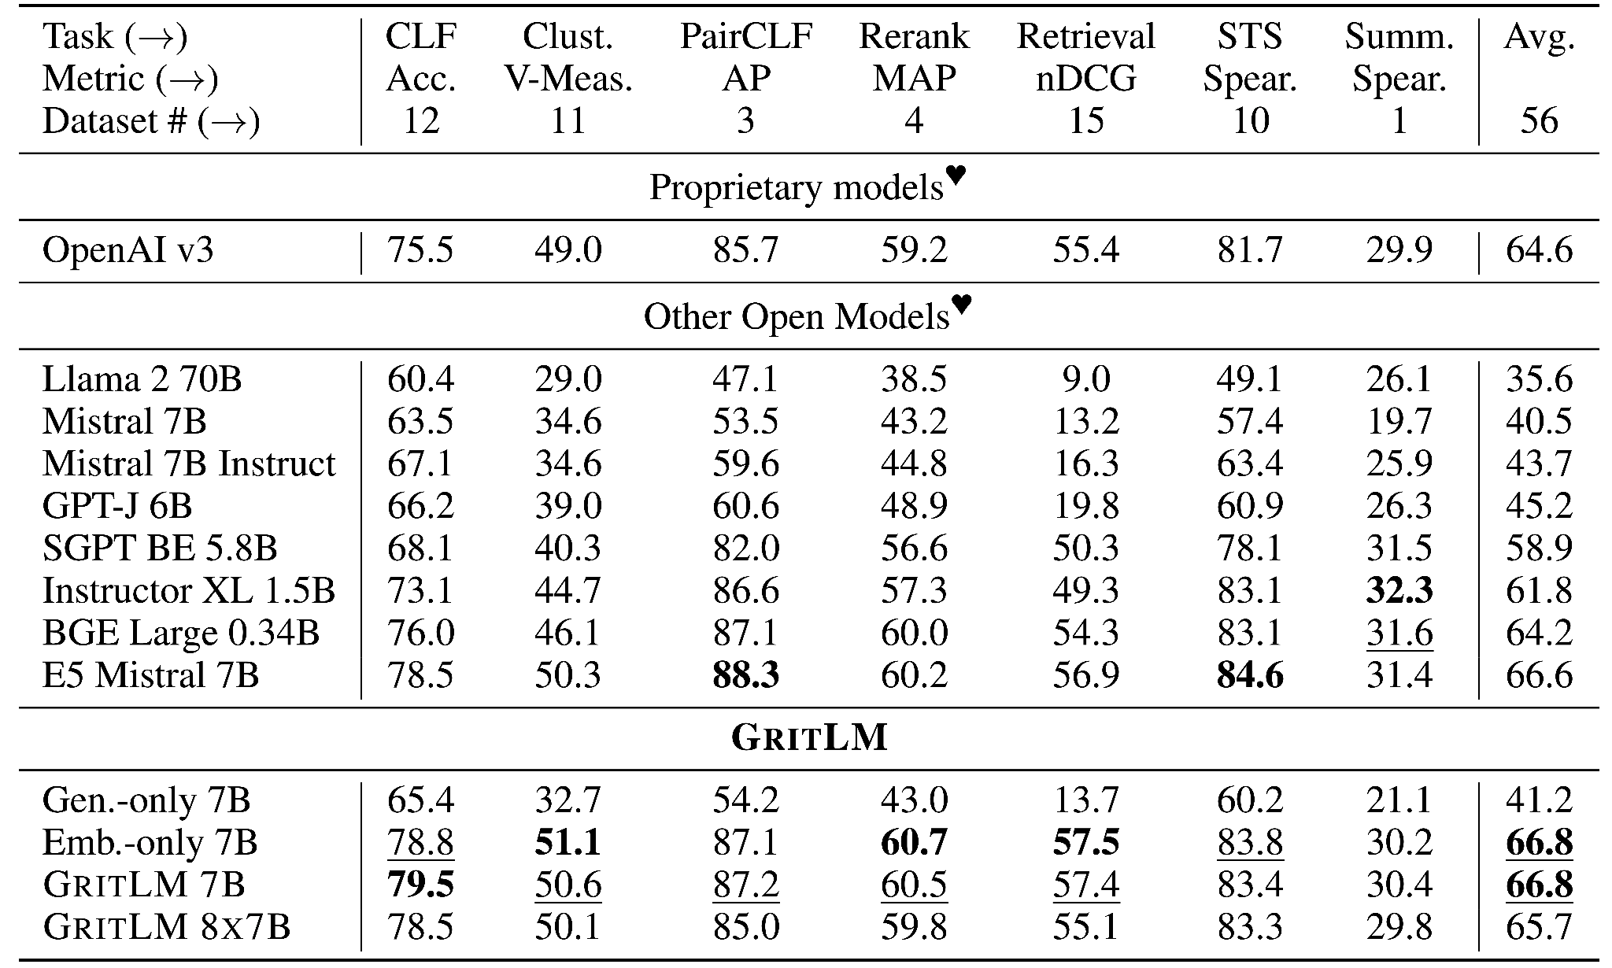
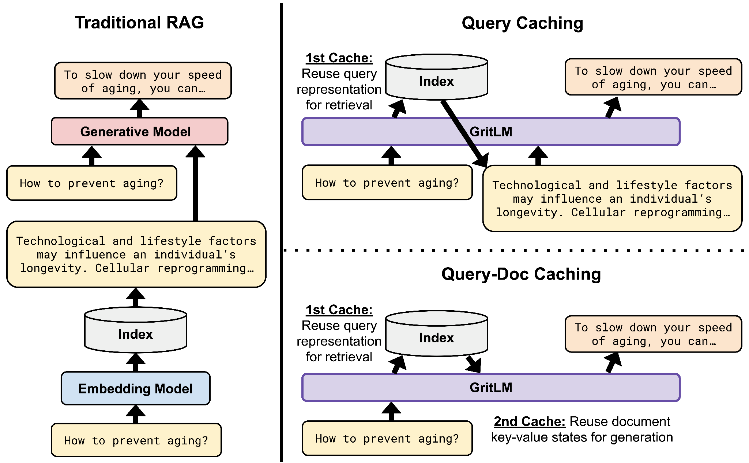
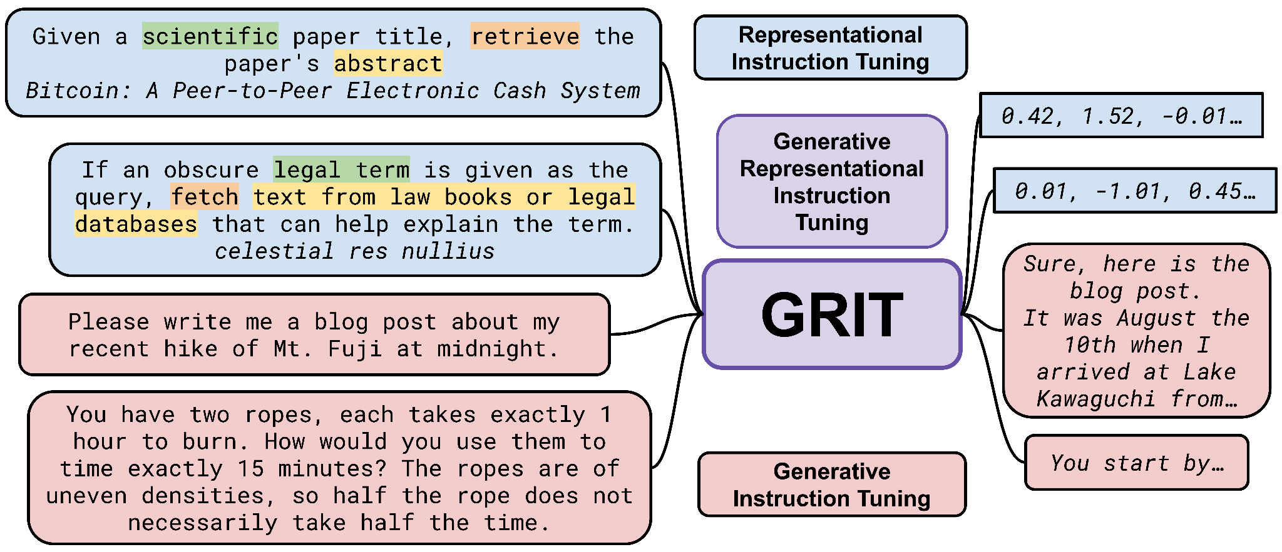
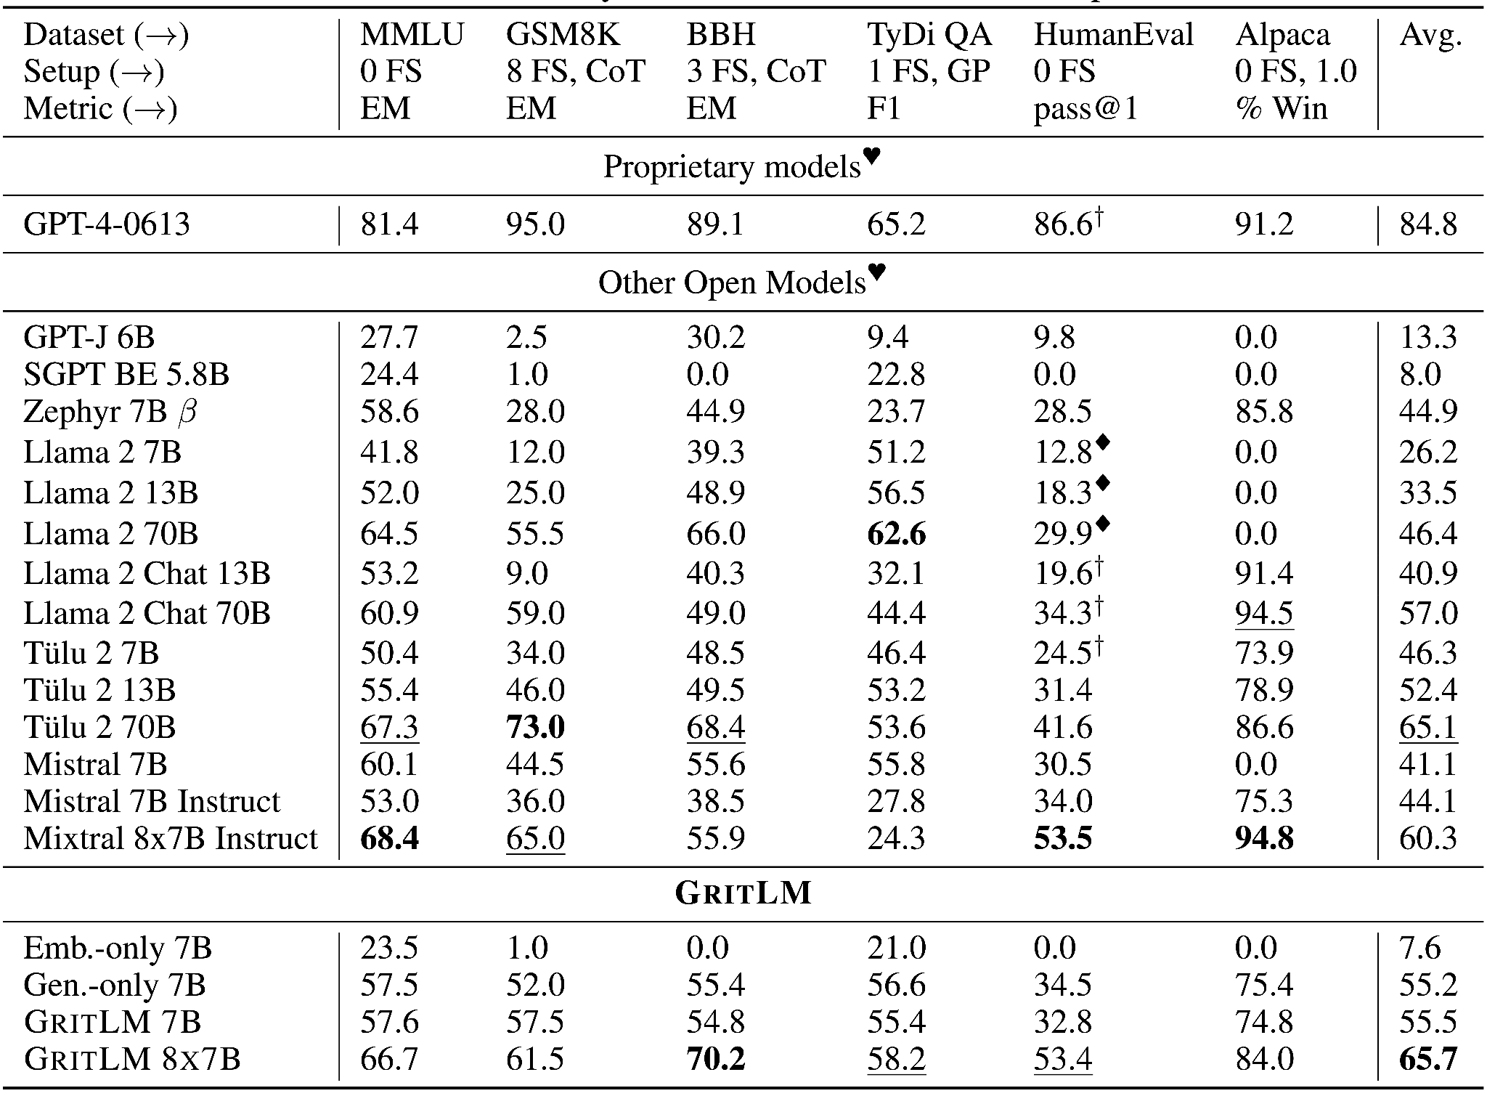
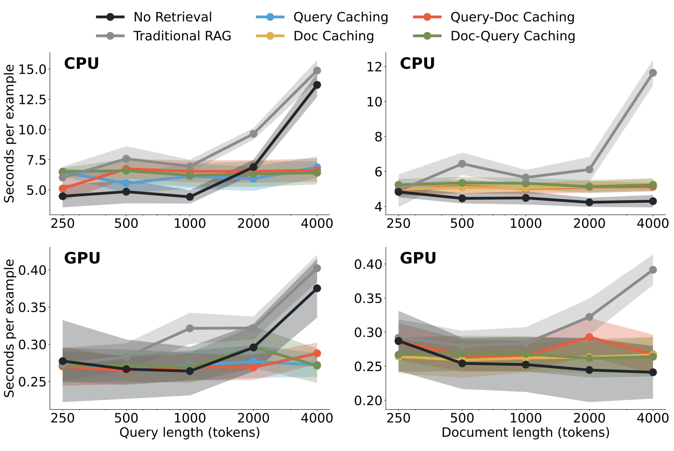
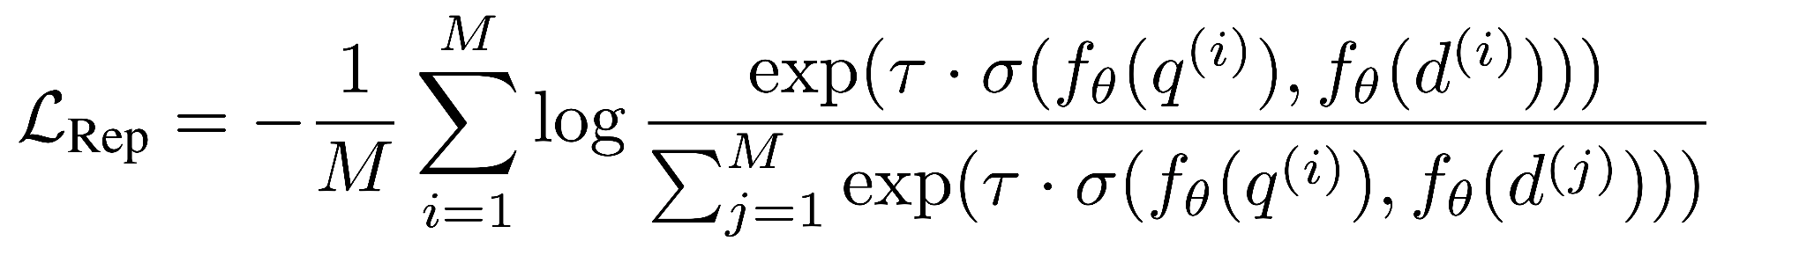
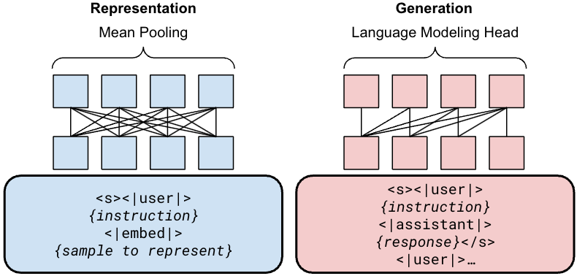
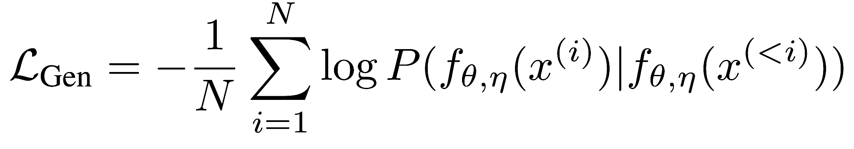
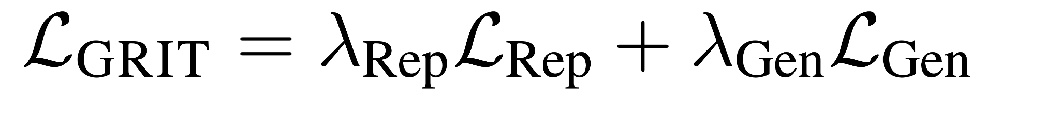
Generative Representational Instruction Tuning
Niklas Muennighoff, Hongjin Su, Liang Wang, Nan Yang,
Furu Wei, Tao Yu, Amanpreet Singh, Douwe Kiela
GRIT: Generative Representational
Instruction Tuning
GritLM on embedding and generation
RAG with GRIT
Embedding
Generation
objective & format
> 60% faster at inference with long documents or long queries
Top performance in 1 unified model at both types of tasks

