Slide 1




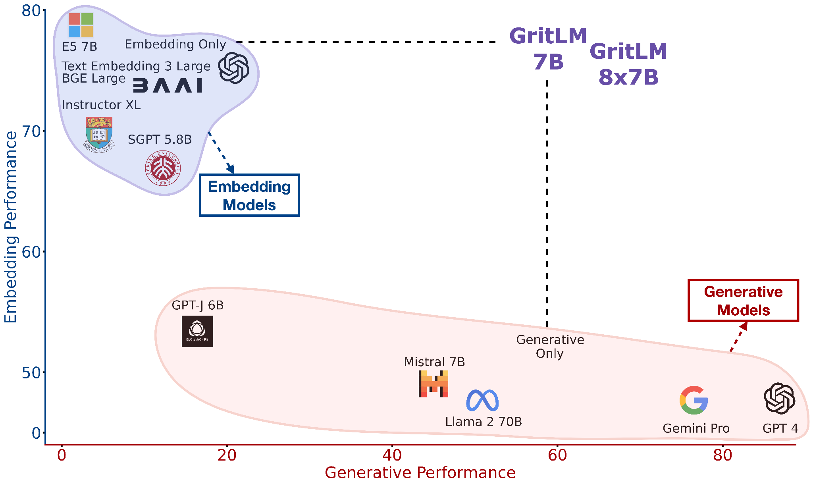
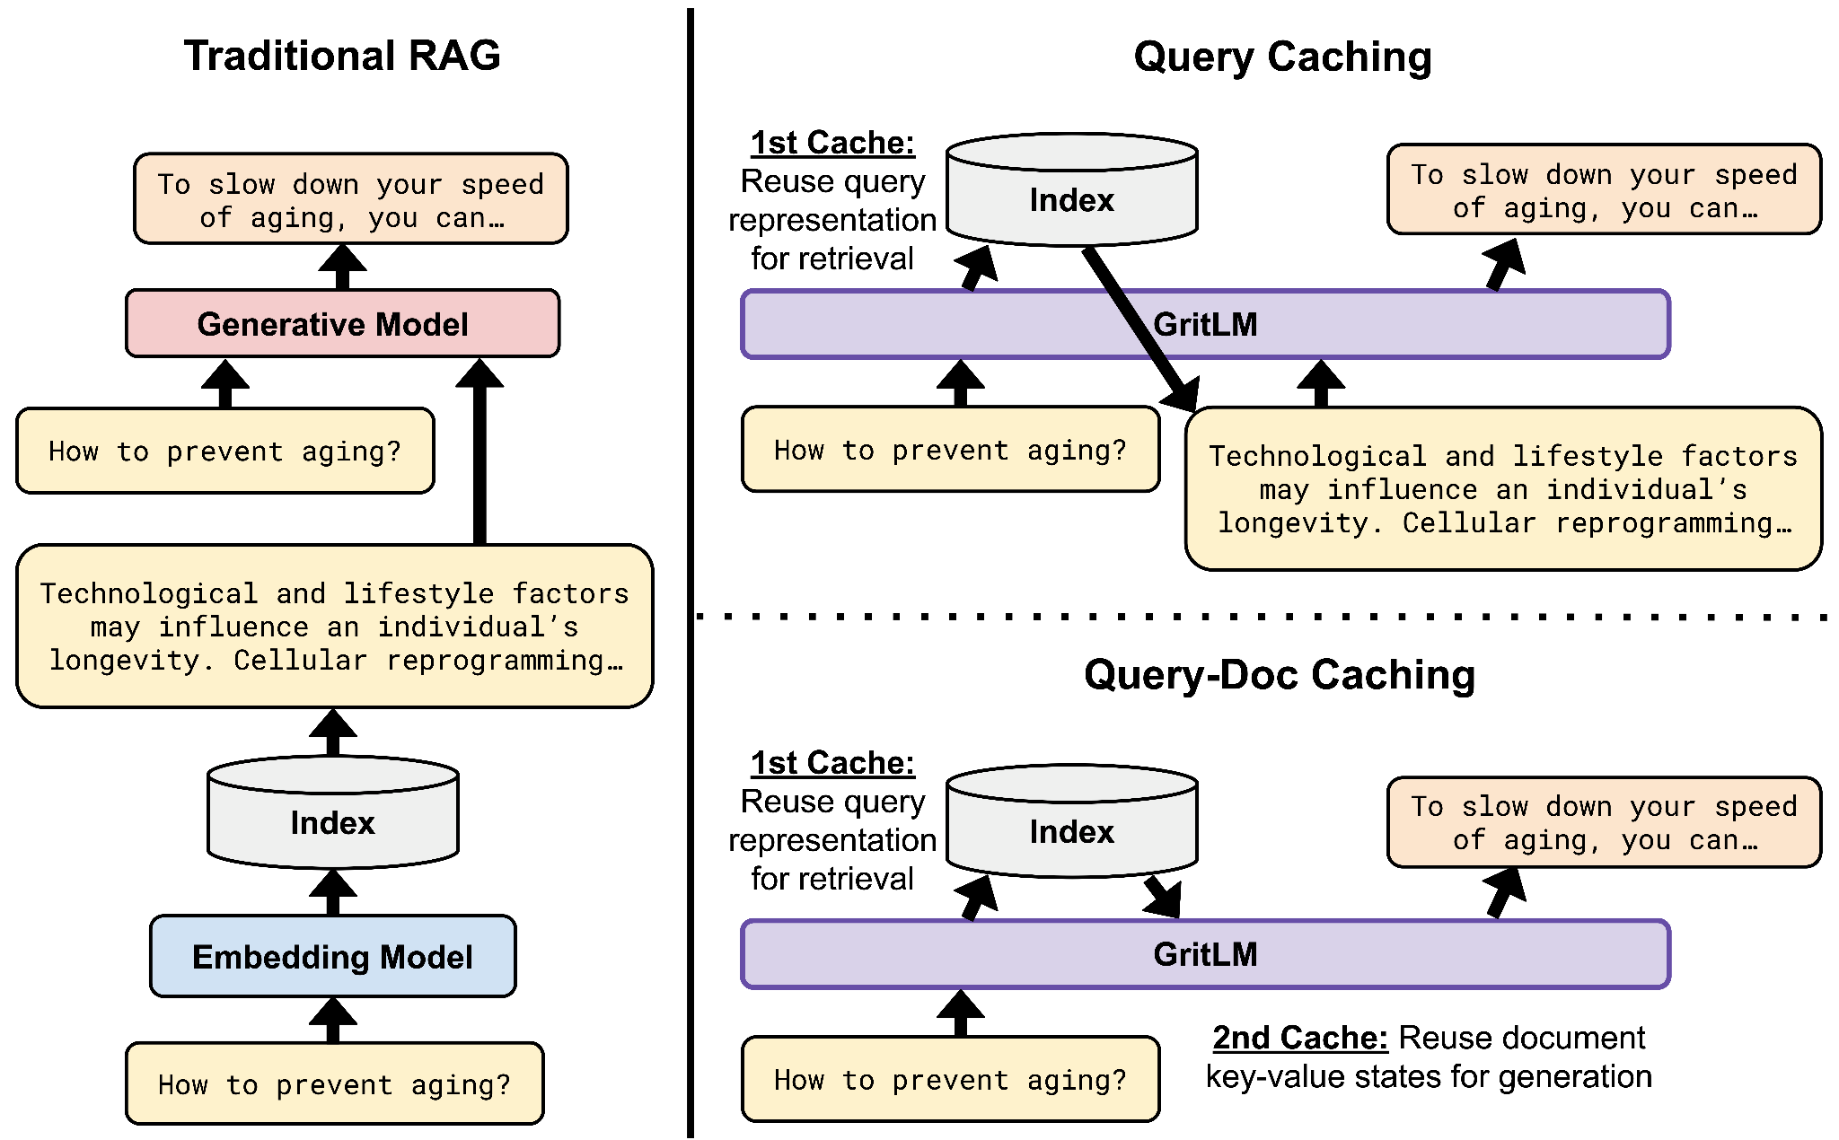
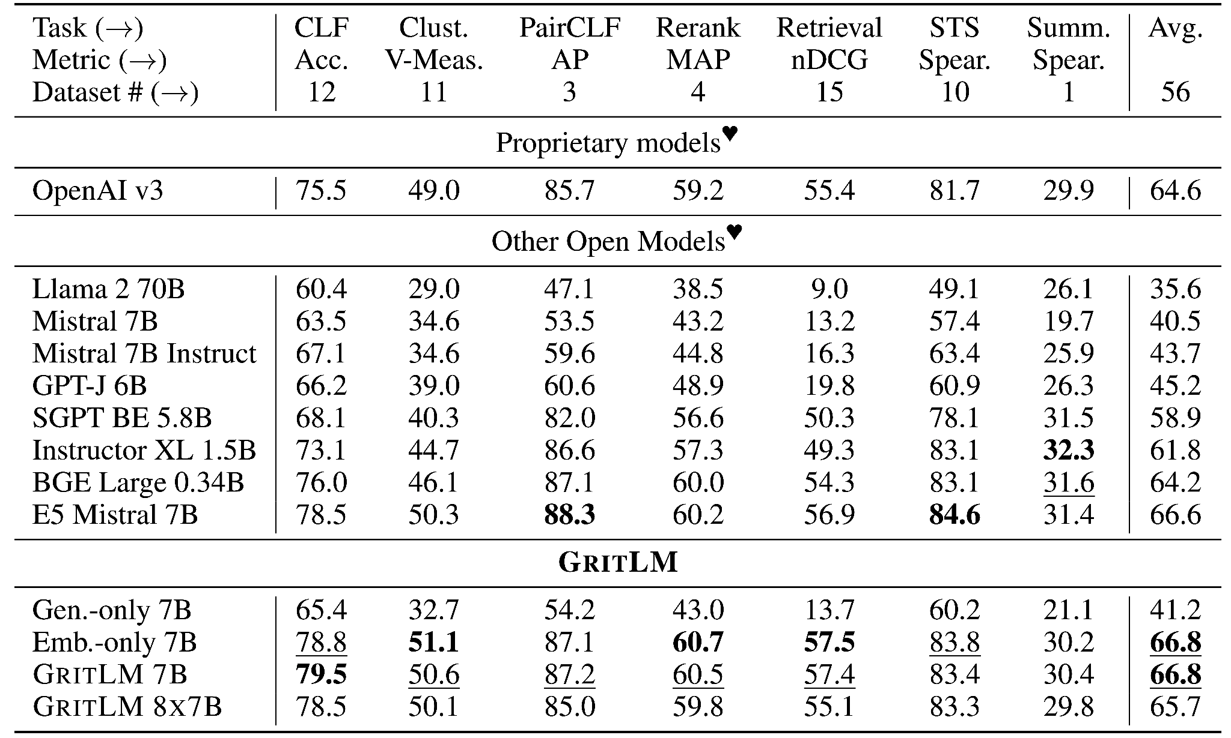
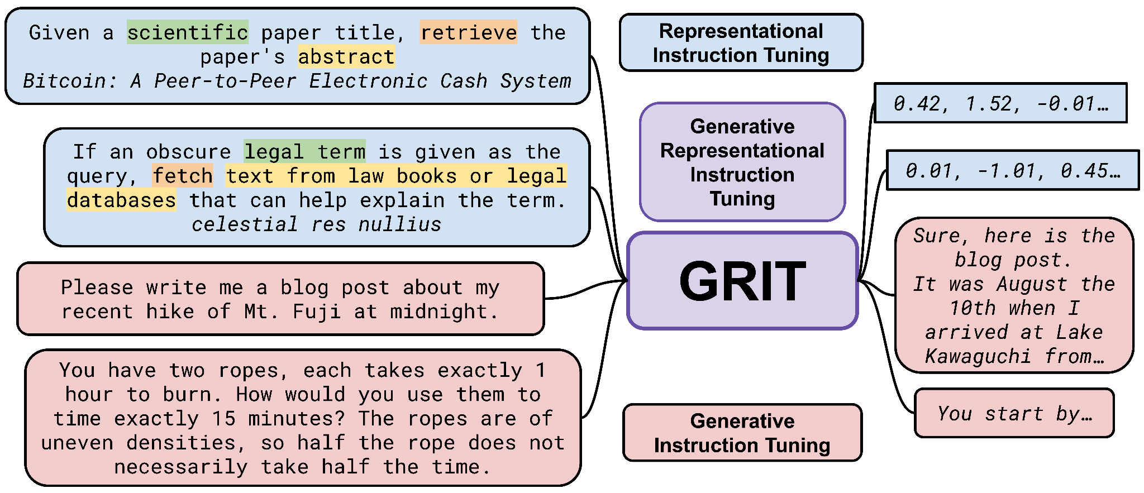
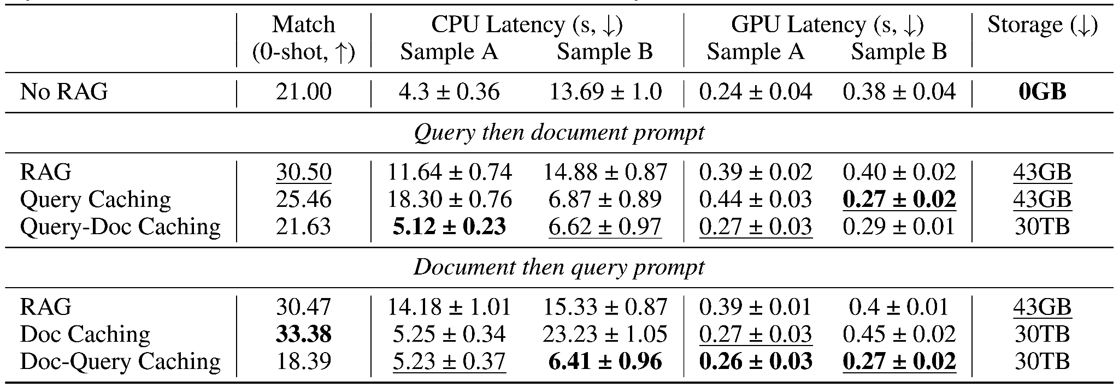
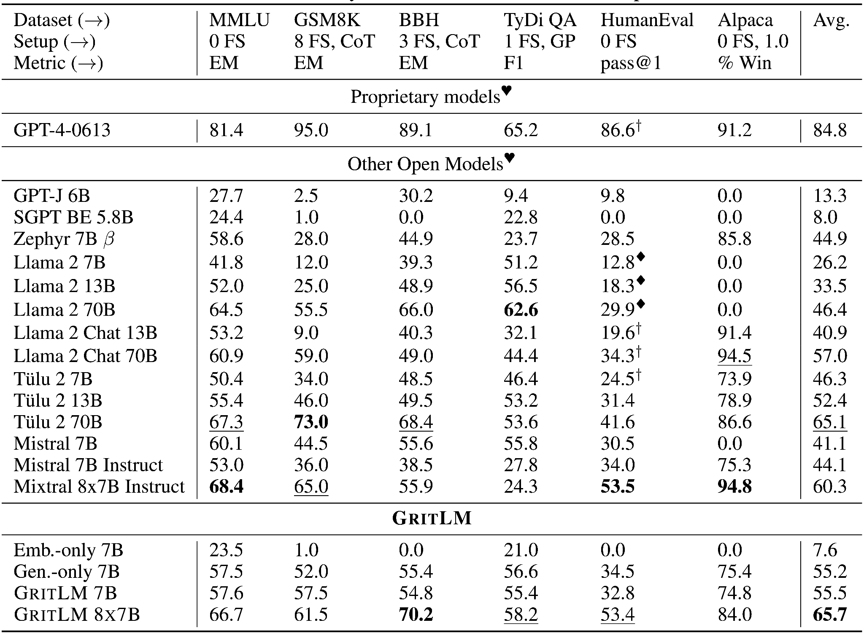
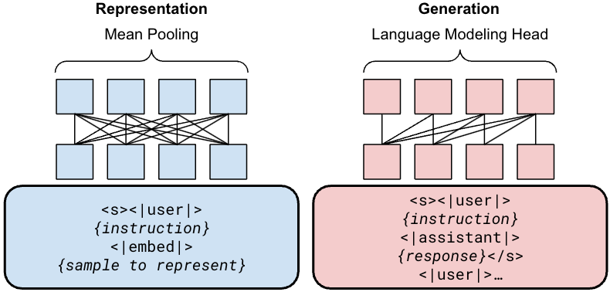
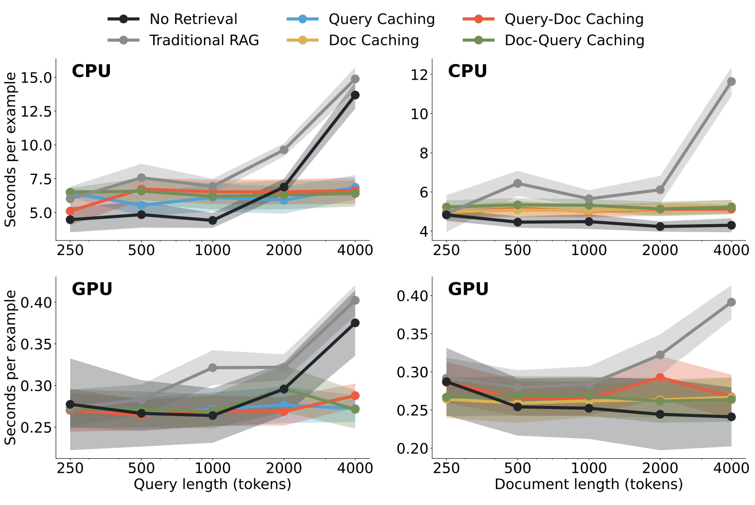
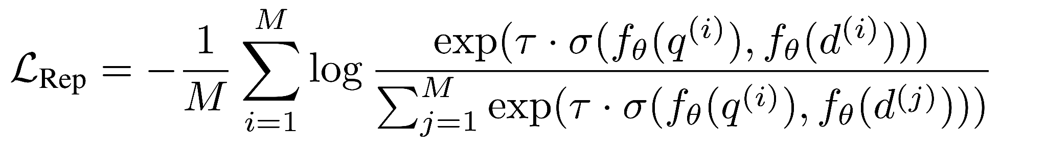
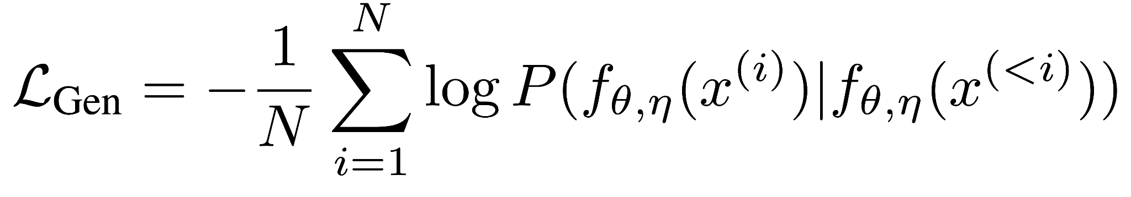
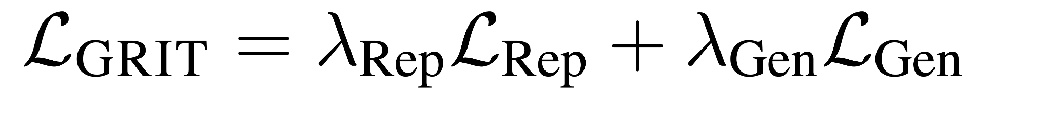
Generative Representational Instruction Tuning
Niklas Muennighoff, Hongjin Su, Liang Wang, Nan Yang,
Furu Wei, Tao Yu, Amanpreet Singh, Douwe Kiela
GRIT: Generative Representational Instruction Tuning
GritLM on embedding and generation
RAG with GRIT
Embedding
Generation
> 60% faster at inference with long documents or long queries
objective
Best-in-class performance in a single unified model at both types of tasks simultaneously

