Slide 1
Verifying OS Kernels with Modal Abstractions of Systems Concepts
Ismail Kuru
Drexel University

Slide 2
Talk
Background
Verification is important
Operating system kernels as well – some pieces maybe more
Program Logic
Proposed Work
Machine Model
Modal Understanding of Location Virtualization

Slide 3
What is Software Verification?
The activity of understanding programs mathematically
Specification
Proof
Ancient tool -- Logic
Notes:
Basically bringing math (so to say proofs) reasoning to convince yourself on the correctness of the programs
Tools to do – Logic Program logic, the most famous one Hoare
Put hoare triple here and explain it simply and give one more
explain -- while explaining just mention what a program state is (physical resources tbt a program utilizez – memory disk caches etc)

Slide 4
Why Verification? Why OS Kernels?
Kernels are piece of constructs speaking to the bare-metal
One of the closest software artifacts operating something physical!
Convincing ourselves on their (almost) correctness!
Long story of verification attempts OS Kernels
Verisoft – custom-hardware
CertiKOS, SeL4
Notes:
Oses are important
Speaking to the device
Pretty much everything relies on it
What are the samples? Long history of attempts to get – microkernel verification examples
--- still based on a lot assumptions, not general purpose microkernels – so can run a lot of stuff on the userspace
-- In this thesis we focus on principles for relatively ignored p– and what we think as important

Slide 5
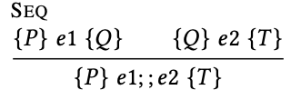

What is a Program Logic?
assumed to hold on the program state before running e
e is our program
must hold after the program state
after e terminates
Notes:
Put a general importance sentence
What is systems software why it is more important
A famous one OS KERNEL

Slide 6
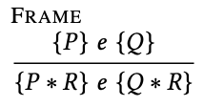
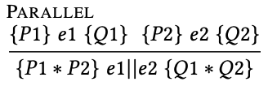

Separation Logic
A logic of resources
Physical resources a program can use
p -> v
P * Q
Notes:
A logic of resources obtained by a proper treatment on the Hoare Logic
What I mean by treatment is basically introducing logical operators and proof rules that allows enforcing proper usage of resource, in its very raw form complete separation (isolation)
Here we see the most famous rule frame rule utilizing a logical operator called separation conj.

Slide 7
More on Separation Logic
Useful concurrent programs shares!
Essence: composing the updates of each thread to model interleaving
Jones introduced Rely-Guarantee reasoning
Current local View for a “guarantee step” changing local program state
Other Views ”rely steps”:
Local state is unchanged
The change in the global state is described by the interference relation
Getting cumbersome
All these local-state related pieces plumbed through all over the proof?
Notes:
components that had to be plumbed through all parts of the proof — even portions that were mostly thread-local. So work started to explore embedding the elements of interference control as resources within separation logic assertions.
Plumbing interference relation throughout the whole proof [TODO]
Cumbersome proof due to carrying all the bits on the local state [TODO]

Slide 8


Abstracting Separation Logic: Ghosts
Generalized notion of resource with PCMs
In addition to many others (in the paper), Iris from Jung et.al.
Either for ghost (logical) or physical state (heap, stack etc.)
Authorative monoids: full vs. fragmental ownership
Capability of custom-tailored “pointsto” relations
e.g. virtual-memory-pointsto!
.........
Notes:
Generalization on the notion of resource – with partial commutative monoids (PCM)s
This allows us to construct any resource that help us to reasoning
Iris is the frame work that allow us to obtain, we define abstract protocols defining how two different accesses are regulated into a resource
The second mechanism invariants

Slide 9


Separation Logic: Iris Invariants
Capability of sharing knowledge
Even using it under a promise
Notes:
Capability of sharing knowledge: up until now we were …

Slide 10
Modal Logic: Contingency
Logic for contingent truth
Hybrid logic [Areces, Blackburn, and Marx 2001]
Inspired by dynamic logic’s satisfaction operator [Fisher and Ladner 1977]
[l]𝑃: 𝑃 is true in the specific alternate circumstance (Kripke world) named by the nominal l
More than hiding: the choice of what state (world in Kripke Semantic) a modalized assertions is true on the assertion itself
Kripke models [Hughes and Cresswell 1996]
Labelled transition systems (LTS)es, state-transition-systems (STS)es
A model for a logic of propositions representing contingency
Notes:
Contingency
The modals we are interested in this paper are shaped around
Hybrid logic style understanding of
[] satisfaction operatos
Unknown of other world
Interpreting Kripke models as stses
Multiple generated submodels

Slide 11

Modal Logic: Kripke Models
A Kripke Model (W,R_{i},V)
W is a set of worlds
R is subset of W x W -- accessibility relation between worlds
V : PropVar → P(W) gives for each propositional p a set of worlds V(p)
Going back Hoare triple: P => [e]Q or with the rules above <m>Q
[e]Q ⬄ <m>Q ?
Notes:
What exactly is this accessibility relation R?

Slide 12
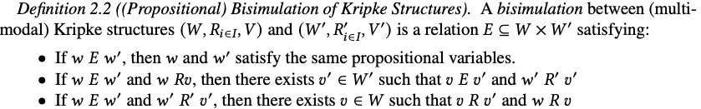
Bisimulation on Kripke Models
How about having the same truth for another similar model?
Bisimulation of Kripke Structures
Notes:
Clearly this holds when for any 𝑤 and 𝑚, there is exactly one 𝑤′ such that 𝑤𝑅𝑚𝑤′.
500 However, it also holds for a broad class of intuitively similar models: those where instead of requiring
501 that each state have exactly one successor for each relation, we instead require that when a world has
502 multiple sucessor states, they have all the same successors and the same propositional variables are
503 true in each:
504 505 ∀𝑤,𝑤′,𝑤′′,𝑚.𝑤𝑅𝑚𝑤′ ∧𝑤𝑅𝑚𝑤′′ ⇒ (∀𝑝.𝑤′ ∈ 𝑉 (𝑝) ⇔ 𝑤′′ ∈ 𝑉 (𝑝)) ∧ (∀𝑠,𝑚′.𝑤′𝑅𝑚′𝑠 ⇔ 𝑤′′𝑅𝑚′𝑠)

Slide 13
Generating (Sub)Models
s_{i}
open
read
write
(s_{i ,} s_{o}) is element of R_{open}
generate a submodel from a state [s_{o}]
with relations R_{read} and R_{write}
s_{o}
close
s_{c}
read
write
s_{o}

Slide 14
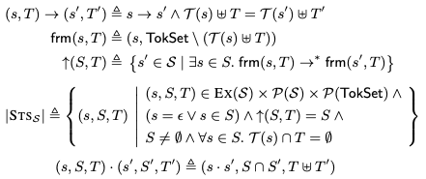
Kripke Models as Iris Invariant Constructions
State transition systems – a well-known specification method
Monoid encoding state-transition-systems (STS)es with Tokens
Tokens as modalities, states as worlds, and interpretations as world predicates
Notes:
Here we see the carrier type STSS of a monoid encoding of state transition system with tokens. It is simply a triple of s set of all possible states and a set of token used in
\phi intention on the state

Slide 15
Proposed Work

Slide 16
Virtualization
Modal Understanding of Location Virtualization

Slide 17
SYSTEM
(Translation & Management)

Slide 18
Memory Location & Virtualization
What do we mean by virtualizing a memory location?
realizing a mechanism to address more memory locations than you physically (actually) have
What is the abstraction for virtualizing memory location in OSes?
an address-space of a process is a container of virtual-addresses used for memory referencing
How do we implement memory-location virtualization?
address-translation: by using per-address-space page-tables – a tree like structure

Slide 19
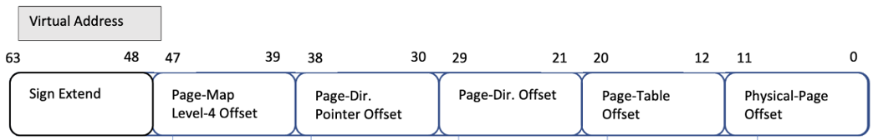
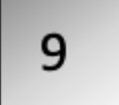


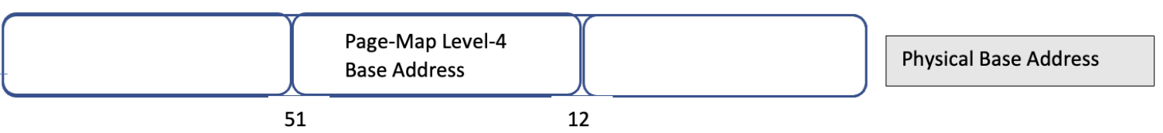
L4_L1 Page Table Walk
L4-Table
L3-Table
L2-Table
L1-Table
Phy. Page
L1-Entry
L4-Entry
L3-Entry
L2-Entry
Page Addr

Slide 20
Virtual Memory Managers
cr3
L4 Base Addr₀ (a₀)
L4 Base Addr₁ (a₁)
va₀
…
va_{i}
va_{n}
va₀
…
va_{i}
va_{n}
mov cr3 a1
L4 Table
L3 Table
L2 Table
L1 Table
L4 Table
L3 Table
L2 Table
L1 Table
pg
pg
…
pg
pg
pg
…
pg

Slide 21
The System of Memory Virtualization
“the virtual memory sub-system can be considered the core of a Solaris instance, and the implementation of Solaris virtual memory affects just about every other subsystem in the operating system”
by authoritative reference on the internals of the Solaris kernel, McDougall and Mauro

Slide 22
LOGIC
(Sharing, Contingency & Satisfaction)

Slide 23



Program Logic: Points-to Relations
Physical state
Physical Memory Map
Register Map
Ownership on Physical State:
A physical points-to assertion (resource):
A register points-to (resource):
How about virtual points-to relation?

Slide 24


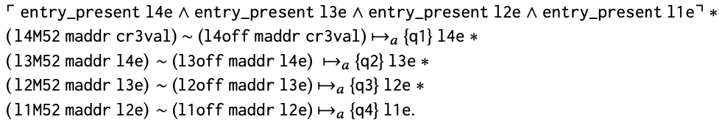
Program Logic: Defining Virtual Points-to
In terms of each physical points-to for a Page-Table
where physical L4_L1 page-table walk
Soundness against updates to page tables e.g. moving page tables to create more continuous physical space for hardware IO buffers?
Table Address
Entry Offset

Slide 25


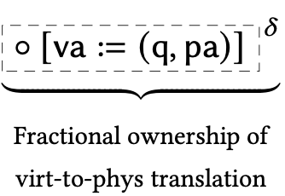
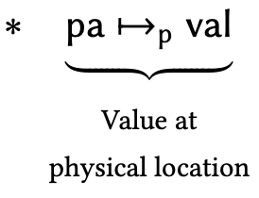

Program Logic: Abstracting Page-Table Walk
Abstract Physical Page Table Walk with a ghost-map mapping and distribute the read-only piece to virtual-pointsto (Fragmental Ownership of the ghost map)
Then keep the physical page table walk next to full ownership of the ghost map which is required to update the page tables

Slide 26




Virtual Memory Managers
cr3
r
r
mov cr3 a1
L4 Base Addr₀ (a₀)
L4 Base Addr₁ (a₁)
Load another address space into the current view of memory
Bookkeeping each virtual address’s address-space explicitly?
Referring to virtual addresses in another space?
Or another abstraction?
…..
…..

Slide 27
Virtual Points-tos as Modal Context Resource
Context-agnostic-resources
each virtual address is valid under a certain address-space
but it does not represent this knowledge of its address-space.
Address-spaces as modal contexts
assertions in our logic are context-dependent

Slide 28
Switching Address-Spaces
Explicitly-modal assertions
provides a means to talk about facts being true in another address space
Address-space switch as changing the "World" of truth

Slide 29


Virtual Memory Managers
r_{s}
cr3
r
r
r
r
L4 Base Addr₀ (a₀)
L4 Base Addr₁ (a₁)
mov cr3 r_{s ;}
P
R
…..
…..

Slide 30
More Experiments
Identity Mapping
Extended our address-space invariants to support:
virtual address of any page used for a page table lives at a virtual address whose value is a constant offset from the physical address a
Page-table-traversal
Using identity mappings
Almost done!
Mapping a new page
Prover with using the page-table-traversal as an axiom to locate L1 entry.

Slide 31
Current Status for x64Iris
What is done?
Machine model – subset of x86
Soundness proofs of all instructions except:
Segment selector related ones, Page fault interrupts
Proof of address-space switching
Proof of identity mapping
Proof of adding a new-page axiomatizing page-table-walk
To be done
Proof of page-table-walk
Fine-tuning instructions’ specs with extended address-space-invariants for identity mappings

Slide 32
Evolution
Modal Understanding of Protocol Modularity

Slide 33
SYSTEM (Protocols & Future Feature Extensions)

Slide 34
Protocols in OS Kernels
user process
Sys Calls
mmap
mmap_lazy
……..
x
Virtual File System (VFS)
Virtual Memory Manager (VMM)
ext2
mem_fs
vmm_flist
page cache
Device Drivers
mem_disk_driver
block disk driver
……..
hw_memory
hw_network
hw_disk
……..

Slide 35
Protocols (STS)es for File Operations
s_{i}
s_{i}
open
read
write
write
open
read
write
s_{o}
s_{f}
flush
s_{o}
read
close
close
s_{c}
s_{c}
A traditional filesystem protocol
A distributed filesystem protocol

Slide 36
LOGIC
(Exploiting Kripke Models, Generated SubModels &Bisimulation)

Slide 37
s_{i}
s_{i}
open
read
write
write
open
read
write
s_{o}
s_{f}
flush
s_{o}
read
close
close
s_{c}
s_{c}
Iris, CaReSL, iCap ?
A traditional filesystem protocol
A distributed filesystem protocol
FCSL ?
read
write
write
read
write
s_{o}
s_{f}
flush
s_{o}
read
A traditional subprotocol from opened (s_{o}) state
A distribute subprotocol from flushed (s_{f}) state

Slide 38
RG-STS: Logic for Modularity of Protocols
Two major pieces
Morphisms to relate two protocol
The Law of Tolerance
The Law of Conformance
The Law of Similarity
Linking to program logic through
Island-Update-Invariance for soundness
Proof rules
Rule Bisim
Rule Submodel

Slide 39


RG-STS: Bisimulation
As an instance of our morphism definition
We denote transitions in the environment
Essentially the generated submodel starting at [s] for AllTok/T
The guarantee (the generated submodel starting at [s] for T)
Intuitively speaking, we need to preserve the rely-start-end pairs exactly
Don’t drop plausible interference
Acknowledge valid starting points

Slide 40


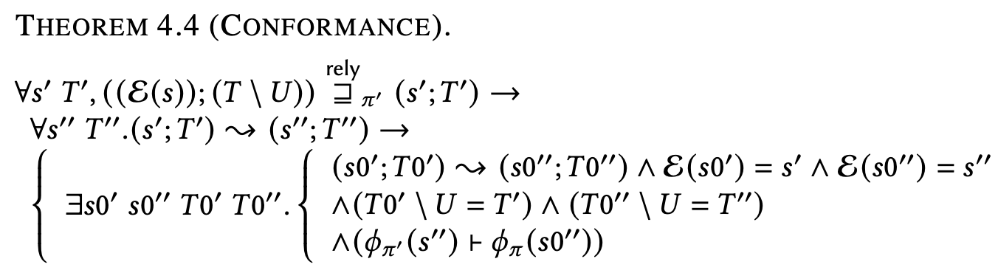
RG-STS: The Laws
Post-Relays corresponds and preserves facts of the interpretation
Guarantees in the submodel preserved in the original.

Slide 41
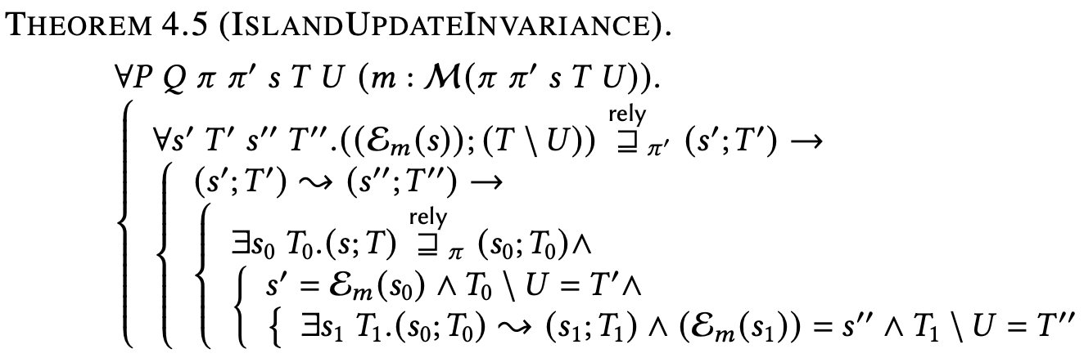
Connecting to a Program Logic (Soundness)
For any two protocols conformance is essential as we would like to see an update in the subSTS equivalent to one in the original under a logical consequence on the tokens. Proof by almost conformance.
Notes:
We want to prove, abstractly, that any island update performed in terms of the
sub-STS is valid in terms of the original STS. Intuitively, we'd like to think
of an update in terms of the sub-STS as equivalent to a combination of
consequence, local anti-frame (on tokens), and island update on the original.
(Eventually, we'd also like to include an analog of anti-frame on invariants
to permit ignoring unaffected state).

Slide 42
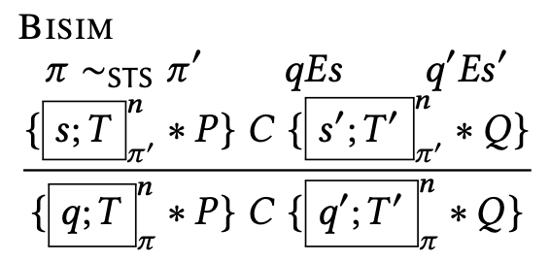
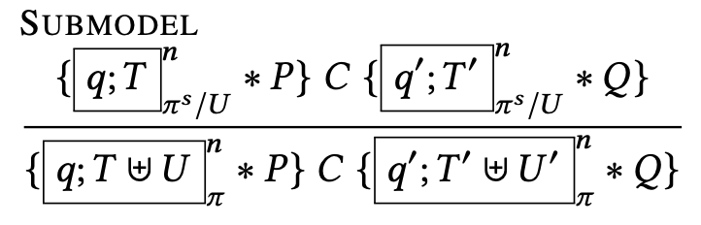
RG-STS: Proof Rules for Bisimilar Protocols
Indistinguishable STS. Proof by the definition of soundneess for CaReSL
Possible rely-reachable in the original STS with the local tokens contains the same rely-reachable states

Slide 43
Current Status of RG-STS
Currently being worked on
Soundness proofs is under-change
Proofs of filesystem protocols presented in this paper
Already done
mmap and mmap_lazy are implemented inside the kernel as a candidate for being an extra experiment
Vfs -- realized by S5 (already exists inside xv6 OS) and ext2 (implemented by us)
Disk device drivers: A block disk driver for our ext2 vs. in-memory block device driver (to
To be done
Finish the soundness
Pick-up one extra example in addition to the filesystem protocol example amongst the examples mentioned above
Not necessarily the implementation of them
Not necessarily the complete protocol of them

Slide 45
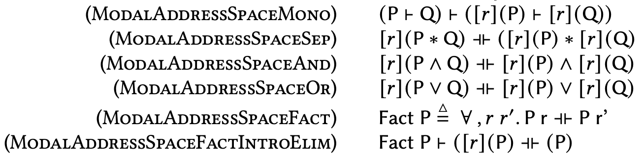
Pure Facts on Address Space
Notes:
As backup slide.

Slide 46

Program Logic: Sharing under Page-Table Update
cr3
Opss! The tables are no longer the ones va₀ know! Invalid L4_L1 path for va₀ !
L4 Base Addr₀ (a₀)
va₀
pg
52/12
va₀
L4 Table
L3 Table
L2 Table
L1 Table
Page Addr
l4e₀
l2e₀
l3e₀
l1e₀
paddr₀
pg
Notes:
It might want to defrag / compress page tables
changes internal page-tables would violate

