Slide 1
Verifying OS Kernels with Modal Abstractions of Systems Concepts
Ismail Kuru
Drexel University

Slide 2
Why do we verify software?
Put a general importance sentence
What is systems software why it is more important
A famous one OS KERNEL

Slide 3
What is Software Verification?
Basically bringing math (so to say proofs) reasoning to convince yourself on the correctness of the programs
Tools to do – Logic Program logic, the most famous one Hoare
Put hoare triple here and explain it simply and give one more
explain -- while explaining just mention what a program state is (physical resources tbt a program utilizez – memory disk caches etc)

Slide 4
Separation Logic
A logic of resources obtained by a proper treatment on the Hoare Logic
What I mean by treatment is basically introducing logical operators and proof rules that allows enforcing proper usage of resource, in its very raw form complete separation (isolation)
Here we see the most famous rule frame rule utilizing a logical operator called separation conj.

Slide 5
Abstract Separation Logic
Generalization on the notion of resource – with partial commutative monoids (PCM)s
This allows us to construct any resource that help us to reasoning
Iris is the frame work that allow us to obtain, we define abstract protocols defining how two different accesses are regulated into a resource
The second mechanism invariants

Slide 6
Modal Logic
Contingency
The modals we are interested in this paper are shaped around
Hybrid logic style understanding of
[] satisfaction operatos
Unknown of other world
Interpreting Kripke models as stses
Multiple generated submodels

Slide 7
Virtualization
Modal Understanding of Location Virtualization

Slide 8
SYSTEM
(Translation & Management)

Slide 9
Memory Location & Virtualization
What do we mean by virtualizing a memory location?
realizing a mechanism to address more memory locations than you physically (actually) have
What is the abstraction for virtualizing memory location in OSes?
an address-space of a process is a container of virtual-addresses used for memory referencing
How do we implement memory-location virtualization?
address-translation: by using per-address-space page-tables – a tree like structure

Slide 10
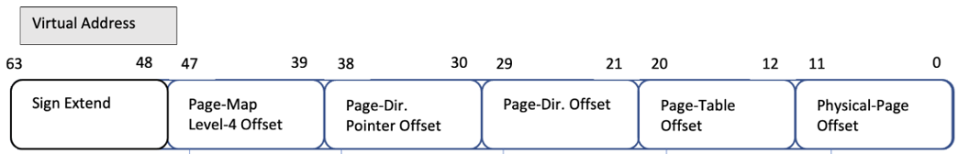
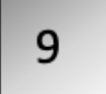


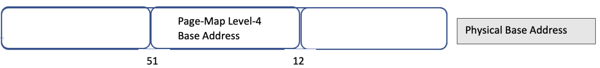
L4_L1 Page Table Walk
L4-Table
L3-Table
L2-Table
L1-Table
Phy. Page
L1-Entry
L4-Entry
L3-Entry
L2-Entry
Page Addr

Slide 11
Virtual Memory Managers
cr3
L4 Base Addr₀ (a₀)
L4 Base Addr₁ (a₁)
va₀
…
va_{i}
va_{n}
va₀
…
va_{i}
va_{n}
mov cr3 a1
L4 Table
L3 Table
L2 Table
L1 Table
L4 Table
L3 Table
L2 Table
L1 Table
pg
pg
…
pg
pg
pg
…
pg

Slide 12
The System of Memory Virtualization
“the virtual memory sub-system can be considered the core of a Solaris instance, and the implementation of Solaris virtual memory affects just about every other subsystem in the operating system”
by authoritative reference on the internals of the Solaris kernel, McDougall and Mauro

Slide 13
LOGIC
(Sharing, Contingency & Satisfaction)

Slide 14



Program Logic: Points-to Relations
Physical state
Physical Memory Map
Register Map
Ownership on Physical State:
A physical points-to assertion (resource):
A register points-to (resource):
How about virtual points-to relation?

Slide 15


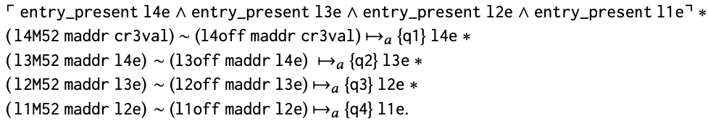
Program Logic: Defining Virtual Points-to
In terms of each physical points-to for a Page-Table
where physical L4_L1 page-table walk
Soundness against updates to page tables e.g. moving page tables to create more continuous physical space for hardware IO buffers?
Table Address
Entry Offset

Slide 16


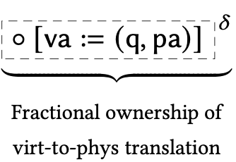
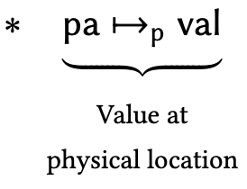

Program Logic: Abstracting Page-Table Walk
Abstract Physical Page Table Walk with a ghost-map mapping and distribute the read-only piece to virtual-pointsto (Fragmental Ownership of the ghost map)
Then keep the physical page table walk next to full ownership of the ghost map which is required to update the page tables

Slide 17




Virtual Memory Managers
cr3
r
r
mov cr3 a1
L4 Base Addr₀ (a₀)
L4 Base Addr₁ (a₁)
Load another address space into the current view of memory
Bookkeeping each virtual address’s address-space explicitly?
Referring to virtual addresses in another space?
Or another abstraction?
…..
…..

Slide 18
Virtual Points-tos as Modal Context Resource
Context-agnostic-resources
each virtual address is valid under a certain address-space
but it does not represent this knowledge of its address-space.
Address-spaces as modal contexts
assertions in our logic are context-dependent

Slide 19
Switching Address-Spaces
Explicitly-modal assertions
provides a means to talk about facts being true in another address space
Address-space switch as changing the "World" of truth

Slide 20


Virtual Memory Managers
r_{s}
cr3
r
r
r
r
L4 Base Addr₀ (a₀)
L4 Base Addr₁ (a₁)
mov cr3 r_{s ;}
P
R
…..
…..

Slide 23
Evolution
Modal Understanding of Protocol Modularity

Slide 24
SYSTEM (Protocols & Future Feature Extensions)

Slide 27
LOGIC
(Kripke Models, Generated SubModels & Bisimulation)

Slide 29
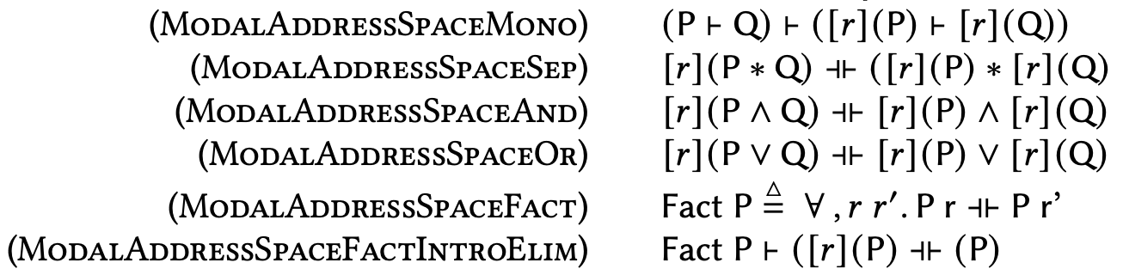
Pure Facts on Address Space
Notes:
As backup slide.

Slide 30

Program Logic: Sharing under Page-Table Update
cr3
Opss! The tables are no longer the ones va₀ know! Invalid L4_L1 path for va₀ !
L4 Base Addr₀ (a₀)
va₀
pg
52/12
va₀
L4 Table
L3 Table
L2 Table
L1 Table
Page Addr
l4e₀
l2e₀
l3e₀
l1e₀
paddr₀
pg
Notes:
It might want to defrag / compress page tables
changes internal page-tables would violate

