Slide 1
Modal Abstractions for Memory Virtualization
Ismail Kuru & Colin S. Gordon
Drexel University
Notes:
Hello everyone,I am Ismail Kuru a Phd student working on systems verification and logic. Today I am going to present you a chapter of my thesis, which are basically a set of reasoning principles for a critical piece of general purpose os kernels.

Slide 2
Talk
System of Virtualization
Abstraction: Address-Spaces
Mechanism: Address-Translation
Logic
Machine Model
Modal Understanding of Location Virtualization
Notes:
We start with a high level understanding of what a

Slide 3
The System of Memory Virtualization
“the virtual memory sub-system can be considered the core of a Solaris instance, and the implementation of Solaris virtual memory affects just about every other subsystem in the operating system”
by authoritative reference on the internals of the Solaris kernel, McDougall and Mauro

Slide 4
SYSTEM
(Translation & Management)

Slide 5
Memory Location Virtualization
What do we mean by virtualizing a memory location?
realizing a mechanism to address more memory locations than you physically (actually) have
V
va_{i}
P
va_{i+1}
pa₀
…
………
pa_{i}
…
va_{n}
pa_{m}
|V| = n |P| = m n >= m

Slide 6


Memory Location Virtualization: Abstraction
What is the abstraction for virtualizing memory location in OSes?
an address-space of a process is a named ($γ$) container of virtual-addresses used for memory referencing
$$γ$$
V
va_{i}
P
va_{i+1}
pa₀
…
………
pa_{i}
…
va_{n}
pa_{m}

Slide 7

Memory Location Virtualization: Mechanism
How do we implement memory-location virtualization?
address-translation: by using per-address-space page-tables – a tree like structure
$$γ$$
V
P
va_{i}
pa₀
va_{i+1}
…
Address Translation
Physical Memory for
Address Translation Tables
………
va_{n}
…
pa_{m}

Slide 8
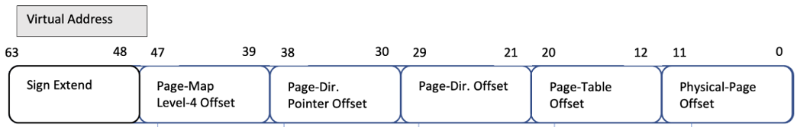
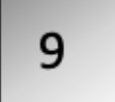


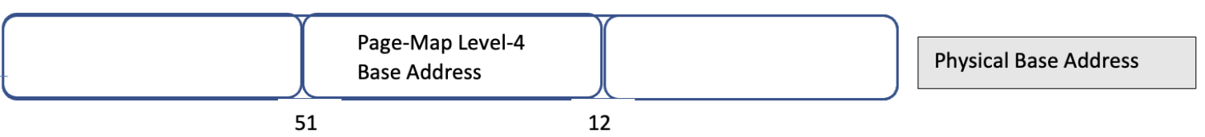
Mechanism: L4_L1 Page Table Walk
L4-Table
L3-Table
L2-Table
L1-Table
Phy. Page
L1-Entry
L4-Entry
L3-Entry
L2-Entry
Page Addr

Slide 9
Virtual Memory Managers
cr3
L4 Base Addr₀ (a₀)
L4 Base Addr₁ (a₁)
va₀
…
va_{i}
va_{n}
va₀
…
va_{i}
va_{n}
mov cr3 a1
L4 Table
L3 Table
L2 Table
L1 Table
L4 Table
L3 Table
L2 Table
L1 Table
pa
pa
…
pa
pa
pa
…
pa

Slide 10
LOGIC
(Sharing, Contingency & Satisfaction)

Slide 11
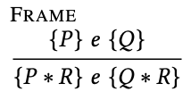
Separation Logic
A logic of resources
Physical resources a program can use
p -> v
P * Q
Notes:
A logic of resources obtained by a proper treatment on the Hoare Logic
What I mean by treatment is basically introducing logical operators and proof rules that allows enforcing proper usage of resource, in its very raw form complete separation (isolation)
Here we see the most famous rule frame rule utilizing a logical operator called separation conj.

Slide 12
Modal Logic: Contingency
Logic for contingent truth
Hybrid logic [Areces, Blackburn, and Marx 2001]
Inspired by dynamic logic’s satisfaction operator [Fisher and Ladner 1977]
[l]𝑃: 𝑃 is true in the specific alternate circumstance (Kripke world) named by the nominal l
More than hiding: the choice of what state (world in Kripke Semantic) a modalized assertions is true on the assertion itself
Kripke models [Hughes and Cresswell 1996]
Labelled transition systems (LTS)es, state-transition-systems (STS)es
A model for a logic of propositions representing contingency
Notes:
Contingency
The modals we are interested in this paper are shaped around
Hybrid logic style understanding of
[] satisfaction operatos
Unknown of other world
Interpreting Kripke models as stses
Multiple generated submodels

Slide 13



Program Logic: Points-to Relations
Physical state
Physical Memory Map
Register Map
Ownership on Physical State:
A physical points-to assertion (resource):
A register points-to (resource):
How about virtual points-to relation?

Slide 14
Mechanism: L4_L1 Page Table Walk
Soundness against updates to page tables e.g. moving page tables to create more continuous physical space for hardware IO buffers?
Opss! The tables are no longer the ones v₀ know! Invalid L4_L1 path for va₀ !
L4-Table
L3-Table
L2-Table
L1-Table
Phy. Page
L1-Entry
L4-Entry
L3-Entry
L2-Entry
Page Addr

Slide 15

Restoring Soundness
Abstract Physical Page Table Walk with a ghost-map mapping and distribute the read-only piece to virtual-pointsto (fragmental ownership of the ghost map)
va_{i}
…..
va_{j}
…………
va_{n}
L4-Table
L3-Table
L2-Table
L1-Table
Phy. Page
va_{i} ->_{f} pa_{i}
*
L1-Entry
$∀ i ∈0…n,$ v_{i} ->_{a} p_{i}
L4-Entry
L3-Entry
pa_{i} ->_{p} val
L2-Entry
pa_{i}
=
va_{i} ->_{v} val
Then keep the physical page table walk next to authorative ownership of the ghost map which is required to update the page tables

Slide 16




Virtual Memory Managers
cr3
r
r
mov cr3 a1
L4 Base Addr₀ (a₀)
L4 Base Addr₁ (a₁)
Load another address space into the current view of memory
Bookkeeping each virtual address’s address-space explicitly?
Referring to virtual addresses in another space?
Or another abstraction?
…..
…..

Slide 17
Virtual Points-tos as Modal Context Resource
Context-agnostic-resources
each virtual address is valid under a certain address-space
but it does not represent this knowledge of its address-space.
Address-spaces as modal contexts
assertions in our logic are context-dependent

Slide 18
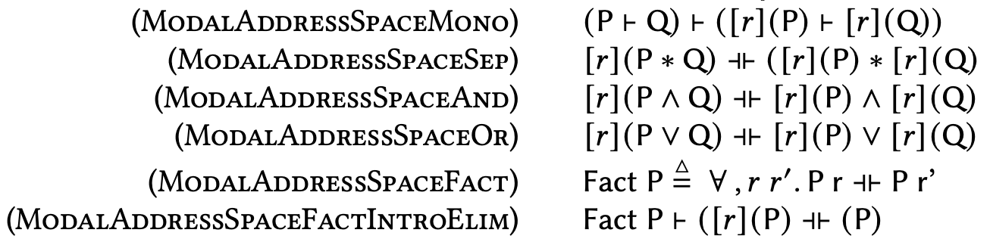
Pure Facts on Address Space
Notes:
As backup slide.

Slide 19
Switching Address-Spaces
Explicitly-modal assertions
provides a means to talk about facts being true in another address space
Address-space switch as changing the "World" of truth

Slide 20


Virtual Memory Managers
r_{s}
cr3
r
r
r
r
L4 Base Addr₀ (a₀)
L4 Base Addr₁ (a₁)
mov cr3 r_{s ;}
P
R
…..
…..

Slide 21
More Experiments
Identity Mapping
Extended our address-space invariants to support:
virtual address of any page used for a page table lives at a virtual address whose value is a constant offset from the physical address a
Page-table-traversal
Using identity mappings
Almost done!
Mapping a new page
Prover with using the page-table-traversal as an axiom to locate L1 entry.

Slide 22
Current Status for x64Iris
What is done?
Machine model – subset of x86
Soundness proofs of all instructions except:
Segment selector related ones, Page fault interrupts
Proof of address-space switching
Proof of identity mapping
Proof of adding a new-page axiomatizing page-table-walk
To be done
Proof of page-table-walk
Fine-tuning instructions’ specs with extended address-space-invariants for identity mappings

Slide 23


Slide 24


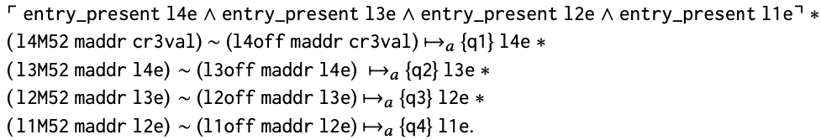
Program Logic: Defining Virtual Points-to
In terms of each physical points-to for a Page-Table
where physical L4_L1 page-table walk
Table Address
Entry Offset

