Slide 1
Modal Understanding of System Evolution
ISMAIL KURU & COLIN S. GORDON
Drexel University

Slide 2
SYSTEM (Protocols & Future Feature Extensions)
Notes:
What is an sts an using ?

Slide 3
Protocols as (STS)es for File Operations
STS_{π}
{initial state}
f := open()
{file opened}
buf := f. write()
{file written}
f.close()
{file closed}
f := open()
buf := f. write()
f.close()
s_{i}
R_{open}
R_{read} , R_{write}
s_{o}
R_{close}
s_{c}
A traditional filesystem protocol

Slide 4
Protocols as (STS)es for File Operations
T_{client} (c) = ⦰ STS_{π}(c) = {Tok_{open} ,Tok_{write} , Tok_{read}, Tok_{close} }
T_{client} (wr) = {Tok_{close} } STS_{π}(wr) = {Tok_{open} Tok_{write} , Tok_{read} }
T_{client} (i) = { Tok_{open} } STS_{π} (i) = { Tok_{write} , Tok_{read,} Tok_{close} }
T_{client} (o) = { Tok_{write} , Tok_{read,} Tok_{close} } STS_{π}(o) = {Tok_{open} }
STS_{π}
STS_{π’}
s_{i}
{ T_{client} (i) * STS_{π} (i) }
f := open()
{ T_{client} (o) * STS_{π} (o) }
buf := f. write()
{T_{client} (wr) * STS_{π} (wr) }
f.close()
{ ⦰ * STS_{π} (c) }
s_{i}
R_{read}
R_{write}
R_{open}
R_{write}
R_{open}
R_{read} , R_{write}
s_{o}
s_{f}
s_{o}
R_{read}
R_{flush}
R_{close}
R_{close}
s_{c}
s_{c}
A traditional filesystem protocol
A distributed filesystem protocol

Slide 5
Narrowing Verification Focus
s_{i}
R_{open}
R_{read}
R_{write}
Not always the whole system!
Generate a submodel from a state [s_{o}]
with relations R_{read} and R_{write}
s_{o}
R_{close}
s_{c}
R_{open}
R_{write}
s_{o}
Notes:
- We see that

Slide 6
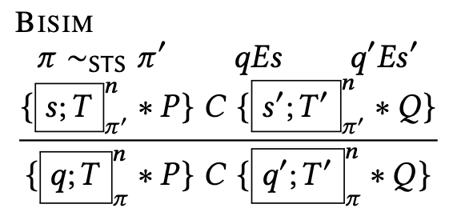
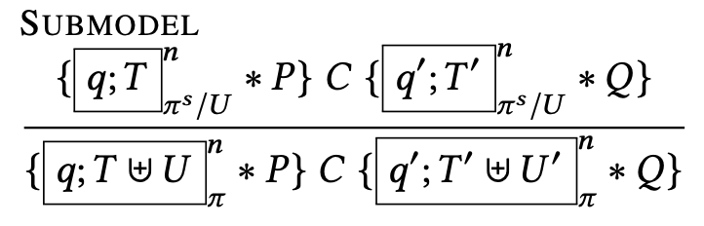
RG-STS: Proof Rules for Bisimilar Protocols

Slide 7
LOGIC
(Exploiting Kripke Models, Generated SubModels &Bisimulation)

Slide 8
Modal Logic: Contingency
Logic for contingent truth
Kripke models [Hughes and Cresswell 1996]
Labelled transition systems (LTS)es, state-transition-systems (STS)es
A model for a logic of propositions representing contingency
A Kripke Model (W,R_{i},V)
W is a set of worlds – can be thought as states in STSes
R is subset of W x W -- accessibility relation between worlds – transition relations in STSes
V : PropVar → P(W) gives for each propositional p a set of worlds V(p) – state interpretation relation
Notes:
Contingency
The modals we are interested in this paper are shaped around
Hybrid logic style understanding of
[] satisfaction operatos
Unknown of other world
Interpreting Kripke models as stses
Multiple generated submodels

Slide 9
RG-STS: Bisimulation under Rely-Guarantee
As an instance of our morphism definition
We denote transitions in the environment (Rely STS)
Essentially the generated submodel starting at [s] for AllTok/T
The generated submodel starting at [s] for T (Guarantee STS)
Intuitively speaking, we need to preserve the rely-start-end pairs exactly
Don’t drop plausible interference
Acknowledge valid starting points

Slide 10
RG-STS: Logic for Modularity of Protocols
Two major pieces
Morphisms to relate two protocol
The Law of Conformance for Local Views
The Law of Environment (Rely) Similarity
Linking to program logic through
Island-Update-Invariance for soundness
Proof rules
Rule Bisim
Rule Submodel

Slide 11
STS-Bisim: Corresponding Local Views
s_{i}
R_{open}
R_{read}
R_{write}
R_{read}
R_{write}
s_{o}
s_{o}
R_{close}
A traditional subprotocol from opened (s_{o}) state
s_{c}
s_{i}
R_{read}
R_{write}
A traditional filesystem protocol
R_{write}
R_{open}
Assuming the valid environments (prev. slide), local views constructed (e.g. {s_{o}}) in the smaller machine have the corresponding one in the bigger machine for the capabilities {Tok_{read}, Tok_{write}}
s_{f}
R_{flush}
s_{o}
R_{read}
Same local view constructed with {Tok_{read}, Tok_{write}} U {Tok_{flush}}
R_{close}
s_{c}
A distributed filesystem protocol
Notes:
- Acknowledging rely-state pairs, so we start
- the rely, which is essentially the generated submodel starting at [s] for AllTok/T
- the guarantee (the generated submodel starting at [s] for T) *)

Slide 12
STS-Bisim: Preserving the Environment
STS_{π}
s_{i}
STS_{π’}
s_{i}
R_{open}
R_{read}
R_{write}
R_{write}
R_{open}
R_{open}
R_{write}
Transitions in the rely-environment of STS_{π} are accounted for the rely-environment of STS_{π’}
s_{o}
s_{f}
R_{flush}
s_{o}
R_{read}
R_{close}
R_{close}
s_{c}
s_{c}
A traditional filesystem protocol
A distributed filesystem protocol
Defining the environment from the mapped state s_{o} with the frame capabilities {Tok_{open}, Tok_{close}} U {Tok_{flush}}
Environment constructed by the frame capabilities {Tok_{open}, Tok_{close}} from the state s_{o}
Notes:
s_{o int} can be defined in the smaller from the embedding state

Slide 13
s_{i}
s_{i}
open
read
write
write
open
read
write
s_{o}
s_{f}
flush
s_{o}
read
close
close
s_{c}
s_{c}
Iris, CaReSL, iCap ?
A traditional filesystem protocol
A distributed filesystem protocol
FCSL ?
read
write
write
read
write
s_{o}
s_{f}
flush
s_{o}
read
A traditional subprotocol from opened (s_{o}) state
A distribute subprotocol from flushed (s_{f}) state

Slide 14
Interfaces in OS Kernels
user process
Sys Calls
mmap
mmap_lazy
……..
x
Virtual File System (VFS)
Virtual Memory Manager (VMM)
ext2
mem_fs
vmm_flist
page cache
Device Drivers
mem_disk_driver
block disk driver
……..
hw_memory
hw_network
hw_disk
……..

Slide 15
TODO:update Current Status of RG-STS
Currently being worked on
Soundness proofs is under-change
Proofs of filesystem protocols presented in this paper
Already done
mmap and mmap_lazy are implemented inside the kernel as a candidate for being an extra experiment
Vfs -- realized by S5 (already exists inside xv6 OS) and ext2 (implemented by us)
Disk device drivers: A block disk driver for our ext2 vs. in-memory block device driver (to
To be done
Finish the soundness
Pick-up one extra example in addition to the filesystem protocol example amongst the examples mentioned above
Not necessarily the implementation of them
Not necessarily the complete protocol of them

Slide 16


Slide 17
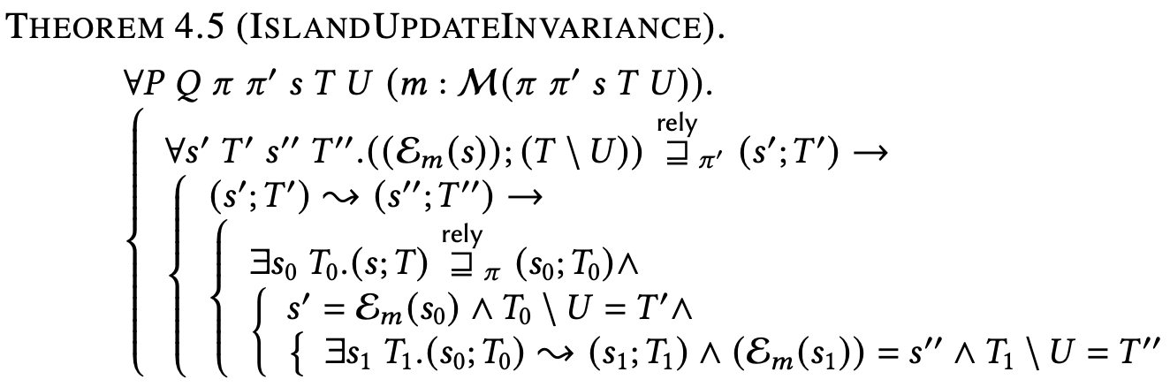
Connecting to a Program Logic (Soundness)
For any two protocols conformance is essential as we would like to see an update in the subSTS equivalent to one in the original under a logical consequence on the tokens. Proof by almost conformance.
Notes:
We want to prove, abstractly, that any island update performed in terms of the
sub-STS is valid in terms of the original STS. Intuitively, we'd like to think
of an update in terms of the sub-STS as equivalent to a combination of
consequence, local anti-frame (on tokens), and island update on the original.
(Eventually, we'd also like to include an analog of anti-frame on invariants
to permit ignoring unaffected state).

