Slide 1
Modal Abstractions for OS Kernels
Ismail Kuru
Drexel University
Notes:
Hello everyone,I am Ismail Kuru a year Phd student at Drexel university, graduating this summer. During my phd I worked on different assurance mechanisms for correctness for low level systems. In this talk, today, I am going to present you a chapter of my thesis, which are basically a set of reasoning principles for a critical piece of general purpose os kernels.

Slide 2
Talk
Modal Understanding of Location Virtualization
System of Virtualization
Abstraction: Address-Spaces
Mechanism: Address-Translation
Logic
Machine Model
Modal Understanding of Location Virtualization
Modal Understanding of How Systems Evolve
System of Interfacing
Abstraction: Protocols
Mechanisms: Interfaces
Logic
Protocols as State Transition Systems (STS)es
Decorating Relations over Kripke Models with Rely-Guarantee
Notes:
We start with asserting why virtual memory managers are important piece to be considered to be verified? Then we will try to build some high level intuition on the aspects of vmms and then, finally, we will be introducing our machine which takes the address translation at its main focus and start explaining some of abstractions and proof rules using these abstractions.

Slide 3
Modal Abstractions for Location Virtualization
Notes:
Hello everyone,I am Ismail Kuru a year Phd student at Drexel university, graduating this summer. During my phd I worked on different assurance mechanisms for correctness for low level systems. In this talk, today, I am going to present you a chapter of my thesis, which are basically a set of reasoning principles for a critical piece of general purpose os kernels.

Slide 4
The System of Memory Virtualization
“the virtual memory sub-system can be considered the core of a Solaris instance, and the implementation of Solaris virtual memory affects just about every other subsystem in the operating system”
by authoritative reference on the internals of the Solaris kernel, McDougall and Mauro
Notes:
In fact, for a conventional general purpose os kernel design, memory virtualization lies in the middle of every other components serving to every other subsystem. It provides isolation of untresteed procees, restrict memory accessed by processes etc. It also works highly tightly coupled with one another giant components -- which is filesystem to ask storing and usage of pages in a cyclic fasion.

Slide 5
SYSTEM
(Memory Translation & Management)

Slide 6
Memory Location Virtualization
What do we mean by virtualizing a memory location?
realizing a mechanism to address more memory locations than you physically (actually) have
V
va_{i}
P
va_{i+1}
pa₀
…
………
pa_{i}
…
va_{n}
pa_{m}
|V| = n |P| = m n >= m
Notes:
So, what we actually mean by virtualizing memory locations is simply trying to figure out ways of pretending that we have more memory locations that actually we have.

Slide 7


Memory Location Virtualization: Abstraction
What is the abstraction for virtualizing memory location in OSes?
an address-space of a process is a named ($γ$) container of virtual-addresses used for memory referencing
$$γ$$
V
va_{i}
P
va_{i+1}
pa₀
…
………
pa_{i}
…
va_{n}
pa_{m}
Notes:
The well-known abstraction dealing with memory abstractions is address-spaces. We can thing of an address-space a name abstraction, a named container (a process named gamma) holding virtual to physical memory location mappings.

Slide 8

Memory Location Virtualization: Mechanism
How do we implement memory-location virtualization?
address-translation: by using per-address-space page-tables – a tree like structure
$$γ$$
V
P
va_{i}
pa₀
va_{i+1}
…
Address Translation
Physical Memory for
Address Translation Tables
………
va_{n}
…
pa_{m}
Notes:
So, the mechanism implemented for realizing the location virtualization for memory is address-translation. OS kernels utilize CPU’ MMU’s kernel page tables (whose themselves reside in the physical memory) to provide indirection to the actual physical memory locations from the virtual addresses.

Slide 9
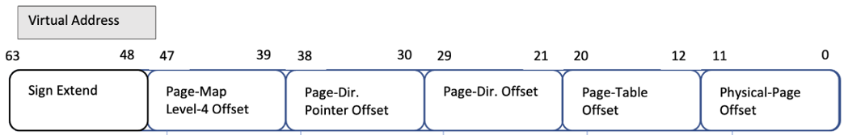
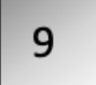


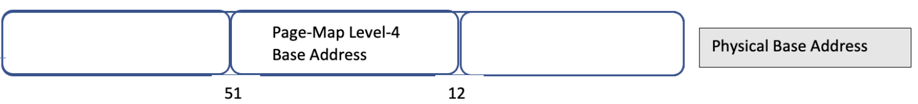
Mechanism: L4_L1 Page Table Walk
L4-Table
L3-Table
L2-Table
L1-Table
Phy. Page
L1-Entry
L4-Entry
L3-Entry
L2-Entry
Page Addr
Notes:
Let’s see how the translation works for a virtual address.Here at the top we see a 64 bit virtual address. At the bottom, we see a physical address which identifies the root of the sparse page-table tree (click) structure per process. Tables for each level includes 512 entries and Virtual address includes offsets to the page-tables at different levels of indirection. To obtain the physical page address.

Slide 10
Virtual Memory Managers
cr3
L4 Base Addr₀ (a₀)
L4 Base Addr₁ (a₁)
va₀
…
va_{i}
va_{n}
va₀
…
va_{i}
va_{n}
mov cr3 a1
L4 Table
L3 Table
L2 Table
L1 Table
L4 Table
L3 Table
L2 Table
L1 Table
pa
pa
…
pa
pa
pa
…
pa
Notes:
Ok, up until now we have tried build intuition on the structure of one single address space. A designated register cr3 a control register shows to an address space with the unique root address a0. I mean of course there are many of these address-spaces and virtual memory manager have to switch in between different address spaces with different unique root addresses. From this left address space kernel loads another address space by loading the rooth address of another ona, unique root address a1.

Slide 11
LOGIC
(Sharing, Contingency & Satisfaction)

Slide 12
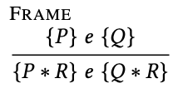
Separation Logic
A logic of resources
Physical resources a program can use
p -> v
P * Q
Notes:
A logic of resources obtained by a proper treatment on the Hoare Logic
What I mean by treatment is basically introducing logical operators and proof rules that allows enforcing proper usage of resource, in its very raw form complete separation (isolation)
Here we see the most famous rule frame rule utilizing a logical operator called separation conj.
These new logical operators appears in the most famous separation logic proof which allows us to incorporate a surrounding frame of resources around a classic hoare style triples. Here we see …

Slide 13



Program Logic: Points-to Relations
Physical state
Physical Memory Map
Register Map
Ownership on Physical State:
A physical points-to assertion (resource):
A register points-to (resource):
How about virtual points-to relation?
Notes:
We start with defining our physical state on top of which we build our logical resources such as physical memory pointso, register points to relations. Here sigma M resembles our physical memory’s a simple nested maps to capture frame and index references from an address and likewise a register on top of which we construct register pointsto relations.
How about virtual pointsto relations? ….

Slide 14
Mechanism: L4_L1 Page Table Walk
Updates to page to physical page table addresses, e.g. moving page tables to create more continuous physical space for hardware IO buffers?
Opss! The tables are no longer the ones va₀ know! Invalid L4_L1 path for va₀!
L4-Table
L3-Table
L2-Table
L1-Table
Phy. Page
L1-Entry
L4-Entry
L3-Entry
L2-Entry
Page Addr
Notes:
All right, so. Let’s go back to the page table walk. And try to construct a virtual pointsto out of physical pateble pointstos. We again start from the top level, and travel the tree to reach to the physical page address, However the path knowledge we constructed through will get violated as updates to the

Slide 15

Restoring Soundness
Abstract Physical Page Table Walk with a ghost-map mapping and distribute the read-only piece to virtual-pointsto (fragmental ownership of the ghost map)
va_{i}
…..
va_{j}
…………
va_{n}
L4-Table
L3-Table
L2-Table
L1-Table
Phy. Page
va_{i} ->_{f} pa_{i}
*
L1-Entry
$∀ i ∈0…n,$ v_{i} ->_{a} p_{i}
L4-Entry
L3-Entry
pa_{i} ->_{p} val
L2-Entry
pa_{i}
=
va_{i} ->_{v} val
Then keep the physical page table walk next to authorative ownership of the ghost map which is required to update the page tables
Notes:
Instead of opening the physical shared page table addresses

Slide 16




Virtual Memory Managers
cr3
r
r
mov cr3 a1
L4 Base Addr₀ (a₀)
L4 Base Addr₁ (a₁)
Load another address space into the current view of memory
Bookkeeping each virtual address’s address-space explicitly?
Referring to virtual addresses in another space?
Or another abstraction?
…..
…..

Slide 17
Modal Logic: Contingency
Hybrid logic [Areces, Blackburn, and Marx 2001]
Inspired by dynamic logic’s satisfaction operator [Fisher and Ladner 1977]
[l]𝑃: 𝑃 is true in the specific alternate circumstance (Kripke world) named by the nominal l
More than hiding: the choice of what state (world in Kripke Semantics) a modalized assertions is true on the assertion itself
Notes:
Contingency
The modals we are interested in this paper are shaped around
Hybrid logic style understanding of
[] satisfaction operatos
Unknown of other world
Interpreting Kripke models as stses
Multiple generated submodels

Slide 18
Virtual Pointstos as Modal Context Resource
Context-agnostic-resources
each virtual address is valid under a certain address-space
but it does not represent this knowledge of its address-space.
Address-spaces as modal contexts
assertions in our logic are context-dependent

Slide 19
Switching Address-Spaces
Explicitly-modal assertions
provides a means to talk about facts being true in another address space
Address-space switch as changing the "World" of truth

Slide 20


Virtual Memory Managers
r_{s}
cr3
r
r
r
r
L4 Base Addr₀ (a₀)
L4 Base Addr₁ (a₁)
mov cr3 r_{s ;}
P
R
…..
…..

Slide 21
Experiments
Identity Mapping
Extended our address-space invariants to support identity mappings
P2V: virtual address of any page used for addressing a page table lives at a virtual address whose value is a constant offset from the physical address a
Page-table-traversal
Using identity mappings
Mapping a new page
Prover with using the page-table-traversal as an axiom to locate L1 entry
Unmapping pages

Slide 22
static pte_t *pte_get_next_table(pte_t *entry, int alloc) {
pte_t *next;
// If not already present, try to allocate
if (!entry->present) {
// If it shouldn't be or cannot be allocated, indicate failure
if (!alloc || pte_alloc(&next)) {
return NULL;
}
entry->writable = 1;
entry->user_acc = 1;
entry->pfn = PTE_ADDR_TO_PHYS_PFN((uintptr_t) next);
entry->present = 1;
} else {
uintptr_t next_phys_addr = PTE_PFN_TO_ADDR(entry->pfn);
uintptr_t next_virt_addr = (uintptr_t) P2V(next_phys_addr);
next = (pte_t *) next_virt_addr;
}
return next;
}
pte_t *walkpgdir(pte_t *pml4, const void *va, int alloc) {
pte_t *pml4_entry = &pml4[PML4EX(va)];
pte_t *pdp = pte_get_next_table(pml4_entry, alloc);
if (pdp == NULL) {
return NULL;
}
pte_t *pdp_entry = &pdp[PDPEX(va)];
pte_t *pd = pte_get_next_table(pdp_entry, alloc);
if (pd == NULL) {
return NULL;
}
pte_t *pd_entry = &pd[PDEX(va)];
pte_t *pt = pte_get_next_table(pd_entry, alloc);
if (pt == NULL) {
return NULL;
}
return &pt[PTEX(va)];
}
Ask for a new page from the page-allocator and set the page entry accordingly.
Open the address-space invariant and access to the ghost P2V mappings!

Slide 23
Current Status for x64Iris
What is done?
Machine model – subset of x86
Soundness proofs of all instructions except:
The ones related to segment selection (in-progress)
Proof of address-space switching
Proof of identity mapping
Proof of page-table-walk
Proof of adding a new-page using page-table-walk
Overall, so much of Roqc proofs

Slide 24
Modal Understanding of System Evolution
Notes:
Hello everyone,I am Ismail Kuru a year Phd student at Drexel university, graduating this summer. During my phd I worked on different assurance mechanisms for correctness for low level systems. In this talk, today, I am going to present you a chapter of my thesis, which are basically a set of reasoning principles for a critical piece of general purpose os kernels.

Slide 25
SYSTEM (Protocols & Future Feature Extensions)
Notes:
What is an sts an using ?

Slide 26
Protocols as (STS)es for File Operations
STS_{π}
{initial state * client_can_open}
f := open()
{file opened * client_can_read/write}
buf := f. write()
{file written * client_can_close}
f.close()
{file closed}
f := open()
buf := f. write()
f.close()
s_{i}
R_{open}
R_{read} , R_{write}
s_{o}
R_{close}
s_{c}
A traditional filesystem protocol

Slide 27
Protocols as (STS)es for File Operations
T_{client} (c) = ⦰ STS_{π}(c) = {Tok_{open} ,Tok_{write} , Tok_{read}, Tok_{close} }
T_{client} (wr) = {Tok_{close} } STS_{π}(wr) = {Tok_{open} Tok_{write} , Tok_{read} }
T_{client} (i) = { Tok_{open} } STS_{π} (i) = { Tok_{write} , Tok_{read,} Tok_{close} }
T_{client} (o) = { Tok_{write} , Tok_{read,} Tok_{close} } STS_{π}(o) = {Tok_{open} }
STS_{π}
STS_{π’}
s_{i}
{ T_{client} (i) * STS_{π} (i) }
f := open()
{ T_{client} (o) * STS_{π} (o) }
buf := f. write()
{T_{client} (wr) * STS_{π} (wr) }
f.close()
{ ⦰ * STS_{π} (c) }
s_{i}
R_{read}
R_{write}
R_{open}
R_{write}
R_{open}
R_{read} , R_{write}
s_{o}
s_{f}
s_{o}
R_{read}
R_{flush}
R_{close}
R_{close}
s_{c}
s_{c}
A traditional filesystem protocol
A distributed filesystem protocol

Slide 28
Narrowing Verification Focus
s_{i}
R_{open}
R_{read}
R_{write}
Not always the whole system!
Generate a submodel from a state [s_{o}]
with relations R_{read} and R_{write}
s_{o}
R_{close}
s_{c}
R_{open}
R_{write}
s_{o}
Notes:
- We see that

Slide 29
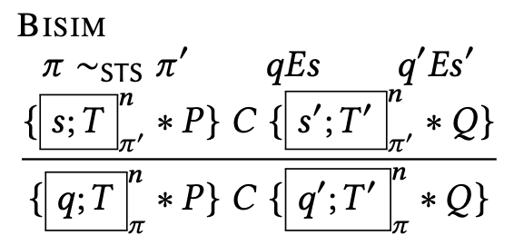
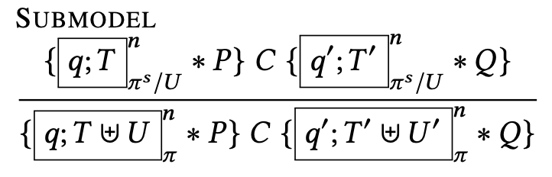
A Gist of Proof Rules for Bisimilar Protocols

Slide 30
LOGIC
(Exploiting Kripke Models, Generated SubModels &Bisimulation)

Slide 31
Modal Logic: Contingency
Logic for contingent truth
Kripke models
Labelled transition systems (LTS)es, state-transition-systems (STS)es
A model for a logic of propositions representing contingency
A Kripke Model (W,R_{i},V)
W is a set of worlds – can be thought as states in STSes
R is subset of W x W -- accessibility relation between worlds – transition relations in STSes
V : PropVar → P(W) gives for each propositional p a set of worlds V(p) – state interpretation relation
Notes:
Contingency
The modals we are interested in this paper are shaped around
Hybrid logic style understanding of
[] satisfaction operatos
Unknown of other world
Interpreting Kripke models as stses
Multiple generated submodels

Slide 32
RG-STS: Bisimulation under Rely-Guarantee
As an instance of our morphism definition
We denote transitions in the environment (Rely STS)
Essentially the generated submodel starting at [s] for AllTok/T
The generated submodel starting at [s] for T (Guarantee STS)
Intuitively speaking, we need to preserve the rely-start-end pairs exactly
Don’t drop plausible interference
Acknowledge valid starting points

Slide 33
RG-STS: Logic for Modularity of Protocols
Two major pieces
Morphisms to relate two protocol
The Law of Conformance for Local Views
The Law of Environment (Rely) Similarity
Linking to program logic through
Soundness: Pretty much the one in CaReSL and Iris
Any update on STS (as logical resources) preserves the laws above
Proof rules (already shown)
Rule Bisim
Rule Submodel

Slide 34
STS-Bisim: Corresponding Local Views
s_{i}
R_{open}
R_{read}
R_{write}
R_{read}
R_{write}
s_{o}
s_{o}
R_{close}
A traditional subprotocol from opened (s_{o}) state
s_{c}
s_{i}
R_{read}
R_{write}
A traditional filesystem protocol
R_{write}
R_{open}
Assuming the valid environments (prev. slide), local views constructed (e.g. {s_{o}}) in the smaller machine have the corresponding one in the bigger machine for the capabilities {Tok_{read}, Tok_{write}}
s_{f}
R_{flush}
s_{o}
R_{read}
Same local view constructed with {Tok_{read}, Tok_{write}} U {Tok_{flush}}
R_{close}
s_{c}
A distributed filesystem protocol
Notes:
- Acknowledging rely-state pairs, so we start
- the rely, which is essentially the generated submodel starting at [s] for AllTok/T
- the guarantee (the generated submodel starting at [s] for T) *)

Slide 35
STS-Bisim: Preserving the Environment
STS_{π}
s_{i}
STS_{π’}
s_{i}
R_{open}
R_{read}
R_{write}
R_{write}
R_{open}
R_{open}
R_{write}
Transitions in the rely-environment of STS_{π} are accounted for in the rely-environment of STS_{π’}
s_{o}
s_{f}
R_{flush}
s_{o}
R_{read}
R_{close}
R_{close}
s_{c}
s_{c}
A traditional filesystem protocol
A distributed filesystem protocol
Defining the environment from the mapped state s_{o} with the frame capabilities {Tok_{open}, Tok_{close}}
Environment constructed by the frame capabilities {Tok_{open}, Tok_{close}} from the state s_{o}
Notes:
s_{o int} can be defined in the smaller from the embedding state

Slide 36
s_{i}
s_{i}
open
read
write
write
open
read
write
s_{o}
s_{f}
flush
s_{o}
read
close
close
s_{c}
s_{c}
Iris, CaReSL, iCap ?
A traditional filesystem protocol
A distributed filesystem protocol
FCSL ?
read
write
write
read
write
s_{o}
s_{f}
flush
s_{o}
read
A traditional subprotocol from opened (s_{o}) state
A distribute subprotocol from flushed (s_{f}) state

Slide 37
Interfaces in OS Kernels
user process
Sys Calls
mmap
mmap_lazy
……..
x
Virtual File System (VFS)
Virtual Memory Manager (VMM)
ext2
mem_fs
vmm_flist
page cache
Device Drivers
mem_disk_driver
block disk driver
……..
hw_memory
hw_network
hw_disk
……..

Slide 38
Current Status of RG-STS
Soundness finished
File resource protocol shown in the talk finished
To be done
mmap and mmap_lazy
Disk device drivers

Slide 39


Slide 40
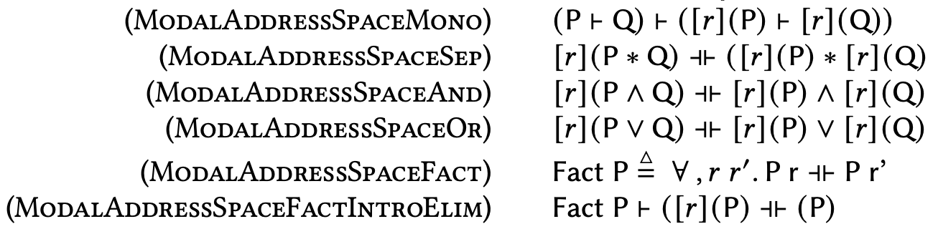
Pure Facts on Address Space
Notes:
As backup slide.

