Slide 1
Modal Abstractions for Virtualizing Memory Addresses
Ismail Kuru & Colin S. Gordon

Slide 2
SYSTEM
(Translation & Management)

Slide 3
Memory Location & Virtualization
What do we mean by virtualizing a memory location?
realizing a mechanism to address more memory locations than you physically (actually) have
What is the abstraction for virtualizing memory location in OSes?
an address-space of a process is a container of virtual-addresses used for memory referencing
How do we implement memory-location virtualization?
address-translation: by using per-address-space page-tables – a tree like structure

Slide 4
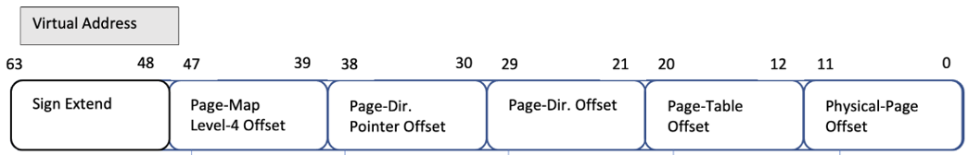



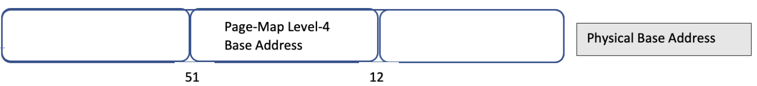
L4_L1 Page Table Walk
L4-Table
L3-Table
L2-Table
L1-Table
Phy. Page
L1-Entry
L4-Entry
L3-Entry
L2-Entry
Page Addr

Slide 5
Virtual Memory Managers
cr3
L4 Base Addr₀ (a₀)
L4 Base Addr₁ (a₁)
va₀
…
va_{i}
va_{n}
va₀
…
va_{i}
va_{n}
mov cr3 a1
L4 Table
L3 Table
L2 Table
L1 Table
L4 Table
L3 Table
L2 Table
L1 Table
pg
pg
…
pg
pg
pg
…
pg
Notes:
When you access an address when you access an address page-fault.
Different address-spaces dont's touch each others memory

Slide 6
The System of Memory Virtualization
“the virtual memory sub-system can be considered the core of a Solaris instance, and the implementation of Solaris virtual memory affects just about every other subsystem in the operating system”
by authoritative reference on the internals of the Solaris kernel, McDougall and Mauro

Slide 7
LOGIC
(Sharing & Contingency)

Slide 8



Program Logic: Points-to Relations
Physical state
Physical Memory Map
Register Map
Ownership on Physical State:
A physical points-to assertion (resource):
A register points-to (resource):
How about virtual points-to relation?

Slide 9



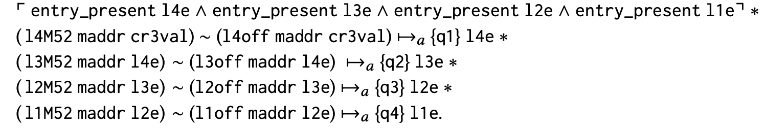
Program Logic: Defining Virtual Points-to
In terms of each physical points-to for a Page-Table
where physical L4_L1 page-table walk
This definition under updated page-tables?
Table Address
Entry Offset
TYPO HERE

Slide 10

Program Logic: Sharing under Page-Table Update
Opss! The tables are no longer the ones va₀ know! Invalid L4_L1 path for va₀ !
Adding a new page requires an update to L1 table: call ensure_L1
cr3
L4 Base Addr₀ (a₀)
va₀
pg
vnew
52/12
va₀
L4 Table
L3 Table
L2 Table
L1 Table
Page Addr
l4e₀
ptel3e
l2e₀
ptel1e
52/12
l3e₀
vanew
ptel4e
ptel2e
l1e₀
paddr₀
pg
Notes:
It might want to defrag / compress page tables
changes internal page-tables would violate

Slide 11

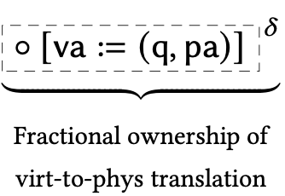
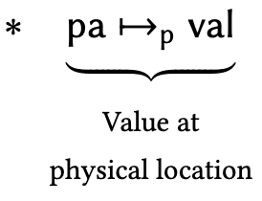


Program Logic: Abstracting Page-Table Walk
Abstract Physical Page Table Walk with a ghost-map mapping and distribute the read-only piece to virtual-pointsto (Fragmental Ownership of the ghost map)
Then keep the physical page table walk next to full ownership of the ghost map which is required to update the page tables

Slide 12




Virtual Memory Managers
cr3
r
r
mov cr3 a1
L4 Base Addr₀ (a₀)
L4 Base Addr₁ (a₁)
Load another address space into the current view of memory
Bookkeeping each virtual address’s address-space explicitly?
Referring to virtual addresses in another space?
Or another abstraction?
…..
…..

Slide 13
Virtual Points-Tos as Modal Context Resource
Context-agnostic-resources
each virtual address is valid under a certain address-space, but it does not represent this knowledge of its address-space.
that is, assertions are not explicitly tagged with their address space validity
Address-spaces as modal contexts
assertions in our logic are context-dependent, in the sense that their truth depends on which address space they are used in, due to the need to support virtual points-to assertions.
Notes:
A lot of text ,
we define all of our assertions relative to the address-space
vProp
lift all the bi stuff

Slide 14
Switching Address-Spaces
Explicitly-modal assertions
provides a means to talk about facts being true in another address space
Address-space switch as changing the "World" of truth
Switching from one address-space to another logically becomes a simultaneous introduction-and-elimination of a pair of modal assertions (for different address spaces)
Notes:
a lot of text

Slide 15


Virtual Memory Managers
r_{s}
cr3
r
r
r
r
L4 Base Addr₀ (a₀)
L4 Base Addr₁ (a₁)
mov cr3 r_{s ;}
R
P
…..
…..

Slide 16
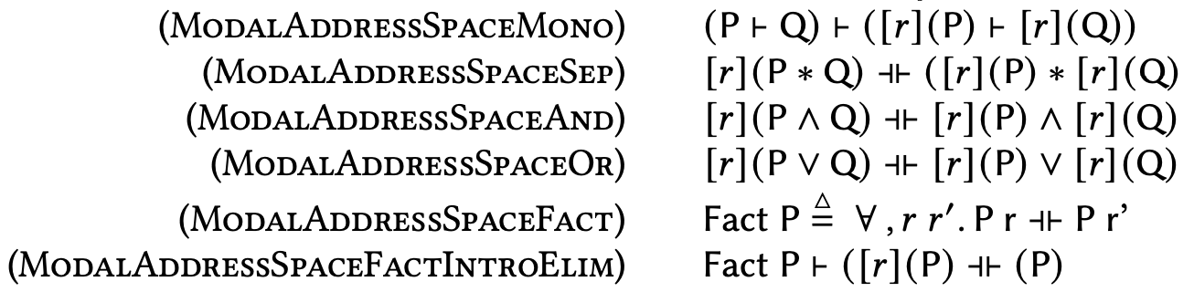
Pure Facts on Address Space
Notes:
As backup slide.

