Slide 1

3D Pose of Human Faces
Group 12
Cai Yujun, Song Guoxian, Zhang Zhijie

Slide 2
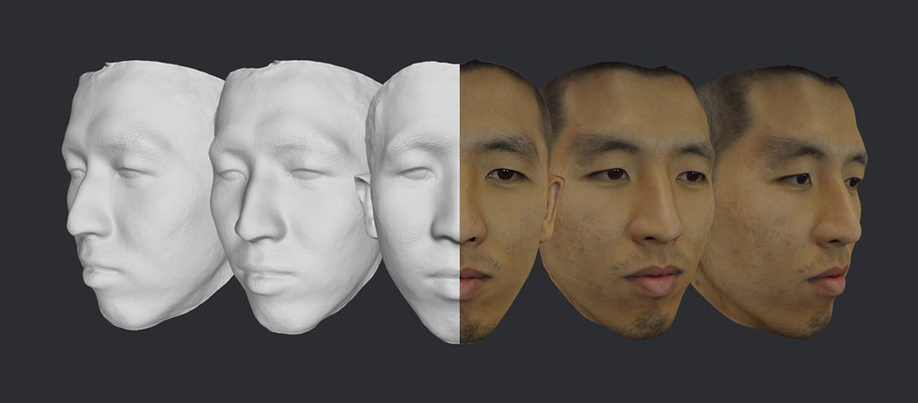
Motivation and Description
3D pose of human faces has rich applications in computer vision and graphics.
Traditional methods requires advanced deceives and significant user intervention.
We tend to use simple RGB image to recovery 3D face pose.
Fig. Lifelike 3D Face Scanning
from Mobile Devices. https://www.bellus3d.com/

Slide 3
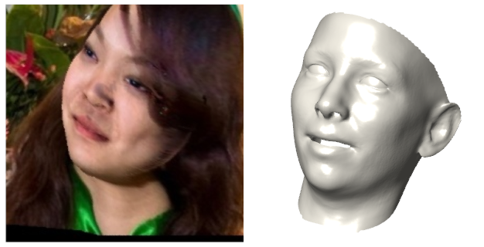
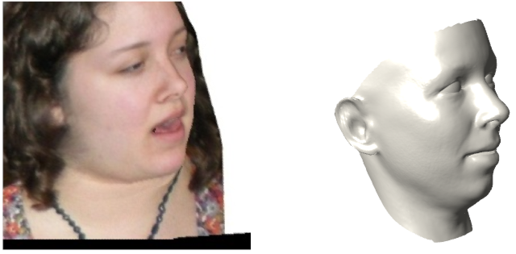
Motivation and Description
aim at utilizing a powerful convolutional neural networks (CNN) for facial pose regression
tries to regress the translation, rotation and scale information of the target face.

Slide 4
Dataset: CoarseData^{[1]}
includes 3,131 subjects in different environments and with different expressions.
66,336 images for training and 5,000 for testing.
labelled with translation, rotation and scale.
is augmented from original image: using a 3D model to fit the original images, and changing its expression in 3D space and image wrap into 2D space.
[1] https://github.com/Juyong/3DFace

Slide 5


Data Pre-process
Normalize the facial images into the same size and put the face in the middle.
use dlib library to detect the face location and 68 facial landmarks
compute the face size from the landmarks
use cv2.resize to scale the input image and then crop it into 224 224 size
normalize and scale data
$$×$$
$$(x−mean)/225$$

Slide 6
Training Process
Choose Network Architecture
Training Details

Slide 7
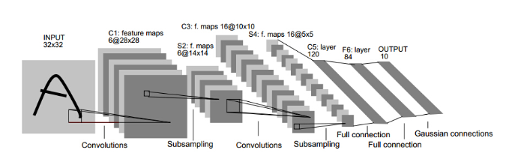
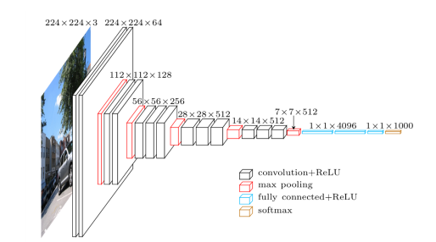
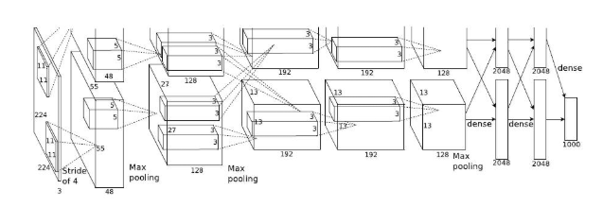
Some popular networks
Lenet
Vggnet
Alexnet

Slide 8
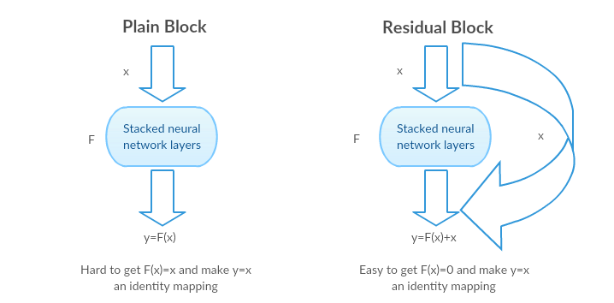
Advantage of Resnet
Residual learning block

Slide 9
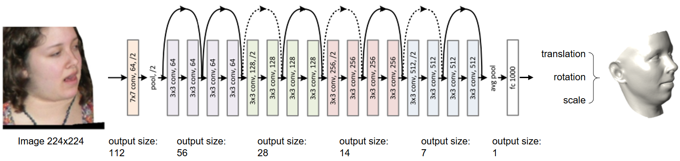
Proposed Model Resnet18
Input：
Cropped images in size 224*224
Batchsize:256
Learning rate:5E-5
Output:
Translation(2 parameters)
Rotation(3 parameters)
Scale(1 parameter)

Slide 10
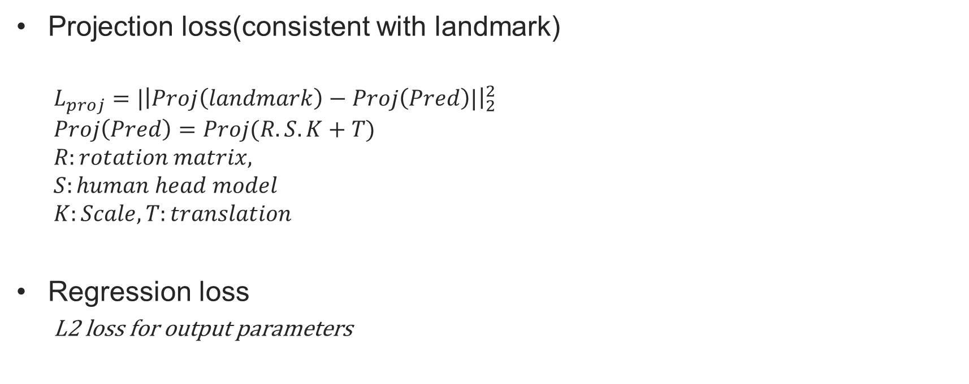
Training loss
Projection loss(consistent with landmark)
$$L_{proj}=|{\left|Proj\left(landmark\right)−Proj\left(Pred\right)|\right|}_{2}^{2}$$
$$Proj\left(Pred\right)=Proj(R.S.K+T)$$
$$R:rotation matrix,$$
$$S:human head model$$
$$K:Scale, T:translation$$
Regression loss
L2 loss for output parameters

Slide 11
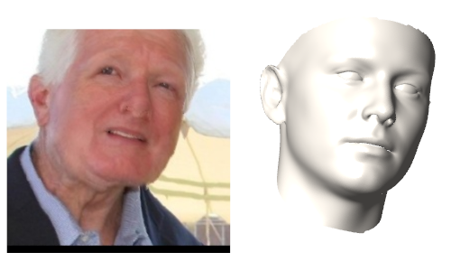
Result
Quantities Result
5000 test image with pose labels
Eular : mean absolute error 0.089
Translation: 7.31 pixels
Scale: 5.21e-05
Test image
3D pose

Slide 12
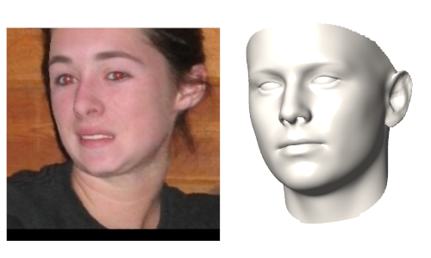
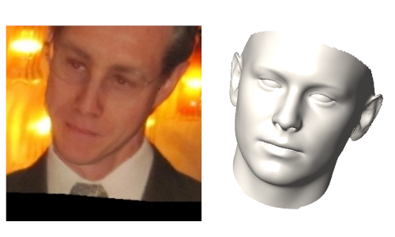
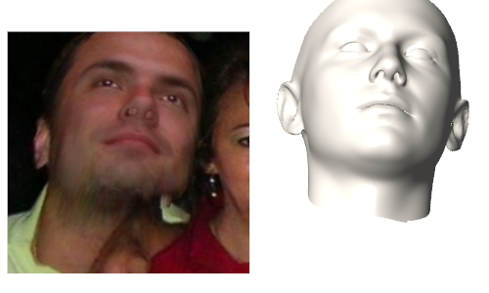
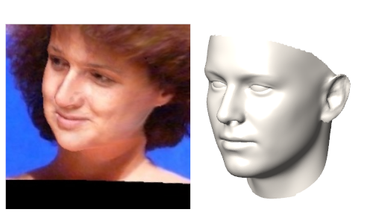
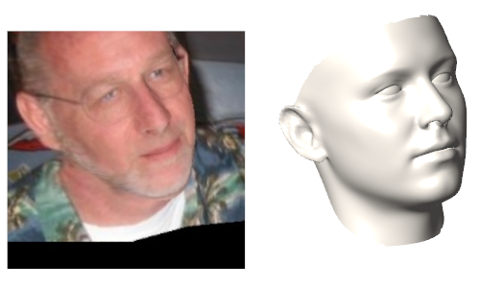
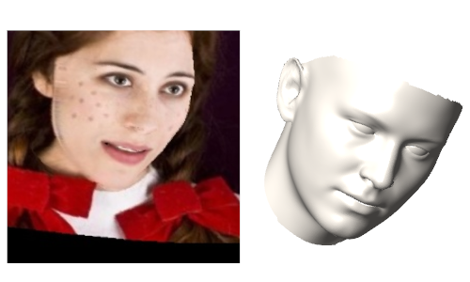
Visual result

Slide 13
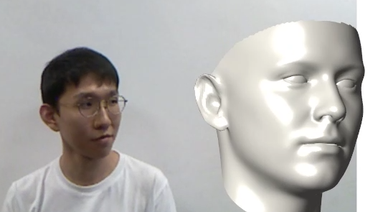
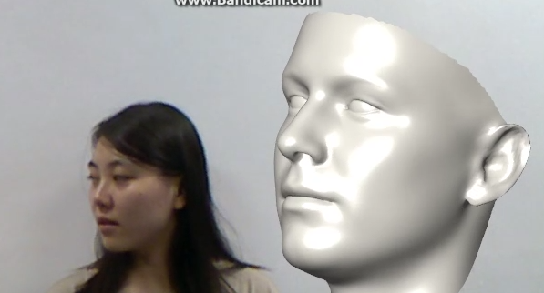
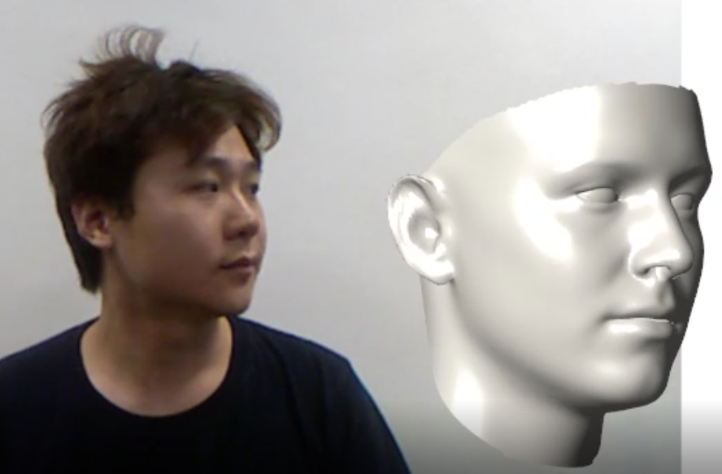
Our face
limitation
Pose shake
Frame based regression.
Wrong prediction
Our face and record environment is different from train data

Slide 14

Video Result
https://youtu.be/-lEDSFC-dgQ

Slide 15
Thanks!
Q&A
This project is available at GitHub and Google Drive:
GitHub: https://github.com/GuoxianSong/Course_porject_face
Google Drive: https://drive.google.com/drive/folders/19mRFcO5IIvzsHl4d_a_RdsTiMJz62NbB

