Slide 1
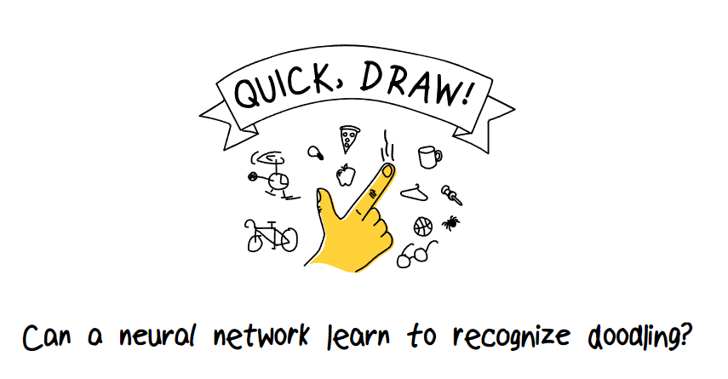
~A production of Group 06~
Brought to you by:
AYE PHYU PHYU AUNG
CHAN GUO WEI ALVIN
ELMO HUANG XUYUN
LEW WAI CHEONG LINCOLN

Slide 2
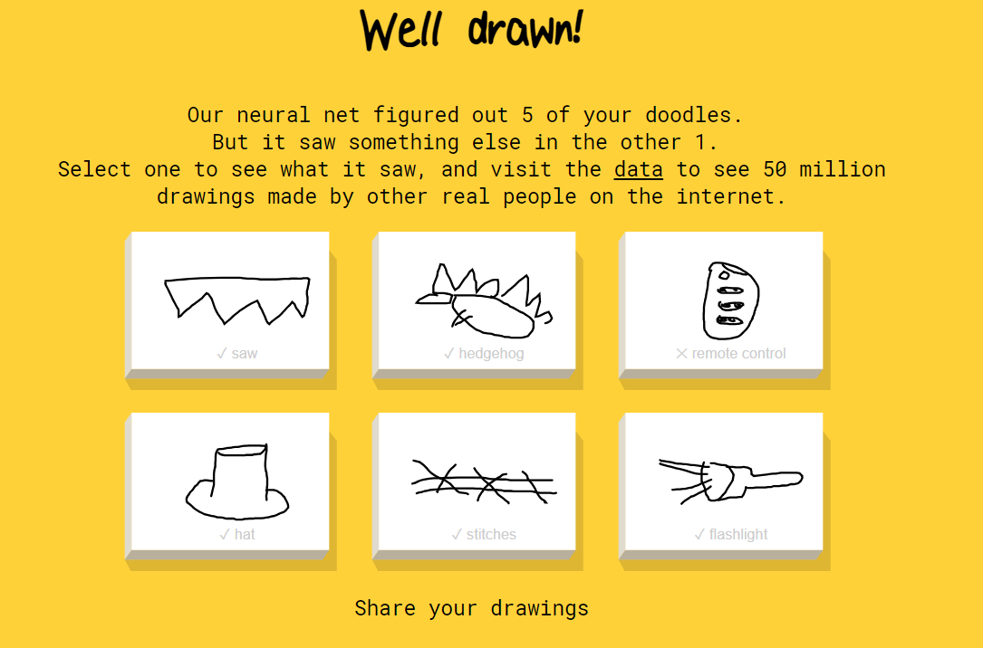
What is Quick Draw?
Goal
Motivation
-Experimental game -Developed by Google AI -Players have 20 secs to draw a picture that best describe the word shown.
-To develop a recognizer that can effectively learn from sets of hand drawn pictures and performed in a noisy environment.
By advancing models on this dataset, one can improve pattern recognition solutions more broadly. This will have an immediate impact on handwriting recognition and its robust applications.

Slide 3
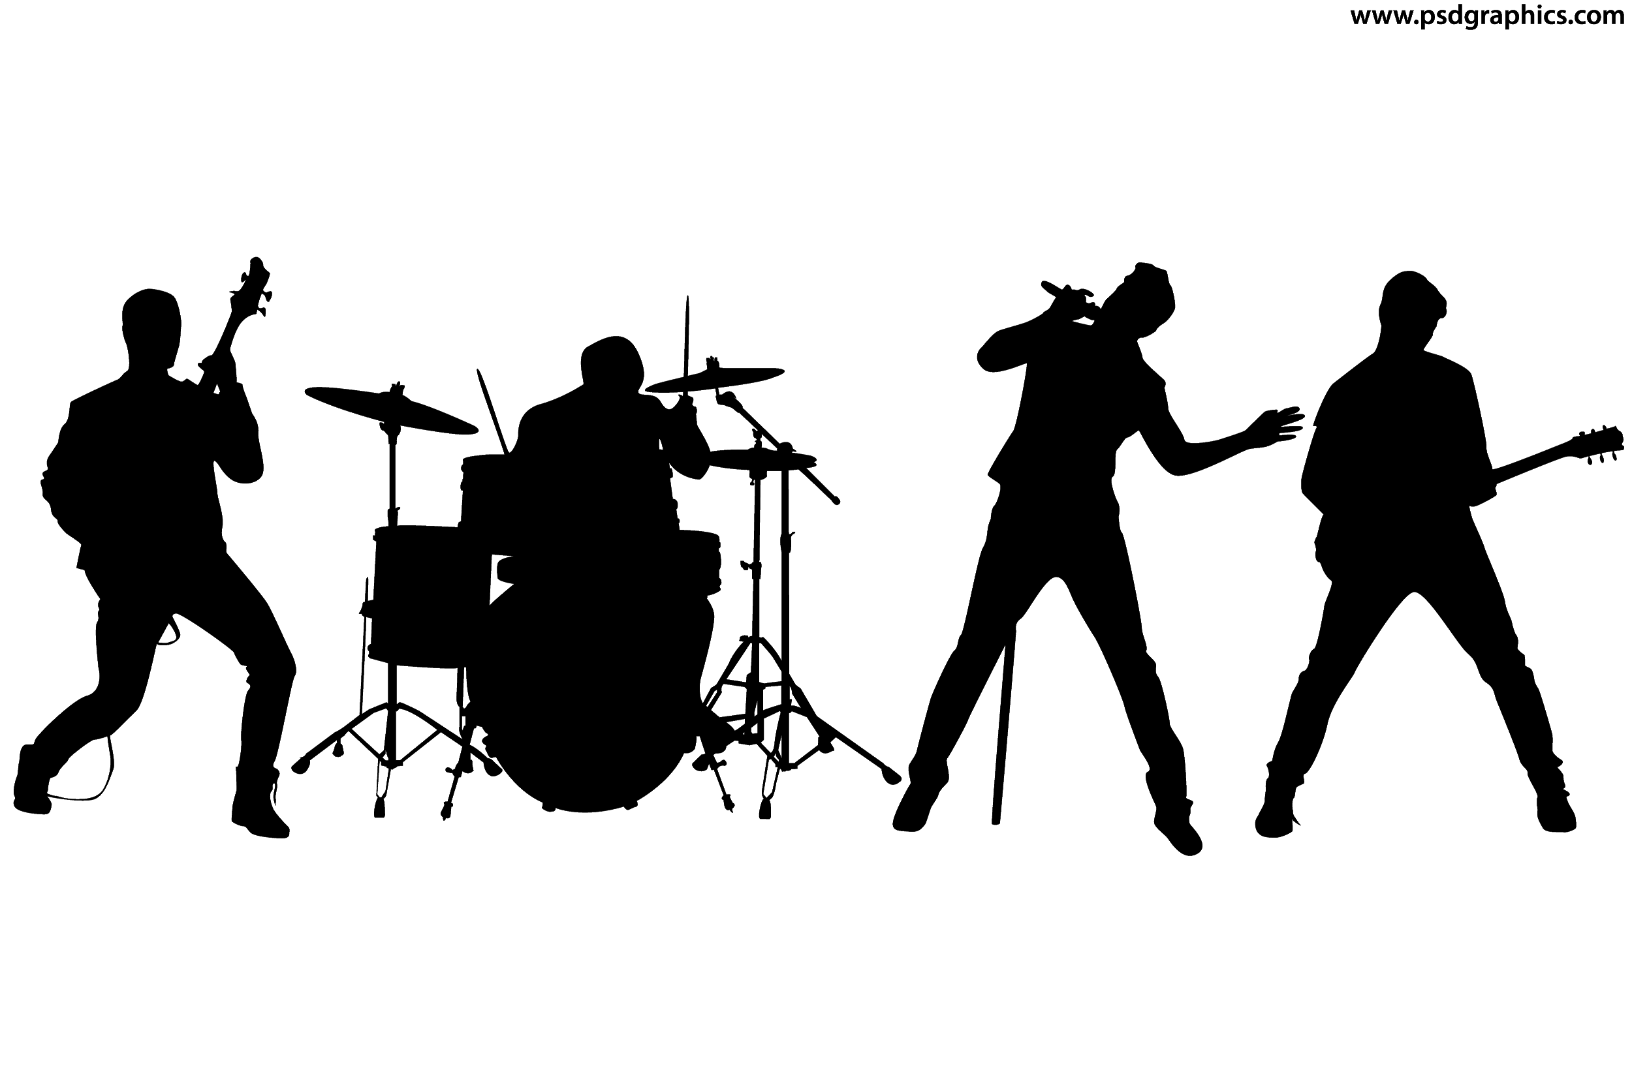
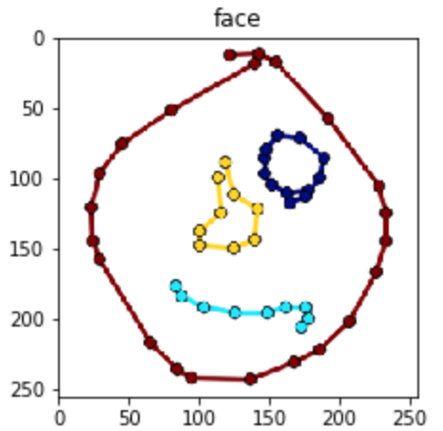
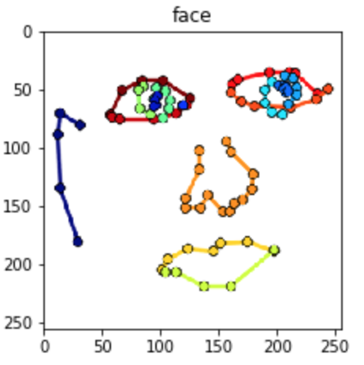
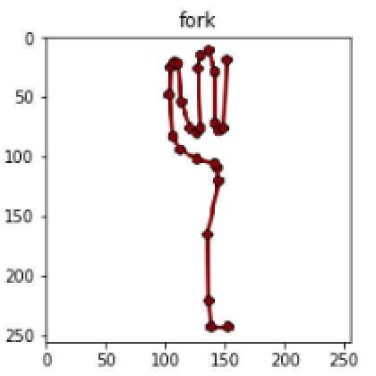
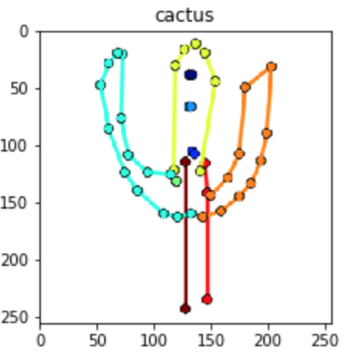
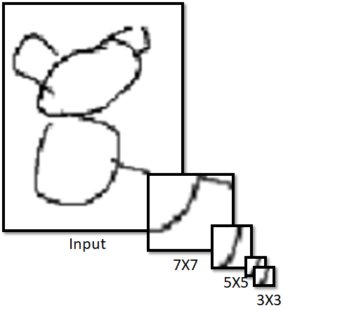
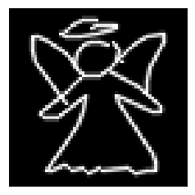
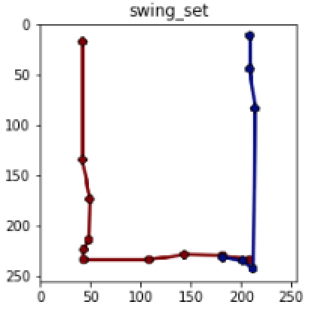
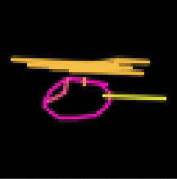
Methodology
30000 diverse training image per class (340 classes)
4 different models
Final ensemble model combines all 4 models to obtain a final prediction
MNIST CNN
Black background Resnet
LSTM Model
Temporal Image Encoding

Slide 4
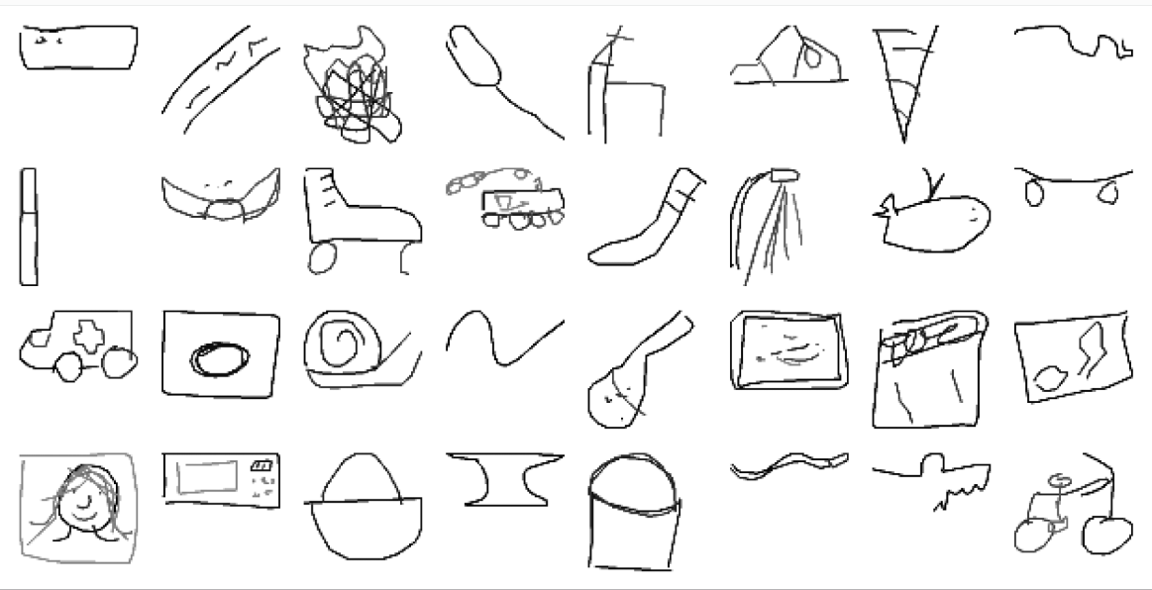
1st Model:MNIST CNN
Data prep:
1. OpenCV to randomly plot images of 64 by 64 pixels
2. Conversion to black stroke and white background to best replicate the actual data
3. Data augmentation. Random rotation of training pictures.
Sample images of black stroke and white background

Slide 5
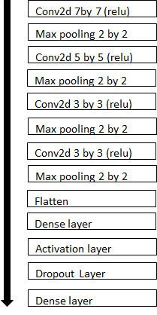

1st Model: Layering architecture and results
Results
Evaluation metric:
where U is the number of scored drawings in the test data, P(k) is the precision at cutoff k, and n is the number predictions per drawing
.
Hyper Parameters: Batchsize: 340 Steps: 4800 Epoch: 18 Adam optimiser Learning rate: 0.0005 with decrement of 0.0001 when plateaued
Map3 = 0.862

Slide 6
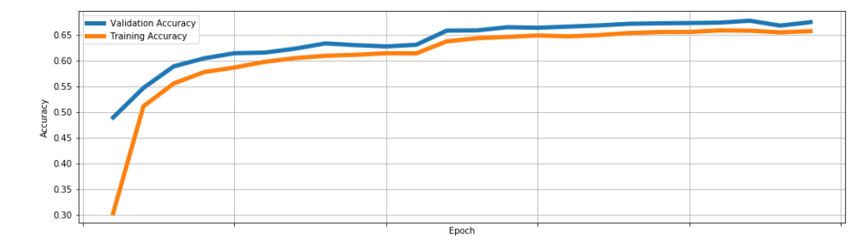


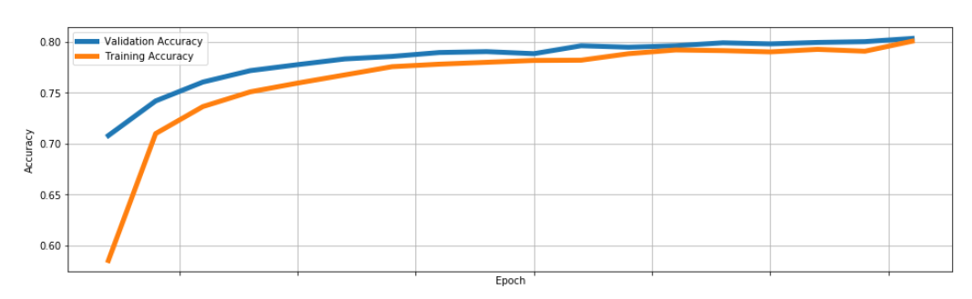
1st Model: Problem faced and solution
Problem
Underfitting of data: Large number of data required for each class. Due to huge differences in the drawings and unrecognised pictures (ard 10%)
Unknown Picture 1
Unknown Picture 2
Solution
Removal of Unrecognised photo for training: After we removed all the unrecognised pictures in the training model, we see a huge improvement in the results in CNN. (15%)

Slide 7
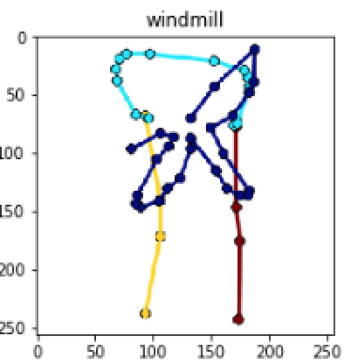
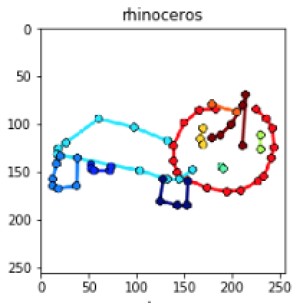
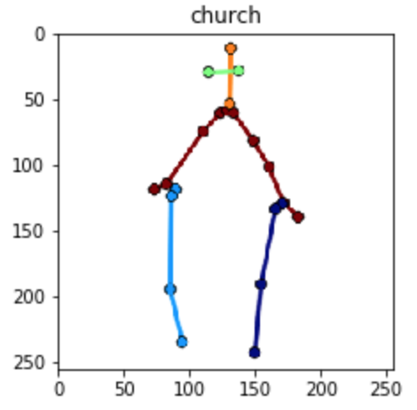
2nd Model: LSTM Model - Data preparation
points to stroke -> take the difference between two adjacent points to get a stroke
-> OpenCV to plot the doodles and color each stroke

Slide 8
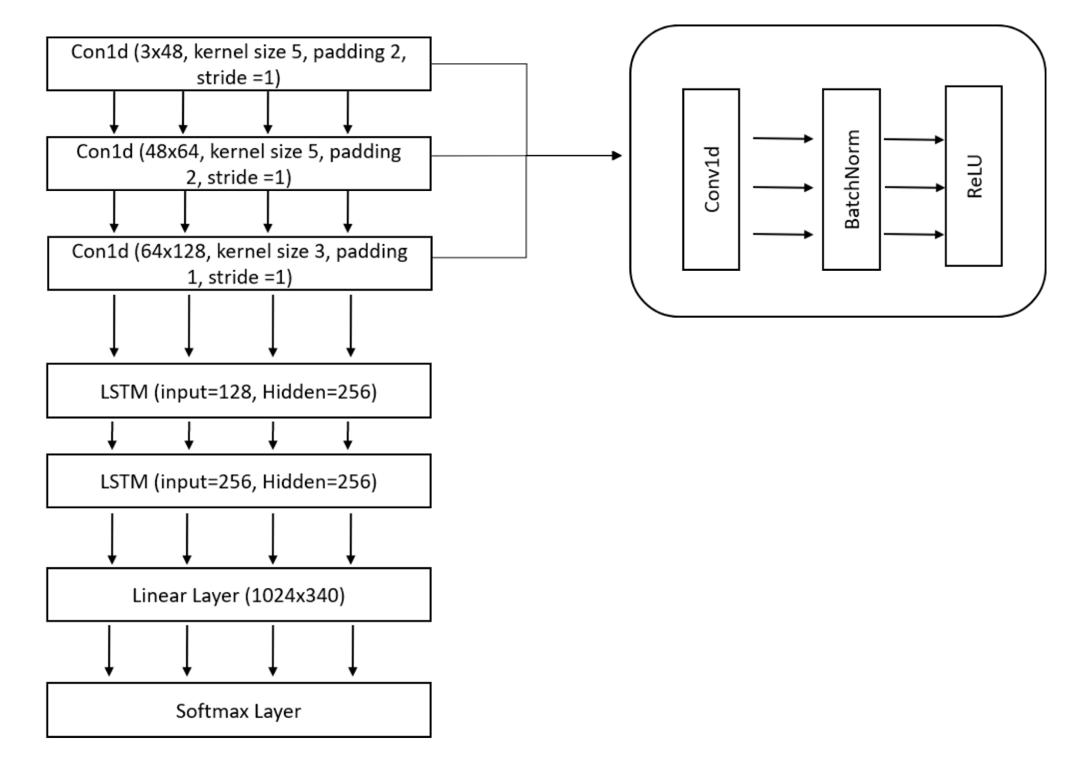
2nd Model: LSTM Model
Convolutional Bi-LSTM - Extract the features first, sequential information of strokes
Hyper Parameters:
Batch size - 680
Iterations -15000
Optimizer - Adam
Epoch: 10
Learning rate: 0.0005
(divided by 1.25 for epoch> 5)
dropout =0.1
dropout =0.1

Slide 9
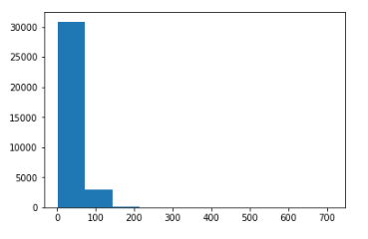
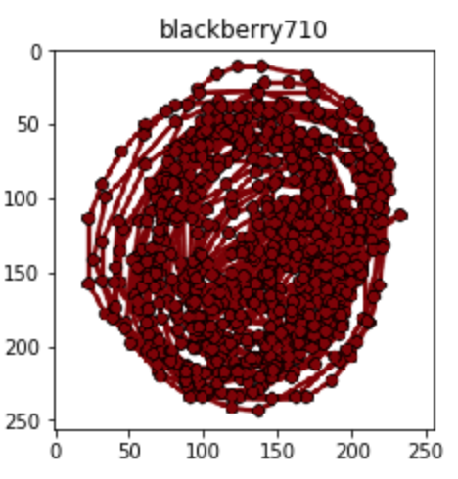
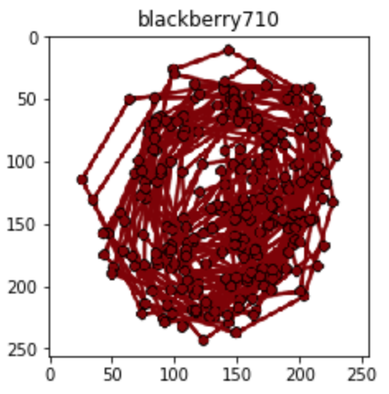
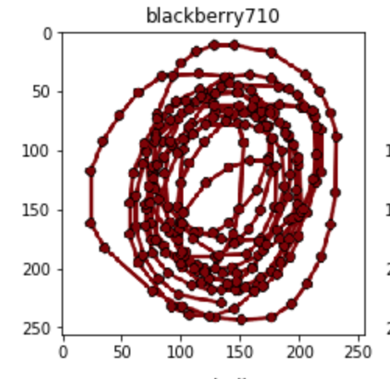
2nd Model: Problems with large number of strokes
- Some outlier doodles have large number of points/strokes in a single doodle
Memory errors
. (we need to pad the pictures with small number of strokes in each batch to match)
Distribution of strokes of each picture in the dataset
Solution
capped the maximum stroke count to 250.
different methods show that recognizable shape is still maintained when cut down to 250
MAP3 - 0.800

Slide 10
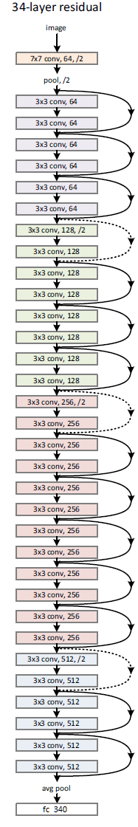
3rd Model: Residual Network - 34
Data Preparation:
Resize the drawing points
cv2.line to connect all the points to produce the image
Hyper Parameters:
Image: 3x64x64; White on black background
Batch size: 512
Learning rate: 0.01 (with decay)
Optimizer: SGD & SGD w/nesterov
A resized version of 64 x 64 image: Angel
Adapted - Kaiming He, Xiangyu Zhang, Shaoqin Ren, & Jian Sun. “Deep Residual Learning for Image Recognition”. CVPR 2016.

Slide 11
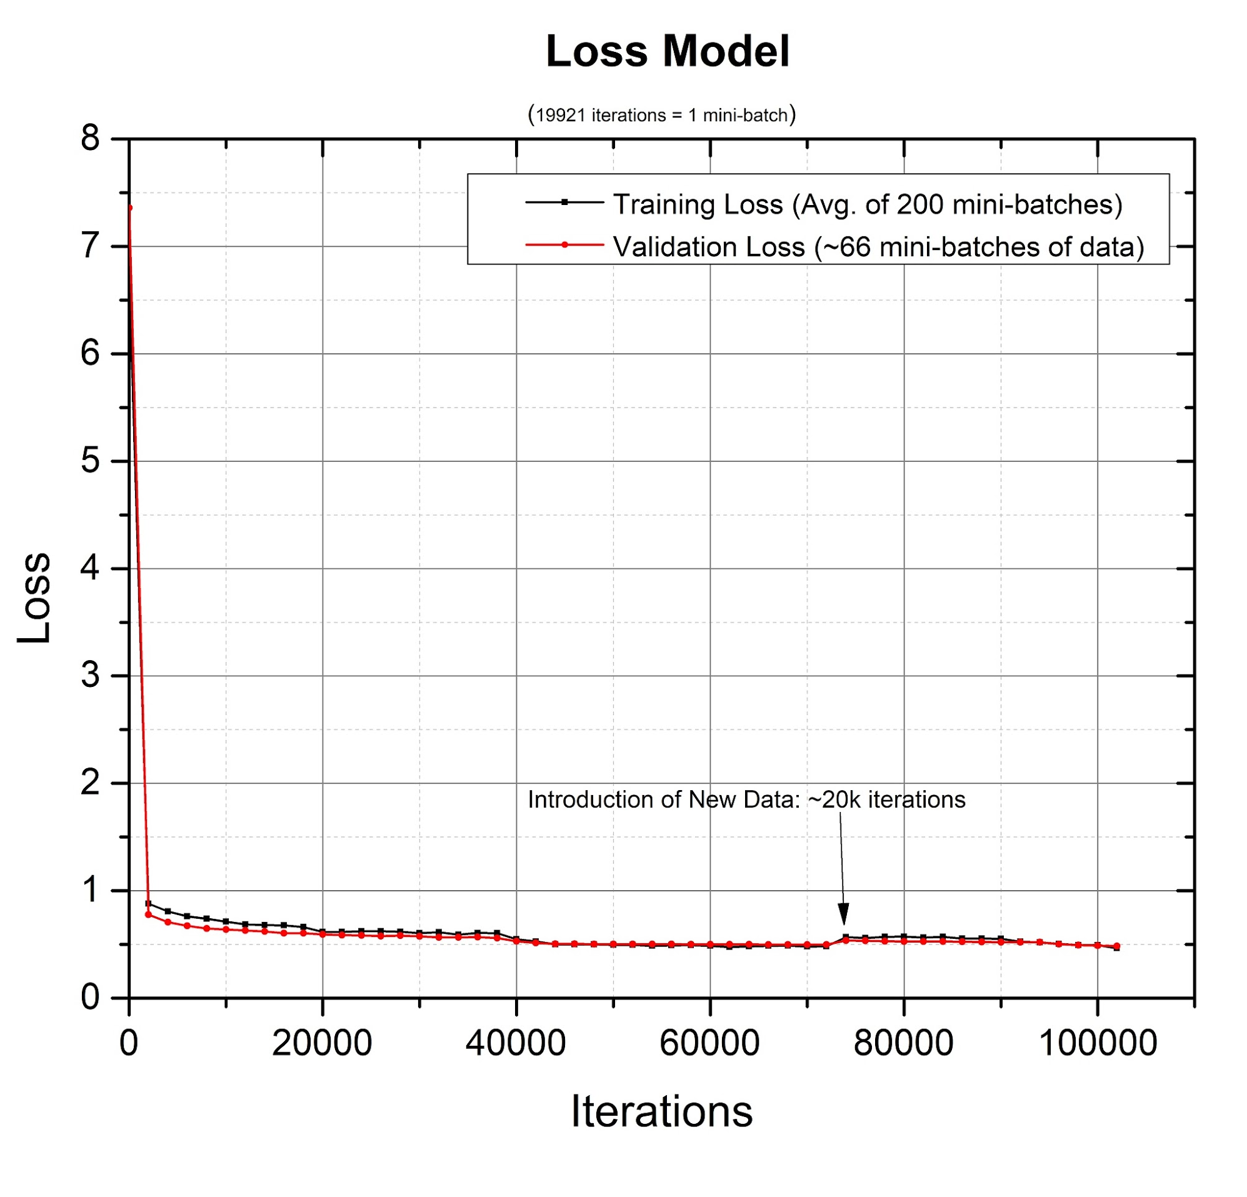
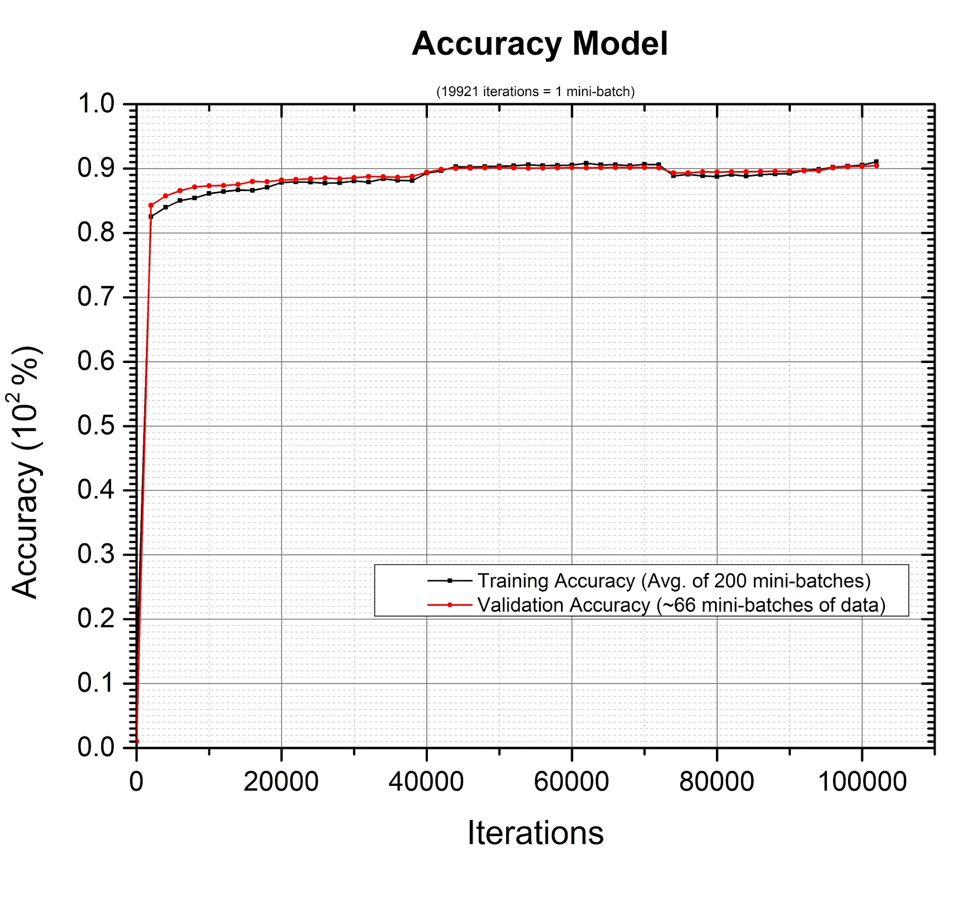
3rd Model: Data Preparation & Results
This is the test predictions: loss: 0.48830, acc1: 0.85153, acc3: 0.96358, lb: 0.90357

Slide 12
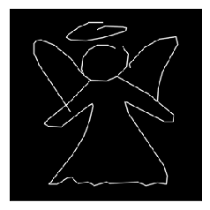
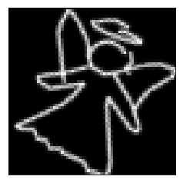
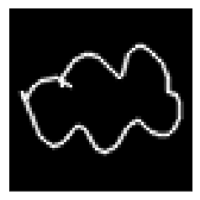
3rd Model: Problems Faced
Angel@ 3 x 64 x 64
Angel@ 3 x 256 x 256
1. Memory limitations - Vram
Minibatch size: Constant @512
Image size: 3 x 64 x 64
2. Plateau at 87% and 90% accuracy
Learning rate
Data Augmentation:
rotation
More training data
3. Bad fitting categories:
E.g. Cloud - Acc1: 0.641 Acc3: 0.973
Data Augmentation
Train Longer
Rotated 30deg Angel@ 3 x 64 x 64
Cloud@ 3 x 64 x 64
Notes:
1. Hyper Parameter Tuning
Minibatch size + img_size V. Memory
Image resolution, batch_size(limited by hardware)Batch_size larger, provides faster convergence, more noise to generalised - noisy labels are mitigated by large bs
Learning rate: 1. Learning rate decay
2. At convergence: Tune lr & beta
2. Data Augmentation:
Rotate image in multiples of 30 degs at random
Images of different sizes
Limitations:
1. Network gets better with larger size image; trade-off between bs and image_size due to hardware limitations.
Current Trained at bs =512, image 64x64
Can be improved
2. Lack of temporal data - <Alvin’s part >

Slide 13
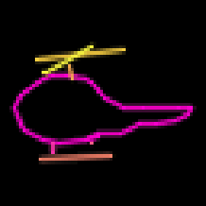
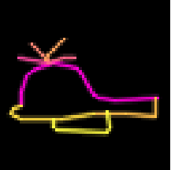
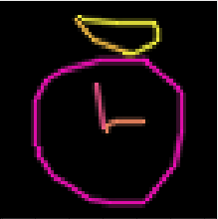
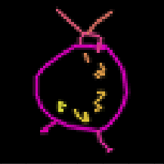
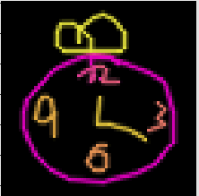
4th Model: Temporal Image Encoding
People start & end at similar features
3 Color Channel
C1: Whole image in max brightness
C2: Strokes with increasing brightness over time
C3: Strokes with decreasing brightness over time
Resnet CNN architecture

Slide 14


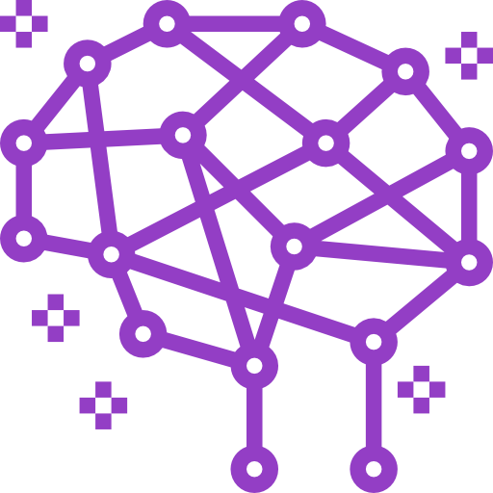

Ensemble
MAP3: 0.862
W1
MAP3: 0.800
W2
MAP3: 0.897
W3
MAP3: 0.895
W4
MAP3: 0.876
Notes:
ensemble
acc-1: 0.847
acc-3: 0.956
lb: 0.897
Model_alvin:
acc-1: 0.815
acc-3: 0.947
lb: 0.876

Slide 15
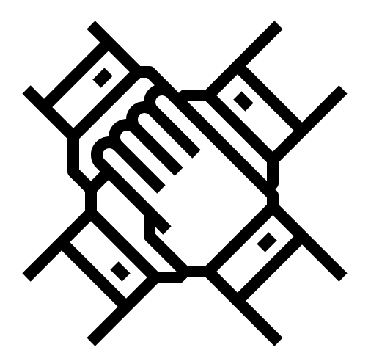
Conclusion
Intuition about task is important
4 models: 1 RNN + 3 CNN
Multiple data preprocessing
Problems faced: Similarities & Differences
Ensemble: Neural Network Teamwork
Notes:
Similarities:
Underfitting
Remove unrecognized
Image Size
Differences:
Temporal and non-temporal
Different architecture

Slide 16
FIN
merci beaucoup
Github: https://github.com/appa-ayephyu/QuickDraw_Kaggle

