Slide 1
Prometheus Storage

Slide 2
Overview
Distributed storage for Prometheus
Project overview
Project status
Architectures
Thanos
Cortex
M3DB
Test setup and results
Test setup
Storage estimation
Other observations
Storage pricing (Azure)
Object storage and operations
Disks: SSD, HDD

Slide 3
Project overview
Internal Prometheus TSDB
Distributed storage backends
M3DB: own format on disk
Thanos: TSDB format on object storage
Cortex: TSDB format on object storage
VictoriaMetrics (not evaluated): own format on disk
Properties
All provide Prometheus-compatible query endpoint
Last three also include distributed Alertmanager and Ruler
Last one also includes Prometheus receiver replacement

Slide 4
Project status
Thanos and cortex:
Community supported
Well-documented
Current de-facto standards
Very active on github
M3DB:
Missing documentation and support
Little github commit activity last year
VictoriaMetrics:
Free version with enterprise option
Promises huge speedups and storage efficiency

Slide 5
Advantages and disadvantages
Object storage (Thanos / Cortex) advantages:
Redundancy handled by the storage provider
Backup configured in storage provider
Cheaper
TSDB format: well-known format

Slide 6
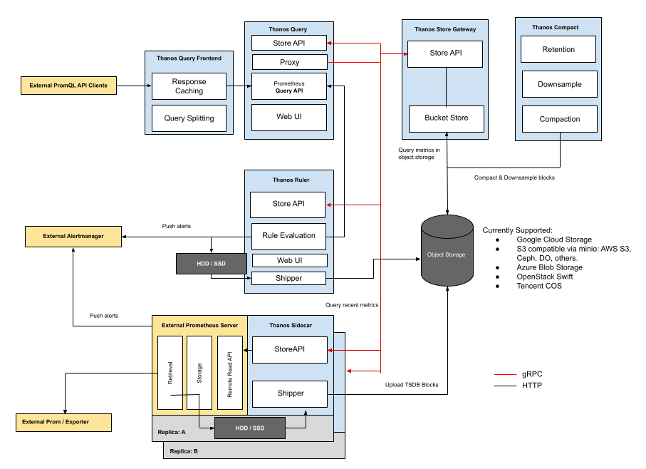
Thanos architecture (with sidecar)

Slide 7
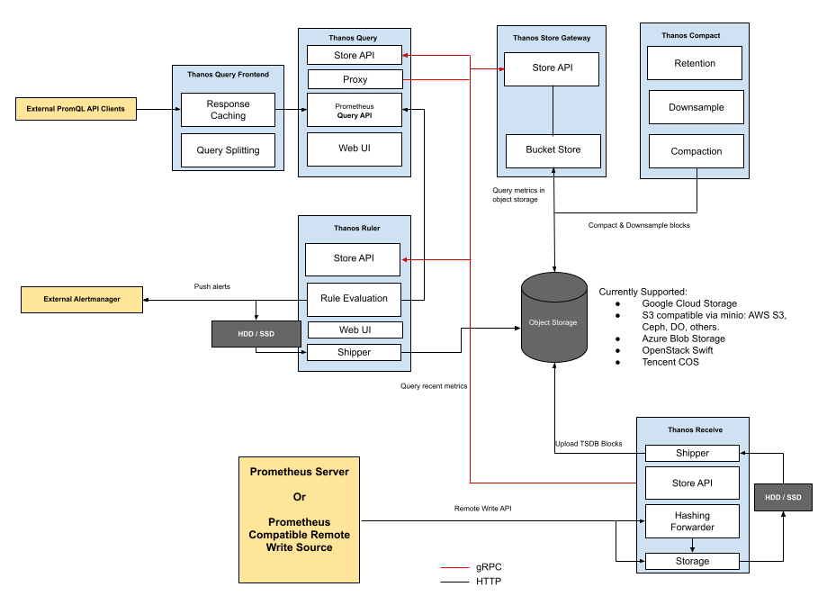
Thanos architecture (with receiver)

Slide 8
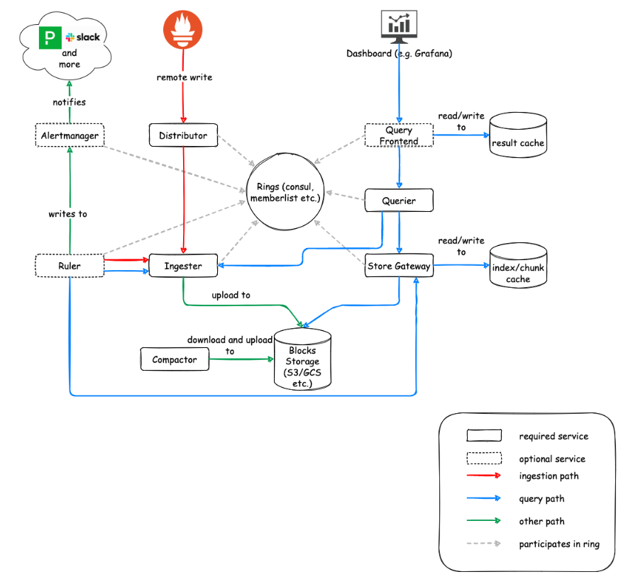
Cortex

Slide 9
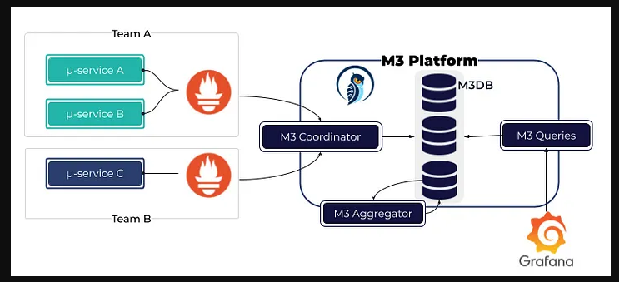
M3DB
(Remote write)

Slide 10
Test setup
Kubernetes: internal K3s cluster
Storage (volumes): local storage on SSD
Storage (object storage): MinIO on SSD (provides S3 API)
Prometheus helm chart
Automatically monitors the Kubernetes cluster
Databases:
M3DB via operator with 10s:2d namespace (3 nodes)
Cortex via helm chart (3 nodes)

Slide 11
Storage estimation
Data Metrics (at end of testing period):
Number of series: 237557
Number of chunks: 471614
Number of label pairs: 7638
DB Metrics:
Prometheus (persistent volume): 8.2 GiB / 15 days
Cortex (storage bucket): 4.6GiB / 4.8 days
M3DB (persistent volume): repl x 10.7GiB / 2 days
Estimates:
Prometheus: 2.4KiB / series / day (?)
Cortex: 4.25KiB / series / day
M3DB: repl x 23.74KiB / series / day

Slide 12
Other observations
Queries run a lot faster on Cortex than on M3DB or Prometheus
M3DB setup gives problems in default setup (cannot find unaggregated namespace)
Github ticket for this problem is open for one year without response

Slide 13
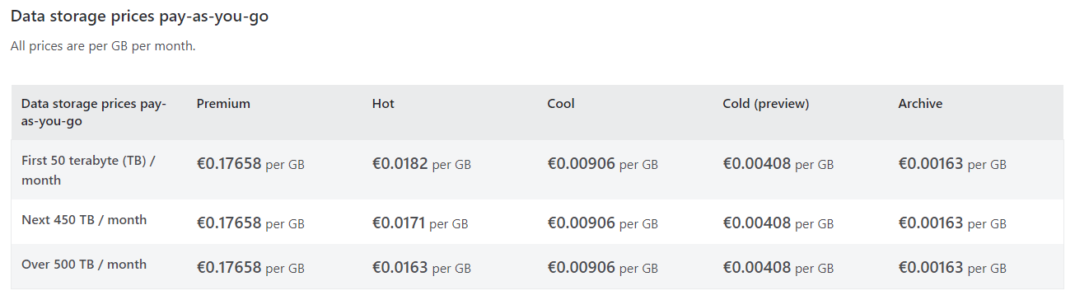
Storage prices (azure object storage)
Storage for Cortex & Thanos
Note: a small disk (currently 1.1GiB for the test setup) is also required to store incoming data (2h)
Example: hot object storage
€0.0182 / GiB / month * 1024 GiB / TiB * 12 months / year = €223.64 / TiB / year (+ operations?)

Slide 14
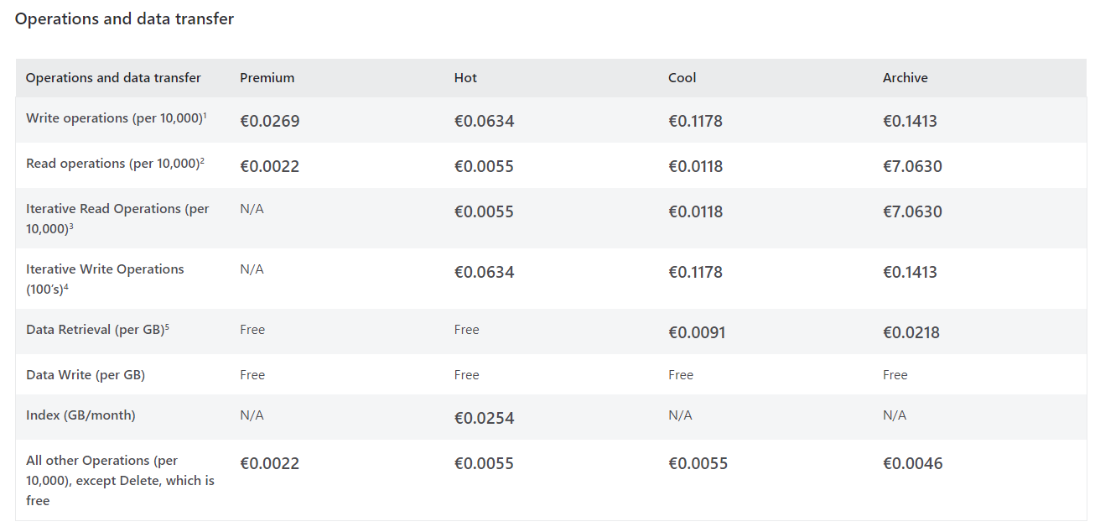
Storage prices (azure object operations)

Slide 15
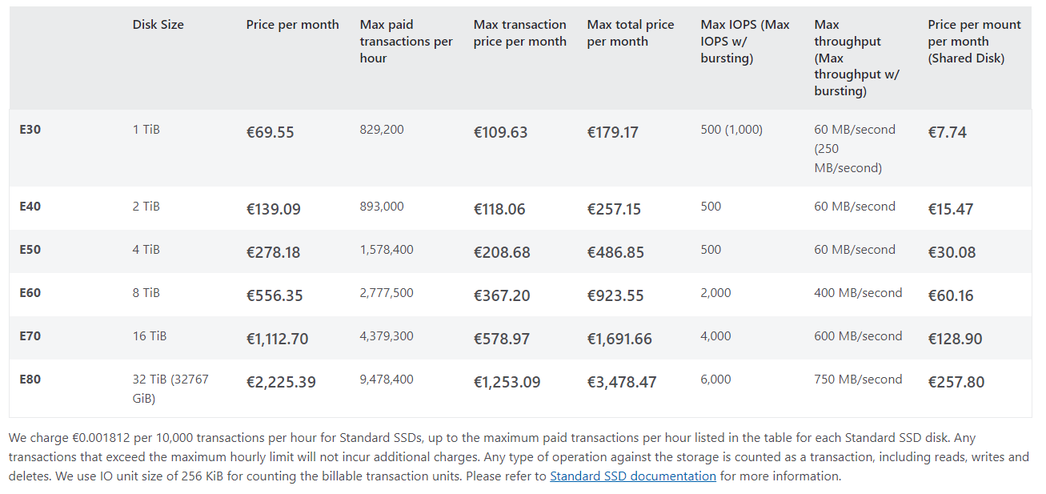
Storage prices (azure disk standard ssd)
Storage for Prometheus and M3DB
Example: 1TiB of storage with replication factor 3
3 * €69.55 / month * 12 months / year = 3 x €834.60 / year = €2503.80 / year

Slide 16
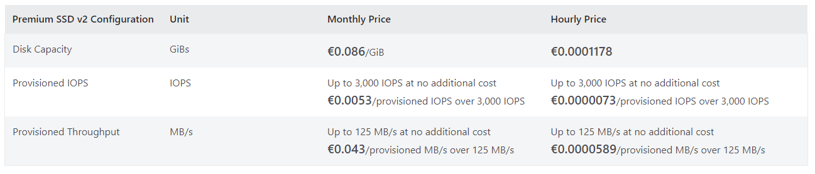
Storage prices (azure disk premium ssd)
Storage for Prometheus and M3DB
Example: 1TiB of storage with replication factor 3
3 * €0.086 / GiB / month * 1024 GiB / TiB * 12 months / year = 3 x €1056.77 / TiB / year = €3170.30 / TiB / year

Slide 17
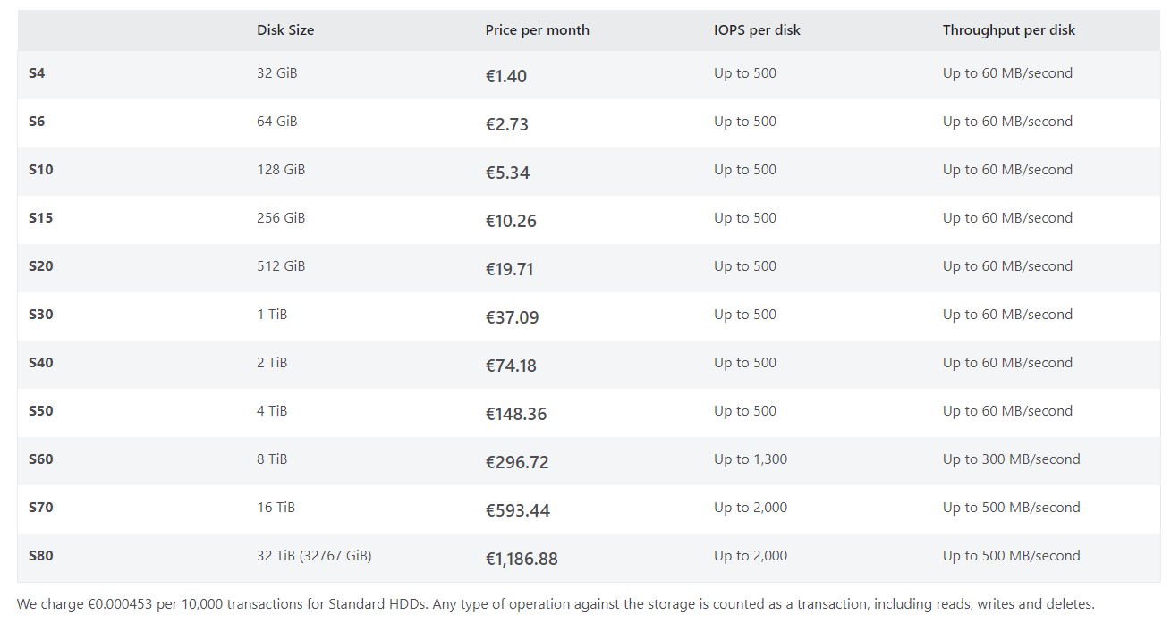
Storage prices (azure disk hdd)
Storage for Prometheus and M3DB
Example: 1TiB of storage with replication factor 3
3 * €37.09 / month * 12 months / year = 3 x €445.08 / year = €1335.24 / year

