Slide 1

Unit Testing Intro
June 4, 2019

Slide 2
Agenda
Part 1: Unit Testing and Jest
Unit Testing overview
Unit testing basics with Jest
Mocking and stubbing
Mocking examples
Exercises
Part 2: Vue testing with Jest
@vue/test-utils overview
Vue component testing basics – mounting options
Wrapper basics
Vue testing examples
Exercises

Slide 3
Installation
Before we get started
1) Install Jest globally
npm install jest –global
2) Clone repo and run npm install
https://github.com/Contrapuntist/jesttutorial

Slide 4
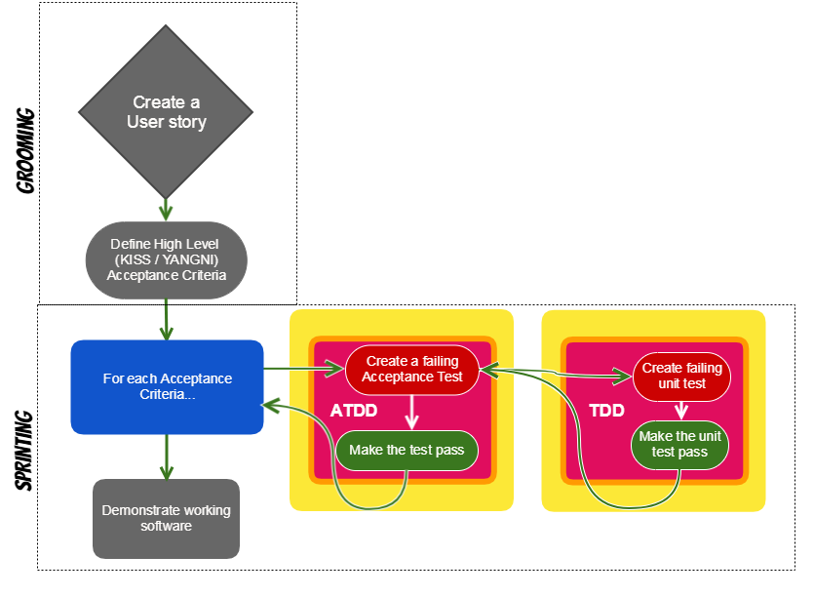
Roadmap to TDD

Slide 5
What is Unit Testing?
Unit testing segregates each part of the program and focuses on testing a small portion or individual section of our application and verifies its behavior independently from other parts. Usually broken down by 3 phases:
Initializes a small piece of an application it wants to test
It applies some stimulus to the system under test (usually by calling a method on it)
Observes the resulting behavior – passes or fails.
These three unit test phases are also known as Arrange, Act and Assert, or simply AAA.
What constitutes a “unit”?
If you're working in a functional language a unit will most likely be a single function. Your unit tests will call a function with different parameters and ensure that it returns the expected values. In an object-oriented language a unit can range from a single method to an entire class.
-- Martin Fowler

Slide 6
Why should we care about unit testing?
How many of you feel confident that when you change or refactor portions of existing/legacy code you are 100% confident your changes will not cause bugs?
Some of the key benefits include:
Testing gives us more confidence that our code is correct thereby increasing code quality
Improve application design because code must by written in a manner that’s testable
Facilitates changes to ensure we are not breaking existing code as we add new functionality and/or refactor legacy code
Captures and identifies bugs or issues early
Tests become part of documentation
Cost saving in development and maintenance due to reduction of bugs
Write only the code that is needed for the test to pass (TDD)
Makes the development process more agile
https://stackoverflow.com/questions/67299/is-unit-testing-worth-the-effort

Slide 7
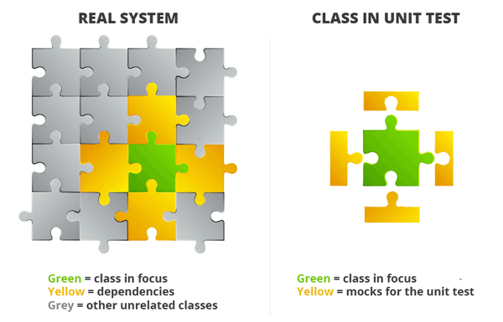
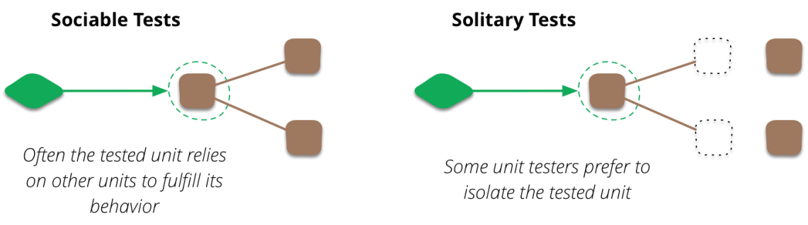
What makes a good unit test?
Independent – tests a single section of code such as a single class, object or component
Does no rely on live systems
Readable - Descriptive names; Easy to read and understand
Repeatable - run unit test multiple times and achieve the same results
Well Structured – Follow the AAA pattern (Arrange, Act, Assert)
Fast – each unit test shouldn’t take long to process
Never write unit tests to meet code coverage requirements, write units tests that make sense, evaluates functionality and important aspects of the application, and reduce bugs in the future.
Sources: https://martinfowler.com/bliki/UnitTest.html, https://medium.com/chris-nielsen/so-whats-a-good-unit-test-look-like-71f750333ac0

Slide 8
Why Jest?
Jest is an open-source testing framework originally created by Facebook
Aspects of Jasmine.js and Mocha.js were originally designed into the framework
It’s really a hybrid of many testing libraries with some Faceboook mojo added on top
It’s well documented: Jestjs.io
Assortment of built-in testing options:
Can be used for unit and integration testing
Flexible configuration options
Includes mocking/spy capabilities and variety of options
Built-in `expect` options for test assertions
Coverage reporting
Snapshot testing
Has a watch mode – will re-run tests as tests are updated
It’s generally pretty fast at running tests
v.23 does have some known performance issues, current version installed in FC; fixed in current version v.24

Slide 9
Jest – Unit Test Suite Setup
jest is auto configured to find any *.spec.js file in __tests__ folder
__tests__/fileName.spec.js
Import statements included section of code, modules needed, @vue/test-utils, etc.
const { multiply } = require('./jestbasics.js');
describe(‘What you are testing ’, () => {
it('multiply function should return result of two
multiplied arguments', () => {
const multiplied = multiply(2, 3);
expect(multiplied).toEqual(6);
expect(multiplied).not.toEqual(5);
});
it(‘add…’, cb(() => {}));
it(‘subtract…’, cb(() => {}));
});
When jest runs, will organize output of results by describe blocks; each requires a descriptor and callback
each it() (or test()) requires descriptor and callback function; one assertion required
Setup code for unit test
expect (whatever) || to have a result with a matchers
It’s common to include positive and negative scenarios within same it callback

Slide 10
Time for examples
jesttutorial repo

Slide 11
Handling imports / node modules
If unit tests should be focused on a specific section of code, how do we handle imports and dependencies? |  | const axios = require('axios'); function getNews() { const url = ‘endpoint to news api’ return axios.get(url); }
As we write unit tests, we can simulate behaviors within the application with mocks. |  | jest.mock('axios'); test('should fetch news', () => { const news = [{headline: ‘Summer is here’}]; const resp = {data: news }; axios.get.mockResolvedValue(resp); return getNews().then( data => expect(data).toEqual(resp) ); }); red = mock || blue = stub
In this example, axios.get needs to be mocked to avoid making a live request. In addition, we create a stubbed response object to used in the mocked implementation.
Jest.mock(whatever) is hoisted above all imports.

Slide 12
Ok, but why mock?
If testing a section of code in isolation and making the outcome predictable is a requirement and best practice, then we need to simulate behavior that mimics live systems and/or other dependencies. Doing so makes tests independent, repeatable and predictable.
Tests the rely on live systems are integration tests, not unit tests.

Slide 13
Mocked Examples – JS/Node only
Admin Hub – Services/User

Slide 14
Your turn
Go to example2/__tests__/parseNewsspec.js
practice write a mock
Update ‘todo’ with a test.
You have 10 minutes.
It’s ok if you don’t finish.

Slide 15
Testing Vue Components
Testing Vue components requires a combination of at least two testing libraries. Vue has test utility library (@vue/test-utils) that we can use in combination with Jest. As a result, setting up a Vue component for a unit test is a little more complicated.
What @vue/test-utils does
Creates a wrapper when we load or mount a component, which then makes it easier to break down and find different aspects of the Vue component with wrapper methods
Mounting the component allows us to load a separate Vue instance with ‘createLocalVue’, register libraries like Vuex to the local Vue instance, mock methods, load stubbed data, stub child components, trigger events, and much more.
The “wrapped component” also makes it possible to test JavaScript, HTML and CSS within a Vue component.

Slide 16
Mounting components
Two mounting options: mount vs. shallowMount
mount – wraps and loads parent and child components
Use when needing to testing output of parent AND child components
shallowMount – wraps and loads parent component, but will stub child components
Use when tests are isolated to parent or component testing
Options – mounting options can be used with either mounting option to load data, store, props, mock methods, etc.
import { shallowMount, createLocalVue } from '@vue/test-utils';
import Tiles from '../Tiles.vue';
import Vuex from 'vuex';
import mockAppsArr from '../__mocks__/mockAppsArr.js';
const localVue = createLocalVue();
localVue.use(Vuex);
describe('Tiles.vue', () => {
let store;
let cmp;
beforeEach(() => {
store = new Vuex.Store({
state: {
apps: mockAppsArr
}
});
cmp = shallowMount( Tiles, { localVue, store });
});
it('Check recently viewed added apps array on load', () => {
expect(cmp.vm.apps).toHaveLength(5);
});
});

Slide 17
Lets look at examples:
- AdminHub – Tiles.vue
- jesttutorial repo

Slide 18
What next?
Be patient with yourself.
Take it one test at time.
The github repo also has a some resources and a copy of this presentation for future reference.
Next sprint starts tomorrow – everyone will be assigned code to add some unit tests in FitchConnect.
Tech leads will identify code to test, I think jira tickets will be created
Objective is to reinforce the concepts talked about today
“Practice makes perfect”
Collectively, we quickly move towards test driven development (TDD)
Change our mindset from code first and test later, to write tests first and then code.
Please keep in mind, I do not know every aspect of testing with Jest and Vue. I’ll be learning, just like all of you.

Slide 20
Testing Vue Components
To test vue components, using Jest by itself isn’t enough. Fortunately, Vue has a testing utility library that can be used with Jest. In addition, snapshot testing vue components requires an additional library to render html as a string to allow Jest to capture a snapshot.
As result, test suites becomes a little more complicated by default.
Sample imports section:
import { mount, (or shallowMount,) createLocalVue } from '@vue/test-utils';
import Parent from '../parent.vue';
import Child from ‘../child.vue’; // (optional)
import { createRenderer } from 'vue-server-renderer‘ (optional for snapshot tests)
import Vuex from 'vuex'; (optional for loading store)
import Router from 'vue-router';
Global components also need to be imported and registered to createLocalVue
Plus any other imports that needs mocking, spying, etc…

Slide 21
Jest Docs
Jestjs.io
Configuration
Setting up jest in projects and various options
collectCoverage – setting for creating coverage reports
verbose - Indicates whether each individual test should be reported during the run (useful for easily tracking down failing tests)
Jest Cli
options when running tests with Jest in command line; ex. jest --watch
Globals
testing methods (ex. describe(), it(), beforeEach(), afterEach(), etc.)
Jest object
Mocking modules
Mock function
Mocking imported methods/functions
Expect library
Testing matchers (ex. .toBe(value), .toHaveLength(number))

Slide 22
What should we be testing?
const renew = function() {
return new Promise((resolve, reject) => {
const jwtToken = getJwt();
const getLoginURL = (message = '') =>
`${urls.login}?script_name=${window.encodeURI(
urls.base + window.location.pathname,
)}&fc_status=fail&fc_message=${message}`;
if (jwtToken) {
validateJwt(jwtToken)
.then(response => {
if (!response || !response.hashkey || response.hashkey.length < 1) {
reject(getLoginURL(response.message));
} else {
resolve(setHashkey(response.hashkey));
}
})
.catch(response => reject(getLoginURL(response.message)));
} else {
reject(getLoginURL());
}
});
};
export default function() {
if (!getHashkey()) {
return renew();
}
return Promise.resolve();
}
In code snippet from FC codebase, think about what we should test?
Don’t think about how we’ll test, focus on what should be evaluating.
Think of both happy paths and sad paths.
Take a minute to write down ideas.

