Slide 1

Unit Testing Intro
June 4, 2019

Slide 2
Agenda
Part 1: Unit Testing and Jest
Unit Testing overview
Unit testing basics with Jest
Mocking and stubbing overview
Mocking examples with Jest
Exercises
Part 2: Vue testing with Jest
@vue/test-utils overview
Vue component testing basics – mounting options
Wrapper basics
Vue testing examples
Exercises

Slide 3
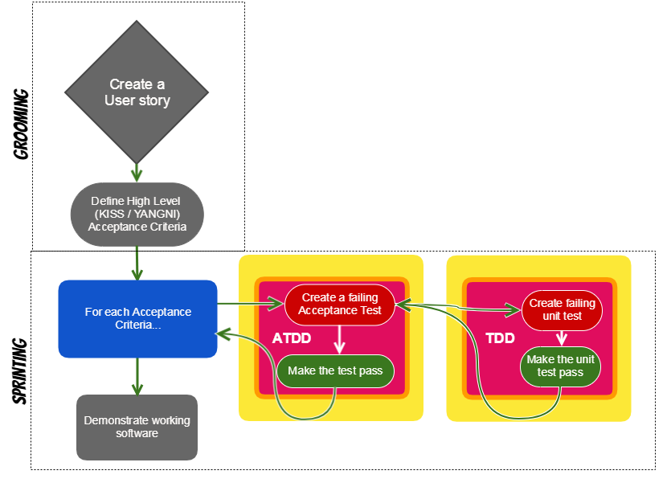
Roadmap to TDD

Slide 4
What is Unit Testing?
Unit testing segregates each part of the program and focuses on testing a small portion or individual section of our application and verifies its behavior independently from other parts. Usually broken down by 3 phases:
Initializes a small piece of an application it wants to test
It applies some stimulus to the system under test (usually by calling a method on it)
Observes the resulting behavior – passes or fails.
These three unit test phases are also known as Arrange, Act and Assert, or simply AAA.
What constitutes a “unit”?
In an object-oriented language a unit can range from a single method to an entire class.
-- Martin Fowler

Slide 5
Why should we care about unit testing?
How many of you feel confident that when you change or refactor portions of existing/legacy code you are 100% confident your changes will not cause bugs?
Some of the key benefits include:
Testing gives us more confidence that our code is correct thereby increasing code quality
Improve application design because code must by written in a manner that’s testable
Facilitates changes to ensure we are not breaking existing code as we add new functionality and/or refactor legacy code
Captures and identifies bugs or issues early
Tests become part of documentation
Cost saving in development and maintenance due to reduction of bugs
Write only the code that is needed for the test to pass (TDD)
Makes the development process more agile
https://stackoverflow.com/questions/67299/is-unit-testing-worth-the-effort

Slide 6
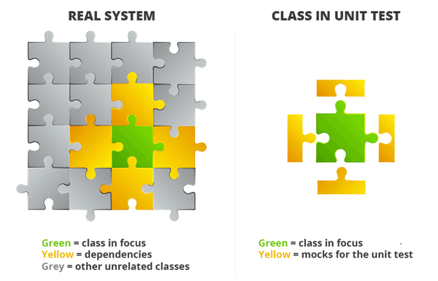
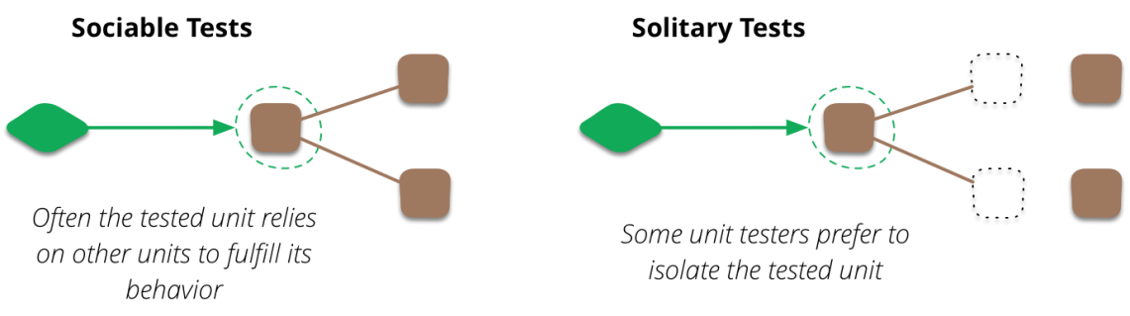
What makes a good unit test?
Independent – tests a single section of code such as a single class, object or component
Does no rely on live systems
Readable - Descriptive names; Easy to read and understand
Repeatable - run unit test multiple times and achieve the same results
Well Structured – Follow the AAA pattern (Arrange, Act, Assert)
Fast – each unit test shouldn’t take long to process
Never write unit tests to meet code coverage requirements, write units tests that make sense, evaluates functionality and important aspects of the application, and reduce bugs in the future.
Sources: https://martinfowler.com/bliki/UnitTest.html, https://medium.com/chris-nielsen/so-whats-a-good-unit-test-look-like-71f750333ac0

Slide 7
Why Jest?
Jest is an open-source testing framework originally created by Facebook
Aspects of Jasmine.js and Mocha.js were originally designed into the framework
It’s really a hybrid of many testing libraries with some Faceboook mojo added on top
It’s well documented: Jestjs.io
Assortment of built-in testing options:
Can be used for unit and integration testing
Flexible configuration options
Includes mocking/spy capabilities and variety of options
Built-in `expect` options for test assertions
Coverage reporting
Snapshot testing
Has a watch mode – will re-run tests as tests are updated
It’s generally pretty fast at running tests
v.23 does have some known performance issues, current version installed in FC; fixed in current version v.24

Slide 8
Jest – Unit Test Suite Setup
jest is auto configured to find any *.spec.js file in __tests__ folder
__tests__/fileName.spec.js
Import statements included section of code, modules needed, @vue/test-utils, etc.
const { multiply } = require('./jestbasics.js');
describe(‘What you are testing ’, () => {
it('multiply function should return result of two
multiplied arguments', () => {
const multiplied = multiply(2, 3);
expect(multiplied).toEqual(6);
expect(multiplied).not.toEqual(5);
});
it(‘add…’, cb(() => {}));
it(‘subtract…’, cb(() => {}));
});
When jest runs, will organize output of results by describe blocks; each requires a descriptor and callback
each it() (or test()) requires descriptor and callback function; one test is required
Setup code for unit test
expect (whatever) || to have a result with a matchers
It’s common to include positive and negative scenarios within same it callback

Slide 9
Time for examples
jesttutorial repo

Slide 10
Your turn
Go to example1/__tests__/jestbasics.spec.js
Complete the todos
You have 10 minutes.
It’s ok if you don’t finish.

Slide 11
Handling imports / node modules
If unit tests should be focused on a specific section of code, how do we handle imports and dependencies? |  | const axios = require('axios'); function getNews() { const url = ‘endpoint to news api’ return axios.get(url); }
As we write unit tests, we can simulate behaviors within the application with mocks. |  | jest.mock('axios'); test('should fetch news', () => { const news = [{headline: ‘Summer is here’}]; const resp = {data: news }; axios.get.mockResolvedValue(resp); return getNews().then( data => expect(data).toEqual(resp) ); }); red = mock || blue = stub || green = assertion
In this example, axios.get needs to be mocked to avoid making a live request. In addition, we create a stubbed response object to use in the mocked implementation.
Jest.mock(whatever) is hoisted above all imports.

Slide 12
Ok, but why mock?
If testing a section of code in isolation and making the outcome predictable is a requirement and best practice, then we need to simulate behavior that mimics live systems and/or other dependencies. Doing so makes tests independent, repeatable and predictable.
Tests that rely on live systems are integration tests, not unit tests.

Slide 13
Mocking and Spying with Jest
In addition to offering a mixture of ways to mock, Jest also offers the ability to spy.
Mock vs. Spy - A mock creates modified implementation for a method, class, node module, etc. A spy doesn’t change implementation, instead a jest wrapper is applied for jest to recognize and track usage.
Jest offers multiple ways to mock/spy
Methods/functions
Manual mocking
Using jest.mock() to simulate module factory param within a test suite
Creating mock and storing mocks in __mocks__ folder
ES6 classes – mock or spy on class methods
Timers – time methods like setTimeout and setInterval always needed a mocked implementation
Automatic mocking
Spy on methods – doesn’t change existing function, instead a jest spy observes usage

Slide 14
Lets look at examples with mocks:
- Admin Hub – Services/User
- jesttutorial repo

Slide 15
Your turn
Go to example2/__tests__/parseNewsspec.js
practice write a mock
Update ‘todo’ with a test.
You have 10 minutes.
It’s ok if you don’t finish.

Slide 16
Testing Vue Components
Testing Vue components requires a combination of at least two testing libraries. Vue has test utility library (@vue/test-utils) that we can use in combination with Jest. As a result, setting up a Vue component for a unit test is a little more complicated.
What @vue/test-utils does
Creates a wrapper when we load or mount a component, which then makes it easier to break down and find different aspects of the Vue component with wrapper methods
Mounting the component allows us to load a separate Vue instance with ‘createLocalVue’, register libraries like Vuex to the local Vue instance, mock methods, load stubbed data, stub child components, trigger events, and much more.
The “wrapped component” also makes it possible to test JavaScript, HTML and CSS within a Vue component.

Slide 17
Mounting components
Two mounting options: mount vs. shallowMount
mount – wraps and loads parent and child components
Use when needing to testing output of parent AND child components
shallowMount – wraps and loads parent component, but will stub child components
Use when tests are isolated to parent or component testing
Options – mounting options can be used with either mounting option to load data, store, props, mock methods, etc.
import { shallowMount, createLocalVue } from '@vue/test-utils';
import Tiles from '../Tiles.vue';
import Vuex from 'vuex';
import mockAppsArr from '../__mocks__/mockAppsArr.js';
const localVue = createLocalVue();
localVue.use(Vuex);
describe('Tiles.vue', () => {
let store;
let cmp;
beforeEach(() => {
store = new Vuex.Store({
state: {
apps: mockAppsArr
}
});
cmp = shallowMount( Tiles, { localVue, store });
});
it('Check recently viewed added apps array on load', () => {
expect(cmp.vm.apps).toHaveLength(5);
});
});

Slide 18
Lets look at examples:
- AdminHub – Tiles.vue
- jesttutorial repo

Slide 19
Questions?

Slide 20
Installation
Before we get started
1) Install Jest globally
npm install jest –global
2) Clone repo and run npm install
https://github.com/Contrapuntist/jesttutorial

