Slide 1

Unit Testing Intro
June 4, 2019

Slide 2
Agenda
Part 1: Unit Testing and Jest
Unit Testing overview
Unit testing basics w/ jest
Mocking examples
Coverage Reporting
Exercises
Part 2: Vue testing w/ Jest
@vue/test-utils overview
Vue component testing basics – mounting options
Wrapper basics
Vue testing examples
Exercises

Slide 3
Installation
Before we get started
1) Install Jest globally
npm install jest –global
2) Clone repo and run npm install
https://github.com/Contrapuntist/jesttutorial

Slide 4
What is Unit Testing?
Unit testing segregates each part of the program and focuses on testing a small portion or individual section of our application and verifies its behavior independently from other parts. Usually broken down by 3 phases:
Initializes a small piece of an application it wants to test
It applies some stimulus to the system under test (usually by calling a method on it)
Observes the resulting behavior – passes or fails.
These three unit test phases are also known as Arrange, Act and Assert, or simply AAA.

Slide 5
Why should we care about unit testing?
How many of you feel confident that when you change or refactor portions of existing/legacy code you are 100% confident your changes will not cause bugs?
Some of the key benefits include:
Captures and identifies bugs or issues early
Improve code quality
Makes the development process more agile
Improve application design because code must by testable
Facilitates changes to ensure the app still works as expected
Build confidence about the code we’re producing
Less bugs reduces costs
https://stackoverflow.com/questions/67299/is-unit-testing-worth-the-effort

Slide 6
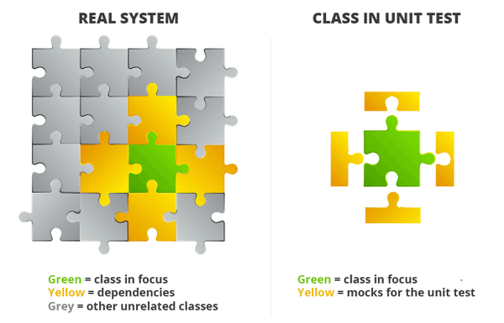
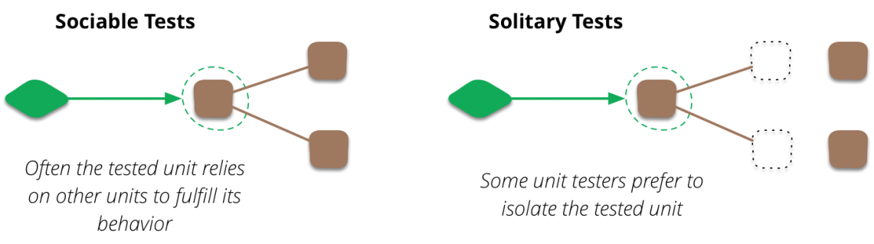
What makes a good unit test?
Independent – tests a single section of code such as a single class, object or component
Does no rely on live systems
Readable - Descriptive names; Easy to read and understand
Repeatable - run unit test multiple times and achieve the same results
Well Structured – Follow the AAA pattern (Arrange, Act, Assert)
Fast – each test shouldn’t take long to process
Never write unit tests to meet code coverage requirements, write units tests to ensure you won’t break code in the future.
Sources: https://martinfowler.com/bliki/UnitTest.html, https://medium.com/chris-nielsen/so-whats-a-good-unit-test-look-like-71f750333ac0

Slide 7
Why Jest?
Jest is an open-source testing framework originally created by Facebook
Aspects of Jasmine.js and Mocha.js were originally designed into the framework
It’s really a hybrid of many testing libraries with some Faceboook mojo added on top
Assortment of built-in testing options:
Can be used for unit and integration testing
Flexible configuration options
Includes mocking/spy capabilities and variety of options
Built-in `expect` options for test assertions
Coverage reporting
Snapshot testing
Has a watch mode – will re-run tests as tests are updated
It’s generally pretty fast at running tests
v.23 does have some performance issues, current version installed in FC; fixed in current version v.24

Slide 8
Jest Docs
Jestjs.io
Configuration
Setting up jest in projects and various options
collectCoverage – setting for creating coverage reports
verbose - Indicates whether each individual test should be reported during the run (useful for easily tracking down failing tests)
Jest Cli
options when running jest in command line; ex. jest --watch
Globals
testing methods (ex. describe(), it(), beforeEach(), afterEach(), etc.)
Jest object
Mocking modules
Mock function
Mocking imported methods/functions
Expect library
Testing matchers (ex. .toBe(value), .toHaveLength(number))

Slide 9
Jest – Unit Test Suite Setup
jest is auto configured to find any *.spec.js file in __tests__ folder
__tests__/fileName.spec.js
Import statements included section of code, modules needed, @vue/test-utils, etc.
const { multiply } = require('./jestbasics.js');
describe(‘What you are testing ’, () => {
it('multiply function should return result of two
multiplied arguments', () => {
const multiplied = multiply(2, 3);
expect(multiplied).toEqual(6);
expect(multiplied).not.toEqual(5);
});
it(‘add…’, cb(() => {}));
it(‘subtract…’, cb(() => {}));
});
When jest runs, will organize output of results by describe blocks; each requires a descriptor and callback
each it() (or test()) requires descriptor and callback function; one assertion required
Setup code for unit test
expect (whatever) || to have a result with a matchers
It’s common to include positive and negative scenarios within same it callback

Slide 10
Lets look at examples in jesttutorial repo

Slide 11
Handling imports / node modules
If unit tests should be focused on a specific section of code, how do we handle imports and dependencies? |  | const axios = require('axios'); function getNews() { const url = ‘endpoint to news api’ return axios.get(url); }
Dealing with imports often requires either mocking or spying on methods used. Unit tests should never make live requests to end points. |  | jest.mock('axios'); test('should fetch news', () => { const news = [{headline: ‘Summer is here’}]; const resp = {data: news }; axios.get.mockResolvedValue(resp); return getNews().then(data => expect(data).toEqual(news)); });

Slide 12
Mocked Examples – JS/Node only
Admin Hub – Services/User
Admin Hub – Services/Authentication

Slide 13
Testing Vue Components
To test vue components, using Jest by itself isn’t enough. Fortunately, Vue has a testing utility library that can be used with Jest. In addition snapshot testing requires an additional library to render html as a string to allow Jest to capture a snapshot. As result, test suite becomes a little more complicated by default.
Sample imports section:
import { mount, (or shallowMount,) createLocalVue } from '@vue/test-utils';
import Parent from '../parent.vue';
import Child from ‘../child.vue’; // (optional)
import { createRenderer } from 'vue-server-renderer‘ (optional for snapshot tests)
import Vuex from 'vuex'; (optional for loading store)
import Router from 'vue-router';
Global components also need to be imported and registered to createLocalVue
Plus any other imports that needs mocking, spying, etc…

Slide 14
Mounting components
Mounting a component with test-utils creates a wrapper around the component test various aspects of vue component including html and css.
Two mounting options: mount vs. shallowMount
mount – wraps and loads parent and child components
Use when needing to testing output of parent AND child components
shallowMount – wraps and loads parent component, but will stub child components
Use when tests are isolated to parent or component testing
Options – mounting options can be used with either mounting option to load data, store, props, mock methods, etc.
import { shallowMount, createLocalVue } from '@vue/test-utils';
import Tiles from '../Tiles.vue';
import Vuex from 'vuex';
import mockAppsArr from '../__mocks__/mockAppsArr.js';
const localVue = createLocalVue();
localVue.use(Vuex);
describe('Tiles.vue', () => {
let store;
let cmp;
beforeEach(() => {
store = new Vuex.Store({
state: {
apps: mockAppsArr
}
});
cmp = shallowMount( Tiles, { localVue, store });
});
it('Check recently viewed added apps array on load', () => {
expect(cmp.vm.apps).toHaveLength(5);
});
});

Slide 15
Vue text examples
AdminHub – Tiles.vue

Slide 16
Lets look at examples in jesttutorial repo

Slide 17
What next?
Next sprint starts tomorrow – everyone will be assigned code to add some unit tests in FitchConnect.
Tech leads will identify code to test
Steadily move towards test driven development

Slide 18
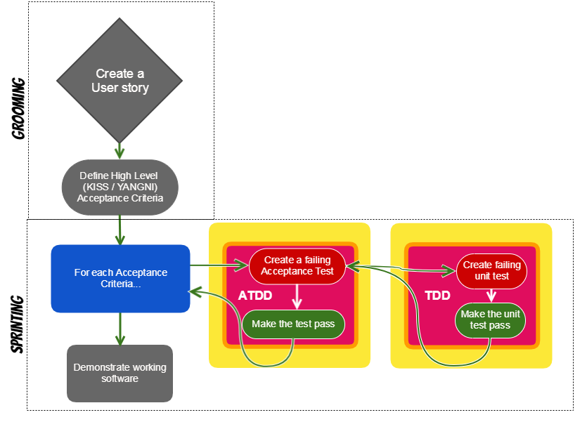
TDD

Slide 19
Resources
https://medium.com/@me_37286/yoni-goldberg-javascript-nodejs-testing-best-practices-2b98924c9347

Slide 21
What should we be testing?
const renew = function() {
return new Promise((resolve, reject) => {
const jwtToken = getJwt();
const getLoginURL = (message = '') =>
`${urls.login}?script_name=${window.encodeURI(
urls.base + window.location.pathname,
)}&fc_status=fail&fc_message=${message}`;
if (jwtToken) {
validateJwt(jwtToken)
.then(response => {
if (!response || !response.hashkey || response.hashkey.length < 1) {
reject(getLoginURL(response.message));
} else {
resolve(setHashkey(response.hashkey));
}
})
.catch(response => reject(getLoginURL(response.message)));
} else {
reject(getLoginURL());
}
});
};
export default function() {
if (!getHashkey()) {
return renew();
}
return Promise.resolve();
}
In code snippet from FC codebase, think about what we should test?
Don’t think about how we’ll test, focus on what should be evaluating.
Think of both happy paths and sad paths.
Take a minute to write down ideas.

Slide 22
Testable vs Untestable Code – placeholder
???

Slide 25
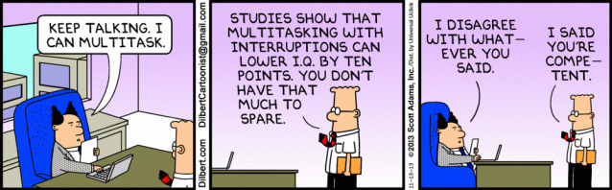
Be present
Phones off
Seriously, phones off
Laptops closed
Seriously, close your laptop

Slide 26
Why ATDD
We at Fitch sometimes look too inwardly, approaching problems without enough regard for those around us
ATDD shifts attention outwardly (on customers, stakeholders, etc)
Because test cases (which are not always automated-tests) are created before coding starts, ‘acceptance test cases’ become the foundation of development
Failing these test cases at any stage implies requirements have not been met, affording instant feedback on whether development is attuned to customer/stakeholder aspirations.

Slide 27


Why ATDD
I don’t know what's being tested
I don’t know how it's being tested
I don’t know when it's being tested
+scope creep

Slide 28
The Vision
To confidently release to production every day
How do we get there?
Expose what is being tested, to the team
Make it clear know how and when things are being tested
Ultimately: we build quality into everything we do. We assure ourselves and our stakeholders that we’re proactively deploying quality from the beginning, not just providing quality validation at the end.

Slide 29
What do scrum teams do?
They build value for stakeholders.
Customers are of course front and centre among those stakeholders. But don’t forget stakeholders include other teams, sales, marketing, support, the next developer to join the team... - they all matter. They're all stakeholders.

Slide 30
How do we know what’s of value?
Product owners. They’re out there gathering stakeholders needs and wants and relay those needs to the team.
Product owners should be away figuring out the highest value thing to build next. Figuring out all the unhappy paths requires a team effort - specifically the QAs. Hence: ‘grooming’.
QA's core purpose in grooming is to imagine stories' unhappy paths, and to then negotiate whether they need to be automated, manually tested or out of scope.
QAs are needed if we are ‘To confidently release to production every day’.

Slide 31
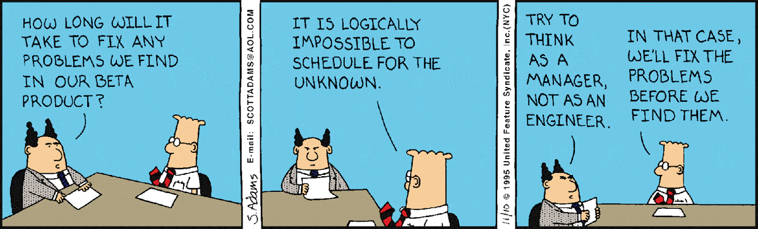
What do QAs do?

Slide 32
What do QAs do?
While the whole team builds value, QAs specifically build... confidence.
Confidence that the code getting laid down is going to work, in all weathers
Confidence that what is being built is what the product owner thinks stakeholders want
QAs are essential for the vision “To confidently release to production every day”.
How is QA going to help get us there?

Slide 33
How are QAs going to get us there?
ATDD baby. ATDD is all about confidence.
Owner’s will write stories which include acceptance criteria and at least one test scenario
This allows the whole team to collaborate on the New Born to better understand the story and enable QAs to add/edit scenarios before the next grooming session.
Eventually it’ll reach adulthood, and enter a sprint. During the sprint the devs will write code to satisfy those scenarios. QA then test manually or provide automated tests to provide confidence that the scenarios have each been met by the code
During grooming testers should be grabbing the opportunity to shine
We succeed or fail as a team... whoever can step up and lead a conversation, should step up and lead a conversation: dev/QA/product/me - it doesn't matter – but really…QA should shine brightest.
How are we going to make it happen?

Slide 34
High Level Flow
User Story (with ACs & Scenarios)
Scenarios become Acceptance Tests
Test Case Automation
Implementation
User Story: ATDD typically begins with a user story with acceptance criteria which encapsulates what the user expects and the specific conditions that need to be met at the end of development. Discussions between stakeholders sees the user story being extrapolated into actions or tasks the system needs to perform to satisfactorily meet the user objectives.
Acceptance tests : The output from the above step becomes the input for deriving the acceptance tests. Starting from an initial list of scenarios, these test cases are extended to take into account all scenarios that may come into play in real time and how the system should respond in each scenario.
Test case automation: The next step is to automate the acceptance test cases. The test cases are turned into an executable format that can be loaded to a testing tool. Tools like Fitnesse, Cucumber and Concordion are popularly used for automation in ATDD.
Implementation: Acceptance tests become the basis for development. Development generally happens in a piecemeal fashion wherein the TDD model may be used to code, test and refactor until a test case is passed. At the end of several small iterations, we have the new functionality up and running.

Slide 35
High level flow
Backlog grooming
Three Amigos
Sprints
User Story
Acceptance Criteria & Scenarios negotiated
Scenarios become test cases
Test cases are automated (if suitable)
“What is needed – not ‘how’”
Written from the perspective of a user
Contains just enough information for the development team to estimate and implement it
Can include functional and non functional requirements
Owned by the Product Owner, written in collaboration with Developers and Testers
Set of statements that outline the conditions of satisfaction that need to be met for a story to be complete.
Owned by the Product Owner, written in collaboration with Developers and Testers
Used to verify the behaviour of the product being built based on scenarios identified
Typically written in Gherkin language (GIVEN,WHEN,THEN)
Used in functional / performance tests and test automation
Includes for both positive (happy path) and negative tests
Owned by Tester, written in collaboration with Product Owner and Developer
The existing acceptance test cases are the basis for development.
Development generally happens in a piecemeal fashion wherein the TDD model may be used to code, test and refactor until a test case is passed.

Slide 36

Understanding the Differences (User Story & Acceptance Criteria)
User Story
Acceptance Criteria
A format for requirements used in Agile (what is needed, not how)
Written from the perspective of a user
Contains just enough information for the development team to estimate and implement it
Can include functional and non functional requirements
Are developed on a just in time (JIT) basis for sprints
Owned by the Product Owner, written in collaboration with Developers and Testers
Set of statements that outline the conditions of satisfaction that need to be met for a story to be complete.
Used as a basis to develop test scenarios and acceptance tests
Owned by the Product Owner, written in collaboration with Developers and Testers

Slide 37

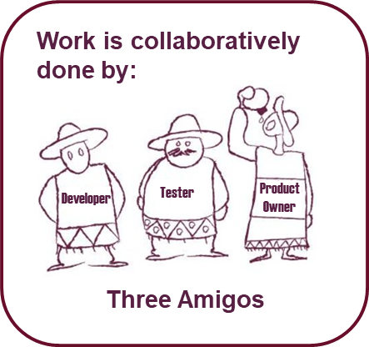
Understanding the Differences (Test Scenarios & Acceptance Tests)
Test Scenarios
Acceptance Tests
Derived from acceptance criteria of user story
Typically written out in a list to capture the key tests to be done
Owned by Tester, written in collaboration with Product Owner and Developer
Used to verify the behaviour of the product being built based on scenarios identified
Typically written in Gherkin language (GIVEN,WHEN,THEN)
Used in functional / performance tests and test automation
Includes for both positive (happy path) and negative tests
Owned by Tester, written in collaboration with Product Owner and Developer

Slide 38
User Story & Acceptance Criteria (template)
No: [unique reference number]
Title: [brief title of user story]
Description:
AS A [specific user type]
I WANT [a specific feature/functionality]
SO THAT I CAN [have a specific benefit]
Acceptance Criteria:
[specific statements that outline conditions to be met for the user story to be deemed as done]
Guidance Note: typically not more than 2 to 3 statements
Business Value: [business priority]
Estimate Value: [development effort]

Slide 39
Acceptance Test (template)
No: [unique reference number]
Title: [brief title of test scenario]
Description:
GIVEN [some context]
AND [additional context] – if needed
WHEN [some action is performed]
THEN [a particular set of observable consequences should be obtained]
AND [additional outcome] – if needed

Slide 40




Story Maturity
New Born
Child
Adolescence
Adult
High
User Story
New user story created
Review of user story, updates
Refined user story, updates
User story complete, agreed with estimate (effort)
Acceptance Criteria
Initial acceptance criteria captured
Review of acceptance criteria, updates
Refined acceptance criteria, updates
Acceptance criteria complete, agreed
Acceptance Tests
Initial test scenarios identified
Acceptance Tests complete, agreed (further tests may be created in sprint)
Not identified at this stage
Refined test scenarios, initial Acceptance Tests created

Slide 41
Test time!
What order do these come in?
Story gets added to a sprint
Developer checks their (sub-task) work against the (story) tests
QA takes gherkin as inspiration for writing real gherkin that they commit as a real test
Story gets matured to an 'adult‘
Acceptance criteria gets discussed and matured
Maybe the story gets split
High level gherkin gets written

Slide 42
Other benefits of ATDD
More focus on customer needs: Although the user acceptance test criteria is taken as the basis for development, however the customer objectives remain in focus throughout development. Developers can visualize the end result holistically which leads to better coding and unit testing. ATDD forces the developer to think from a customer perspective and focus on end user needs at all stages of development.
Better collaboration between stakeholders: Collaboration starts right from the point where the user story is written down with clear acceptance criteria and continues till the developed code meets the acceptance tests. Product Owners, Business Analysts, Testers and Developers work together throughout development. The user story with acceptance criteria and acceptance tests give all members of the team a clear picture of what needs to be achieved and ensure better adherence to requirements.
Faster resolution of issues: Unlike regular development cycles, in ATDD acceptance testing is not an isolated activity performed prior to roll out. It is an integral part of development and is performed multiple times to check whether the new code conforms to expectations. This helps in early identification and resolution of issues.

