Slide 1
Gaslighter V1 Engine
FINAL REVIEW
Designer: Karl Kanmaz
Systems Engineer: Joe Wilson

Slide 2
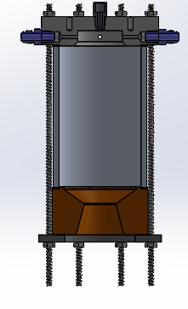
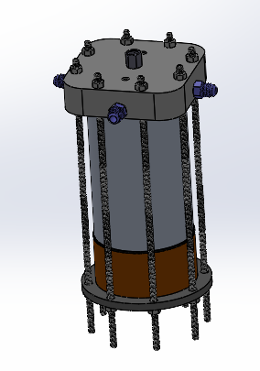
GL V1 Ideal System Specs
Chamber Pressure = 150 psi
Throat Diameter = 1.33 in
Bulk Chamber Temp = 1937 F
L* = 30 in
MR = 1.6
Area Ratio = 2.25
Mass flow = 1.68 lbm/s
Max Thrust = 267.2 lbs

Slide 3
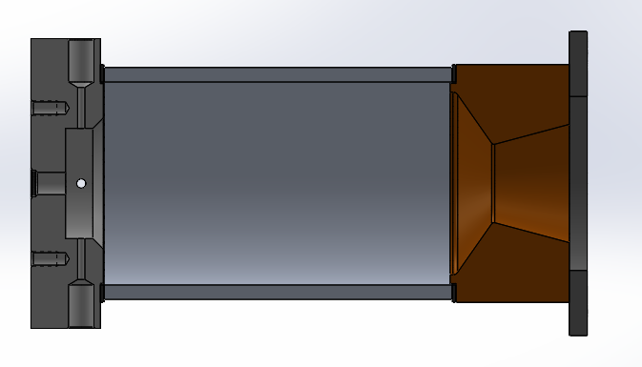
Design
Injector
Material: 6061 Aluminum
Chamber Material: 6061 T6 Tube
Adjustable
Clamp Plate
Material: Mild Steel
Graphite Gasket
Throat-Nozzle
Material: 360 Brass

Slide 4
Pressure Ladder
Mdot_fuel = 0.65 lbm/s (0.29 kg/s)
V_tank = 0.011 m^3
Ullage % = 10%
Mass_fuel_max = 8 kg
Max Burn Time = 28 s
Branch Pipe 2X
Dp = 2.2 psi
P = 182.1 psi
Length = 10”
⌀ 0.375”
Roughness = …
Fuel Tank
187 psi
Injector Orifice 2X
Dp = 31.3 psi
P = 150 psi
⌀ 0.155”
Sump
F-V-052
Injector
Chamber
150 psi
Ball Valve - 052
Dp = 0.2 psi
P = 186.8 psi
Cv = 11.7
Outlet Pipe
Dp = 2.6 psi
P = 184.3 psi
Length = 4.9 ft
⌀ 0.44”
Relative Roughness= 0.0015
Sump
Dp = 0
P = 187 psi
⌀ 0.5”
Cd = 0.65

Slide 5
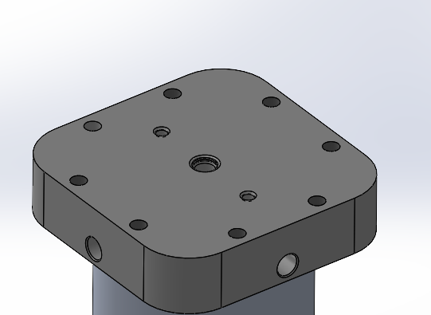
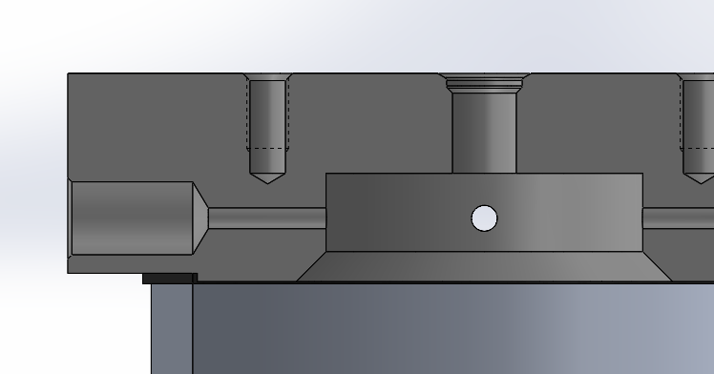
Load - Cell Threads
2X ¼” - 28 Thread
Length = 0.5”
A_{thread} = PI*d_{m}*L_{e} / 3
F_{su} = 30 ksi
FOS = 2
P_{allowed} = 2000 lbf (per thread)
Aluminum threads may wear after many uses, be prepared to insert helicoil replacement

Slide 6
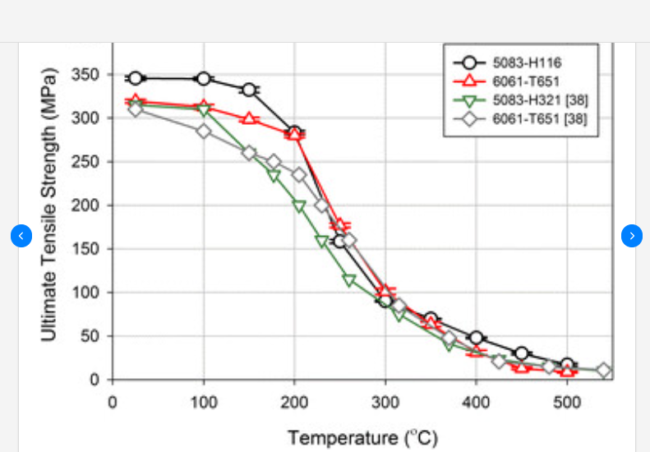
Chamber Pressure Stress
Hoop Stress = Pr/t
= (150 psi) * (1.75”) / (0.25”)
= 1050 psi [7 MPa]
FOS_ult = 2
Temp should be limited to approx. 400 Celsius ( 752 F)

