Slide 1
Gaslighter V1 Engine
FINAL REVIEW
Karl Kanmaz, Joe Wilson

Slide 2
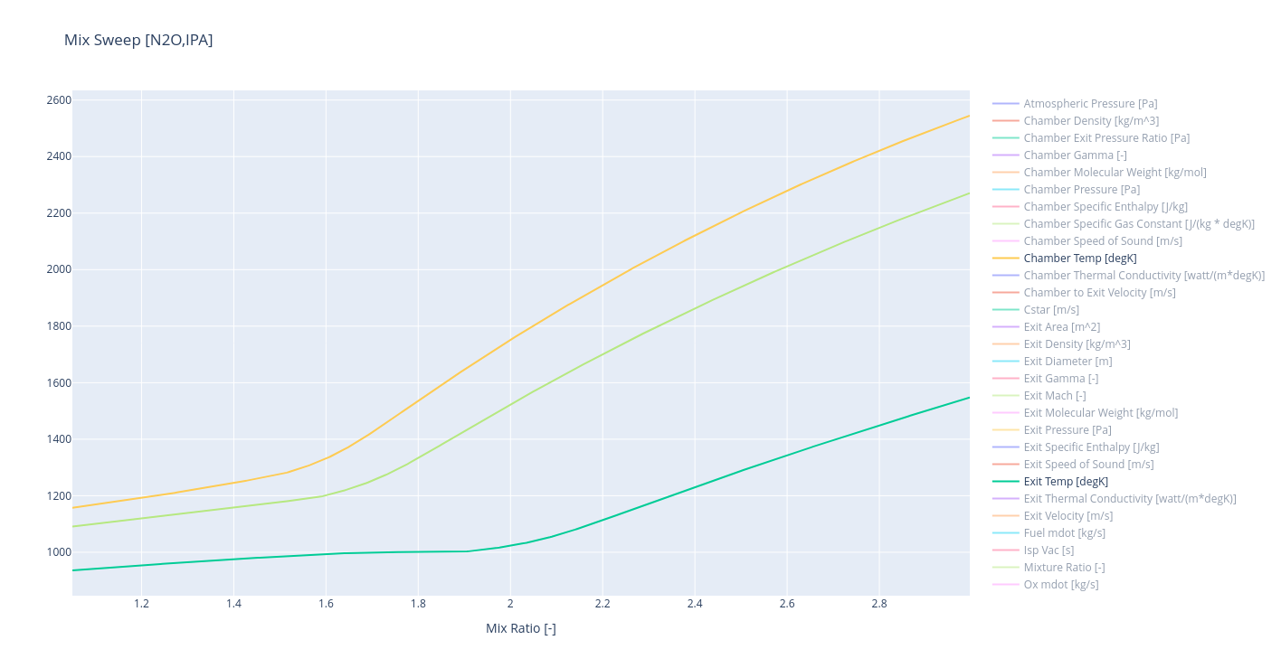
Engine
Chamber pressure chosen to keep fuel runtank < 200psia
Engine mdot limited by fuel runtank pressures and volume (0.5gal/5s)
Mixture ratio chosen to keep chamber temps 10% over melting (1730F)
  This is an conservative choise, based on combustion efficency expectations
Design decisions on this
motor are intended to provide
an easy onramp to liquid propolsion
instead of optimizing performance.

Slide 3
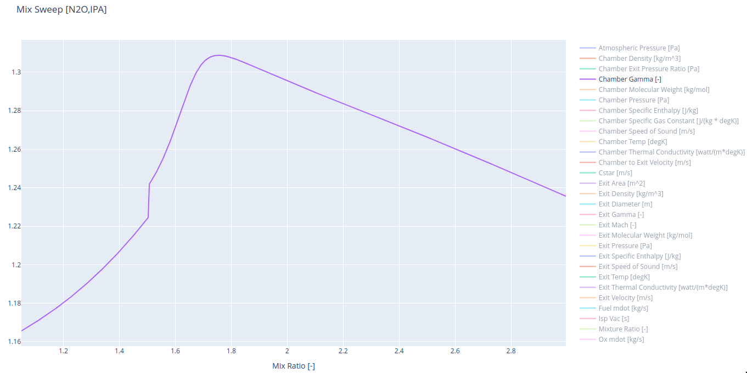

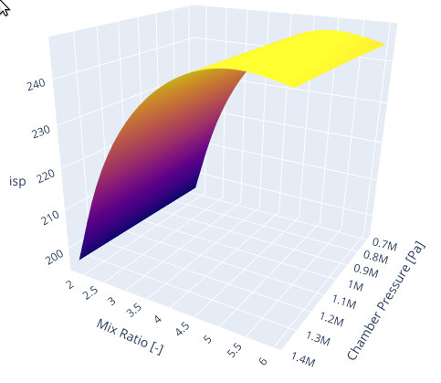
Propellant
Fuel: 99% Ipa
Oxidizer: N2O (Automotive)
Combustion properties from CEA
Propellants chosen for their ease of use and avaliblity, at the cost of performance.
Additional complexity is added by the use of a high vapor pressure oxidizer, this was perfered over the challanges of cryogenics for a small hobby project.

Slide 4
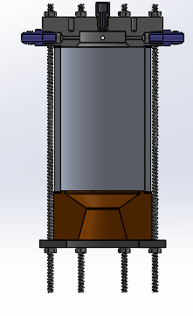
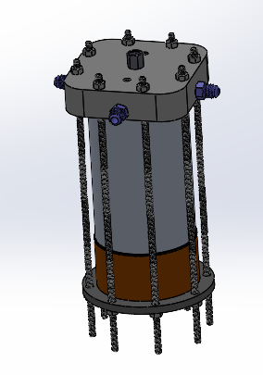
GL V1 Ideal System Specs
Chamber Pressure = 150 psi
Throat Diameter = 1.33 in
Bulk Chamber Temp = 1937 F
L* = 30 in
MR = 1.06
Area Ratio = 2.25
Mass flow = 1.68 lbm/s
Max Thrust = 267.2 lbs

Slide 5
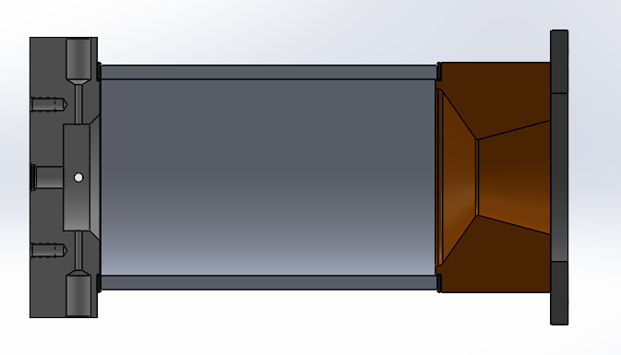
Design
Injector
Material: 6061 Aluminum
Chamber
Material: 6061 T6 Tube
Adjustable
Clamp Plate
Material: Mild Steel
Graphite Gasket
Throat-Nozzle
Material: 360 Brass

Slide 6
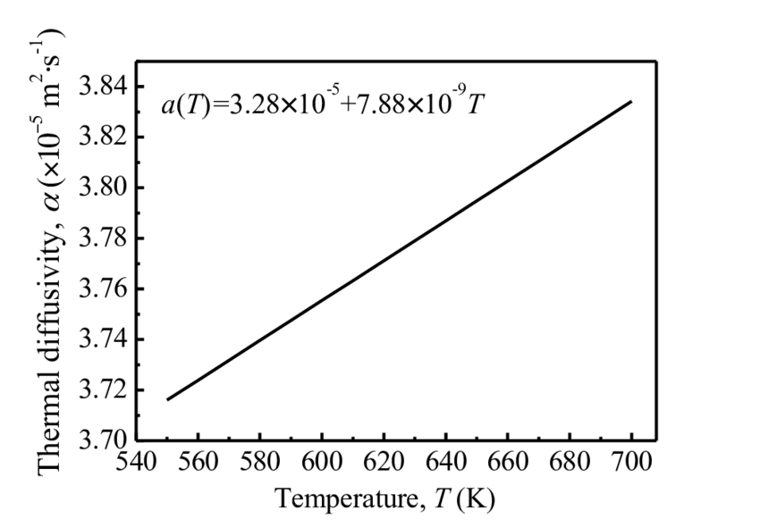
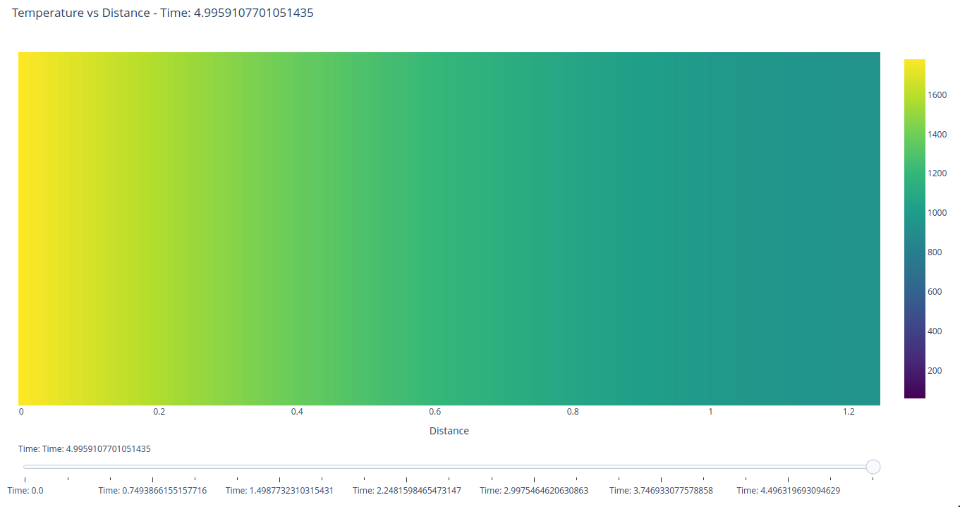

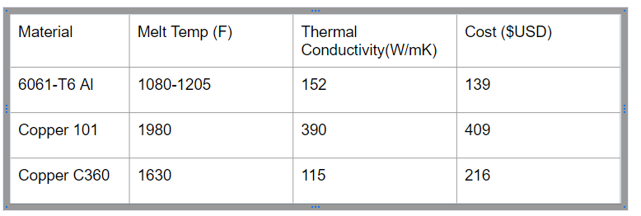
Heat Sink Modeling
Ambient Properties
Frontiers of Solidifcation (MPMD 2016)
Assumes 100% Combustion Efficiency, and perfectly caloric products
Throat temp = Chamber stagnation temperature
Diffusivity chosen based by median flame temp (293K -> 1250K)
Copper C360 (Brass) chosen to balance cost, melting temp and conductivity
Heat transfer done with FDM discrete and rk4 integration
Ambient Diffusivity (293K) = ~3.59e-5 [m2/s]
Frontier Model Diffusivity(293K) = ~3.51e-5 [m2/s]
Frontier Model Diffusivity(771K) = ~3.89e-5 [m2/s]
Calc is likely conservative, but this demonstrates worst case conditions, and drives starting mixture ratio selection.
Melting temp 1160K
(0.141in)!
1244K [FROM CEA]
780K
Adiabatic Outer Wall Temp

Slide 7
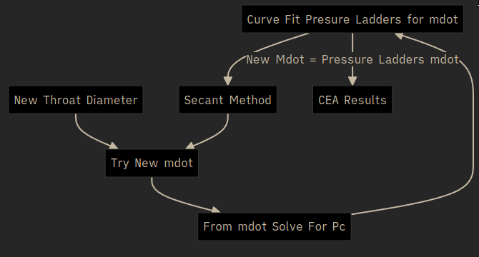
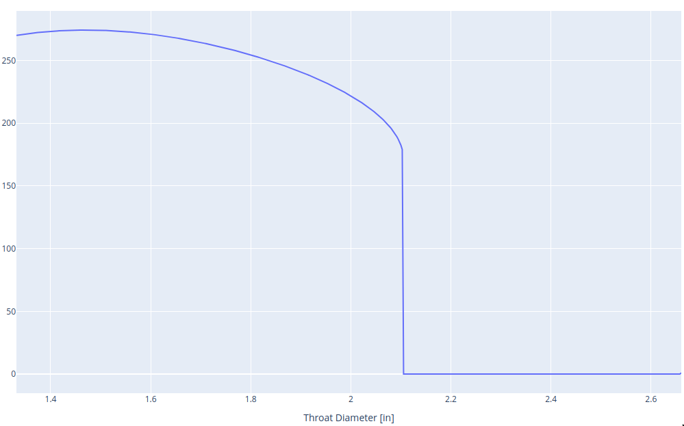
Throat Errosion
Based on conservative heat sink modeling, throat erosion is likely.
Effects of this:
  Chamber pressure reduction
  Exit Ratio decreases inverse with Exit Pressure and proportional to Exit velocity
  Slight Chamber temperature reduction
  Increased mdot from both injectors
  For small erosion thrust increases, until exit velocity compromises mdot increase
Risks:
  Reduced injector stiffness (instability, or combustion gas up the feedline)
  Loss of engine performance
  (lower isp, transition to under expansion and decreased exit velocity)
Thrust
Expansion = Unity
Even with max expected errosion during a 5s burn, thrust loss is minimal.
Injector stiffness risk will be accepted, and mitigated with an intial lower duration burn to access erosion

Slide 8
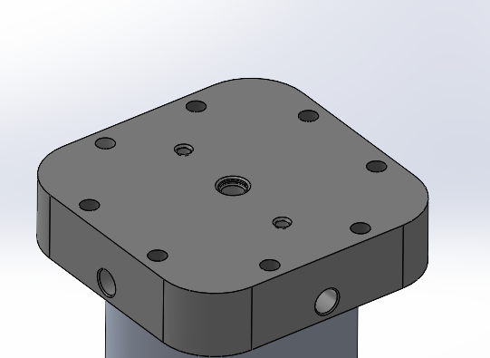
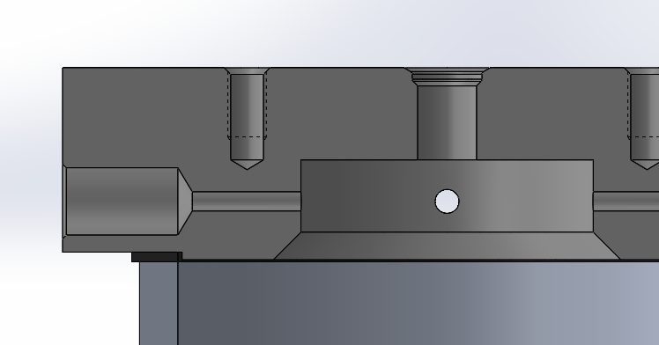
Load - Cell Threads
2X ¼” - 28 Thread
Length = 0.5”
A_{thread} = PI*d_{m}*L_{e} / 3
F_{su} = 30 ksi
FOS = 2
P_{allowed} = 2000 lbf (per thread)
Aluminum threads may wear after many uses, be prepared to insert helicoil replacement

Slide 9
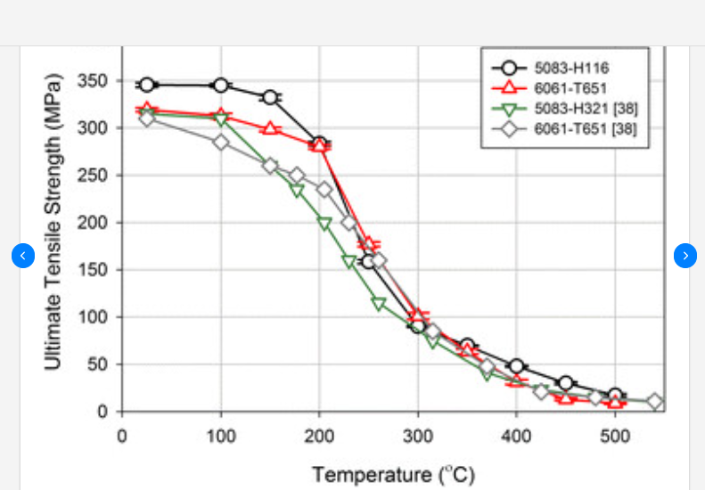
Chamber Pressure Stress
Hoop Stress = Pr/t
= (150 psi) * (1.75”) / (0.25”)
= 1050 psi [7 MPa]
FOS_ult = 2
Temp should be limited to approx. 400 Celsius ( 752 F)

Slide 10

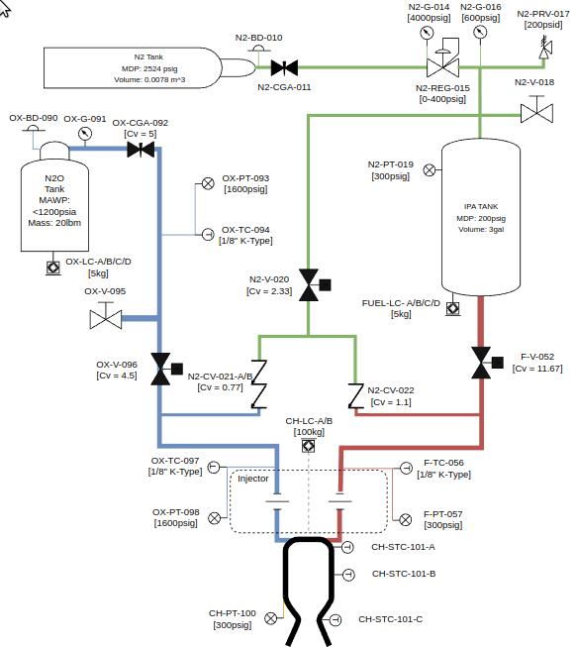
Test P&ID / Instrumentation
Risk Profile:
  2 Fault tolerant during manual operations
  1 Fault tolerant to loss of GSE
  0 Fault tolerant to engine loss
Nitrous:
  Nitrous outlet 20lbm + high flow siphon valve
  Pressure / Temp at all major locations
  Redundant purge checks to mitigate leakage flowing
  into fuel system if checked off
  4 x calibrated load cells to measure mass usage against injector mdot
IPA:
  IPA temperature considered ideally constant, only ullage pressure
  and injector fluid state are measured
  4 x calibrated load cells to measure mass usage against injector mdot
Purge:
  Limits moisture (from icing in Nos leakage or combustion products)
  Acts as a small gas damper during startup (startup timing tbd)
Chamber:
  Chamber pt with thermal standoff
  Chamber temperatures although low enough to measure with a K-type TC where not installed
  due to possibilities of increased chamber temps in the future
  3 x Skin temperature sensors on injector wall, chamber wall and throat location
If budget allowed normally open valves , a remote pressurant isolation, and a separate volume
for purge gas would have been desirable from a test stand perspective.

Slide 11
Pressure Ladder
Mdot_fuel = 0.65 lbm/s (0.29 kg/s)
V_tank = 0.011 m^3
Ullage % = 10%
Mass_fuel_max = 8 kg
Max Burn Time = 28 s
Branch Pipe 2X
Dp = 2.2 psi
P = 182.1 psi
Length = 10”
⌀ 0.375”
Roughness = …
Fuel Tank
187 psi
Injector Orifice 2X
Dp = 31.3 psi
P = 150 psi
⌀ 0.155”
Sump
F-V-052
Injector
Chamber
150 psi
Needle Valve - 052
Dp = 0.2 psi
P = 186.8 psi
Cv = 11.7
Outlet Pipe
Dp = 2.6 psi
P = 184.3 psi
Length = 4.9 ft
⌀ 0.44”
Relative Roughness= 0.0015
Sump
Dp = 0
P = 187 psi
⌀ 0.5”
Cd = 0.65

Slide 12
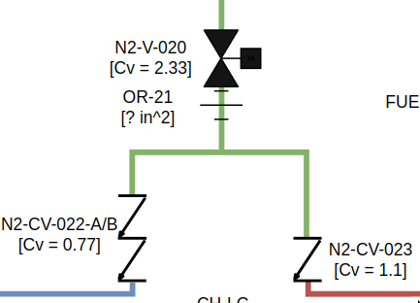
Purge Sizing
Control Mass Flow by choking upstream of feedlines this ensures down stream conditions do not effect purge mass flow-rate until critical conditions are met
Ensure a minimum of 3 x volume exchanges based onNASA Lessons Learned (For hydrogen but few sources exist for nitrous oxide / IPA)

Slide 13
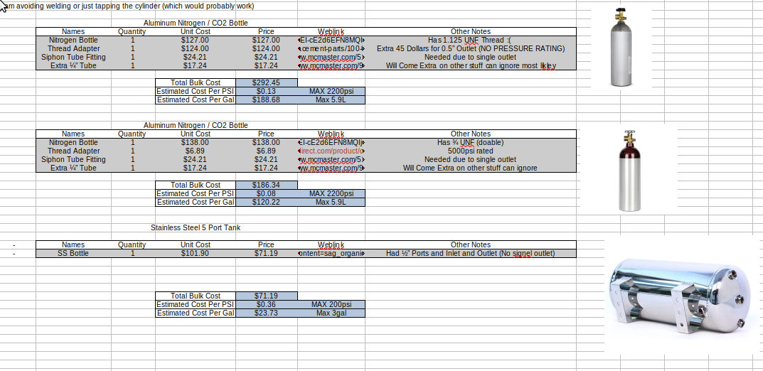
Fuel Tank
Fuel Tank was chosen purley on cost and for lack of fabrication, for higher chamber pressures tapping the bottom of the nitrogen bottle, buying a 3/4” UNF fitting and proofing the assembly per B31.3 would be very cost effective

Slide 14
DESIGN

