Slide 1
Command-line:
-pluginCustomization /path/to/settings.ini
Product:
plugin_customization.ini
Plugin: preferences.ini

Slide 2
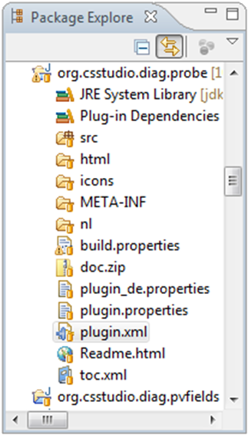
Workspace Source Code
~/CSS/Workspace
.metadata/
.log
.plugins
org.eclipse.core.runtime
.settings
~/CSS/Sources
org.csstudio.diag.probe/
src/
plugin.xml
…
IDE

Slide 3
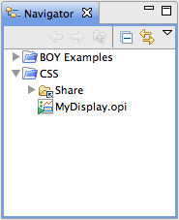
Workspace File System
/path/to/my/Workspace
.metadata/
.log
.plugins
org.eclipse.core.runtime.settings
BOY Examples/
CSS/MyDisplay.opi

Slide 4
Product Features Plugins
My Product
*.product
splash.bmp
plugin_customization.ini
org.eclipse.core.runtime
Eclipse
Core
org.cs-studio.data
Applications
org.cs-studio.display.probe
Optional
org.cs-studio.alarm.*

Slide 5
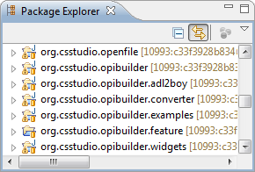

Build Directory Layout
features/
org.csstudio.*.feature
plugins/
org.csstudio.*
build.properties
# Product to build
product=/org.csstudio.….product/css.product
# Generate P2 repository
p2.gathering=true
# Name of generated archive
archivePrefix=css_3.0
# Configurations to build.
configs=win32,win32,x86 & linux,gtk,x86_64

Slide 6
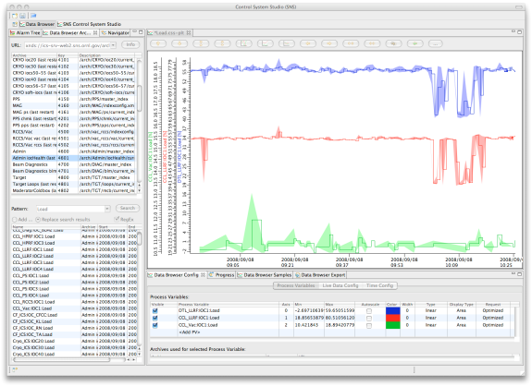
IOC
Channel Access
ArchiveEngine
config.xml
Config.
Samples
RDB (Oracle,MySQL, PostgreSQL)
ArchiveConfigTool
Other tools for config & samples
CSS-based OPI

