Slide 1
T&RH-Monitoring
Dashboard screens
Controlytics AI Pvt Ltd · 21 CFR Part 11

Slide 2
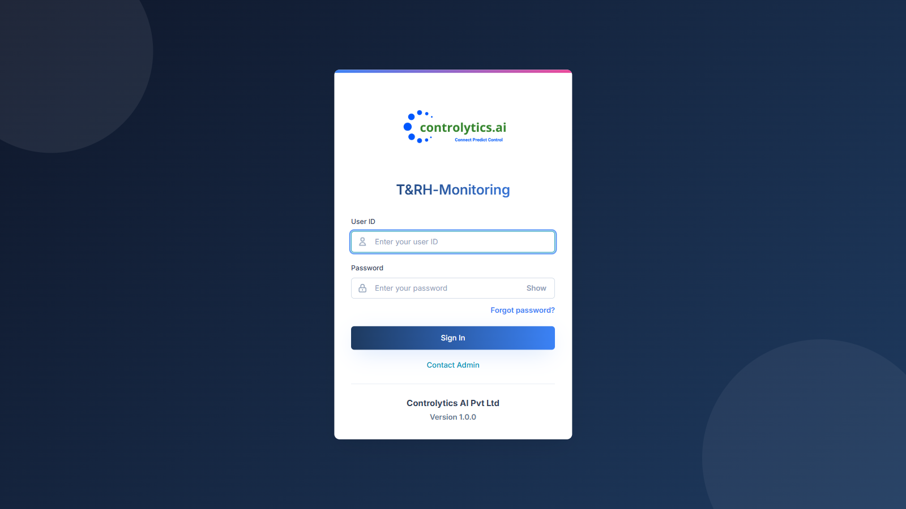
Sign in
Notes:
Sign in

Slide 3
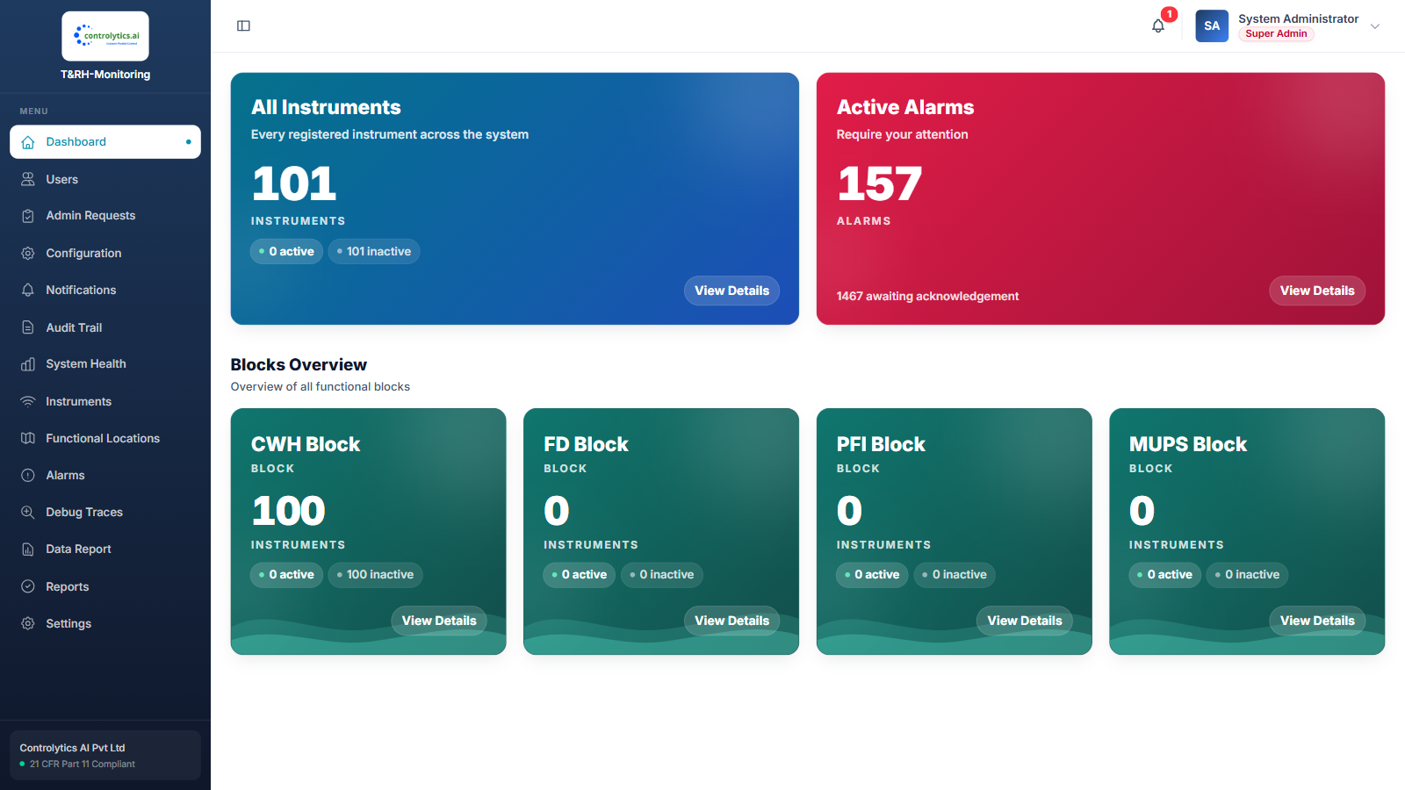
Dashboard — overview
Notes:
Dashboard — overview

Slide 4
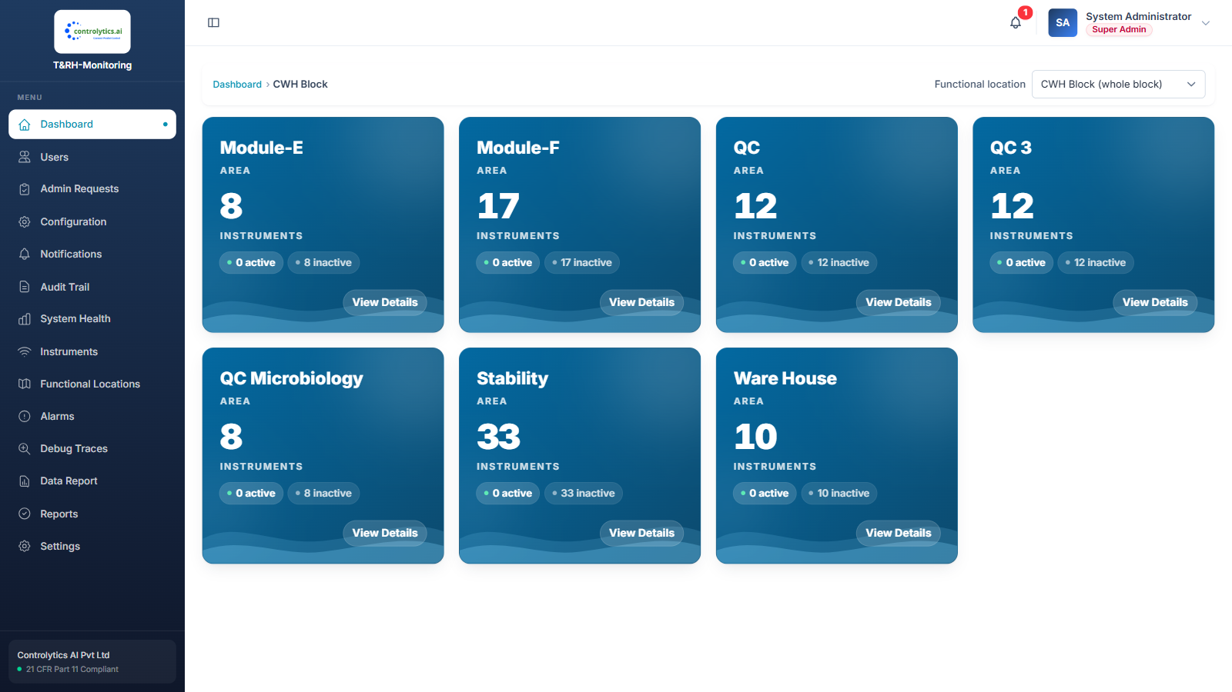
Dashboard — CWH Block areas
Notes:
Dashboard — CWH Block areas

Slide 5
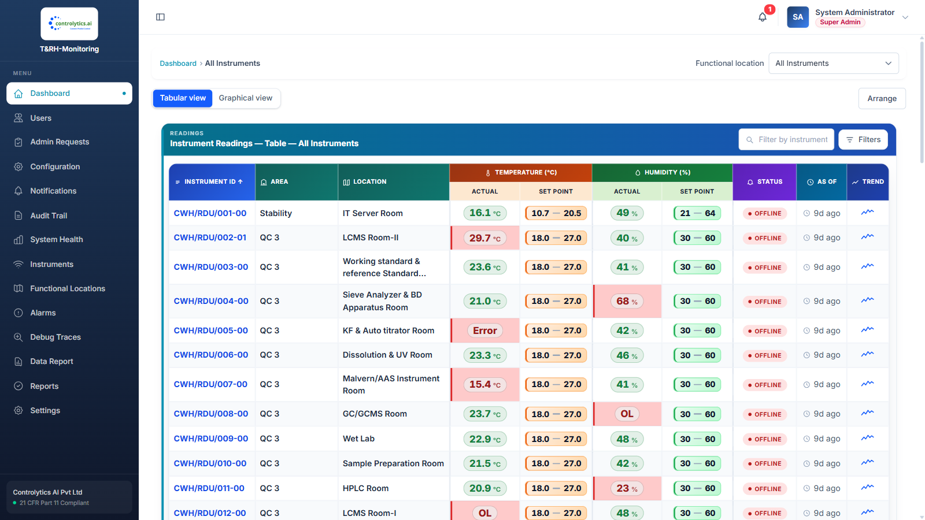
All Instruments — tabular view
Notes:
All Instruments — tabular view

Slide 6
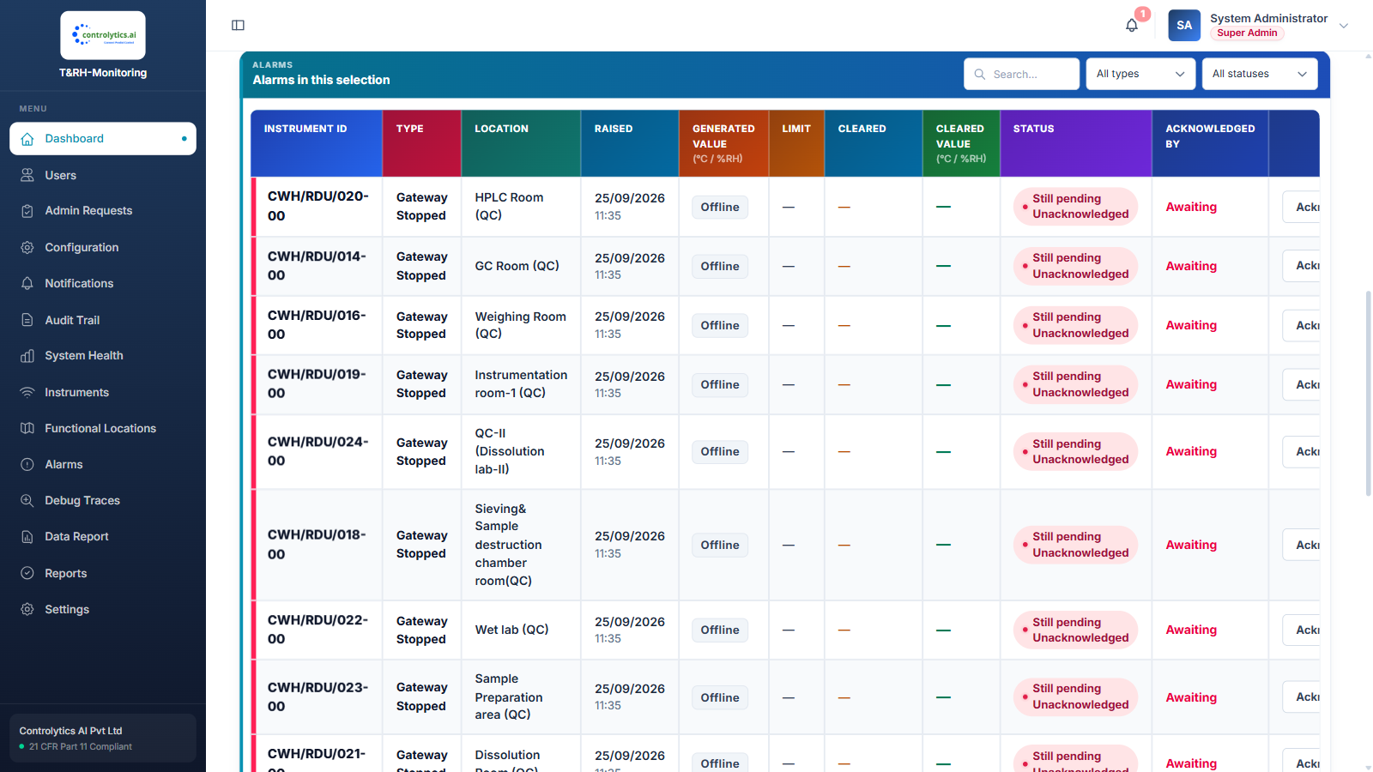
Area — alarms in this selection
Notes:
Area — alarms in this selection

Slide 7
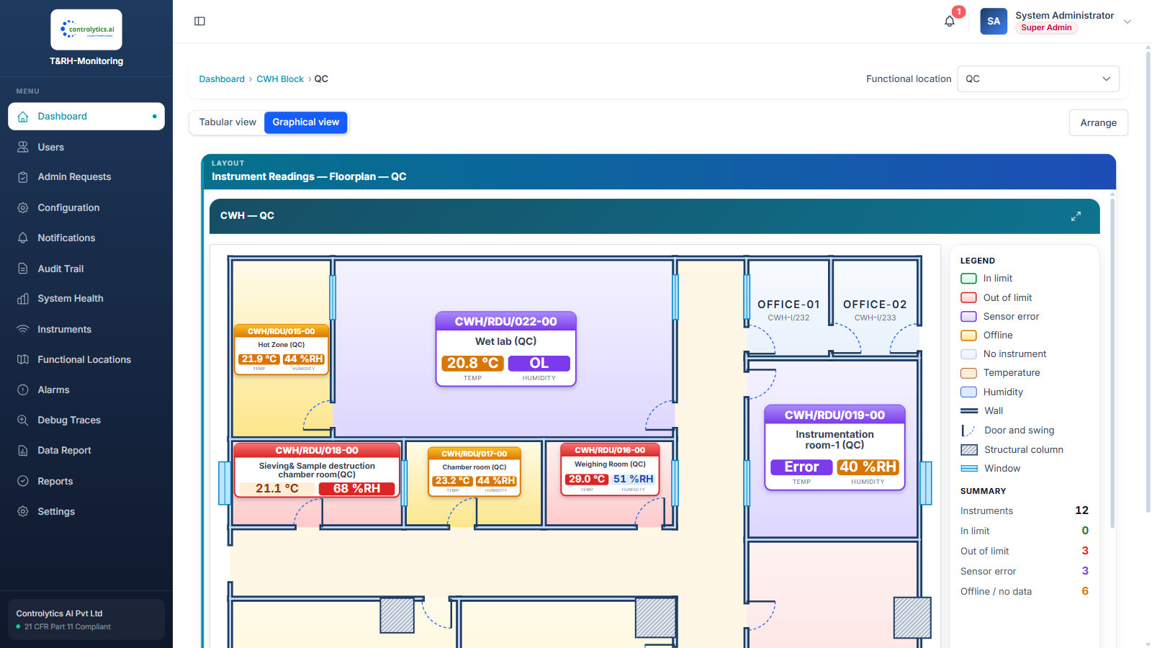
QC — graphical view
Notes:
QC — graphical view

Slide 8
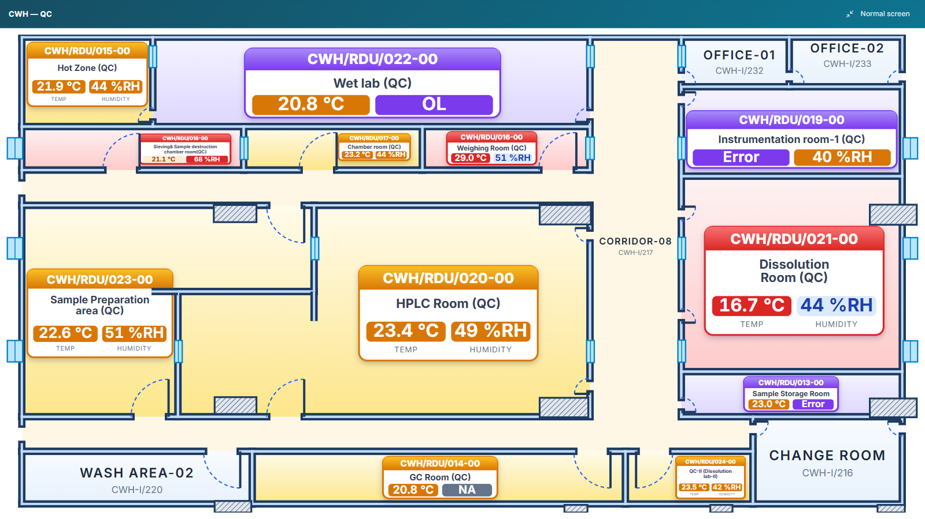
QC — floor plan, full screen
Notes:
QC — floor plan, full screen

Slide 9
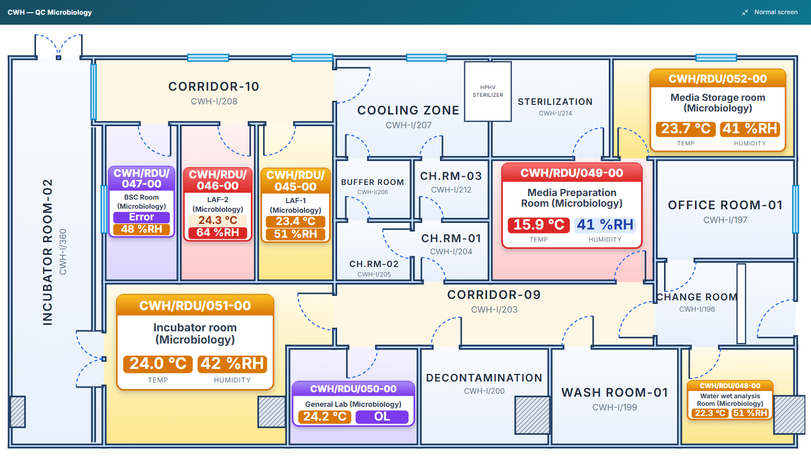
QC Microbiology — floor plan
Notes:
QC Microbiology — floor plan

Slide 10
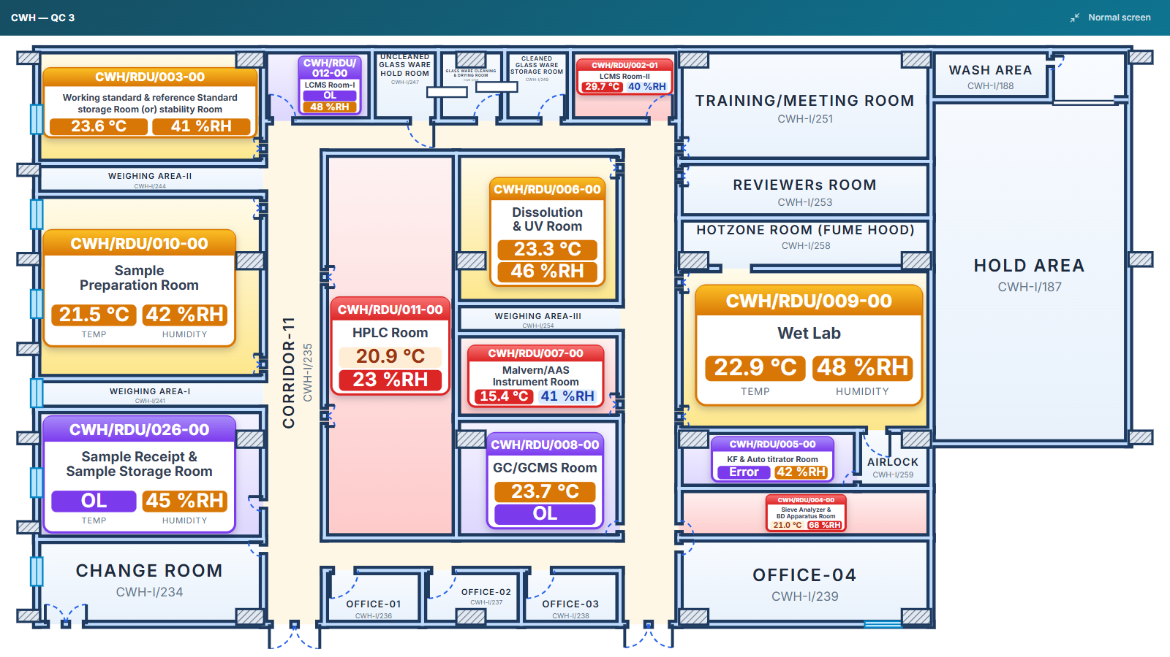
QC 3 — floor plan
Notes:
QC 3 — floor plan

Slide 11
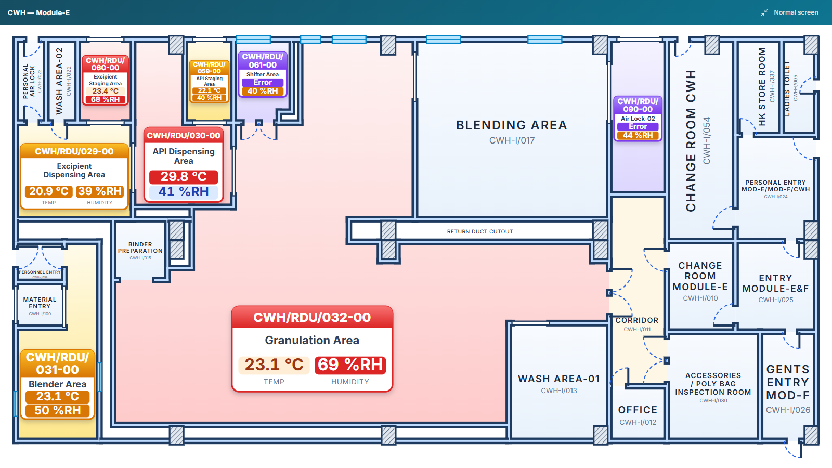
Module-E — floor plan
Notes:
Module-E — floor plan

Slide 12
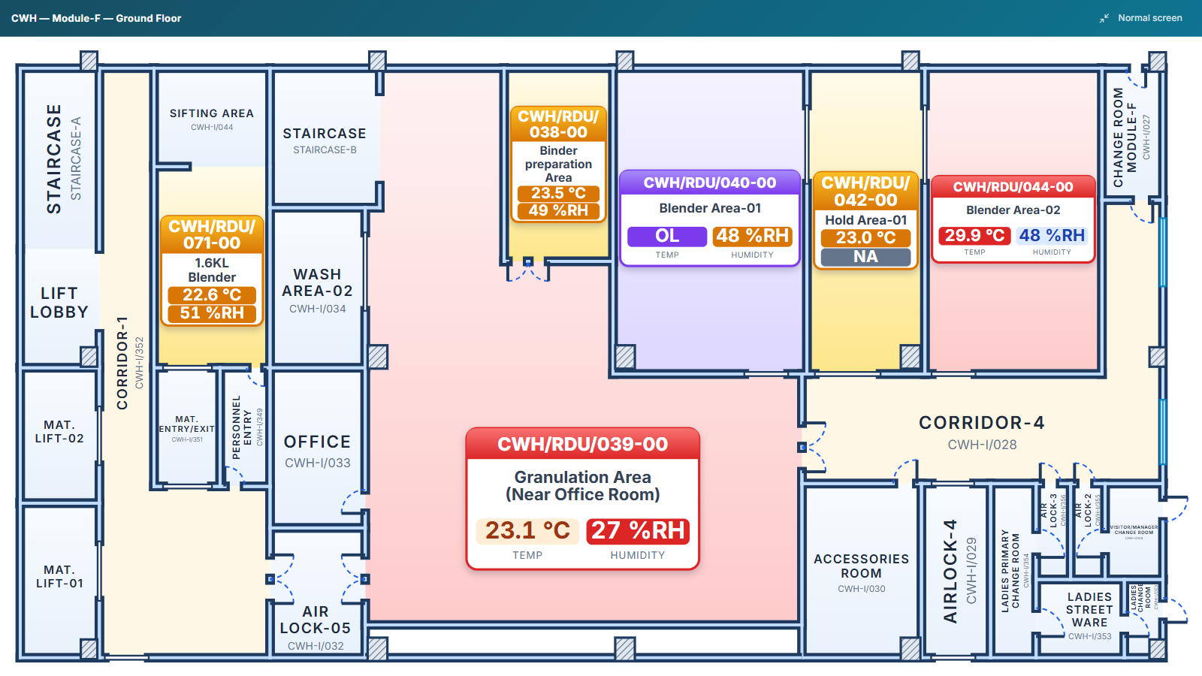
Module-F — ground floor
Notes:
Module-F — ground floor

Slide 13
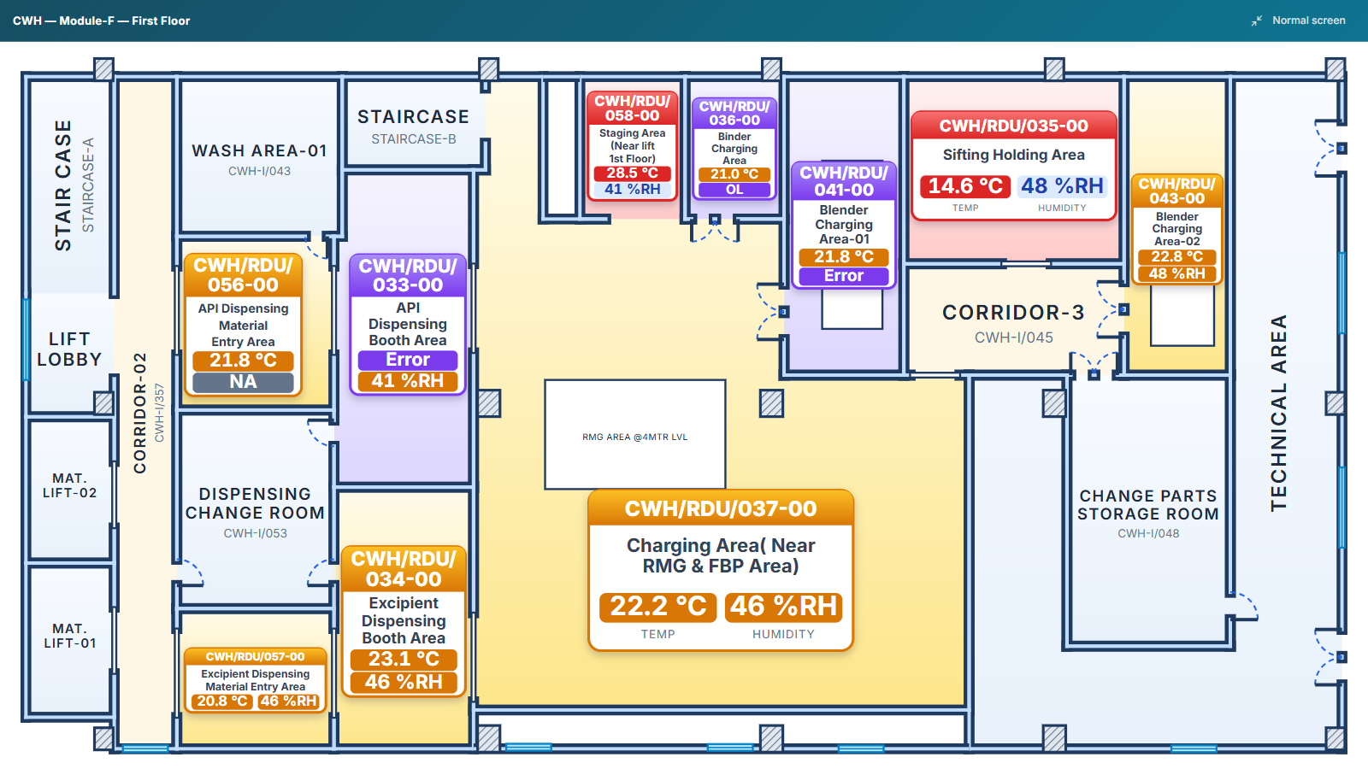
Module-F — first floor
Notes:
Module-F — first floor

Slide 14
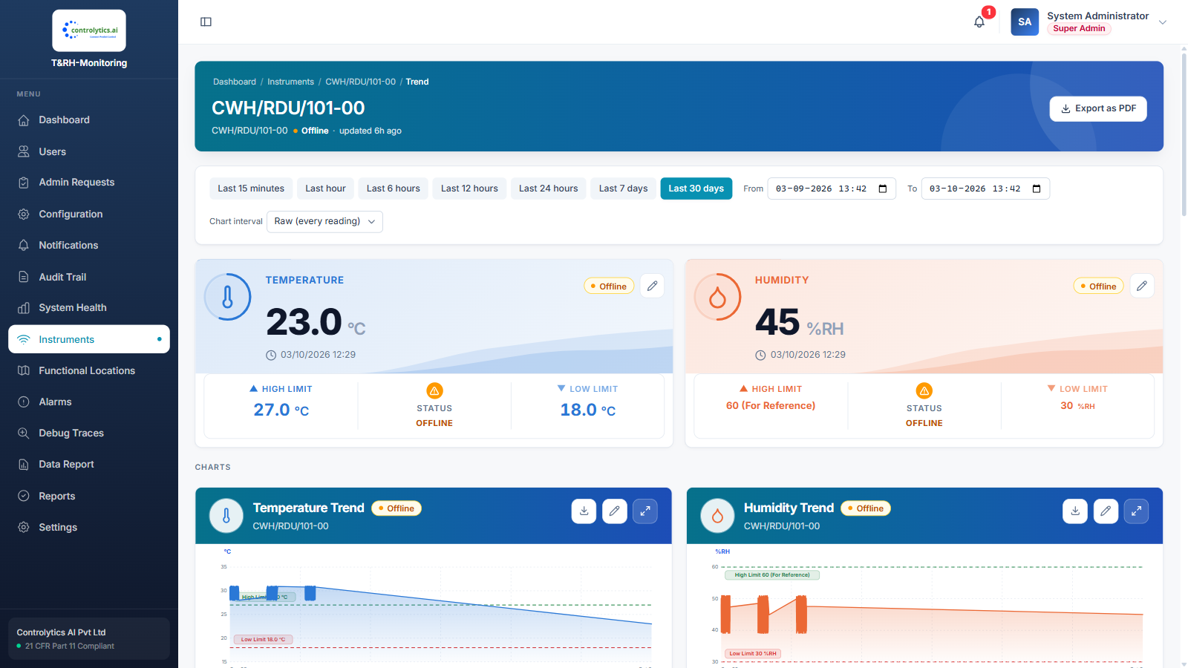
Instrument trend
Notes:
Instrument trend

Slide 15
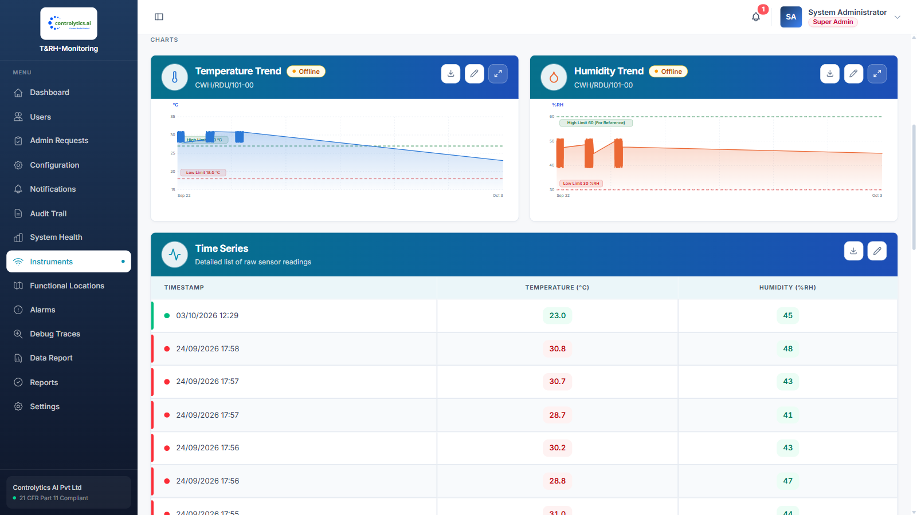
Instrument trend — charts
Notes:
Instrument trend — charts

Slide 16
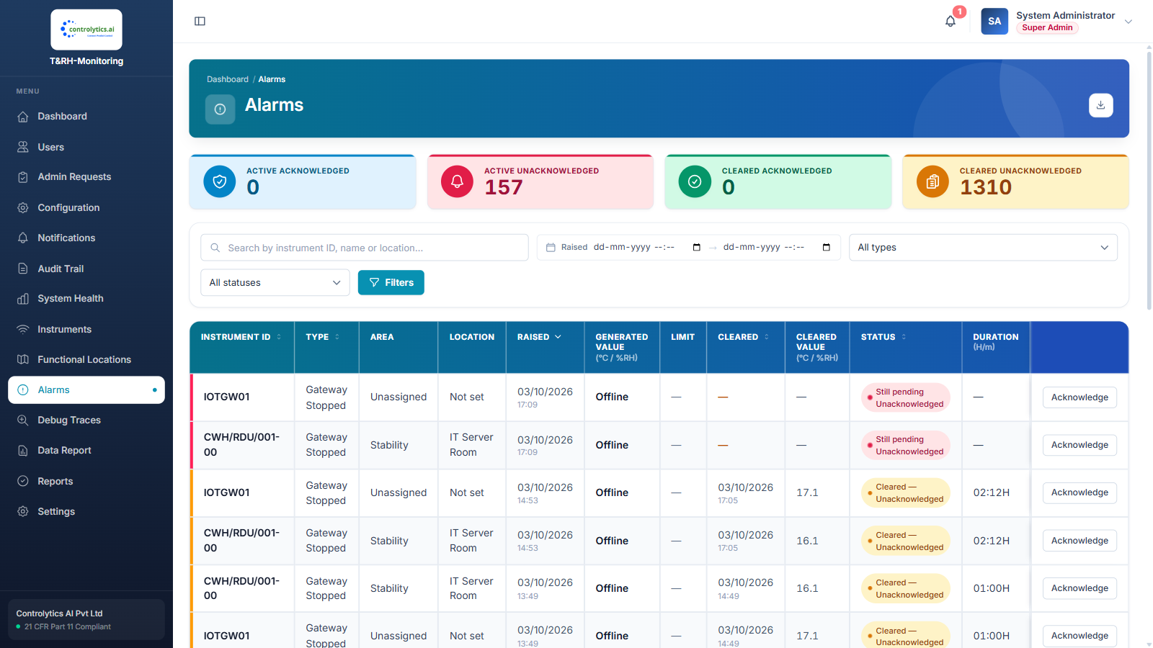
Alarms
Notes:
Alarms

Slide 17
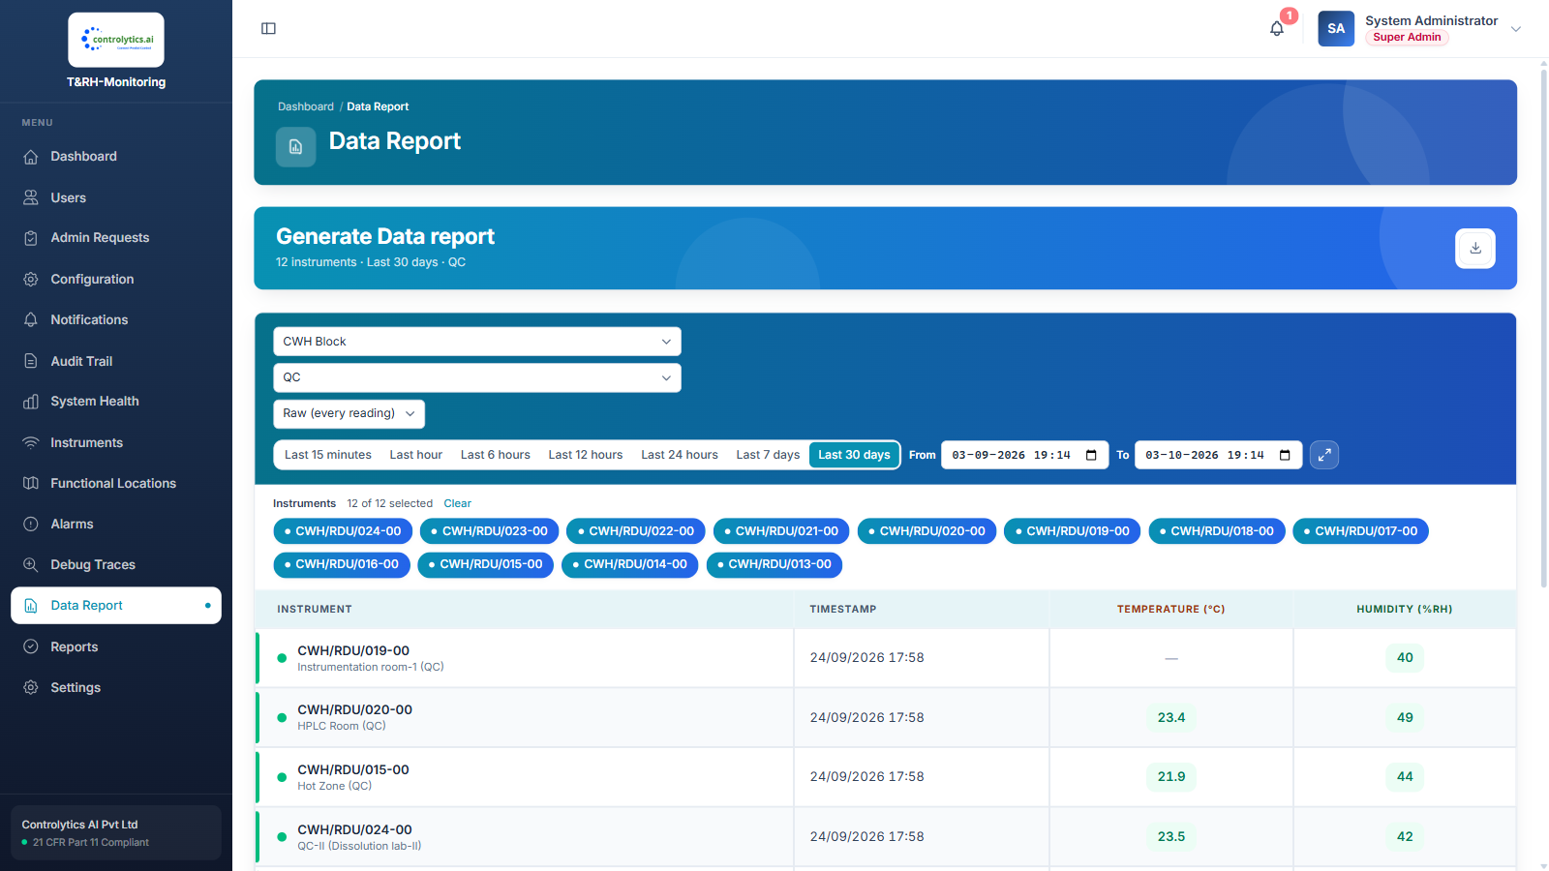
Data Report
Notes:
Data Report

Slide 18
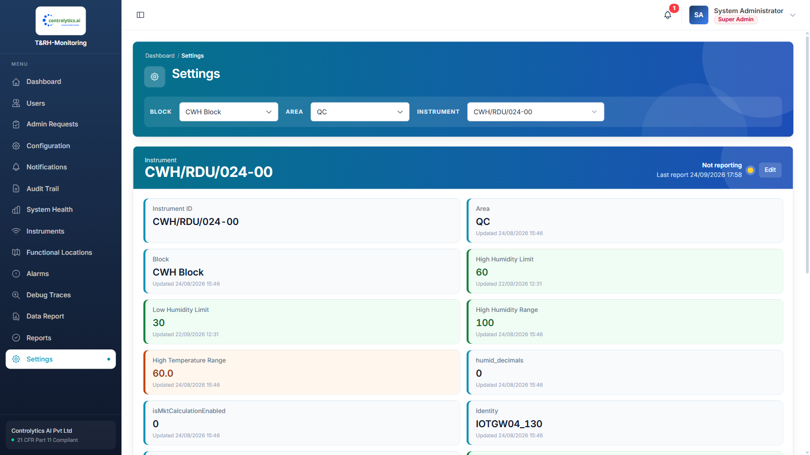
Settings
Notes:
Settings

Slide 19
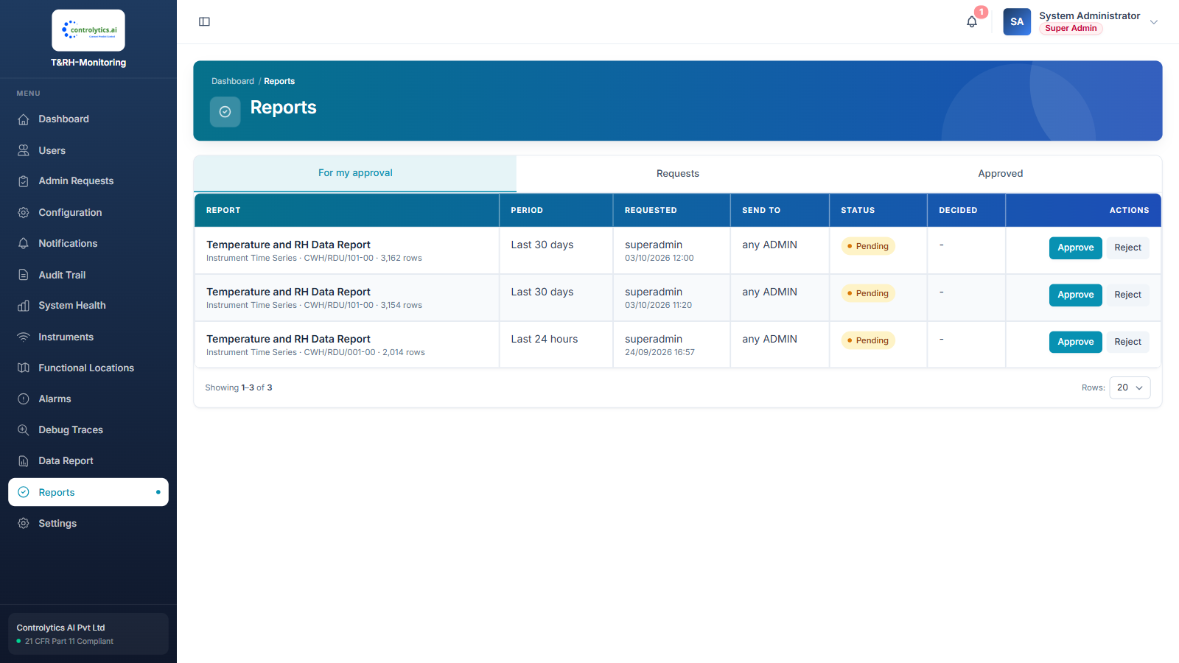
Reports
Notes:
Reports

Slide 20
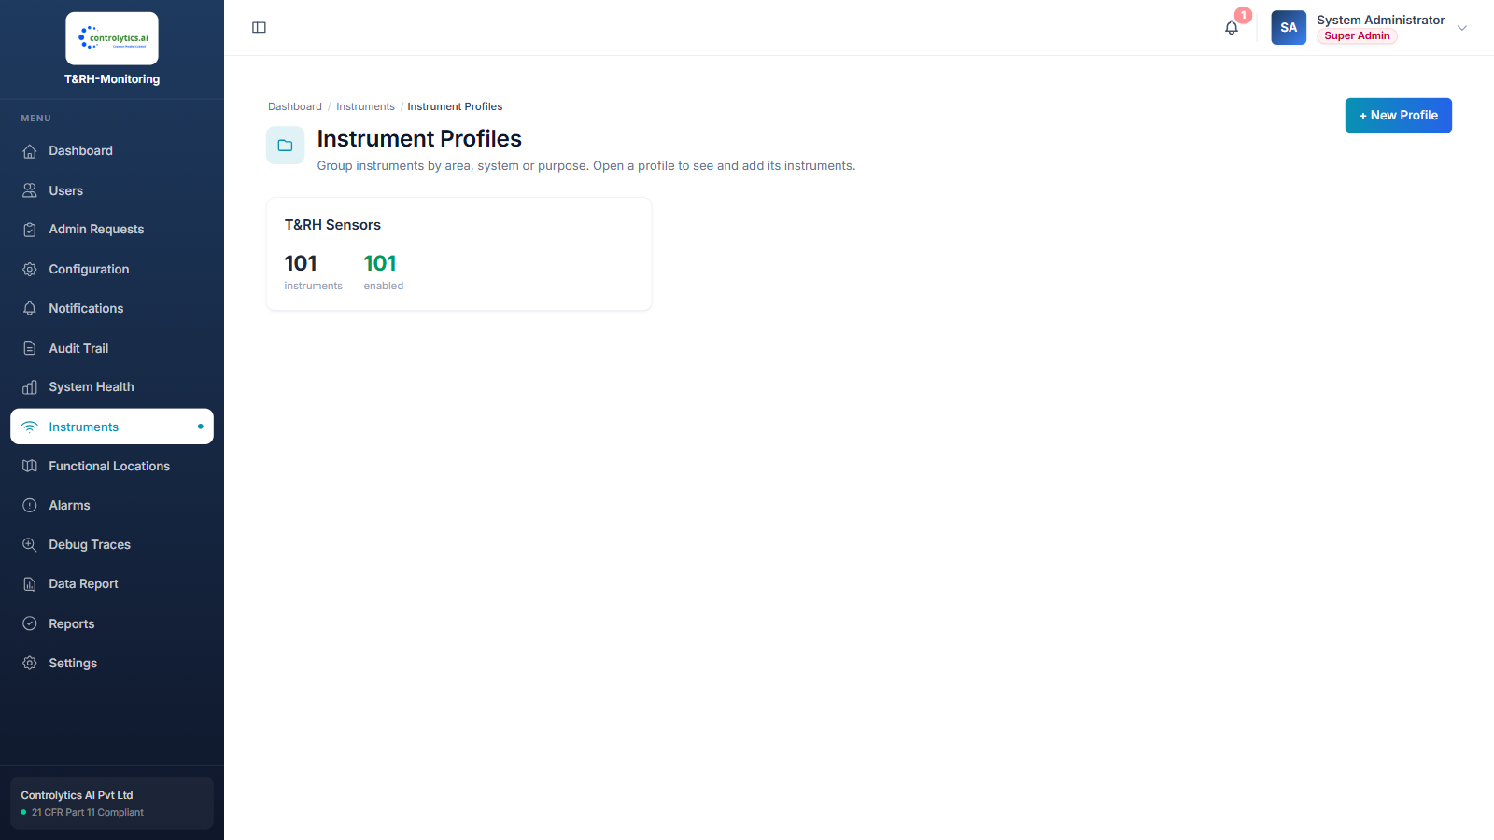
Instruments
Notes:
Instruments

Slide 21
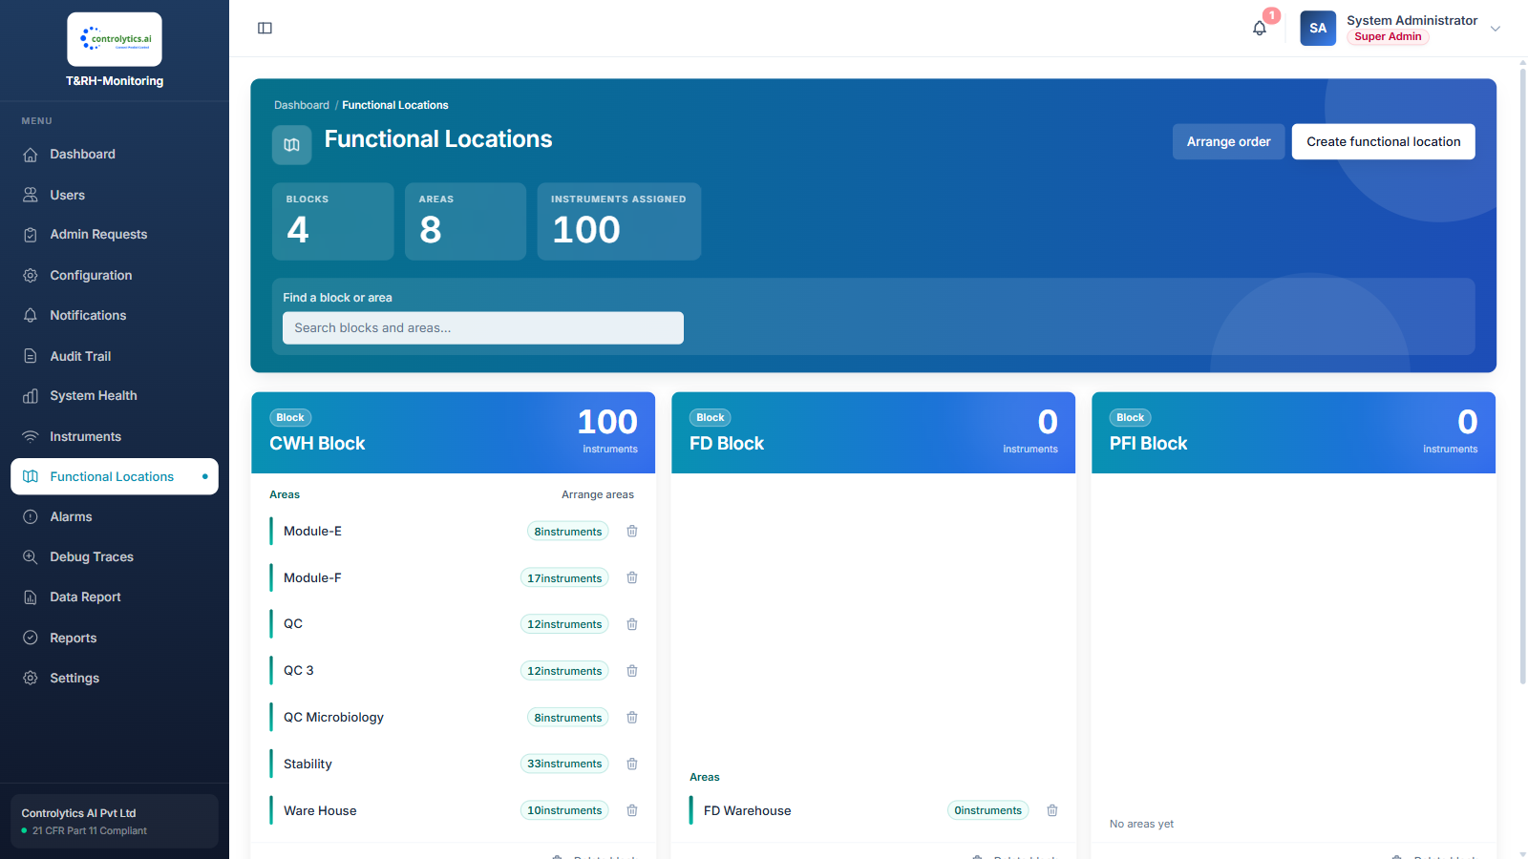
Functional Locations
Notes:
Functional Locations

Slide 22
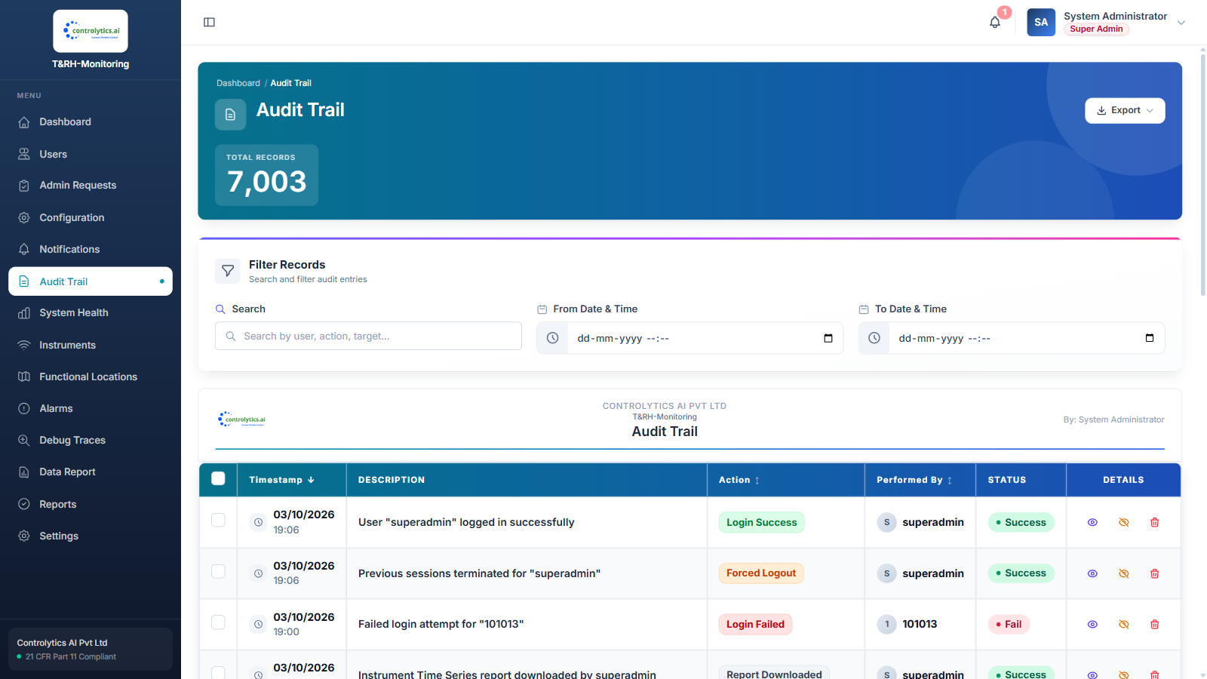
Audit Trail
Notes:
Audit Trail

Slide 23
Thank you
controlytics.ai

