Slide 1
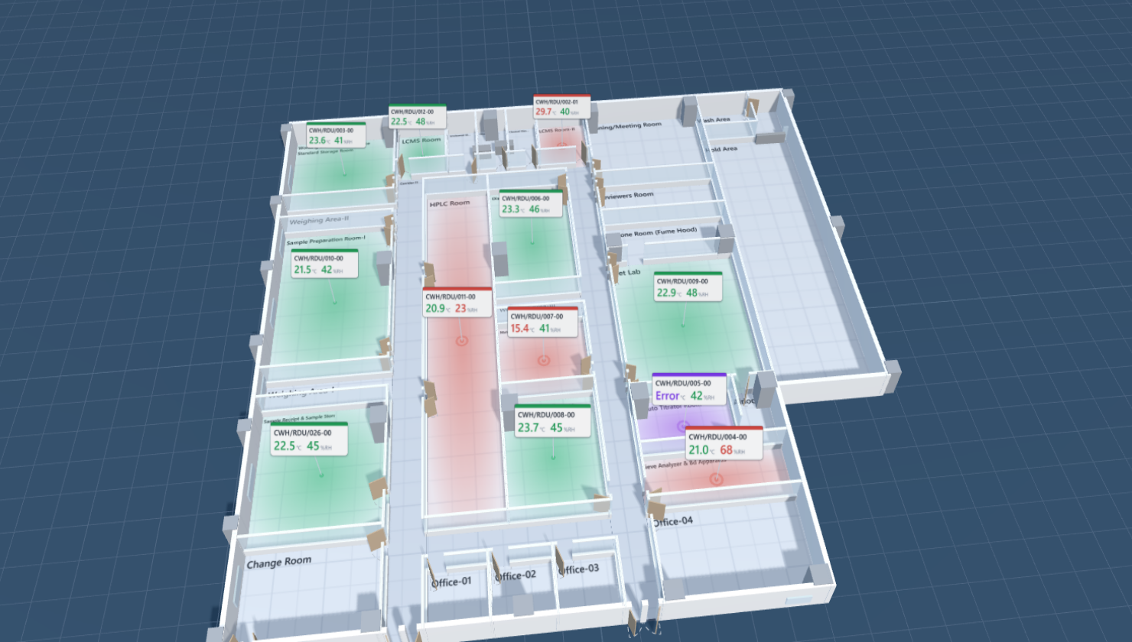
Floor layouts, eight ways
The same CWH floors drawn in eight presentation models — for you to choose the one that goes on the monitoring dashboard.
October 2026
Notes:
Opening: the six floors we traced from the drawings are already live on the dashboard in a 2D architectural style. This deck shows the same floors in four alternative models, built as standalone pages, so the client can compare and pick.

Slide 2
What is being compared
Same floors
Same instruments
QC, QC Microbiology, QC 3, Module-E and both Module-F floors — 143 rooms traced from the architectural drawings.
56 instruments, each in the room its Location says; IDs, limits and readings identical in every model.
Same status language
Only the look changes
Green in limit · red out of limit · violet sensor fault · amber not reporting · grey no reading — in every model.
Eight models: four plan views, three three-dimensional, one tile board. Pick for legibility, alarm visibility and the screen it will live on.
Notes:
Everything but the visual style is held constant so the comparison is fair. The sample readings are a snapshot; a few instruments are set to demonstration states so every colour appears.

Slide 3
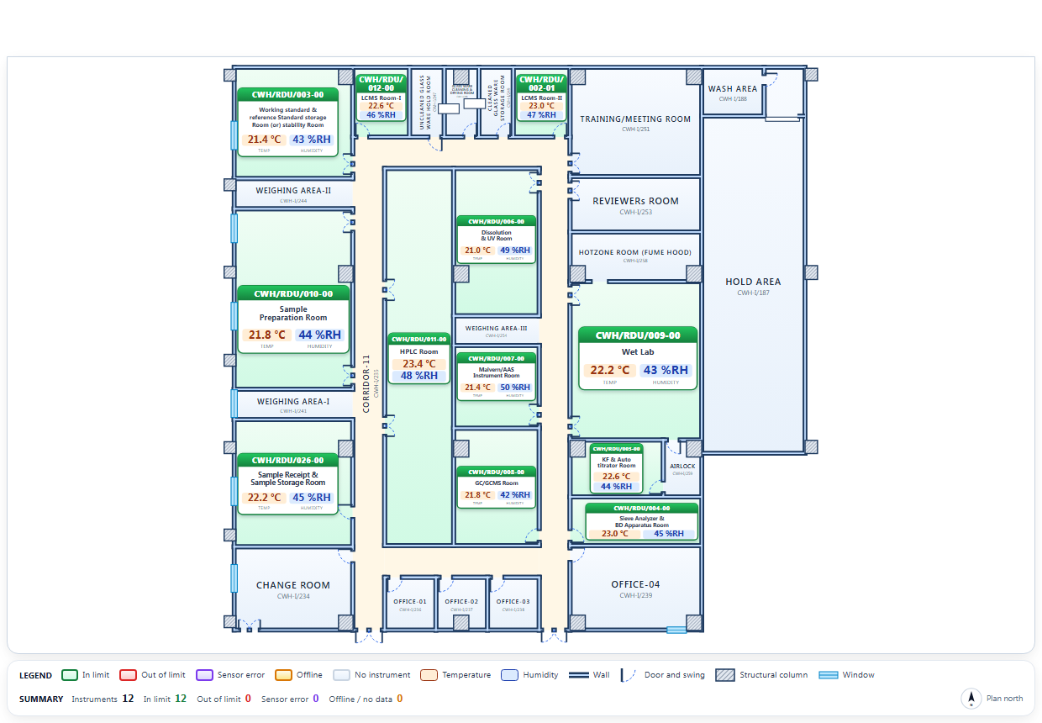
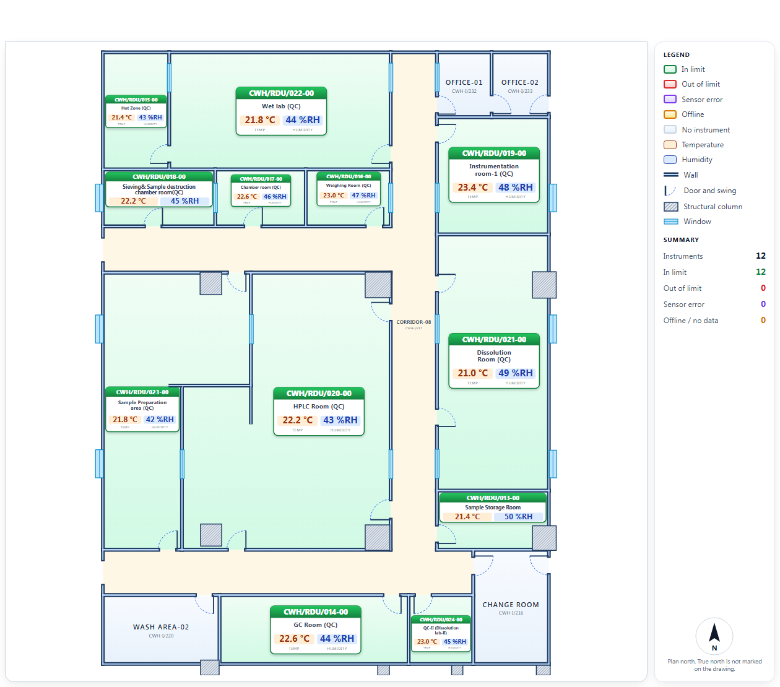
Today: the 2D architectural style on the dashboard
Double walls, columns and windows exactly as drawn
One card per instrument, status-washed rooms
Legend and plan north under the plan
This stays as it is — the models that follow are alternatives, not replacements until chosen
Notes:
Reference point: the live dashboard today. QC 3 (left) and QC (right).

Slide 4
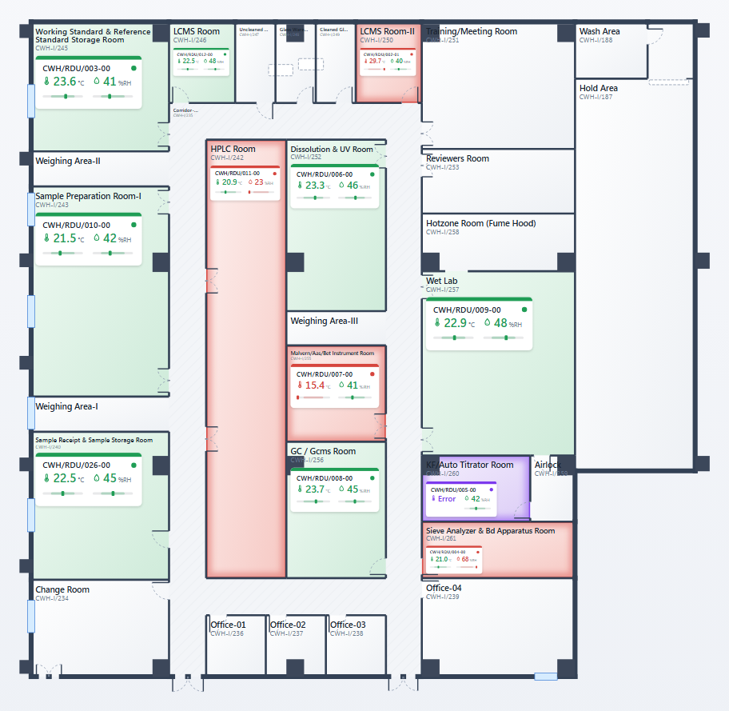
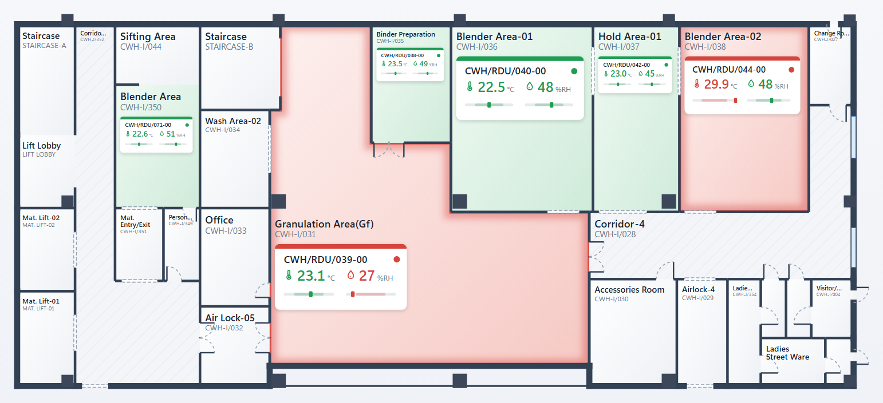
Normal — flat plan
A clean plan: thin walls, status-washed rooms, one card per instrument with icons, readings and a bar showing where each value sits in its limits. Alarm rooms glow.
Best for
Fast to read; prints and projects well
Easiest on the eye for an all-day office screen
Plain SVG — runs on any PC
Trade-offs
The quietest of the eight
Status is a wash, so an alarm is softer than in the dark model
QC 3
Module-F — Ground Floor
Notes:
Normal — flat plan. Open model-normal.html in the presentation folder to show it live; switch floors with the tabs; hover a room for its readings and limits.

Slide 5
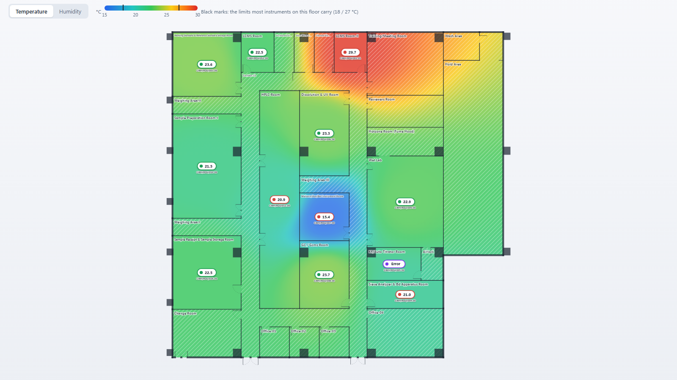
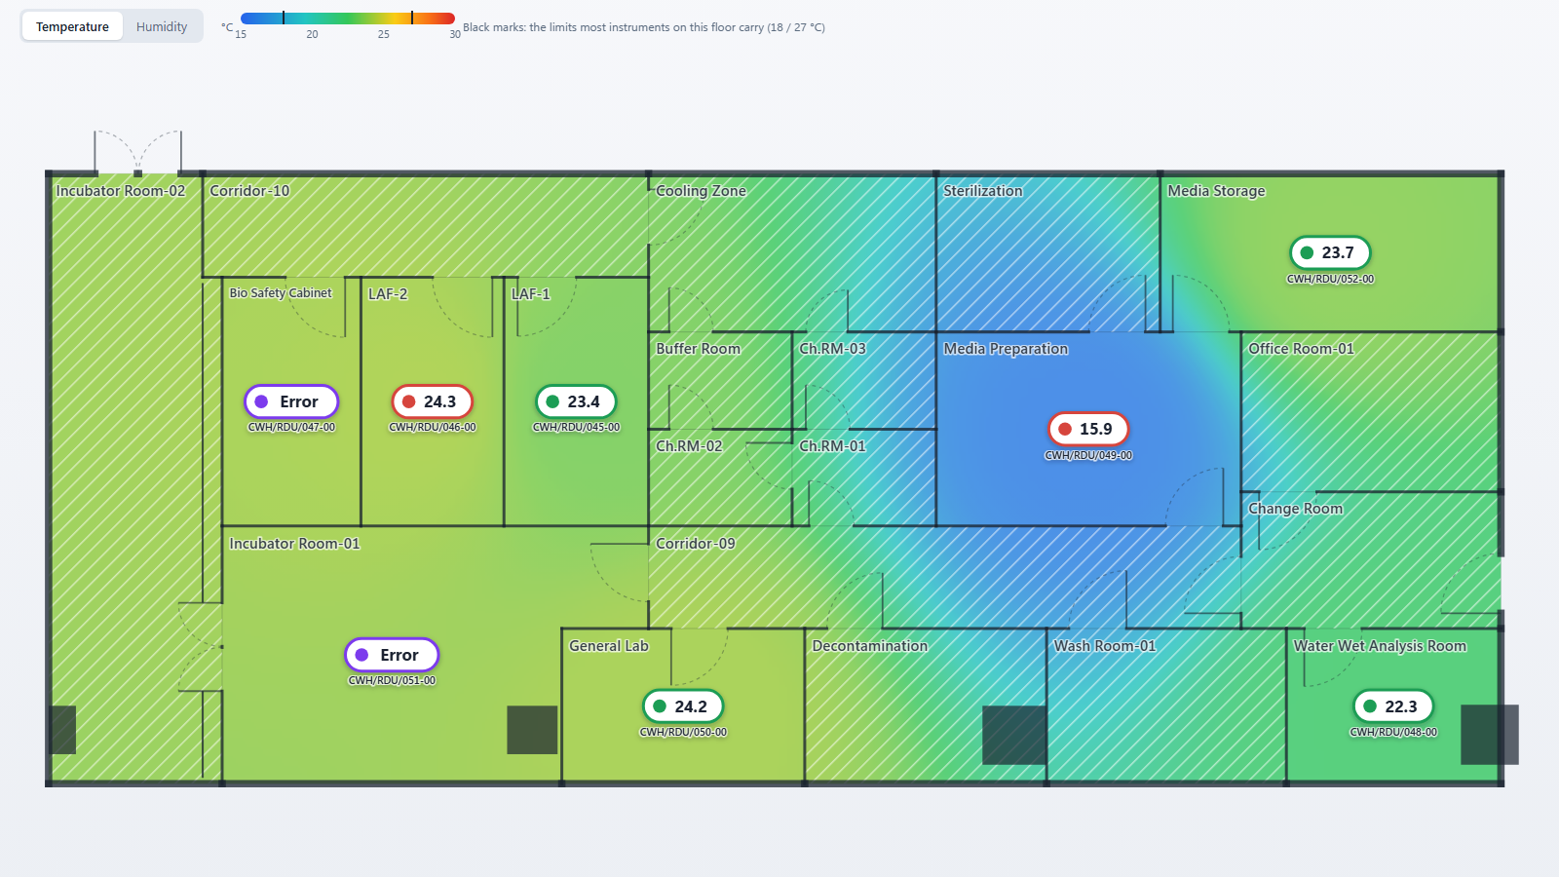
Thermal heatmap
The temperature or humidity field blended across the whole floor from every sensor, with the measured value pinned at each instrument. Switch between the two with one click.
Best for
Shows gradients and drift between rooms, which no other model does
Reads instantly: hot is red, cold is blue
Great for HVAC balancing and investigations
Trade-offs
Colour between sensors is interpolated, not measured (hatched rooms say so)
Less precise about limits than cards
QC 3
QC Microbiology
Notes:
Thermal heatmap. Open model-heatmap.html in the presentation folder to show it live; switch floors with the tabs; hover a room for its readings and limits.

Slide 6
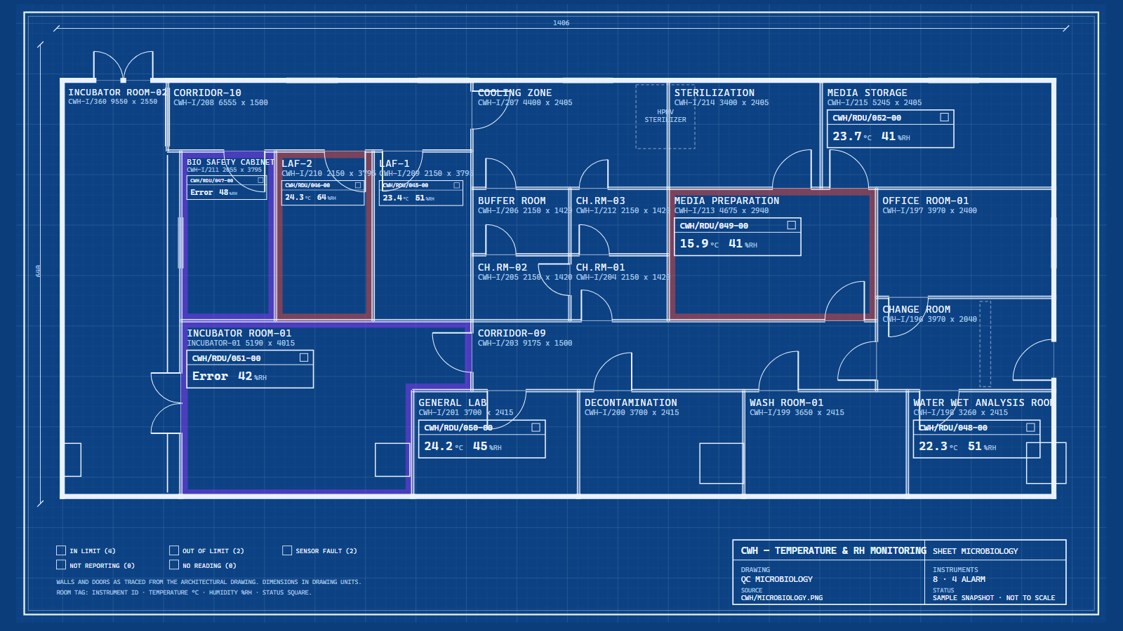
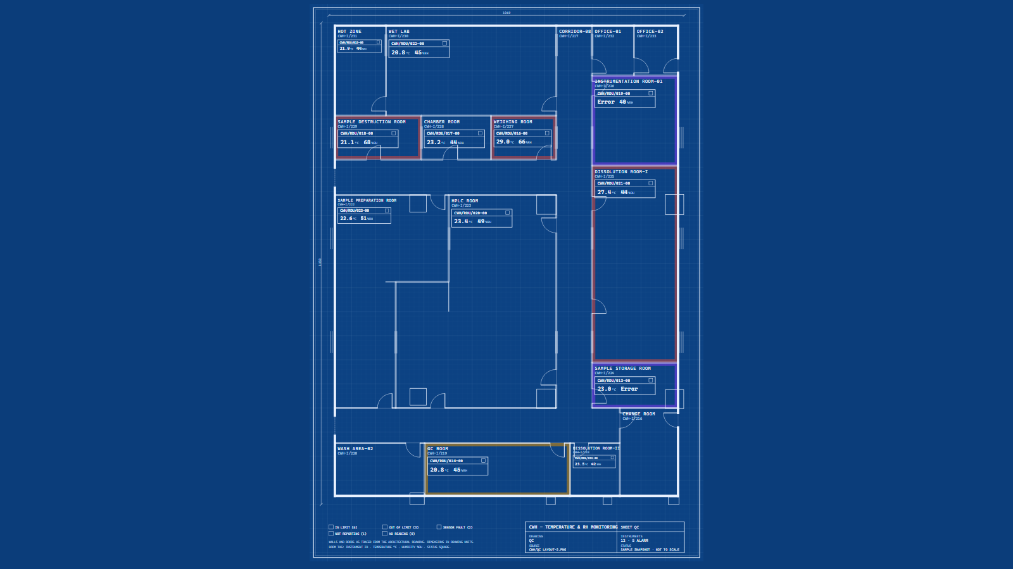
Blueprint
A drawing-office sheet: white line work on engineering blue, double-line partitions, hatched columns, a title block and boxed instrument tags.
Best for
Familiar to engineering and validation teams
Looks like a controlled document — fits a GMP site
Monochrome except the status squares, so an alarm still stands out
Trade-offs
Readings are small; made for a desk, not a wall
Dark blue print
QC Microbiology
QC
Notes:
Blueprint. Open model-blueprint.html in the presentation folder to show it live; switch floors with the tabs; hover a room for its readings and limits.

Slide 7
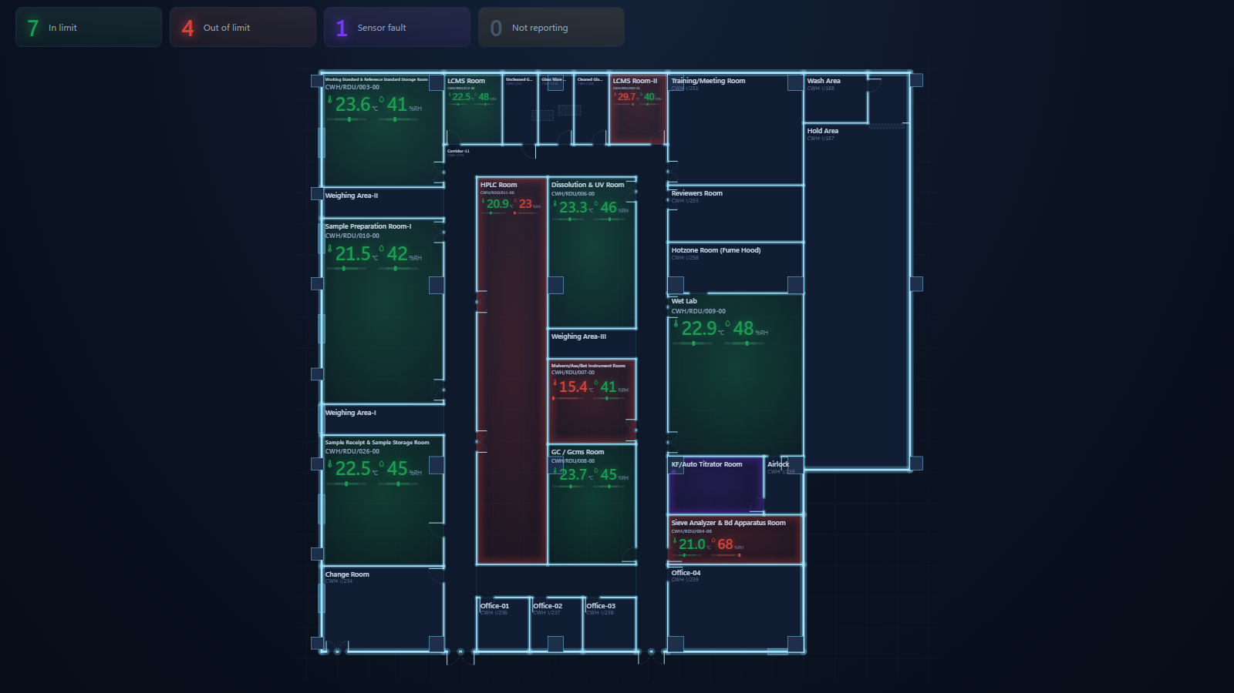
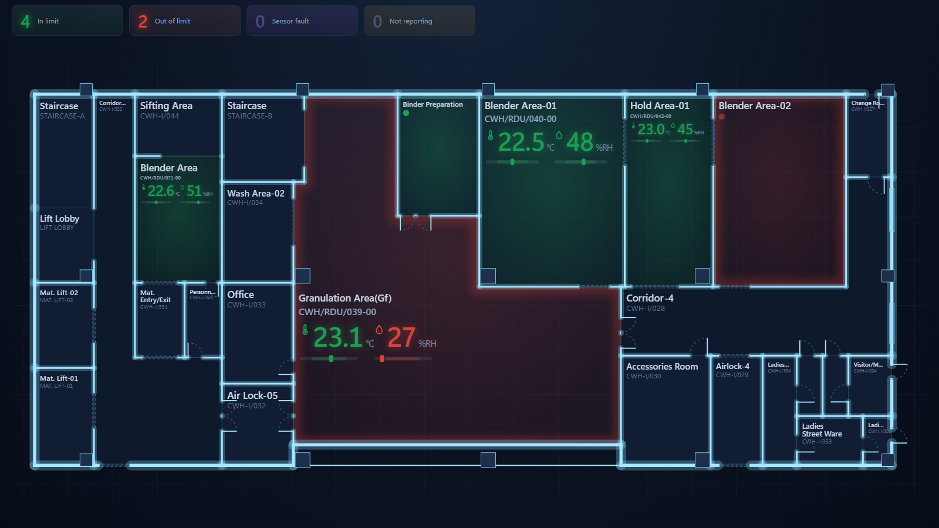
Dark control room
A monitoring-wall theme: dark plate, glowing walls, big glowing numerals straight on the room, limit bars, counters across the top. Alarm rooms pulse.
Best for
Alarms are unmistakable from across the room
Suits a 24 x 7 wall and low-light control rooms
Counters give the plant state before you read a room
Trade-offs
Heavy on a bright office screen
Dark print; needs a light model for reports
QC 3
Module-F — Ground Floor
Notes:
Dark control room. Open model-dark.html in the presentation folder to show it live; switch floors with the tabs; hover a room for its readings and limits.

Slide 8
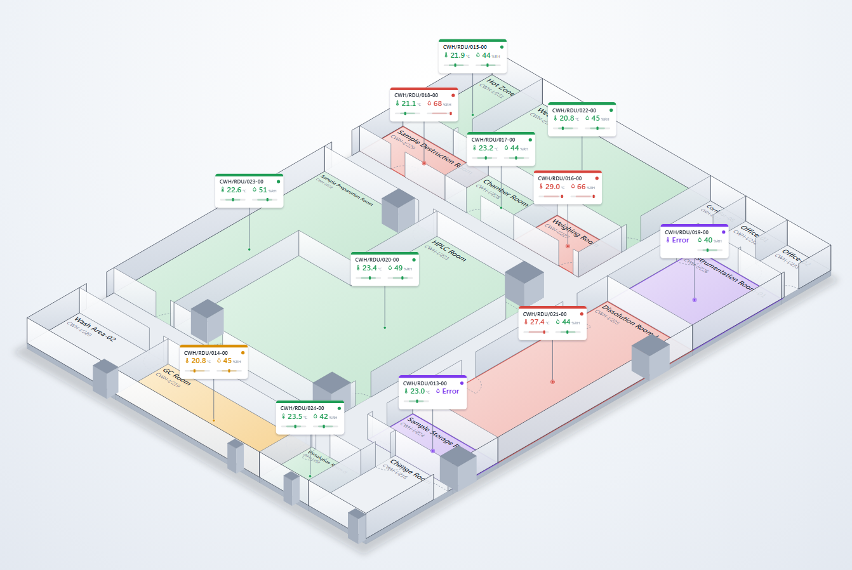
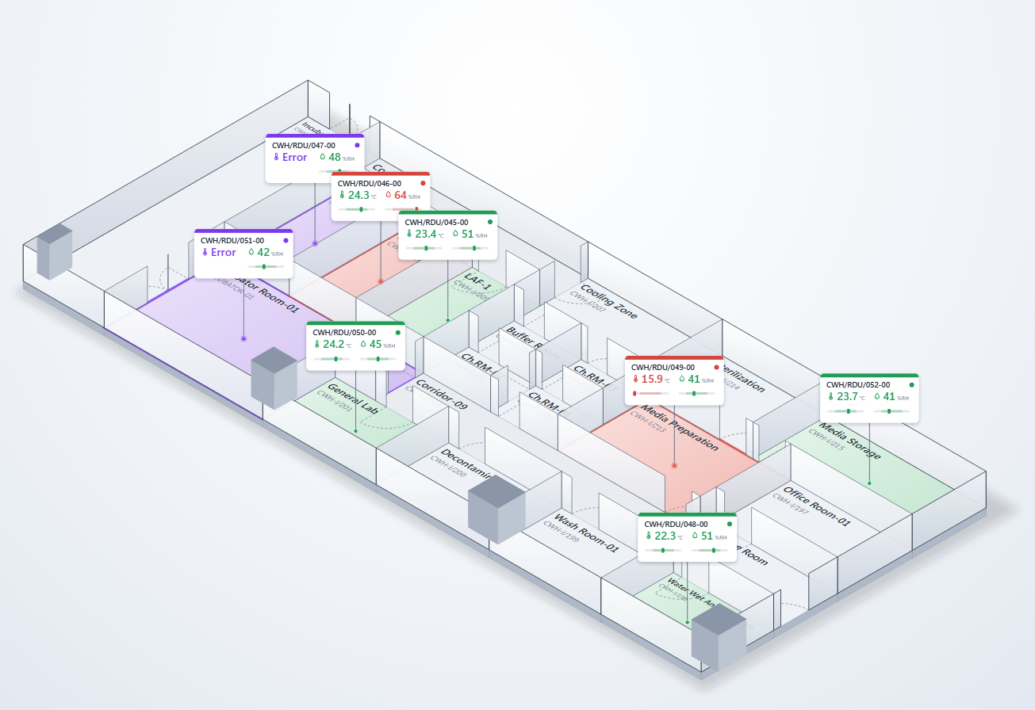
Isometric 2.5D
A fixed bird’s-eye angle drawn in SVG: shaded raised walls, floating cards with limit bars, door swings on the floor, beacons on alarms. 3D feel with no interaction.
Best for
Depth without a mouse — fine on a wall screen
No library, no graphics card, prints well
Every card legible at one angle
Trade-offs
Far rooms sit behind near walls
Long floors become wide; portrait floors become diamonds
QC
QC Microbiology
Notes:
Isometric 2.5D. Open model-isometric.html in the presentation folder to show it live; switch floors with the tabs; hover a room for its readings and limits.

Slide 9
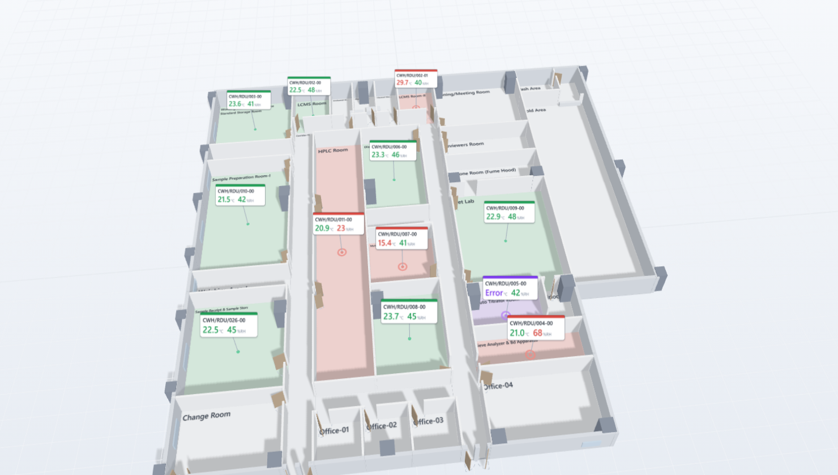
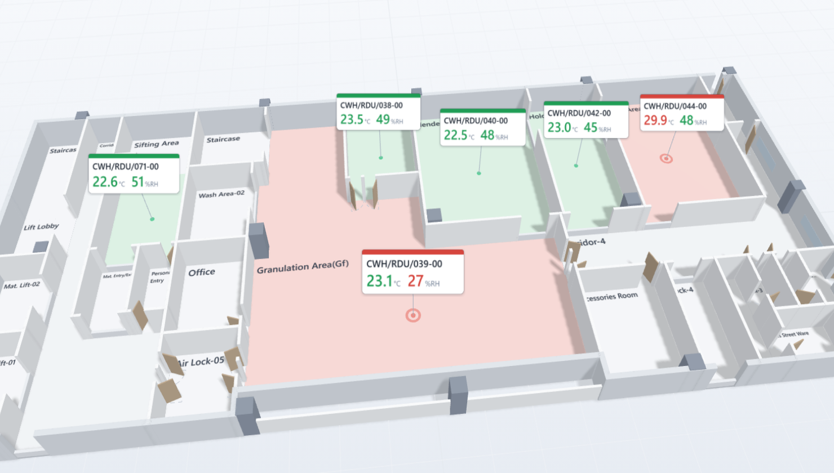
3D interactive
A true 3D model you orbit, zoom and pan. Walls stand up, floors take the status colour, cards float above rooms, alarm rooms get a beacon and a pulsing ring, hover shows the reading and its limits.
Best for
Rooms read as spaces, not boxes
Strong in a demo; a visitor can explore it
Several floors can be stacked later
Trade-offs
Needs a graphics-capable PC and a mouse
Cards overlap in dense areas until you zoom
QC 3
Module-F — Ground Floor
Notes:
3D interactive. Open model-3d.html in the presentation folder to show it live; switch floors with the tabs; hover a room for its readings and limits.

Slide 10
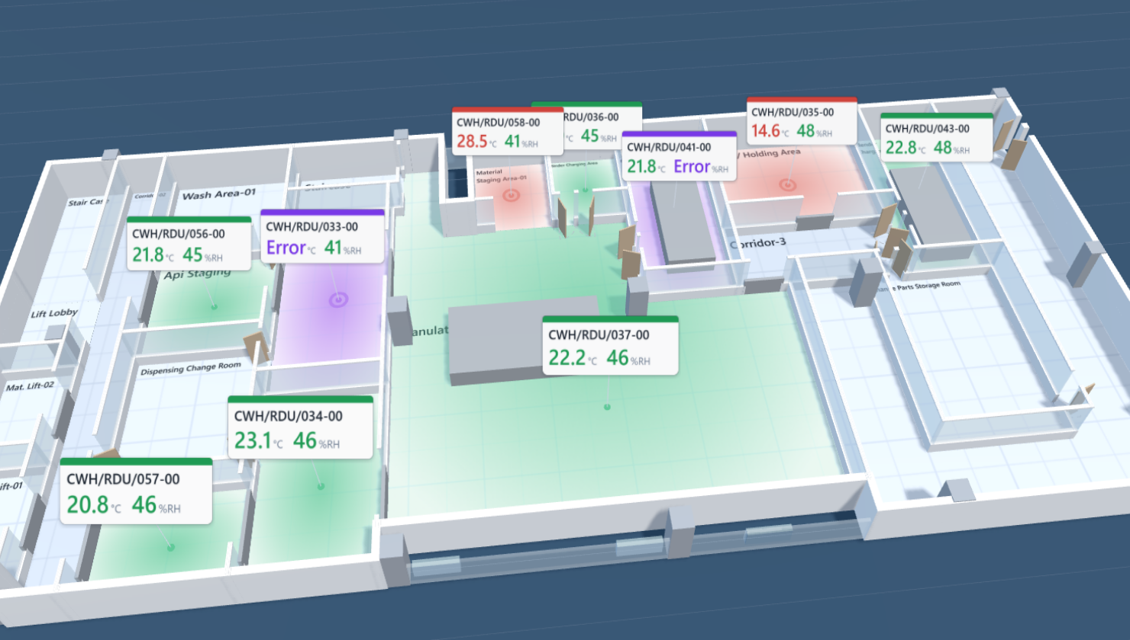
Digital twin 3D
The 3D model dressed as a digital twin: glass partitions on low sills, tiled floors, metallic equipment, status glowing out from each instrument, a slow turntable that stops when you take the mouse.
Best for
The showpiece — reception, visitor area, management review
Status glows read from a distance
Still the same data and hover detail as the plain 3D
Trade-offs
Needs a graphics-capable PC
Glass and glow trade some legibility for looks
QC 3
Module-F — First Floor
Notes:
Digital twin 3D. Open model-twin.html in the presentation folder to show it live; switch floors with the tabs; hover a room for its readings and limits.

Slide 11
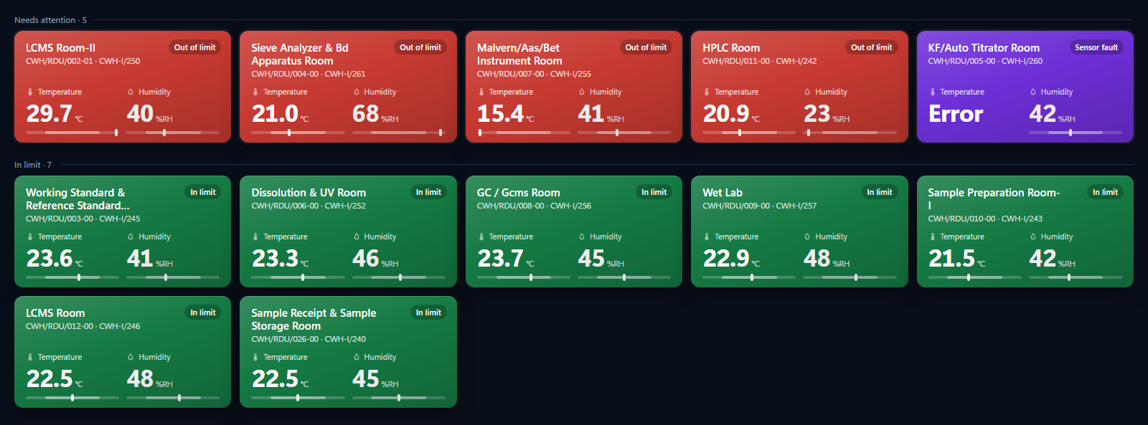
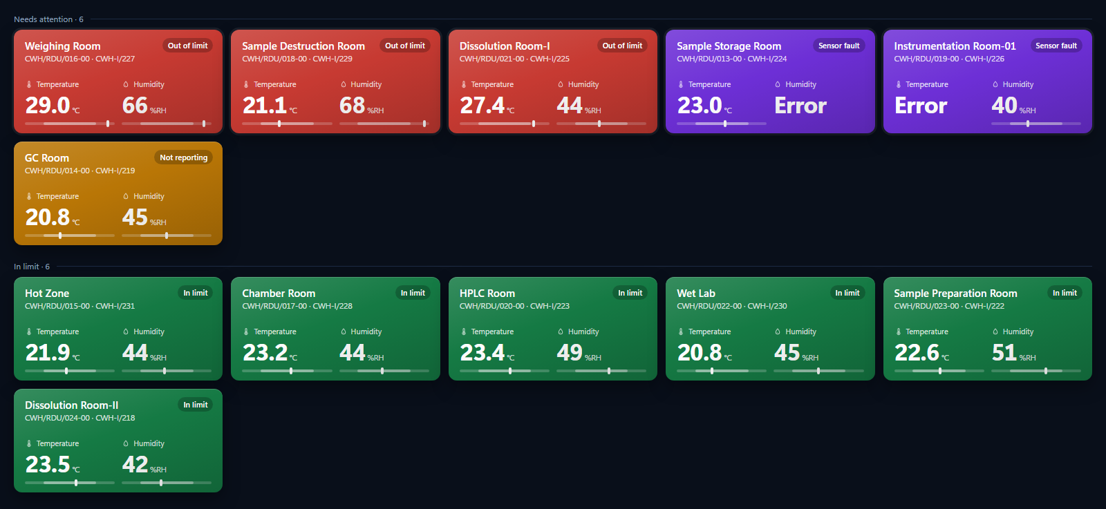
Tile wall
No floor plan at all: one large tile per instrument with the room, the ID, two big numerals and limit bars, alarms grouped first. Built for a wall screen read from ten metres.
Best for
Largest numerals of any model
Alarms sort to the top — nothing to hunt for
Works on any screen, including a TV
Trade-offs
No sense of where a room is
Many instruments mean scrolling
QC 3
QC
Notes:
Tile wall. Open model-tiles.html in the presentation folder to show it live; switch floors with the tabs; hover a room for its readings and limits.

Slide 12
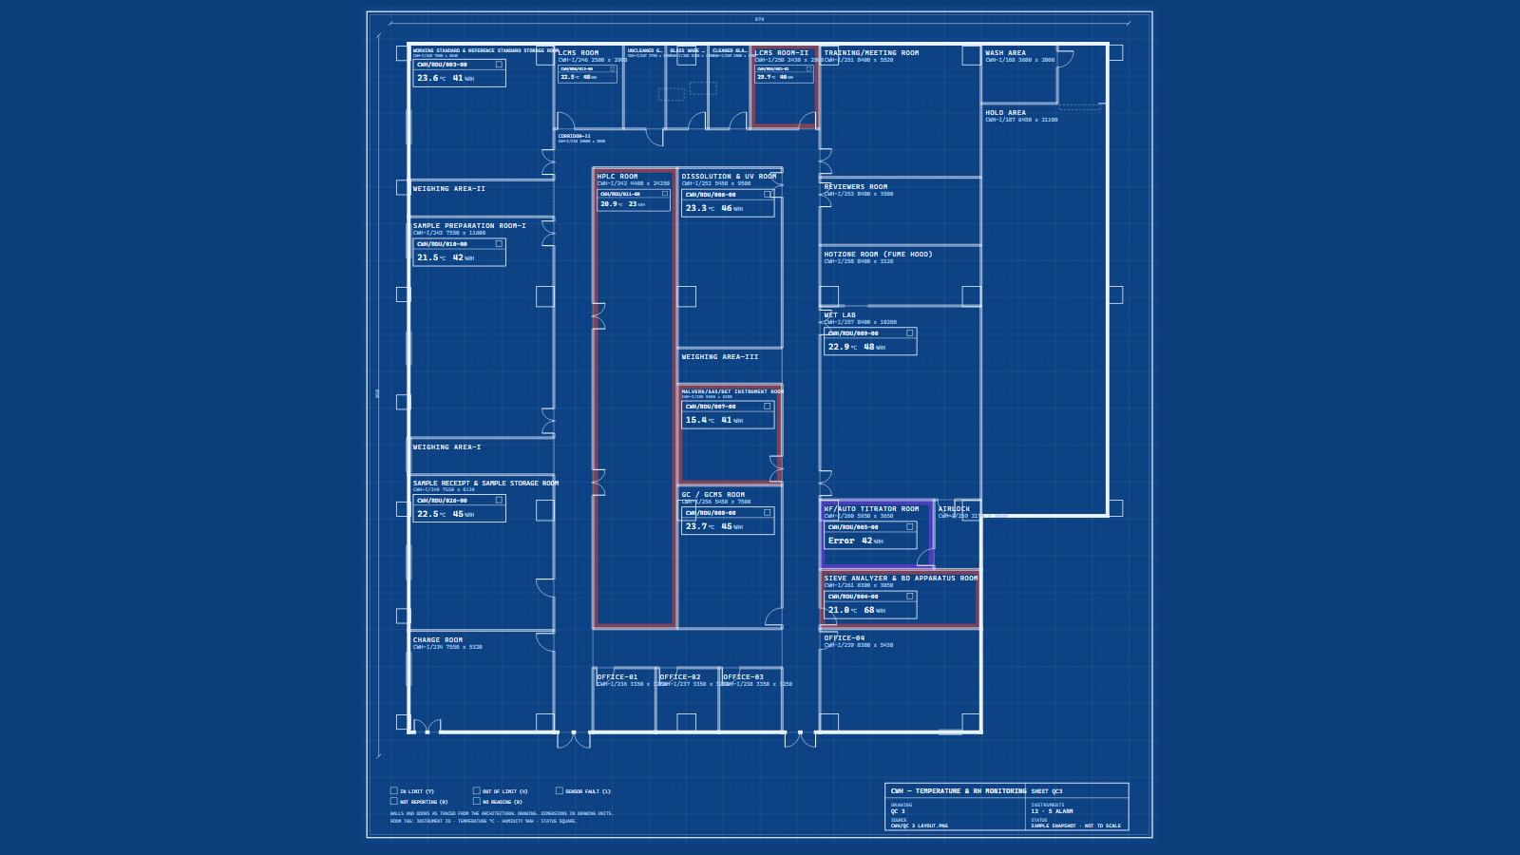
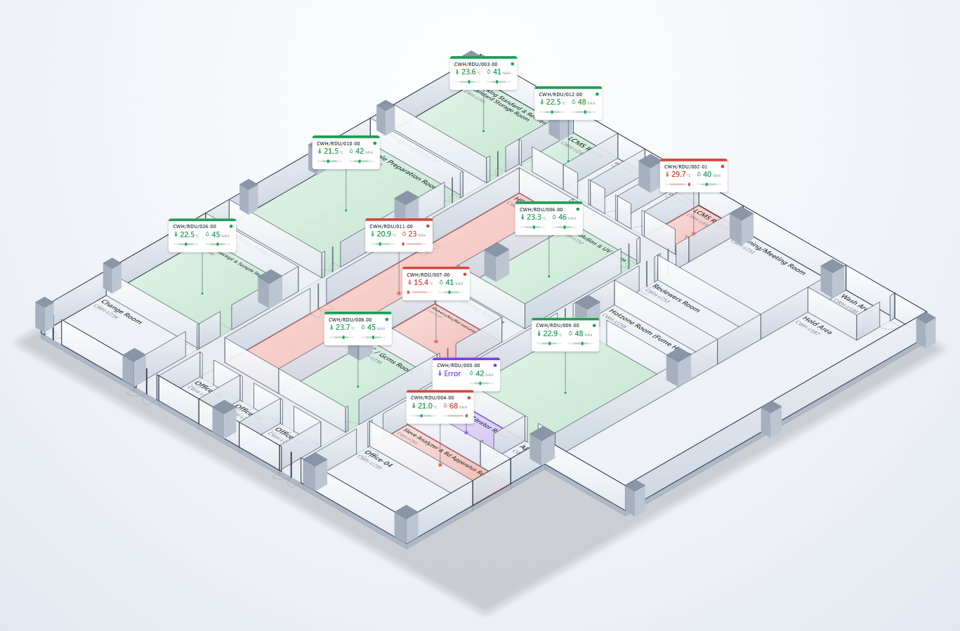
The same floor in all eight models — QC 3
Normal
Thermal heatmap
Blueprint
Dark control room
Isometric 2.5D
3D interactive
Digital twin 3D
Tile wall
Notes:
Side by side on one floor: identical rooms, identical readings, eight treatments.

Slide 13
How they compare
Model | Read at a glance | Alarm stands out | Demo impression | Wall display | Prints / reports | Hardware | Effort to integrate
Normal | ●●● | ●●○ | ●●○ | ●●○ | ●●● | Any PC | Low
Thermal heatmap | ●●● | ●●○ | ●●● | ●●● | ●●○ | Any PC | Medium
Blueprint | ●●○ | ●●○ | ●●○ | ●○○ | ●●● | Any PC | Low
Dark control room | ●●● | ●●● | ●●○ | ●●● | ●○○ | Any PC | Low
Isometric 2.5D | ●●○ | ●●○ | ●●● | ●●● | ●●● | Any PC | Medium
3D interactive | ●○○ | ●●○ | ●●● | ●○○ | ●○○ | Graphics PC | High
Digital twin 3D | ●○○ | ●●● | ●●● | ●●○ | ●○○ | Graphics PC | High
Tile wall | ●●● | ●●● | ●○○ | ●●● | ●●○ | Any PC, TV | Low
● more ○ less — a working assessment to discuss, not a measurement. "Effort" = work to put the model on the live dashboard.
Notes:
A frank comparison. Dark and tile wall for a control-room wall; normal and heatmap for everyday use; the twin and 3D for demos and visitors; blueprint for the engineering office.

Slide 14
What we need from you
1
Choose a model
One primary model for the dashboard’s graphical view. A second may be kept as a toggle (for example dark or tile wall for the wall, normal or heatmap for desks).
2
Tell us the screen
Office monitor, control-room wall, or tablet — it decides the default and whether 3D is practical.
3
We integrate it
The chosen model replaces or joins the 2D view on the live dashboard, reading live data; the floors, doors and instruments are already in place.
4
Review on live data
A review on the plant’s own readings before sign-off; the other models stay available as standalone pages.
Notes:
Close on the decision. All four pages are in Layouts/presentation — open index.html to show any of them live during the discussion.

