Slide 1
ConvDeck: Conversational Paper-to-Slide Generation via Stage-Specific User Feedback
Tarik Can Ozden, Sachidanand VS, Furkan Horoz, Ozgur Kara, Dilek Hakkani-Tür, Junho Kim, James M. Rehg

Slide 2
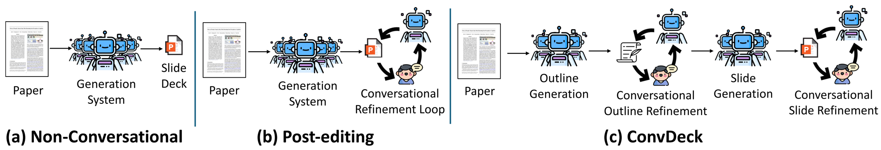
01
Motivation & Gap: From Single-Pass Slides to Conversational Control
Paper-to-slide generation demands adaptable narratives and emphasis for diverse audiences.
Single-pass and post-hoc edits leave structural issues unresolved early in the pipeline.
Internal critics miss user-specific goals and presentation context during planning.
Multi-stage design enables earlier intervention on outline and content allocation.
Conversational control targets better alignment with presenter goals.

Slide 3
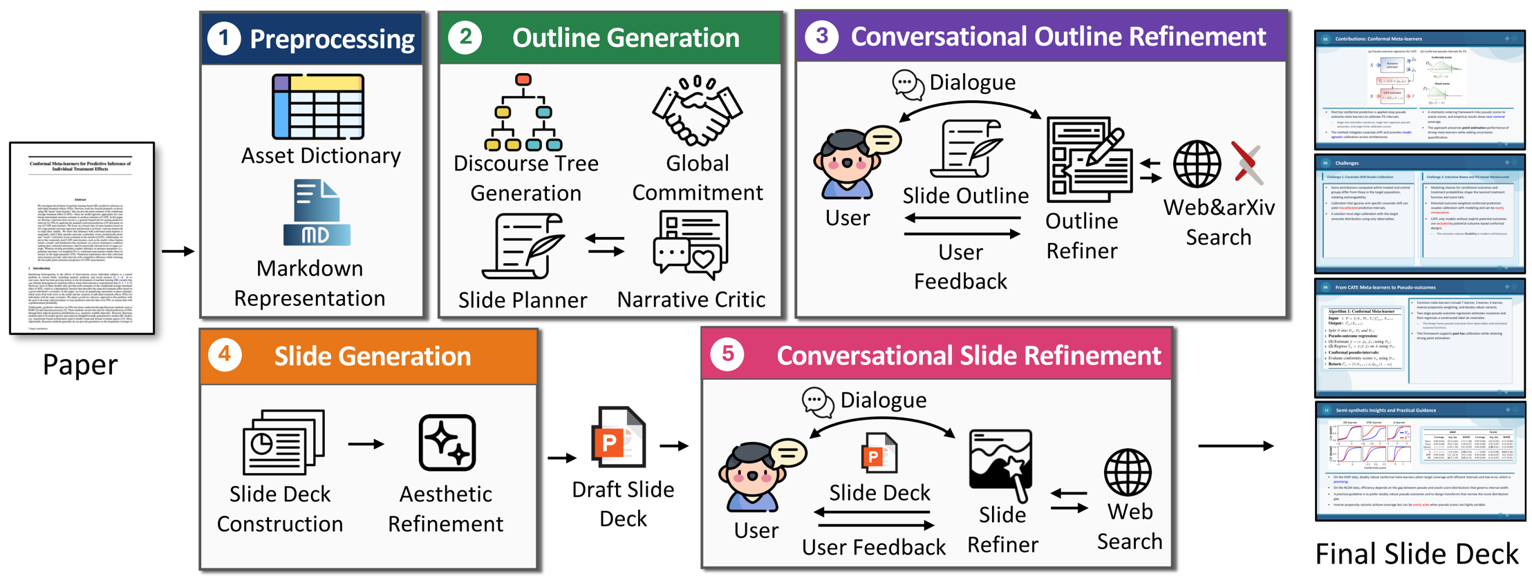
02
Introducing ConvDeck: Multi-Agent, Stage-Specific Conversational Refinement
Two conversational loops operate at outline refinement and slide refinement stages.
Agents reason, ask, and edit using a think, speak, and act protocol.
Evaluation covers slide quality and user-goal satisfaction without sacrificing coherence.
Stage-aligned feedback enables fine-grained control with localized edits.
Structured interactions improve goal fulfillment across diverse categories.

Slide 4
03
Related Work: Agentic Pipelines vs. Post-hoc Conversational Editing
Prior systems span non-interactive pipelines, post-hoc editors, and personalization methods.
Template/reference-driven; narrative/discourse-centered; critique–revise loops; personalization; posters/videos.
ConvDeck uniquely routes feedback to the most effective stage for impact.
Our positioning emphasizes stage-aligned loops and coherent refinement.
Evaluation extends beyond quality to user-goal satisfaction and alignment.
Conversational editing after rendering often shows limited structural leverage.

Slide 5
04
System & Pipeline: Five Stages + Key Components
Five stages progress from preprocessing to conversational slide refinement with clear outputs.
Structured JSON paired with PPTXGenJS enables precise and reversible edits.
Outline interaction precedes rendering to shape narrative and coverage effectively.
Slide interaction polishes content, layout, and assets after materialization.
Two refinement loops support stable iteration with low edit cost.

Slide 6
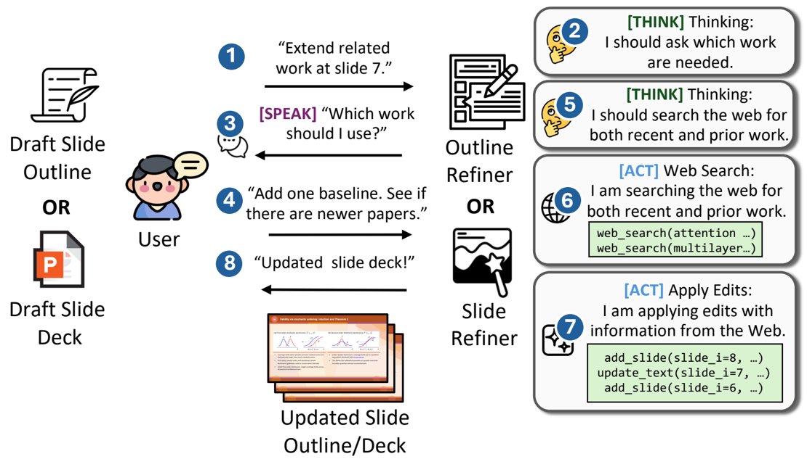
05
Mechanisms: Think–Speak–Act and Local Edit Operations
Outline operations include add, edit, split, merge, remove, and reorder with optional retrieval.
Slide operations include insert, delete, modify, layout adjustments, and typography tuning.
Think–Speak–Act enables clarification or immediate local edits.
Rendered previews guide fixes for overflow and layout crowding.
Structured edits maintain revision stability across refinement rounds.

Slide 7
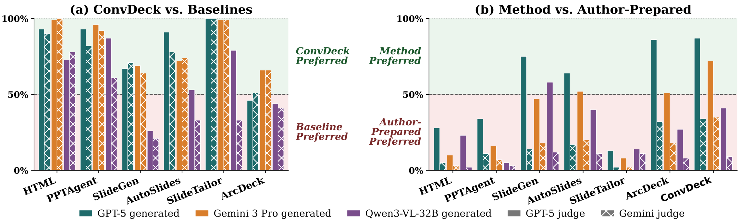
06
Baselines, Dataset, and Protocol
Comparisons include non-conversational and post-hoc conversational baselines on ArcBench.
ArcBench provides 100 paper and slide pairs with cross-judge evaluation to limit bias.
Up to five refiner and user rounds proceed with early stopping for efficiency.
Multiple backbones and cross-judging reduce self-preference bias.
Success rate measures the fraction of runs that render a complete deck.
Baselines: HTML, PPTAgent, SlideGen, SlideTailor, ArcDeck; conversational: ConvHTML, AutoSlides.

Slide 8
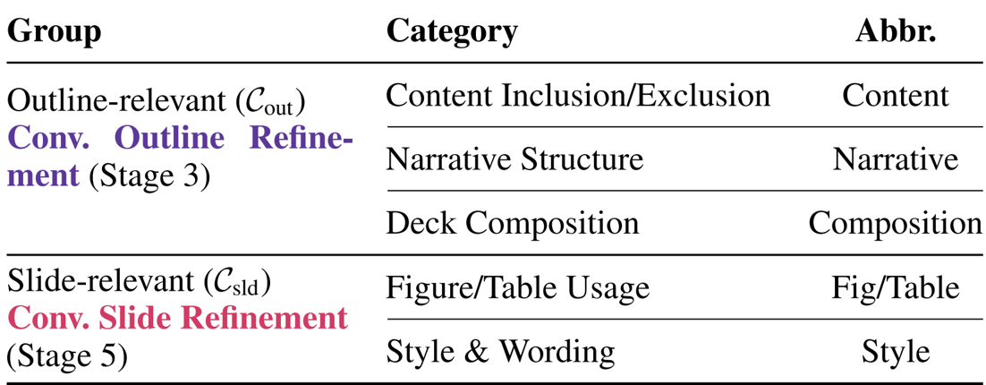
07
Evaluating User-Goal Satisfaction: Goals, Categories, and Alignment
Stage-aligned refinement is hypothesized to better meet presenter-specific requirements.
Goals map to outline categories and slide categories for targeted evaluation.
Evaluation emphasizes verifiable goals and clear alignment signals.

Slide 9
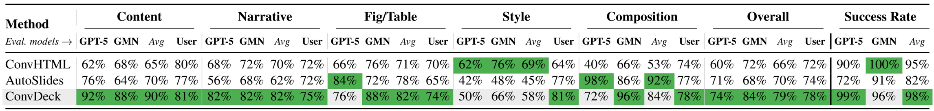
08
Study 1: Does Conversational Refinement Close Unmet Goals?
ConvDeck satisfies 79%, versus ConvHTML at 72% and AutoSlides at 70%.
Performance is strong on content, narrative, figures and tables, and composition while style remains harder.
Success rate remains high across backbones with stable rendering outcomes.
Category gains reflect propagated fixes from outline into final slides.
Residual style gaps indicate surface-level challenges under constraints.

Slide 10
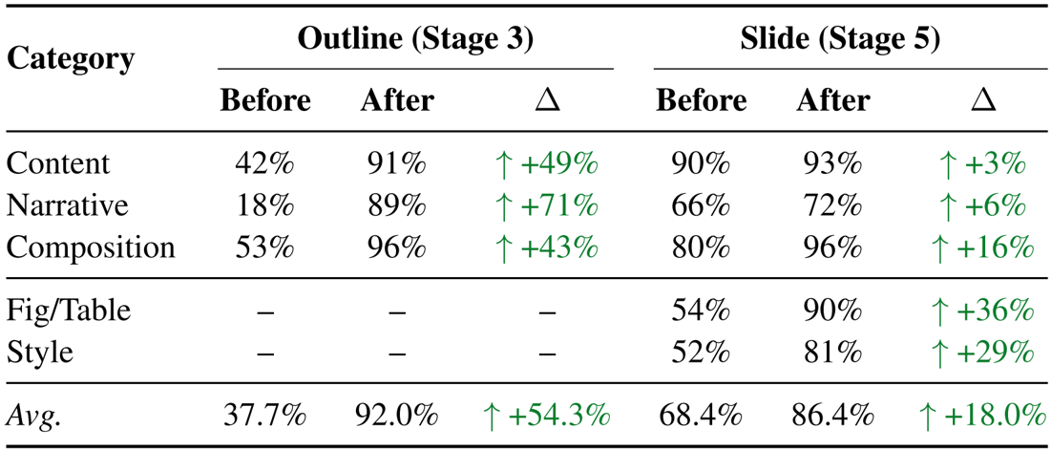
09
Stage-wise Gains: Outline vs. Slide Refinement
Outline refinement delivers large improvements in narrative and content planning.
Slide refinement boosts presentation aspects including figures, tables, and style.
Complementary stages combine structural gains with visual polish.
Composition benefits appear at both outline and slide phases.
Targeted loops reduce misplaced edits that undermine coherence.
Narrative +71, Content +49, Fig/Table +36, Style +29.

Slide 11
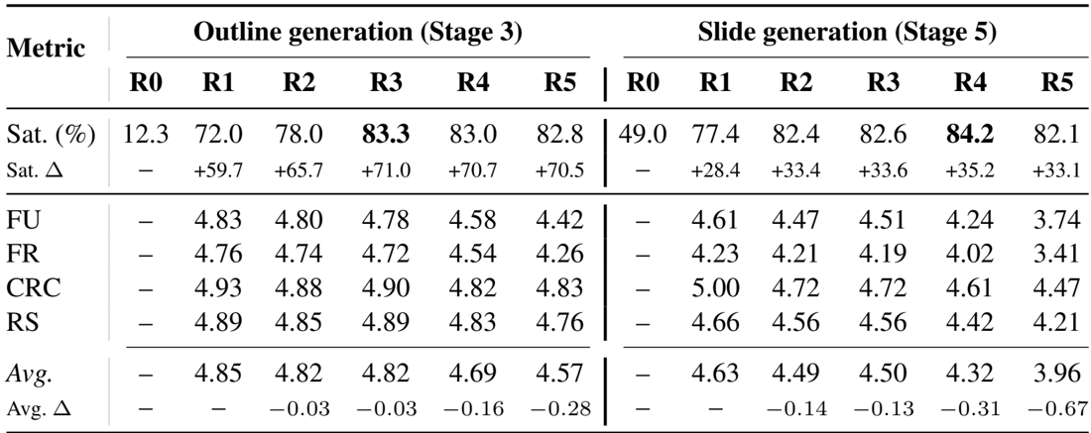
10
Round Dynamics: Rapid Early Gains and Stability
Early rounds achieve most gains with diminishing returns in later interaction.
High consistency and stability persist across consecutive rounds of refinement.
Conversation quality remains strong despite slight later-round decline.
Front-loaded progress provides efficient convergence on goals.
Extended rounds can introduce minor drift without added benefit.

Slide 12
11
Overall Quality: Preference vs. Baselines and Author-Prepared
ConvDeck is preferred over baselines with strong backbones under cross-judging.
Quality approaches author-prepared decks while weaker backbones converge near parity.
Backbone strength modulates preference with larger margins on top-tier models.
Pairwise wins signal robust narrative and clear visuals.
Judging artifacts may cause reference bias against generated decks.

Slide 13
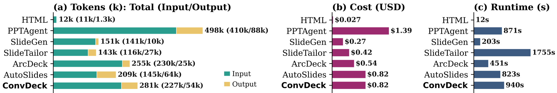
12
Compute Footprint: Cost and Runtime
Token cost remains moderate and competitive with comparable baselines.
Runtime overhead stays modest relative to added interactive capability.
Structured JSON enables low-cost edits across iterative rounds.
Overall footprint reflects balanced tradeoffs between quality and speed.
Repeated reads introduce overhead mitigated by localized changes.
Tokens per paper: 281k; cost approx $0.82; runtime 940 s; ArcDeck 451 s

Slide 14
13
Conclusion: Stage-Aligned Conversation Improves Slide Generation
Two-loop conversational design improves user-goal satisfaction over post-hoc editing.
Quality and cost-effectiveness are maintained across backbones and settings.
Stage-specific refinements provide coherent decks with targeted changes.
Outline-first control propagates structural improvements through rendering.
Slide-level polishing finalizes clarity, layout, and asset choices.

Slide 15
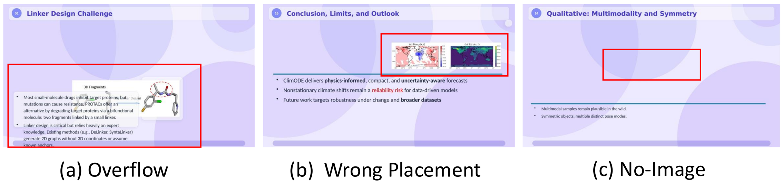
14
Limitations & Scope
Heavy reliance on an LLM simulator requires broader human evaluation for robustness.
Layout sensitivity and backbone dependence reduce consistency on weaker models.
Prototype state needs engineering hardening before production deployment.
Visual inspection may miss rare overflow or crowding edge cases.
Open-model gaps highlight performance variance across settings.

Slide 16
Thank You
Questions & Discussion

