Slide 1
The Hadoop
Presented by Manoranjan Biswal
9/21/2015

Slide 2
Outline
Architecture revisited
Map reduce
Job Tracker
Task Tracker
Daemon Process
Re-cap

Slide 3
Architecture revisited
Namenode
Metadata(Name, replicas..)
(/home/foo/data,6. ..
Metadata ops
Client
Block ops
Read
Datanodes
Datanodes
B
replication
Blocks
Rack1
Write
Rack2
Client

Slide 4
Map + Reduce
Map:
Accepts input key/value pair
Emits intermediate key/value pair
R
E
D
U
C
E
Reduce :
Accepts intermediate key/value* pair
Emits output key/value pair
Very
big
data
M
A
P
Partitioning
Function
Result

Slide 5
Map Reduce View
Namenode
Job Tracker
Rack1 / Datanodes
Rack2 / Datanodes
B
Process
Task tracker

Slide 6
Daemons Revisited
Hadoop is comprised of five separate daemons.
Daemons run on Master nodes (3):
NameNode
Secondary NameNode (Performs housekeeping functions for the NameNode)
JobTracker (Manages MapReduce jobs, distributes individual tasks to machines running the Task Tracker)
Daemons run on Slave nodes (2)
DataNode (Stores actual HDFS data blocks)
TaskTracker (Responsible for instantiating and monitoring individual Map and Reduce tasks)
Note: Each of these daemon runs in its own JVM.

Slide 7
Daemons ..
JobTracker
JobTracker is responsible for taking in requests from a client and assigning TaskTrackers with tasks to be performed.
Note: The JobTracker tries to assign tasks to the TaskTracker on the DataNode where the data is locally present (Data Locality). If that is not possible it will at least try to assign tasks to TaskTrackers within the same rack. If for some reason the node fails the JobTracker assigns the task to another TaskTracker where the replica of the data exists since the data blocks are replicated across the DataNodes. This ensures that the job does not fail even if a node fails within the cluster.
TaskTracker
TaskTracker is a daemon that accepts tasks (Map,Reduce and Shuffle) from the JobTracker.
Note: The TaskTracker keeps sending a heart beat message to the JobTracker to notify that it is alive. Along with the heartbeat it also sends the free slots available within it to process tasks. TaskTracker starts and monitors the Map & Reduce Tasks and sends progress/status information back to the JobTracker.
All the above daemons run within have their own JVMs.

Slide 8
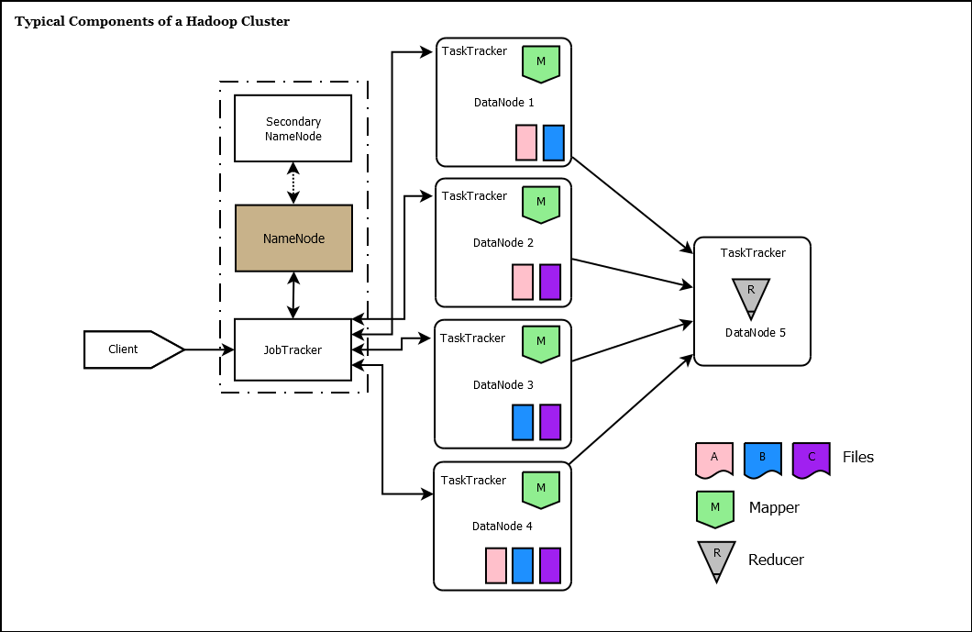
Notes:
In the diagram you see that the NameNode, Secondary NameNode and theJobTracker are running on a single machine. Usually in production clusters having more that 20-30 nodes, the daemons run on separate nodes.

Slide 9
Re-cap
NameNode
The NameNode in Hadoop is the node where Hadoop stores all the location information of the files in HDFS.
It holds the metadata for HDFS. Whenever a file is placed in the cluster a corresponding entry of it location is maintained by the NameNode.
So, for the files A, B and C we would have something as follows in the NameNode:
File A – DataNode1, DataNode2, DataNode4
File B – DataNode1, DataNode3, DataNode4
File C – DataNode2, DataNode3, DataNode4
This information is required when retrieving data from the cluster as the data is spread across multiple machines. The NameNode is a Single Point of Failure for the Hadoop Cluster.

Slide 10
Re-cap
Secondary NameNode
IMPORTANT - The Secondary NameNode is not a failover node for the NameNode.
The secondary name node is responsible for performing periodic housekeeping functions for the NameNode.
It only creates checkpoints of the filesystem present in the NameNode.
DataNode
The DataNode is responsible for storing the files in HDFS.
It manages the file blocks within the node.
It sends information to the NameNode about the files and blocks stored in that node and responds to the NameNode for all filesystem operations.

Slide 11
Re-cap
1. The secondary namenode instructs the namenode to roll its edits file and begin writing to edits.new.
2. The secondary namenode copies the namenode’s fsimage and edits files to its local checkpoint directory.
3. The secondary namenode loads fsimage, replays edits on top of it, and writes a new, compacted fsimage file to disk.
4. The secondary namenode sends the new fsimage file to the namenode, which adopts it.
5. The namenode renames edits.new to edits.

Slide 12
Re-cap
Hadoop uses HDFS to store files efficiently in the cluster.
When a file is placed in HDFS it is broken down into blocks, 64 MB block size by default.
These blocks are then replicated across the different nodes (DataNodes) in the cluster.
The default replication value is 3, i.e. there will be 3 copies of the same block in the cluster.
A Hadoop cluster can comprise of a single node (single node cluster) or thousands of nodes.

Slide 13
Map reduce work flow
A typical (simplified) flow in Hadoop is a follows:
A Client (usaually a MapReduce program) submits a job to theJobTracker.
The JobTracker get information from the NameNode on the location of the data within the DataNodes. The JobTracker places the client program (usually a jar file along with the configuration file) in the HDFS. Once placed, JobTracker tries to assign tasks to TaskTrackers on the DataNodes based on data locality.
The TaskTracker takes care of starting the Map tasks on the DataNodesby picking up the client program from the shared location on the HDFS.
The progress of the operation is relayed back to the JobTracker by theTaskTracker.
On completion of the Map task an intermediate file is created on the local filesystem of the TaskTracker.
Results from Map tasks are then passed on to the Reduce task.
The Reduce tasks works on all data received from map tasks and writes the final output to HDFS.
After the task complete the intermediate data generated by theTaskTracker is deleted.

Slide 14
hadoop fs -ls
hadoop fs -put <path_of_local> <path_in_hdfs>
hadoop fs -get <path_in_hdfs> <path_of_local>
hadoop fs -cat <path_of_file_in_hdfs>
hadoop fs -rmr <path_in_hdfs>

