Slide 1
Internship Presentation
Wissem Yousfi

Slide 2
Plan
Introduction
BIRD dataset
CHESS method
Results
Experiments
Error Analysis

Slide 3
Introduction
During my internship, I’ve been working on implementing and improving a Text2SQL pipeline using the CHESS method ,
Aimed at making easier to convert human language into SQL queries,
This work is critical because it addresses the need for more intuitive and user-friendly ways to interact with databases accessible for all people,
The primary objective of my internship has been to implement the CHESS method with comparable accuracy and enhance its limitations,

Slide 4

BIRD dataset
BIRD-SQL is a cross-domain large-scale benchmark that addresses gaps in existing Text-to-SQL benchmarks (Spider,WikiSQL)by focusing on both database schema and content,
BIRD-SQL is distinguished by its large dataset, which includes 12,751 text-to-SQL pairs, 95 databases encompassing 37 professional domains, and a total size of 33.4 GB.
The task in BIRD is represented by its db_id(the name of the related database),question_id,question,evidence(the external knowledge evidence annotated by experts),SQL(Ground truth SQL),difficulty(simple,moderate,challenging)

Slide 5
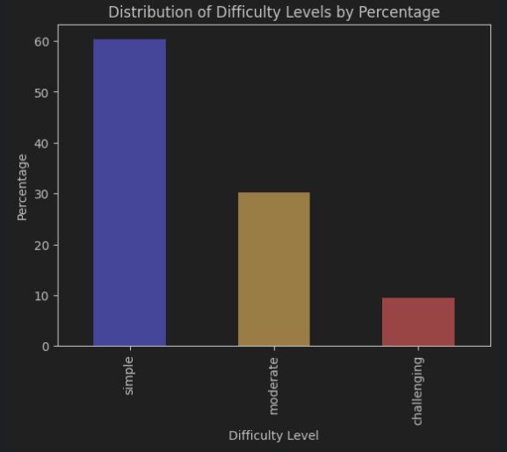
BIRD Dev Set
The BIRD dev set that we will be working on for the tests because the test data is masked.
It contains over 1534 unique question-SQL pairs and 11 big databases.
with the distribution of the question difficulties as follow :

Slide 6
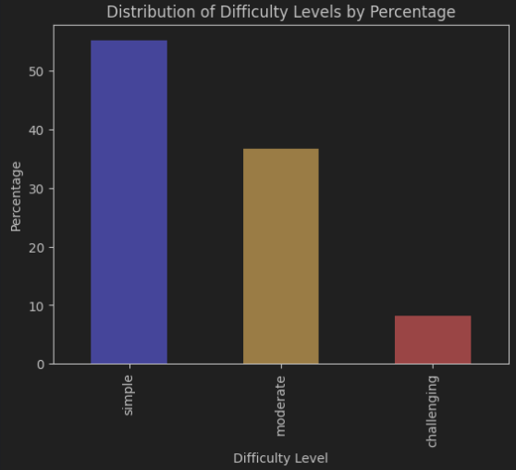
BIRD Dev Set Subsample
To facilitate local tests, reduce costs, and maintain the distribution of the BIRD development set,we subsampled 10% of each database in the development set, resulting in the Subsampled Development Set.
This SDS consists of 147 samples: 81 simple, 54 moderate, and 12 challenging questions.
the subsampled dev set gives mainly the same results as the dev set in the CHESS paper 65% with dev_set and 64.62% with subsampled_dev_set.So we will be reducing the cost of testing while maintaining the same performance

Slide 7
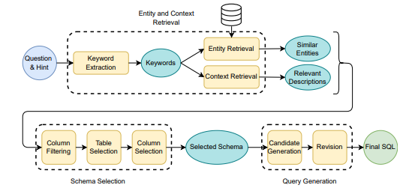
CHESS method

Slide 8
I-Entity and Context Retrieval
The first module in the pipeline identifies the relevant information in the input, including the entities referred to in the question and the contextual information provided about them in the database schema, It has 3 submodules
Keyword Extraction : Extract keywords, keyphrases, and named entities from the natural-language question and the HINT to be used later on in the Entity and Context Retrieval.
Entity Retrieval: From the list of keywords extracted from the question, some may correspond to entities present in the database values.In this step, we search for similar values in the database and return the most relevant ones, along with their corresponding columns, for each keyword.
Context Retrieval: In addition to the values, database catalogs explaining the schema may be available. For instance, each column may have a description, an extended column name (in the case of abbreviations), and a value description. This information can be very useful to generate an efficient SQL query.

Slide 9
II-Schema Selection
Our goal in this step is to narrow down the schema to include only the necessary tables and columns needed for generating the SQL query. Achieving an efficient schema leads to better performance in SQL query generation by excluding irrelevant information.
Column Filtering : A database can contain hundreds of columns, many of which may be semantically irrelevant to the question. Looking for an efficient schema, we aim to filter out the irrelevant columns and pass only the most relevant ones to the table selection step.
Table Selection: Select only the essential tables for generating the final SQL query,
Column Selection : In the final step of schema selection, we aim to reduce the schema to the minimal set of columns necessary for generating the SQL query.

Slide 10
III-Query Generation
At this point, we have selected an efficient schema augmented by the relevant context, containing all the necessary information to craft a SQL query that answers the question.
Candidate Generation: Generate the candidate SQL query that answers the question.
Revision : In the final step of the pipeline, we aim to fix potential logical and syntactic errors in the candidate SQL query.

Slide 11
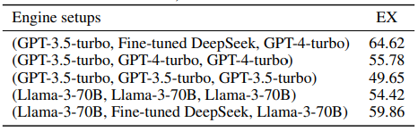
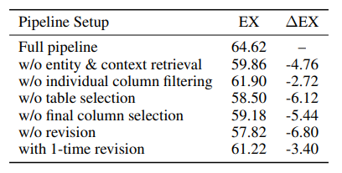
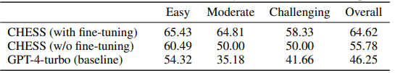
IV-CHESS Studies
1) This table shows the execution accuracy (EX) of different engine setups on the subsampled development set. Each engine setup is represented as a triplet (column filtering, candidate query generation, table/column selection + revision).
2) The execution accuracy (EX) of the pipeline by removing each component on the subsampled dev set.
3) Comparing the performance of CHESS method in two different settings with naively passing all information to GPT-4 across different difficulty levels on the subsampled development set.

Slide 12
Result
Finally I’ve implemented all the modules of the CHESS pipeline successfully,
I run the pipeline with gpt-4-turbo OpenAI api for all modules ,
Note that i run the result without the finetuned model and without column filtering module
Let’s run an example of the pipeline :

Slide 13
"question": "How many accounts were opened in Litomerice in 1996?"
"evidence": "A2 refers to district name; Litomerice is one of district names.“
"SQL": "SELECT COUNT(T2.account_id) FROM district AS T1 INNER JOIN account AS T2 ON T1.district_id = T2.district_id WHERE STRFTIME('%Y', T2.date) = '1996' AND T1.A2 = 'Litomerice’”,
"difficulty": "simple"
Keyword extraction
"accounts", "opened", "Litomerice", "1996", "district name“, "A2", "district names"
|-- district :
a16 :
-"column_name": "no. of committed crimes 1996"
-"column_description": "no. of committed crimes 1996"
-"value_description": "“
a2 :
-"column_name": “district_name"
-"column_description": “district_name"
-"value_description": "“
|-- account :
date :
-"column_name": “date"
-"column_description": “the creation date of the account"
-"value_description": “in the form YYMMDD“
Entity retrieval
Similar columns:
|-- trans: account, |-- district : A2
Similar values:
|-- district : A2 : [ "Litomerice" ]
Context retrieval
Table selection
Selected tables:
|-- account
|-- district

Slide 14

Column selection
Selected Columns:
|-- account : [account_id , district_id , date]
|-- district : [district_id , A2]
Candidate generation
SELECT COUNT(*) FROM account AS T1 JOIN district AS T2 ON T1.district_id = T2.district_id WHERE T2.A2 = 'Litomerice' AND strftime('%Y', T1.date) = '1996';
Revision
SELECT COUNT(*) FROM account AS T1 JOIN district AS T2 ON T1.district_id = T2.district_id WHERE T2.A2 = 'Litomerice' AND strftime('%Y', T1.date) = '1996';

Slide 15
 | Simple | Moderate | Challenging | All
Num examples | 81 | 54 | 12 | 147
Execution Accuracy | 58,0% | 63,0% | 50,0% | 59,18%
Distribution of Execution accuracy by difficulty levels

Slide 16
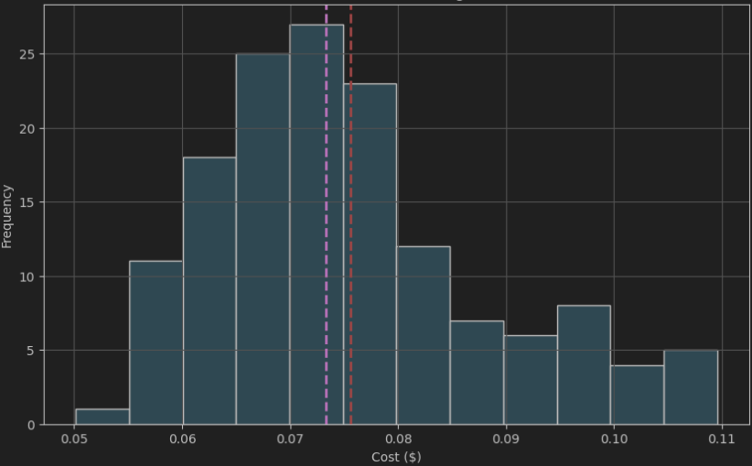
Cost Distribution Diagramm (average cost 0,076$)

Slide 17
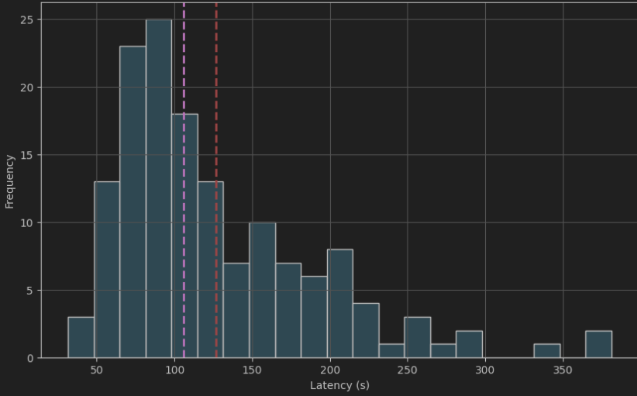
Latency Distribution Diagramm (average latency 126,67s = 2,1 m)

Slide 18
Module | Average Cost ($) | Average Latency (s)
keyword_extraction | 0.000122 | 1.106783
entity_retrieval | 0.000074 | 79.676951
context_retrieval | 0,00000 | 8.816522
table_selection | 0.019616 | 9.501653
column_selection | 0.014896 | 7.772628
candidate_generation | 0.016010 | 10.176176
revision | 0.024910 | 9.412662
Average Cost and Latency for Each Pipeline Module

Slide 19
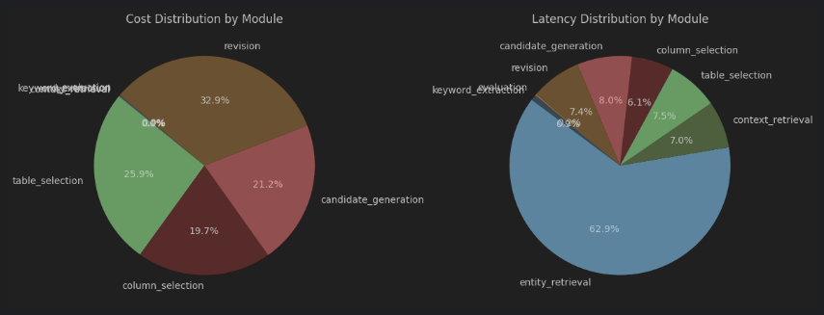
Cost and Latency distribution by module

Slide 20
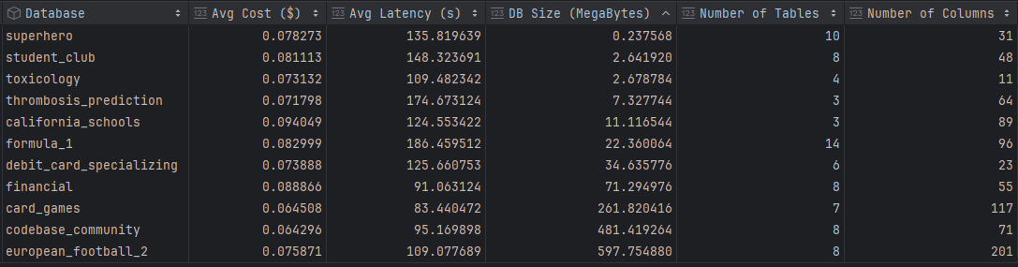
Average Cost and Latency Grouped by Database

Slide 21
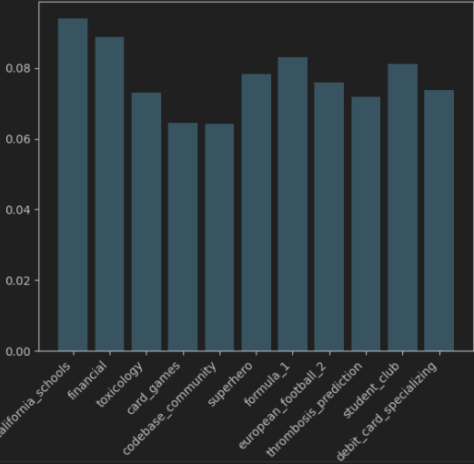
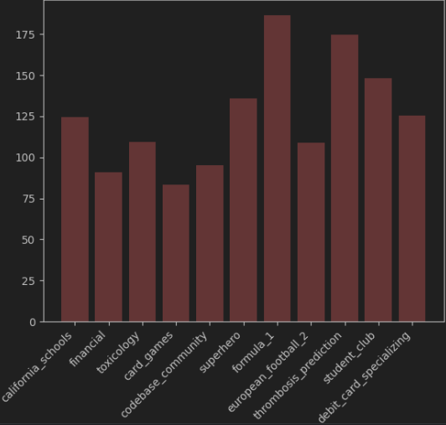
Average cost by database
Average latency by database

Slide 22
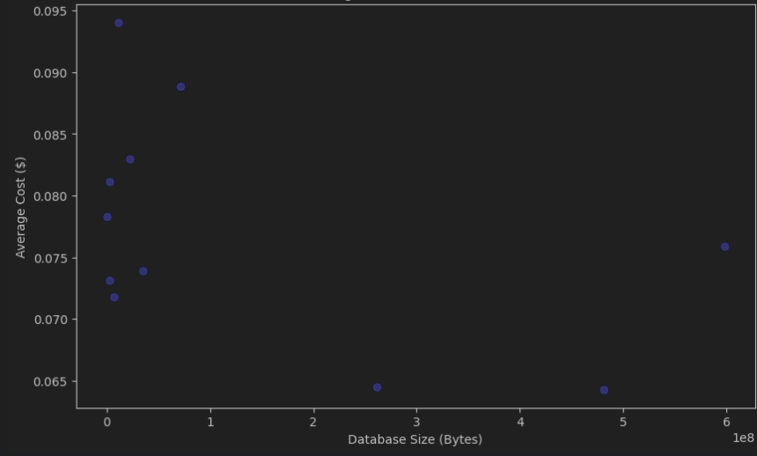
Average cost vs Database size

Slide 23
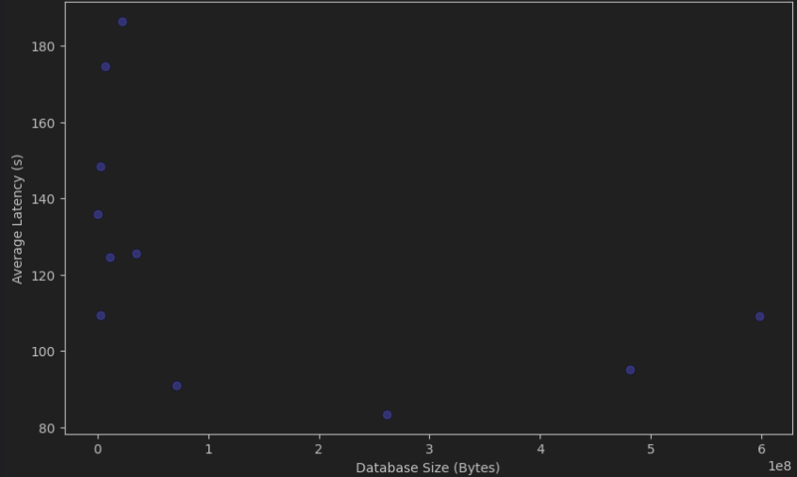
Average latency vs Database size

Slide 24
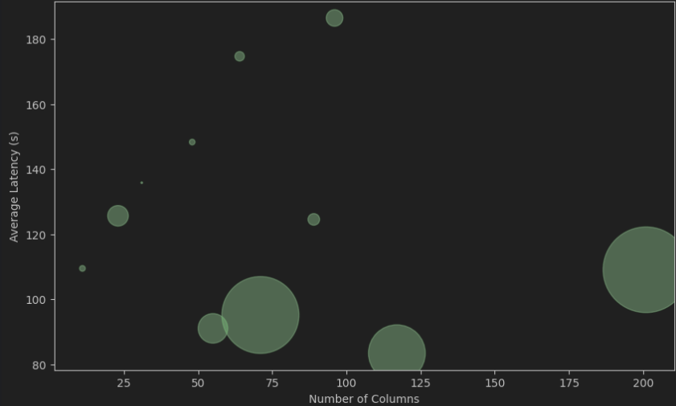
Average latency vs number of columns

Slide 25
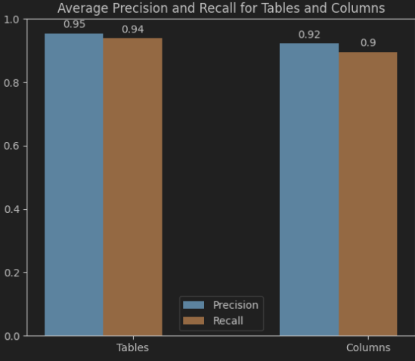
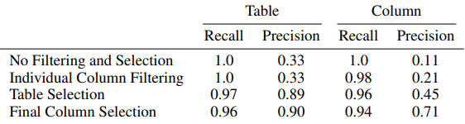
Recall and Precision for schema selection compared to the tables and columns used in correct SQL
CHESS results
Our results

Slide 26
Comments
The pipeline surpasses the results of CHESS, achieving an execution accuracy of 59.18% for the same dev set, compared to CHESS's 55.78% without fine-tuning. This shows a significant improvement of 3.4%.
The latency of the pipeline is notably high, with execution times reaching over 2 to 5 minutes per query. This performance issue must be addressed to improve the usability and efficiency of the system, as such long response times are impractical.
The average cost of processing one query is around $0.076, which may be considered slightly expensive for large-scale applications. Optimizing this cost is necessary to make the solution more affordable.

Slide 27
Experiments
Pipeline with gpt-4o and 3 times revision
Pipeline with gpt-4o and w/o entity retrieval
Pipeline with gpt-4o and optimized entity retrieval
Pipeline with gpt-4o and schema selection fusion

Slide 28
Experiment I
I tried running the pipeline with 3 revision attempts and switched to the GPT-4o model to reduce costs while maintaining performance.

Slide 29
 | Simple | Moderate | Challenging | All
Num examples | 81 | 54 | 12 | 147
Execution Accuracy | 56,8% | 64,8% | 50,0% | 59,18%
Distribution of Execution accuracy by difficulty levels

Slide 30
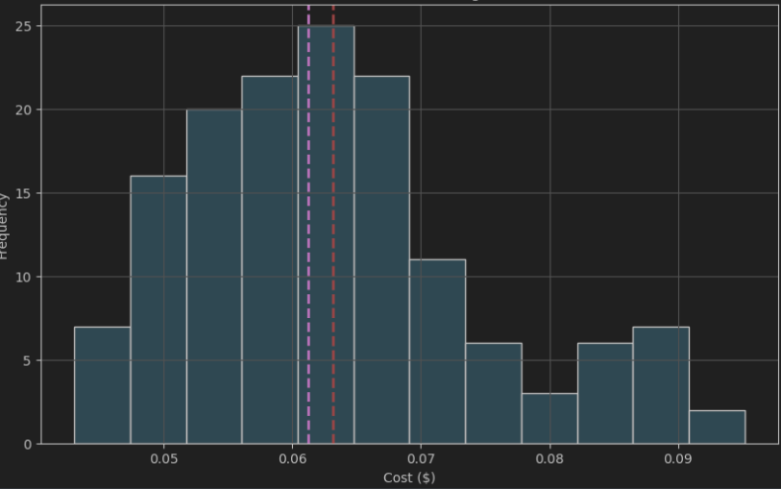
Cost Distribution Diagramm (average cost 0,063$)

Slide 31
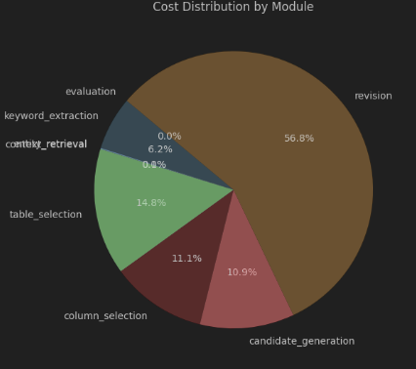
Cost distribution by module

Slide 32
Comments
The pipeline maintains the same performance as the previous version, making it unnecessary to add additional costs by attempting multiple revisions.
The average cost per query has been reduced to $0.063 (down from $0.076), achieving a cost reduction of $0.013 per query without compromising accuracy.
Despite cost reduction, the pipeline adds more latency, with an average query time of 2.5 minutes due to running multiple revision attempts. This further exacerbates the already high latency issue.

Slide 33
Experiment II
Ran the pipeline using GPT-4o while excluding the entity retrieval module to assess performance without this lazy module

Slide 34
 | Simple | Moderate | Challenging | All
Num examples | 81 | 54 | 12 | 147
Execution Accuracy | 54,3% | 55,6% | 50,0% | 54,42%
Distribution of Execution accuracy by difficulty levels

Slide 35
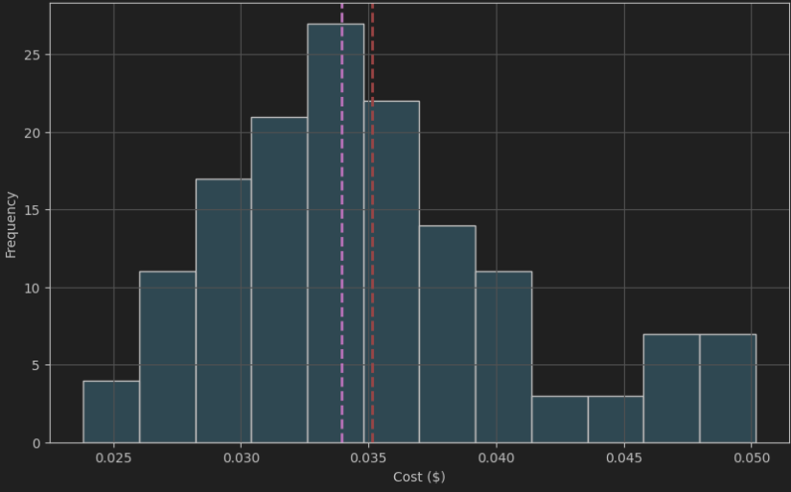
Cost Distribution Diagramm (average cost 0,035$)

Slide 36
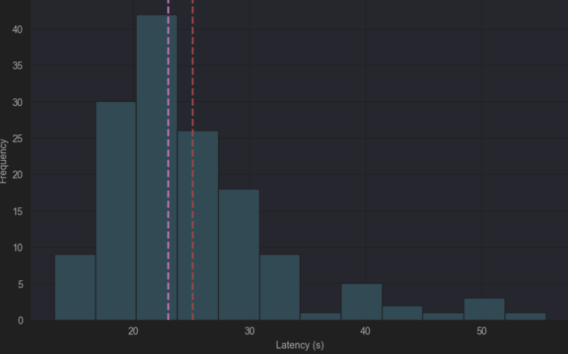
Latency Distribution Diagramm (average latency 25,1 s)

Slide 37
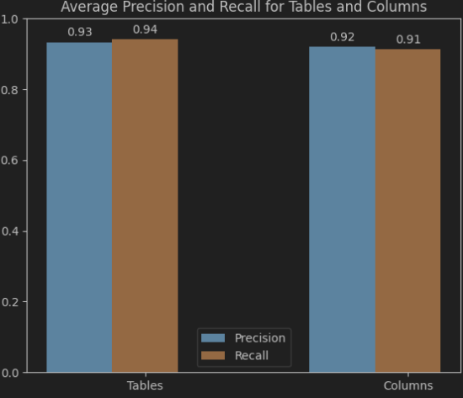
Recall and Precision for schema selection compared to the tables and columns used in correct SQL
Results from the original pipeline
Results for Experiment II

Slide 38
Comments
Removing the entity retrieval module led to a significant performance drop from 59.18% to 54.42%, resulting in a 4.76% decrease, which is not acceptable.
The cost per query decreased to $0.035 after removing unnecessary revision repetitions, making it more cost-effective.
The average latency saw an impressive reduction from 126.67 seconds to 25.1 seconds, a decrease of 101.57 seconds (80,2%). This new execution time is now logical and acceptable.
The schema selection accuracy remained almost unchanged despite removing the entity retrieval module.

Slide 39
Experiment III
The pipeline was run using all modules and GPT-4o, but with optimizations applied specifically to the entity retrieval module. The goal was to reduce its latency while maintaining the same performance.

Slide 40
 | Simple | Moderate | Challenging | All
Num examples | 81 | 54 | 12 | 147
Execution Accuracy | 58,0% | 63,0% | 50,0% | 59,18%
Distribution of Execution accuracy by difficulty levels

Slide 41
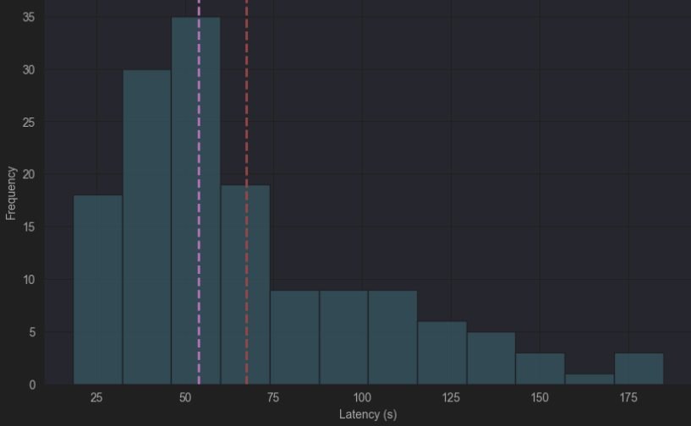
Latency Distribution Diagramm (average latency 67,25 s)

Slide 42
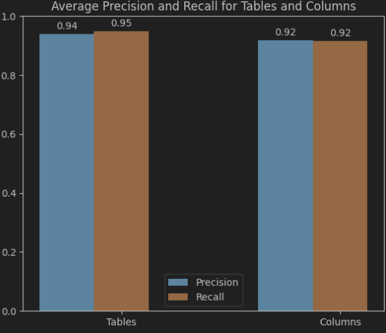
Recall and Precision for schema selection compared to the tables and columns used in correct SQL
Results from the original pipeline
Results for Experiment III

Slide 43
Comments
The optimization done for the entity retrieval module did not affect the performance, which remained consistent.
Latency was reduced from 126.67 seconds to 67.25 seconds, showing a reduction of 59.42 seconds, equivalent to a percentage decrease of 46.9%. This execution time is much more acceptable, with over half of the examples now running in less than or equal to 1 minute.
The schema selection accuracy remained almost unchanged, even with the optimization.
This optimized pipeline appears to be the best choice, considering its balanced performance(59,18%), latency(67,25 s), and cost (0,035$).

Slide 44
Experiment IV
Ran the pipeline with GPT-4o, optimized entity retrieval, and included the schema selection fusion module (a fusion between table and column selection in one module ). Trying to reduce more cost,

Slide 45
 | Simple | Moderate | Challenging | All
Num examples | 81 | 54 | 12 | 147
Execution Accuracy | 54,3% | 63,0% | 50,0% | 57,14%
Distribution of Execution accuracy by difficulty levels

Slide 46
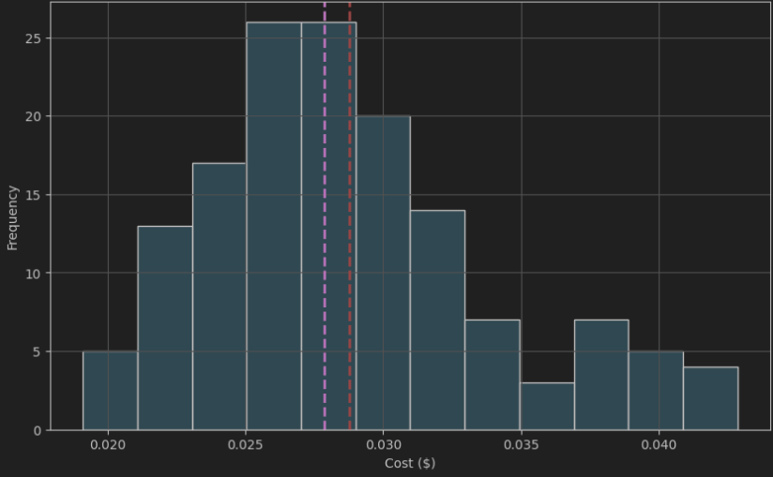
Cost Distribution Diagramm (average cost 0,029$)

Slide 47
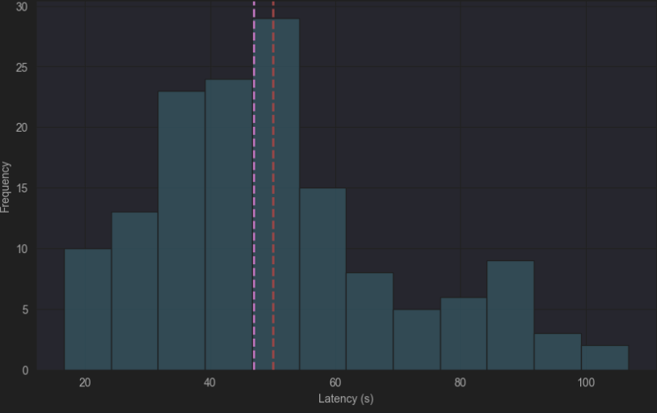
Latency Distribution Diagramm (average latency 50,03s)

Slide 48

Recall and Precision for schema selection compared to the tables and columns used in correct SQL
Results from the experiment III
Results from Experiment IV

Slide 49
Comments
The performance using the schema selection fusion module decreased slightly to 57.14%, with a reduction of 2.04%.
The average cost per query with this fusion dropped to $0.029 from $0.035 in the previous experiment, gaining $0.006. However, this cost reduction is not significant when compared to the performance decrease.
The average latency per query also decreased from 71.87 seconds to 50.03 seconds, with a gain of 21.84 seconds, which is a significant improvement in execution time.
The current question is whether we prioritize the 2% performance loss or the material gains of $0.006 per query and a 21-second reduction in execution time. Should we favor performance, or lean towards optimizing cost and time?

Slide 50
Error Analysis
In the end, we need to understand the reasons behind the errors in the pipeline. I have conducted a detailed analysis of the incorrect tasks,
Let’s explore the causes of these errors together,

Slide 51
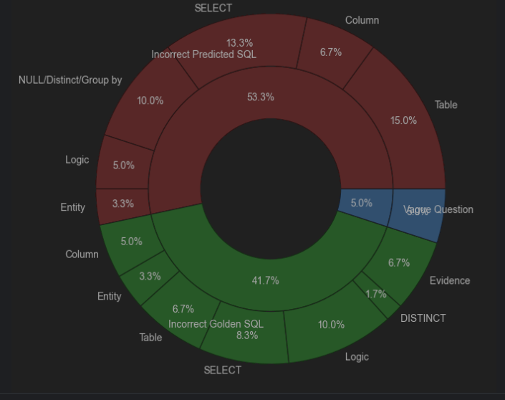
Distribution of errors

Slide 52
Incorrect Predicted SQL
Column : The columns used in the predicted SQL are either missing or incorrect
Table : The tables used in the predicted SQL are either missing or incorrect
Entity : The entity used for filtering is incorrect in the predicted SQL.
NULL/DISTINCT/GROUP BY: Missing or wrong usage of NULL, DISTINCT, or GROUP BY in the predicted SQL,
SELECT : Incorrect selected columns in the SELECT clause ,
Logic : The logic of the query is incorrect,

Slide 53
Incorrect Golden SQL
Column : The columns used in the Golden SQL are either missing or incorrect
Table : The tables used in the Golden SQL are either missing or incorrect
Entity : The entity used for filtering is incorrect in the Golden SQL.
NULL/DISTINCT/GROUP BY: Missing NULL, DISTINCT, or GROUP BY in the Golden SQL,
SELECT : Incorrect selected columns in the SELECT clause ,
Logic : The logic of the query is incorrect,
Evidence: : The gold SQL does not use the evidence correctly or the evidence is incorrect.

Slide 54
Vague Question
The question do not specify which columns should be included in the SELECT statement, making it impossible to determine the correct columns from the provided information and database,
The question do not specify the exact format of the result,
For more details you can access the detailed analysis here :
https://convergenceai.sharepoint.com/:b:/s/ConvergenceAI/EZx0__bcJC5JjMT7ob7l1RMBgqBeEeeUQMP4pjmqK4YqDw?e=vxdOHd

Slide 55
Thank you
Wissem Yousfi​
23115182
wissem.yousfi@insat.ucar.tn
https://www.linkedin.com/in/wissem-yousfi/

