Slide 1
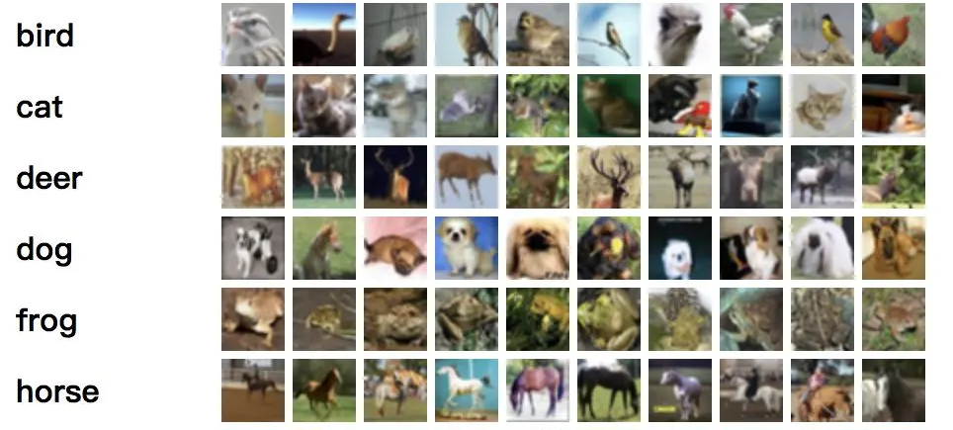
Motivation
Image Classification: Identifying and classifying images into categories
One of the core tasks in computer vision
Image classification is the process of distinguishing different categories of images based on their semantic information. It is a fundamental problem in computer vision and serves as the foundation for other high-level vision tasks such as object detection, semantic segmentation, object tracking, and behavior analysis.
Broad array of applications:
Medical Image Analysis
Scientific Imagery
Intelligent Agriculture
Product Classification
Facial Recognition
Cybersecurity
Industrial Automation
Presenter: Wenjia Du (z5536121)

Slide 2
Problem Statement
Based on the significant demand for fashion shopping, the applications of automated classification of fashion items are extensive:
product categorization
precise product recommendations
fashion style suggestions
search optimization
However, due to the increasing variety and complexity of fashion products’ styles and designs, accurately classifying fashion items is becoming more and more challenging.
This project aims to address this challenge by leveraging deep learning techniques, particularly convolutional neural networks (CNNs), to develop a robust and efficient system for classifying fashion items based on images.
Presenter: Wenjia Du (z5536121)

Slide 3
Literature Review
Hu, W., Huang, Y., Wei, L., Zhang, F., & Li, H. (2015). Deep convolutional neural networks for hyperspectral image classification Journal of Sensors, Volume 2015, Article ID 258619, 12 pages. http://dx.doi.org/10.1155/2015/258619
Meshkini, K., Platos, J. and Ghassemain, H., 2020. An analysis of convolutional neural network for fashion images classification (fashion-mnist). In Proceedings of the Fourth International Scientific Conference “Intelligent Information Technologies for Industry”(IITI’19) 4 (pp. 85-95). Springer International Publishing.
Xin, J., Yi, T.J., Yi, V.P., Yu, P.J. and Salam, Z.A.A., 2023. Convolutional Neural Network for Fashion Images Classification (Fashion-MNIST). Journal of Applied Technology and Innovation (e-ISSN: 2600-7304), 7(4), p.11.
Presenter: Wenjia Du (z5536121)

Slide 4
Literature Review
Hussain, M., Bird, J.J., Faria, D.R. (2019). A Study on CNN Transfer Learning for Image Classification. In: Lotfi, A., Bouchachia, H., Gegov, A., Langensiepen, C., McGinnity, M. (eds) Advances in Computational Intelligence Systems. UKCI 2018. Advances in Intelligent Systems and Computing, vol 840. Springer, Cham. https://doi.org/10.1007/978-3-319-97982-3_16.
Sohn, K., Berthelot, D., Carlini, N., Zhang, Z., Zhang, H., Raffel, C.A., Cubuk, E.D., Kurakin, A. and Li, C.L., 2020. Fixmatch: Simplifying semi-supervised learning with consistency and confidence. Advances in neural information processing systems, 33, pp.596-608.
Presenter: Wenjia Du (z5536121)

Slide 5
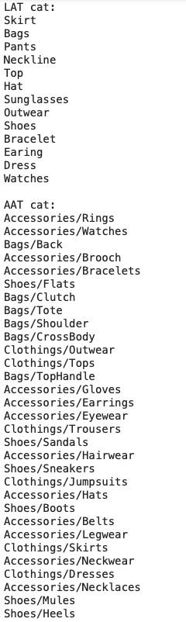
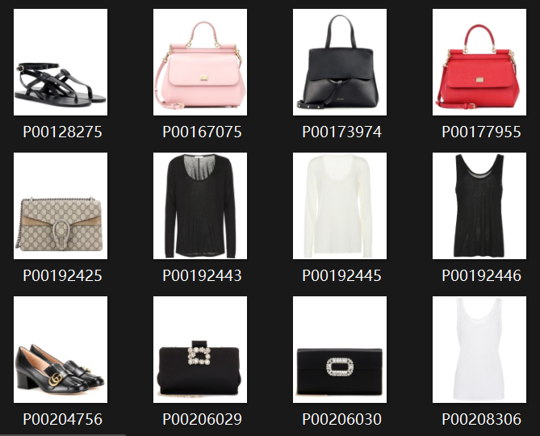
Datasets and Analysis
The UT Fashion dataset (A100 dataset)
8415 images with 1663 labels in two folders: LAT and AAT
LAT: 7427 images with 680 labels.
AAT: 988 images with 983 labels.
Heavily imbalanced data with too few labels
High-resolution images(962*1088)
White background, no noise in the image
Presenter: ZhiYang Xing (z5522418)

Slide 6












Datasets and Analysis
Fashion Product Images (Small)
URL: https://www.kaggle.com/datasets/paramaggarwal/fashion-product-images-small
used for transfer learning and category organization
44441 small images(80*60) of 143 different classes
enough to train a bigger model for transfer learning
need to re-organization the labels by their relevance
good overall quanlity of images: little noise exists in some images
Presenter: ZhiYang Xing (z5522418)

Slide 7
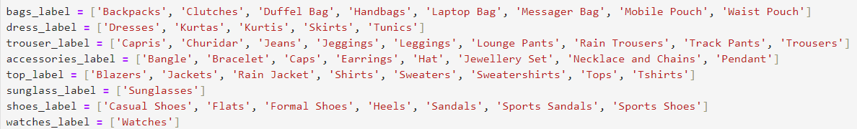
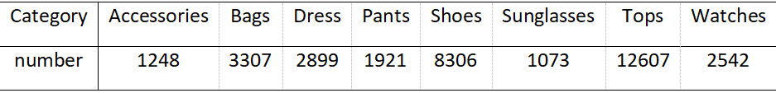
Datasets and Analysis
Fashion Product Images (Small) (Cont.)
choose 33603 images out of 47 classes into 8 categories
the data is still unbalance
make fully use of the data using undersampling
similar to cross validation
800 for training, 100 for testing, change set every epoch
Presenter: ZhiYang Xing (z5522418)

Slide 8
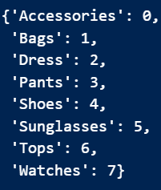
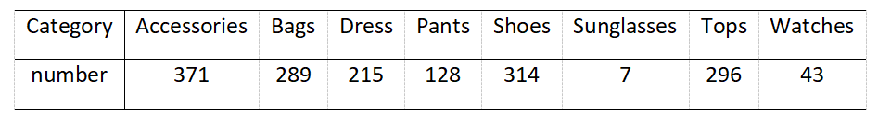
Datasets and Analysis
A100 dataset (Cont.)
rearrange the labeled images into 8 catrgories
heavily imbalance still exists
split the dataset by 0.8/0.2
change the training/testing set every epoch
probability of image not trained in 5 epoch: 0.2⁵=0.00032
the label’s corresponding number are:
Presenter: ZhiYang Xing (z5522418)

Slide 9
Method - direct learning
Firstly, we train 3 different models by using the dataset directly.
Two pretrained models: VGG and ResNet
One CNN with three convolutional layers
split the labeled data by 0.8/0.2
train for 10 epoches
mainly as a contrast with other methods
Presenter: Jiacheng Ling (z5529848)

Slide 10
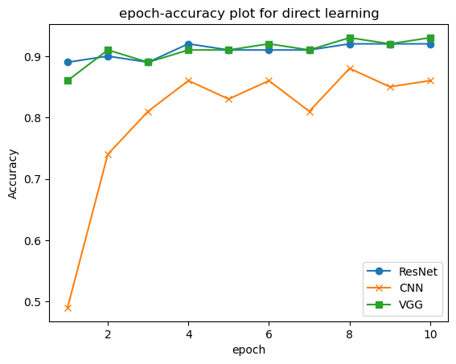
Results - direct learning
The epoch-accuracy plot is showing below:
We got three different results—the VGG model achieves the highest accuracy , which is 93.4%, followed by Resnet(91.6%), and CNN(86.5%)
Presenter: Jiacheng Ling (z5529848)

Slide 11
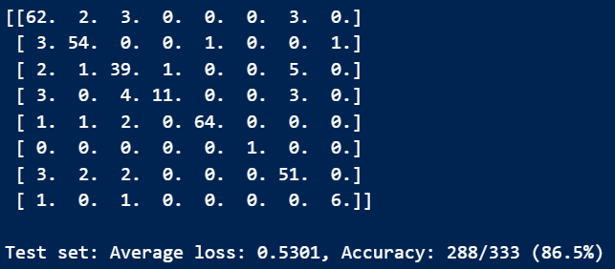
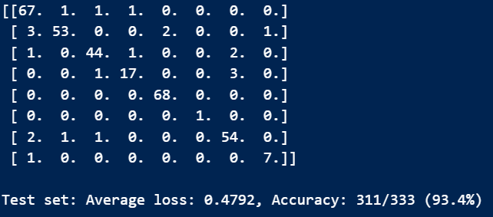
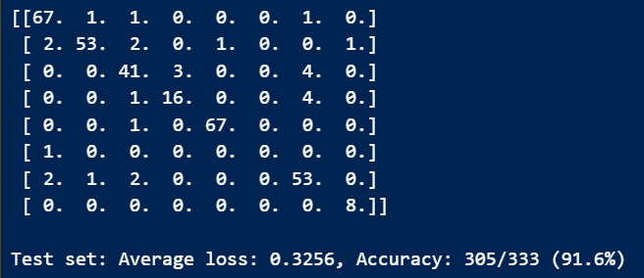
Discussion - direct learning
CNN confusion matrix:
unacceptable—the model throws the accessories into every bucket except sunglasses
VGG confusion matrix:
seems good, however mistakes tops for dress and bags for accessories
ResNet confusion matrix:
tops are always mistaken for dresses and pants
acceptable but still needs to be improved
Presenter: Jiacheng Ling (z5529848)

Slide 12
Discussion - direct learning(cont.)
Simply train the model can’t get the result we want.
The disadvantages are obvious:
Due to the size of the dataset, the only way to get an acceptable result is to use pretrained models.
The number of pictures in different labels is quite unbalance, which leads to the inaccurate when test the model in the whole dataset.
The models just simply throw some picture into each buckets.
So we have to use more ways to train the dataset to improve the model.
Presenter: Jiacheng Ling (z5529848)

Slide 13
Method - transfer learning
Steps:
Train models to learn the features utilizing the Fashion Product Images dataset
Freeze convolutonal layer parameters
Adjust the classifier parameters by training on the A100 dataset
Implemented three models: MiniVGG, DenseNet-40 and ResNet-18
To get comparable result, they are trained and tested simultaneously on the same sets due to undersampling in feature learning
Feature learning for 20 epoches, transfer learning for 5 epoches
Presenter: Chenyan Li (z5467843)

Slide 14
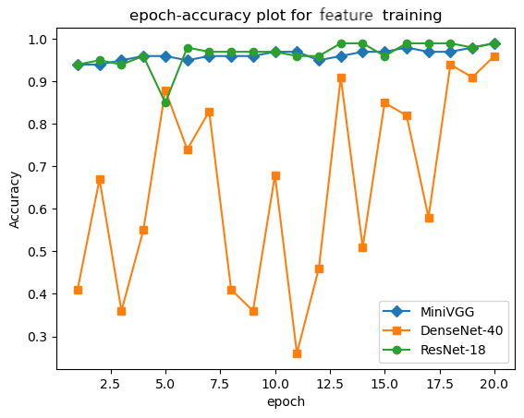
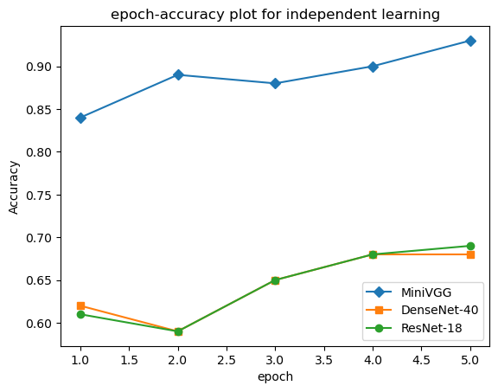
Results - transfer learning
MiniVGG: 92.7%
DenseNet: 68.4%
ResNet: 68.7%
MiniVGG and ResNet: 99.3%
DenseNet: 96.5%
Presenter: Chenyan Li (z5467843)

Slide 15
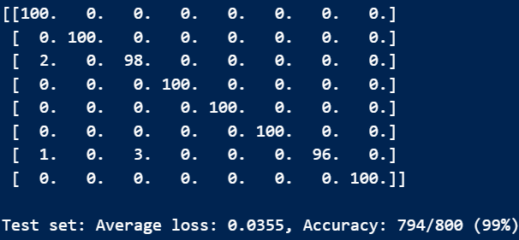
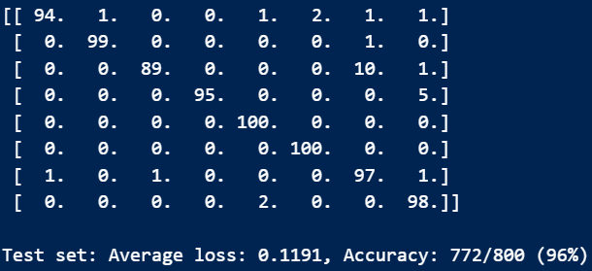
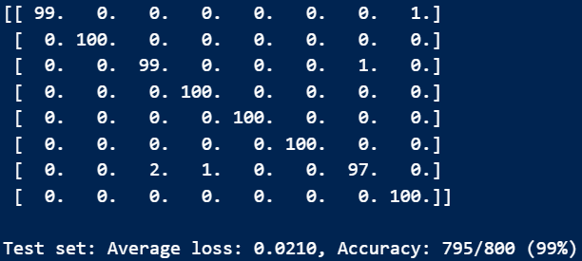
Discussion- transfer learning(cont.)
From top to bottom: confusion matrix for feature learning of MiniVGG, DenseNet and ResNet
MiniVGG: mistake tops for dress, confuses tops and dress for accessories
ResNet: mistake tops for dress
DenseNet: heavily mastakes dress for tops, also mistakes accessories into many other categories.
From the previous epoch-accuracy plot, DenseNet has a jumping accuracy during the training process. We suspect there may be some overfitting due to every layer is connected with all previous layers.
Presenter: Chenyan Li (z5467843)

Slide 16
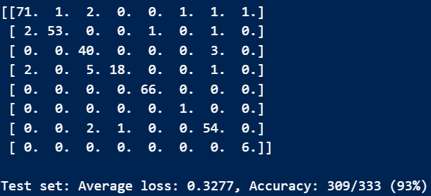
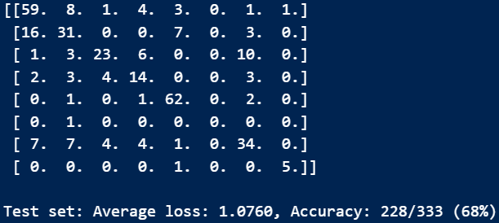
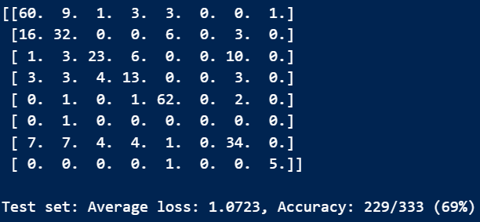
Discussion- transfer learning(cont.)
From top to bottom: confusion matrix for transfer learning of MiniVGG, DenseNet and ResNet
The common mistakes they make is mistakes for accessories and confusion between Dress, Pants and Tops
DenseNet and ResNet: makes a lot mistakes in Dress, Pants and Tops
MiniVGG: will be rather satisfying in this task. There is still room to improve given more epoches
DenseNet and ResNet are to improve performance in much more complexing problems, thus there may be overfitting for this simple-image classification task.
Presenter: Chenyan Li (z5467843)

Slide 17
Method - Semi-Supervised Learning
Semi-Supervised Learning
Labeled Data
Unlabeled Data
Presenter: Xiaojie Yu (z5469466)

Slide 18
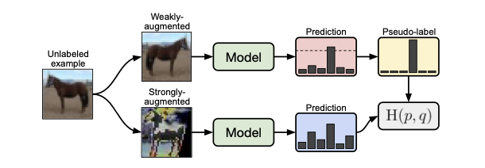
Method - Semi-Supervised Learning
FixMatch: Simplifying SSL
p: Pseudo-label
q: Prediction
Presenter: Xiaojie Yu (z5469466)

Slide 19
Method - Semi-Supervised Learning
FixMatch: Simplifying SSL
p: Pseudo-label
q: Prediction
Generate weakly and strongly augmented images.
Presenter: Xiaojie Yu (z5469466)

Slide 20
Method - Semi-Supervised Learning
FixMatch: Simplifying SSL
Use current model to produce pseudo-labels on weakly augmented images.
Retain a pseudo-label only when confidence is above the threshold.
Presenter: Xiaojie Yu (z5469466)

Slide 21
Method - Semi-Supervised Learning
FixMatch: Simplifying SSL
Train a model to predict pseudo-labels from strongly augmented images.
Presenter: Xiaojie Yu (z5469466)

Slide 22
Method - Semi-Supervised Learning
FixMatch: Simplifying SSL
Stop Gradients
p: Pseudo-label
q: Prediction
Gradients
Presenter: Xiaojie Yu (z5469466)

Slide 23
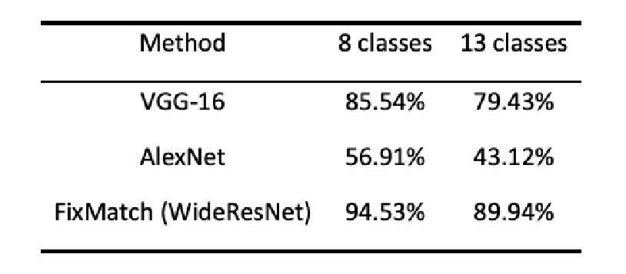
Results - Semi-Supervised Learning
LAT results
Presenter: Xiaojie Yu (z5469466)

Slide 24
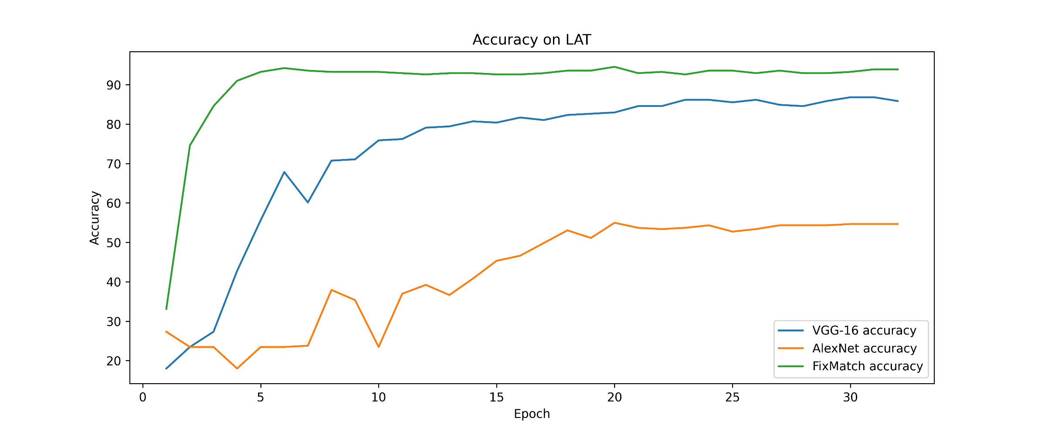
Results - Semi-Supervised Learning
LAT results
Presenter: Xiaojie Yu (z5469466)

Slide 25
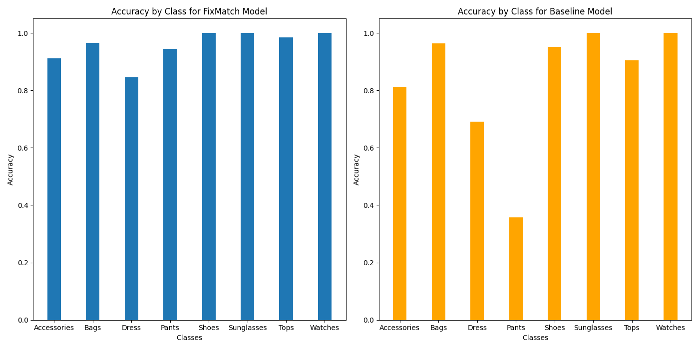
Results - Semi-Supervised Learning
Accuracy by class
Presenter: Xiaojie Yu (z5469466)

Slide 26
Discussion - Semi-Supervised Learning
FixMatch achieved high performance by
Confidence: retain pseudo-label if model prediction is confident.
Consistency: strong augmentation to predict pseudo-label of weak augmentation.
Advantage of Simplicity
Easier to tune hyperparameters, reproduce, extend, …
Presenter: Xiaojie Yu (z5469466)

Slide 27

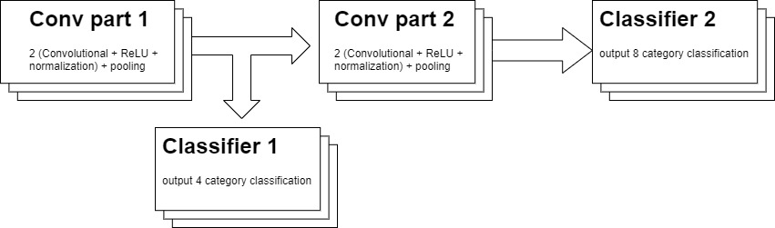
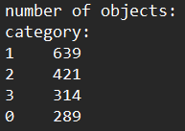
Method - H-CNN
The task also mentions four main categories – shoes, clothing, accessories, bags
MiniVGG is an acceptable model, so I try to modify it to output 4 and 8 categories classification at the same time
combine some labels into 4 classes
Using hierarchy CNN as shown below:
Presenter: ZhiYang Xing (z5522418)

Slide 28
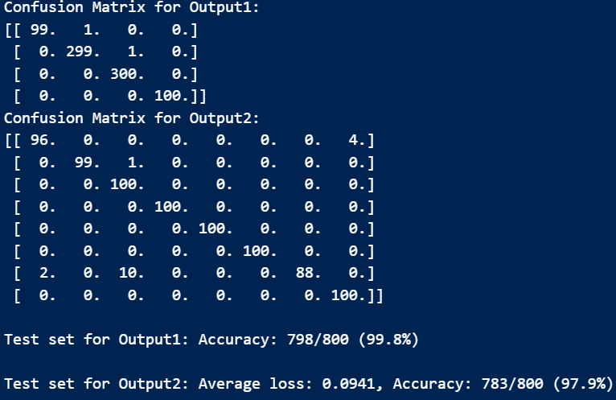
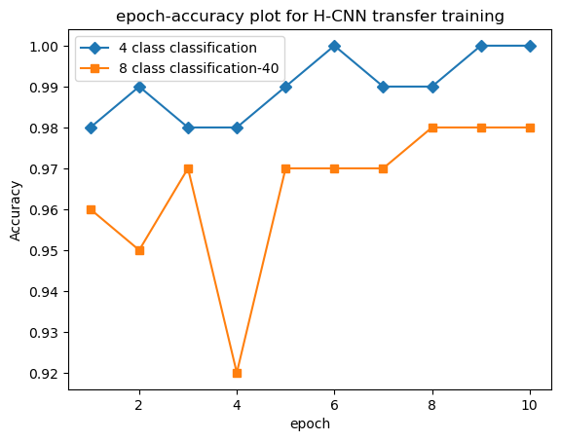
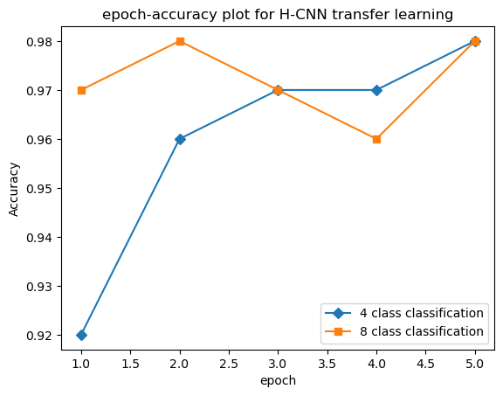
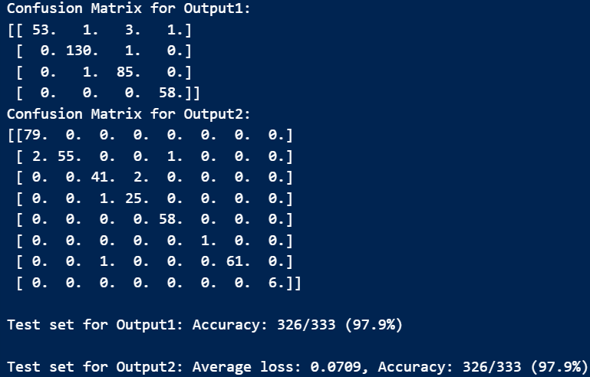
Results and Discussion
two output both produce very beautiful results
avoids mistakes in similar categories: Dress, Pants and Tops
simple and effective, easy to modify to handle different tasks
Presenter: ZhiYang Xing (z5522418)

Slide 29
Conclusion
To perform the fashion item classification while dealing with massive unlabeled data, we implement 3 approaches.
Training models on the labeled images is the most intuitive and direct approach yet the worst one. Only the pretrained models perform okay.
Next, we tried transfer learning based on another similar dataset. The MiniVGG model gets the most potential result, and the H-CNN modified proves it is a perfect model for this task.
Lastly, there is semi-supervised learning with FixMatch. The result is also very satisfying and it fully utilizes the massive unlabeled images. Thus this is the most suitable model for this particular task.
Presenter: ZhiYang Xing (z5522418)

Slide 30

This Photo by Unknown Author is licensed under CC BY-SA

