Slide 1
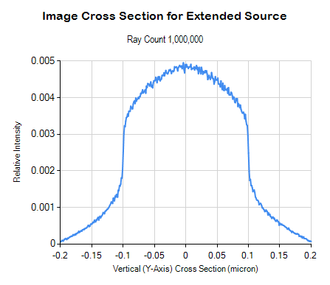
53 sec
With debug checking
12 sec
Optimized Trace Methods

Slide 2

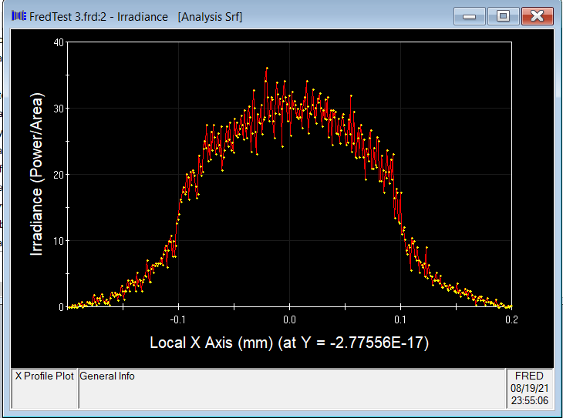
Fred Map

