Slide 1
Unemployment, Inflation, and Productivity
Measuring Macroeconomic
Performance continued

Slide 2
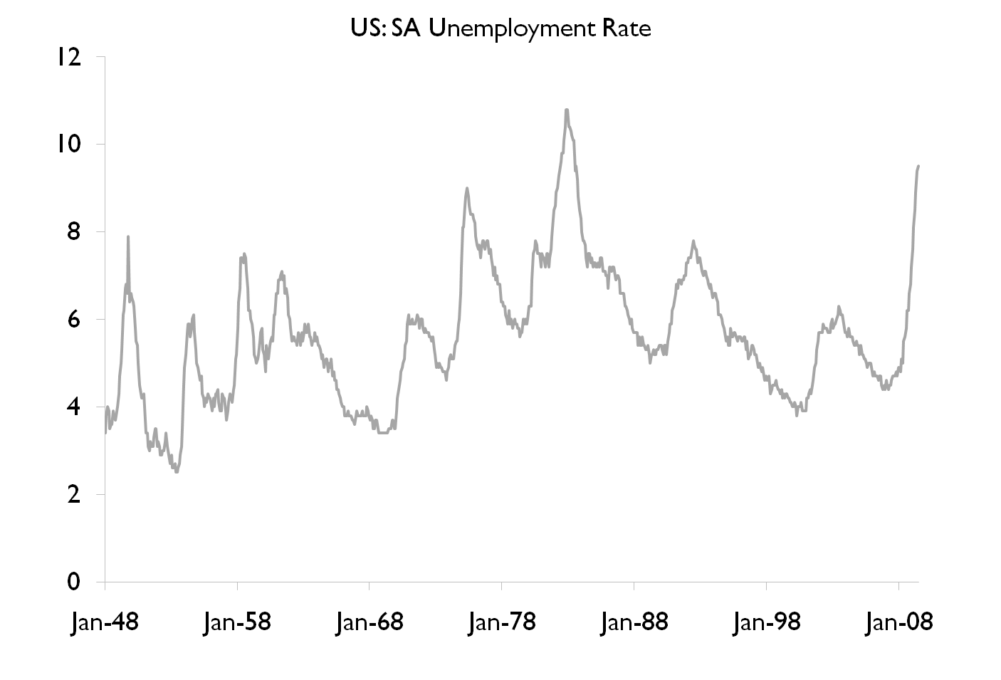
Notes:
Abstract This paper documents three stylized facts for the quarterly unemployment rate in the United States.
Firstly, unemployment is asymmetric over the business cycle, i.e. it rises sharply in recessions and it falls slowly in expansions.
Secondly, its seasonal fluctuations are not constant across the two business cycle stages in the sense that there is less seasonality in recession periods.
Thirdly, the effect of shocks to the unemployment rate in expansions seem transitory, while this effect is permanent in recessions. Some implications of these stylized facts for empirical macroeconomics and seasonal adjustment are discussed.

Slide 3
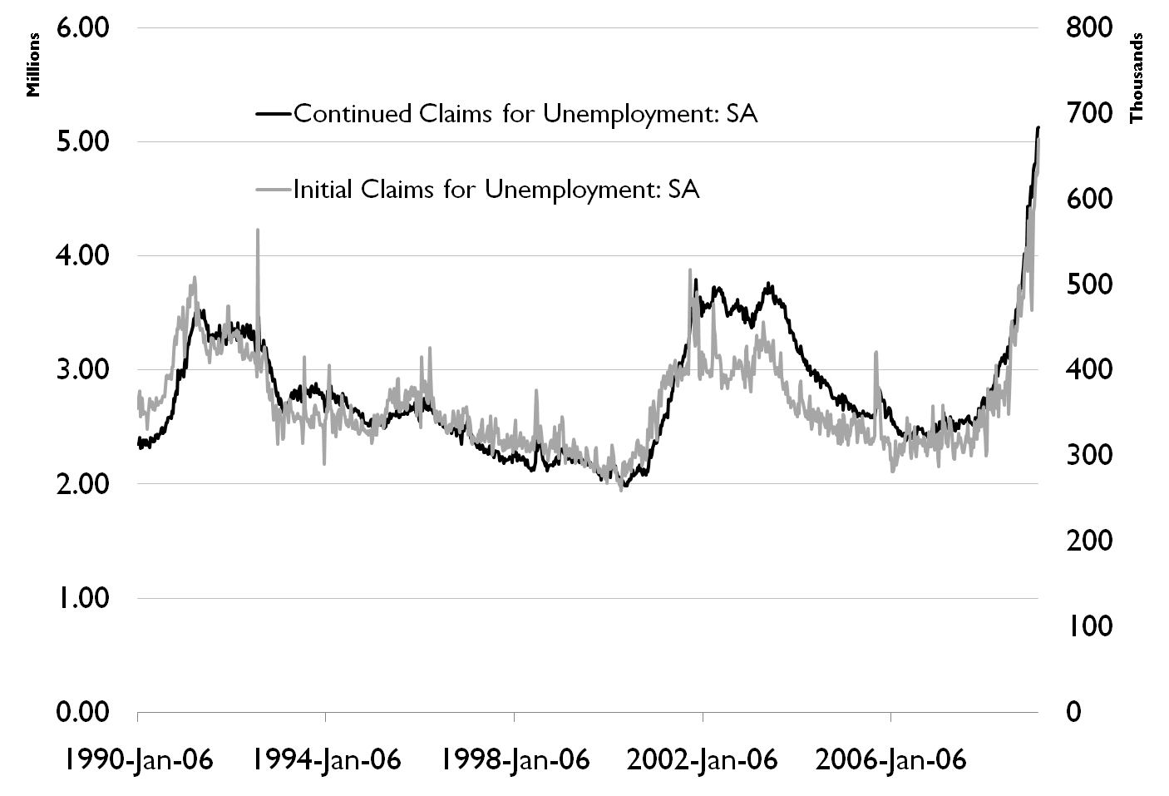

Slide 4
Unemployment
Unemployment Rate Dating Exercise
Why do we care?
  Human Factors
    Self Esteem
    Crime
  Economic Factors
    Loss of Output
    Idle resources

Slide 5
Defining and
Measuring Unemployment
The most frequently discussed symptom of a recession is unemployment.
An employed person is any person 16 years old or older:
  who works for pay, either for someone else or in his or her own business for 1 or more hours per week,
  who works without pay for 15 or more hours per week in a family enterprise, or
  who has a job but has been temporarily absent, with or without pay.
Notes:
The Labor force is the employed plus the unemployed

Slide 6
Defining and
Measuring Unemployment
An unemployed person is a person 16 years old or older who:
  is not working,
  is available for work, and
  has made specific efforts to find work during the previous 4 weeks.
A person who is not looking for work, either because he or she does not want a job or has given up looking, is not in the labor force.

Slide 7
The Composition of the Adult Population
Labor Force
Not Working
(employed)
(unemployed)
Military
(not in labor force)

Slide 8
Elizabeth Lloyd reported to the interviewer that last week she worked 40 hours as a sales manager for the Western Beverage Company.
Steve Hogan lost his job when the local plant of the Chariot Aircraft Manufacturing Company was closed down. Since then, he has been visiting the personnel offices of the other factories in the town trying to find a job.
Linda Coleman is a homemaker. Last week, she was occupied with her normal household chores. She neither held a job nor looked for a job. Her 80-year old father who lives with her has not worked or looked for work because of a disability.
Notes:
Each of these examples is clear cut. Elizabeth is employed; Steve is unemployed; and Linda and her father are not in the labor force.

Slide 9

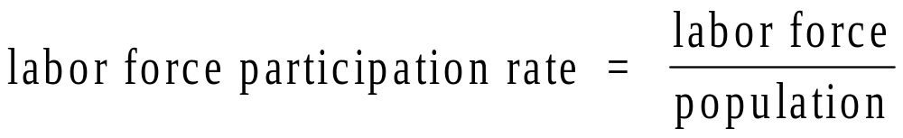
Defining and
Measuring Unemployment

Slide 10
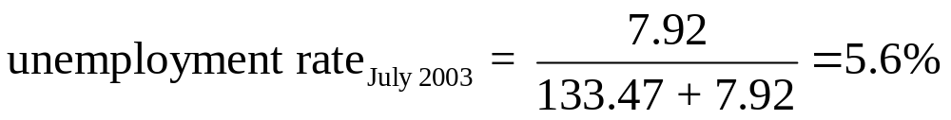
Defining and
Measuring Unemployment
Computing the unemployment rate for the month of July 2003:
  Labor force: 141.39 million
  Employed: 133.47 million
  Unemployed: 7.92 million

Slide 11
Employed, Unemployed, and the Labor Force, 1953-2002
Employed, Unemployed, and the Labor Force, 1953–2002
 | (1) |  | (2) |  | (3) |  | (4) |  | (5) |  | (6)
 | POPULATION 16 YEARS OLD OR OVER (MILLIONS) |  | LABOR FORCE (MILLIONS) |  | EMPLOYED (MILLIONS) |  | UNEMPLOYED (MILLIONS) |  | LABOR-FORCE PARTICIPATION RATE |  | UNEMPLOYMENT RATE
1953 | 107.1 |  | 63.0 |  | 61.2 |  | 1.8 |  | 58.9 |  | 2.9
1960 | 117.2 |  | 69.6 |  | 65.8 |  | 3.9 |  | 59.4 |  | 5.5
1970 | 137.1 |  | 82.8 |  | 78.7 |  | 4.1 |  | 60.4 |  | 4.9
1980 | 167.7 |  | 106.9 |  | 99.3 |  | 7.6 |  | 63.8 |  | 7.1
1982 | 172.3 |  | 110.2 |  | 99.5 |  | 10.7 |  | 64.0 |  | 9.7
1990 | 189.2 |  | 125.8 |  | 118.8 |  | 7.0 |  | 66.5 |  | 5.6
2002 | 211.9 |  | 141.8 |  | 135.1 |  | 6.7 |  | 66.9 |  | 4.7
Note: Figures are civilian only (military excluded). Source: Economic Report of the President, 2003, Table B-35.

Slide 12
Unemployment Rates for
Different Demographic Groups
Unemployment Rates by Demographic Group, 1982 and 2003
 |  | YEARS |  | NOVEMBER 1982 |  | JULY 2003
Total |  |  |  | 10.8 |  | 4.2
White |  |  |  | 9.6 |  | 3.6
 | Men |  | 20+ | 9.0 |  | 2.6
 |  |  | 16–19 | 22.7 |  | 11.7
 | Women |  | 20+ | 8.1 |  | 3.5
 |  |  | 16–19 | 19.7 |  | 10.2
African-American
 | Men |  |  | 20.2 |  | 8.6
 |  |  | 20+ | 19.3 |  | 7.1
 |  |  | 16–19 | 52.4 |  | 28.5
 | Women |  | 20+ | 16.5 |  | 7.0
 |  |  | 16–19 | 46.3 |  | 27.2
Source: U.S. Department of Labor, Bureau of Labor Statistics. Data are not seasonally adjusted.

Slide 13
Regional Differences in Unemployment
Regional Differences in Unemployment, 1975, 1982, 1991, and 2003
 | 1975 |  | 1982 |  | 1991 |  | 2003
U.S. avg. | 8.5 |  | 9.7 |  | 6.7 |  |  | 5.8
Cal. | 9.9 |  | 9.9 |  | 7.5 |  |  | 6.6
Fla. | 10.7 |  | 8.2 |  | 7.3 |  |  | 5.2
Ill. | 7.1 |  | 11.3 |  | 7.1 |  |  | 6.5
Mass. | 11.2 |  | 7.9 |  | 9.0 |  |  | 5.6
Mich. | 12.5 |  | 15.5 |  | 9.2 |  |  | 6.6
N.J. | 10.2 |  | 9.0 |  | 6.6 |  |  | 5.7
N.Y. | 9.5 |  | 8.6 |  | 7.2 |  |  | 6.1
N.C. | 8.6 |  | 9.0 |  | 5.8 |  |  | 5.8
Ohio | 9.1 |  | 12.5 |  | 6.4 |  |  | 6.0
Tex. | 5.6 |  | 6.9 |  | 6.6 |  |  | 6.6
Sources: Statistical Abstract of the United States, various editions.

Slide 14
The Duration of Unemployment
Average Duration of Unemployment, 1979–2002
YEAR | WEEKS | YEAR | WEEKS
1979 | 10.8 | 1991 | 13.7
1980 | 11.9 | 1992 | 17.7
1981 | 13.7 | 1993 | 18.0
1982 | 15.6 | 1994 | 18.8
1983 | 20.0 | 1995 | 16.6
1984 | 18.2 | 1996 | 16.7
1985 | 15.6 | 1997 | 15.8
1986 | 15.0 | 1998 | 14.5
1987 | 14.5 | 1999 | 13.4
1988 | 13.5 | 2000 | 12.6
1989 | 11.9 | 2001 | 13.2
1990 | 12.0 | 2002
Sources: U.S. Department of Labor, Bureau of Labor Statistics.

Slide 15
Current Data
United States
  The National Unemployment Rate for August 2009 is 9.7%.
  http://stats.bls.gov/news.release/empsit.nr0.htm
Industrialized Countries
  http://www.stls.frb.org/publications/iet/
  http://www.cia.gov/cia/publications/factbook/

Slide 16
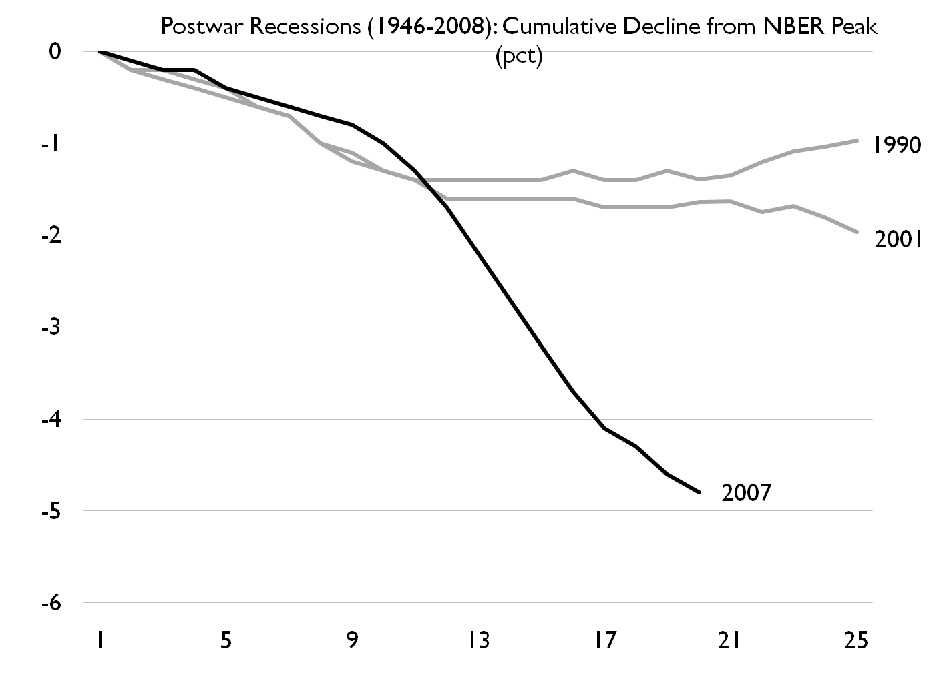

Slide 17
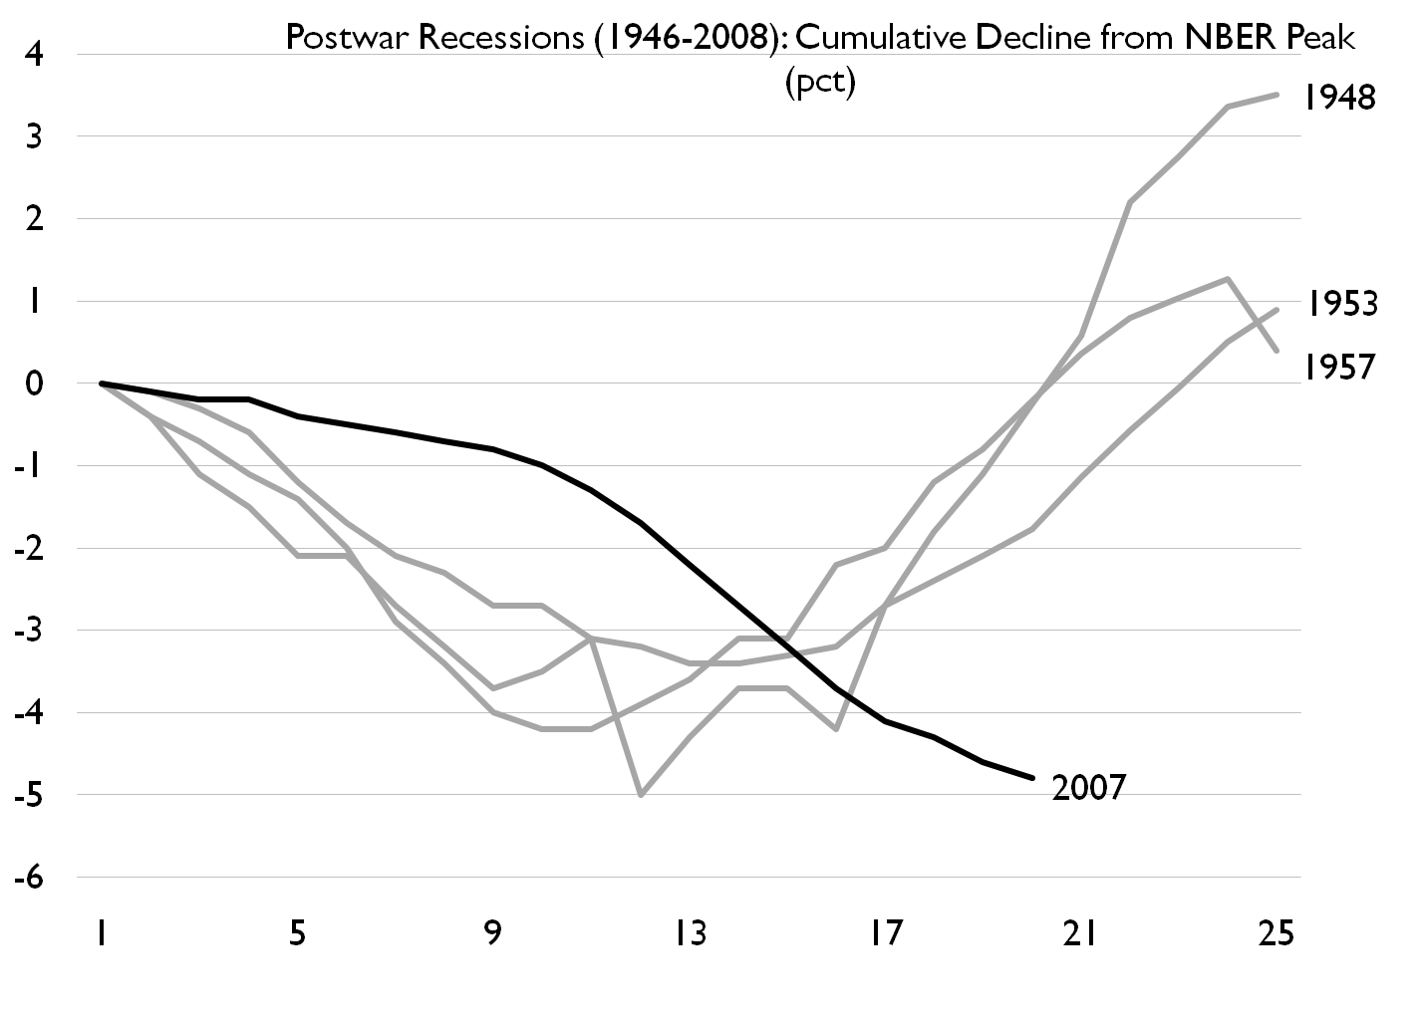

Slide 18
Types of Unemployment
Frictional unemployment is the portion of unemployment that is due to the normal working of the labor market; used to denote short-run job/skill matching problems.
Notes:
Frictional unemployment arises because of the time needed to match qualified job seekers with available job openings
Although frictional unemployment is temporary for an individual, it is ongoing within the economy as a whole

Slide 19
Types of Unemployment
Structural unemployment is the portion of unemployment that is due to changes in the structure of the economy that result in a significant loss of jobs in certain industries.
  Geographical based mismatch
  Skills based mismatch
Notes:
Structural unemployment arises because the skills demanded by employers do not match the skills of the unemployed, or the unemployed do not live where the jobs are located
Structural unemployment is reduced as adjustments come about in the economy
Geographical mismatch vs. Skill mismatch

Slide 20
Types of Unemployment
Cyclical unemployment is the increase in unemployment that occurs during recessions and depressions.
Notes:
Cyclical unemployment occurs because of declines in the economy’s aggregate production during recessions

Slide 21

Seasonal Unemployment
Seasonal unemployment is caused by seasonal shifts in labor supply and demand
  Examples: construction, agriculture,
  Life Guards

Slide 22
Full Employment
Full employment is the level of employment when there is no cyclical unemployment
Full employment does not necessarily imply zero unemployment (due to frictional, structural, and seasonal unemployment)
A 5-6% unemployment rate is considered full employment?

Slide 23
Types of Unemployment
The natural rate of unemployment is the unemployment that occurs as a normal part of the functioning of the economy. Sometimes taken as the sum of frictional unemployment and structural unemployment.

Slide 24
Unemployment Insurance
Temporary income provided to unemployed workers who actively seek employment and who meet other qualifications
Research on UI

Slide 25
Problems with Official Unemployment Stats
Sources of Understatement
  Discouraged Workers
  Underemployment
Sources of Overstatement
  Unemployment insurance
  Welfare programs
On Net we believe the official measure understates the problem

Slide 26
The Discouraged-Worker Effect
The discouraged-worker effect lowers the unemployment rate.
Discouraged workers are people who want to work but cannot find jobs.
Notes:
They grow discouraged and stop looking for work, thus dropping out of the ranks of the unemployed and the labor force.

Slide 27
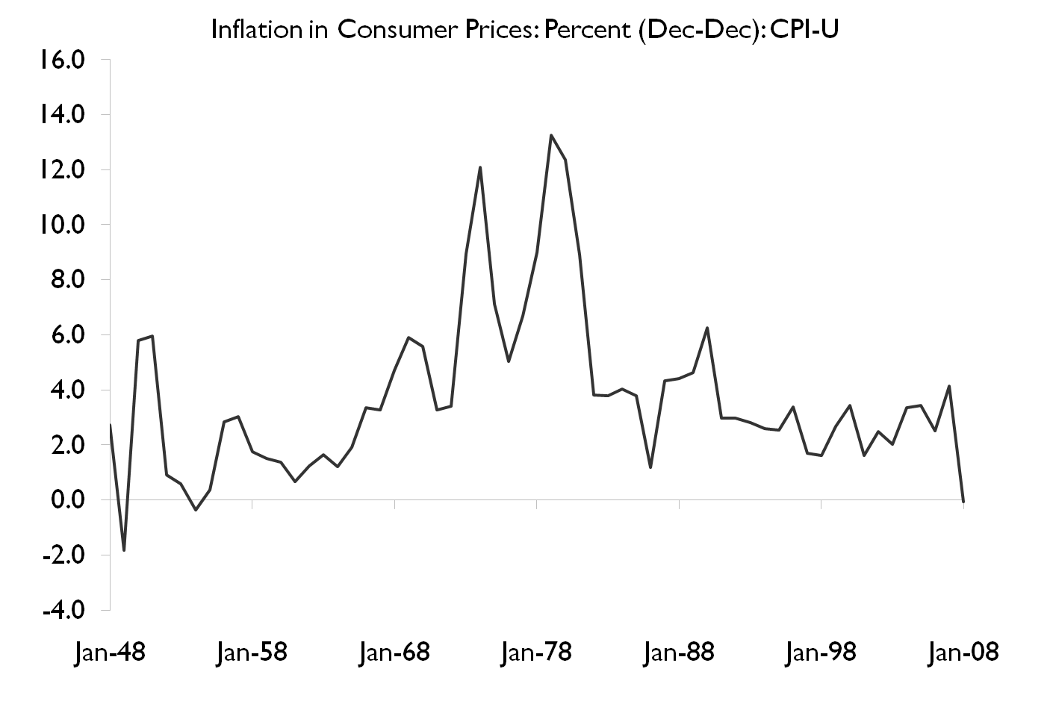
Notes:
We establish five facts about prices in the U.S. economy:
1) The median duration of consumer prices when sales are excluded at the product level is 11months. The median duration of finished goods producer prices is 8.7 months.
2)Two-thirds of regular price changes are price increases.
3) The frequency of price increases responds strongly to inflation while the frequency of price decreases and the size of price increases and price decreases do not.
4) The frequency of price change is highly seasonal: It is highest in
the 1st quarter and lowest in the 4th quarter.
5) The hazard function of price changes for individual consumer and producer goods is downward sloping for the first few months and then flat (except for a large spike at 12 months in consumer services and all producer prices).
These facts are based on CPI microdata and a new comprehensive data set of microdata on producer prices that we construct from raw production files underlying the PPI. We show that the 1st, 2nd and 3rd facts are consistent with a benchmark menu-cost model, while the 4th and 5th facts are not.

Slide 28
Inflation
Inflation Dating Exercise
Notes:
We establish five facts about prices in the U.S. economy:
1) The median duration of consumer prices when sales are excluded at the product level is 11months. The median duration of finished goods producer prices is 8.7 months.
2)Two-thirds of regular price changes are price increases.
3) The frequency of price increases responds strongly to inflation while the frequency of price decreases and the size of price increases and price decreases do not.
4) The frequency of price change is highly seasonal: It is highest in
the 1st quarter and lowest in the 4th quarter.
5) The hazard function of price changes for individual consumer and producer goods is downward sloping for the first few months and then flat (except for a large spike at 12 months in consumer services and all producer prices).
These facts are based on CPI microdata and a new comprehensive data set of microdata on producer prices that we construct from raw production files underlying the PPI. We show that the 1st, 2nd and 3rd facts are consistent with a benchmark menu-cost model, while the 4th and 5th facts are not.

Slide 29
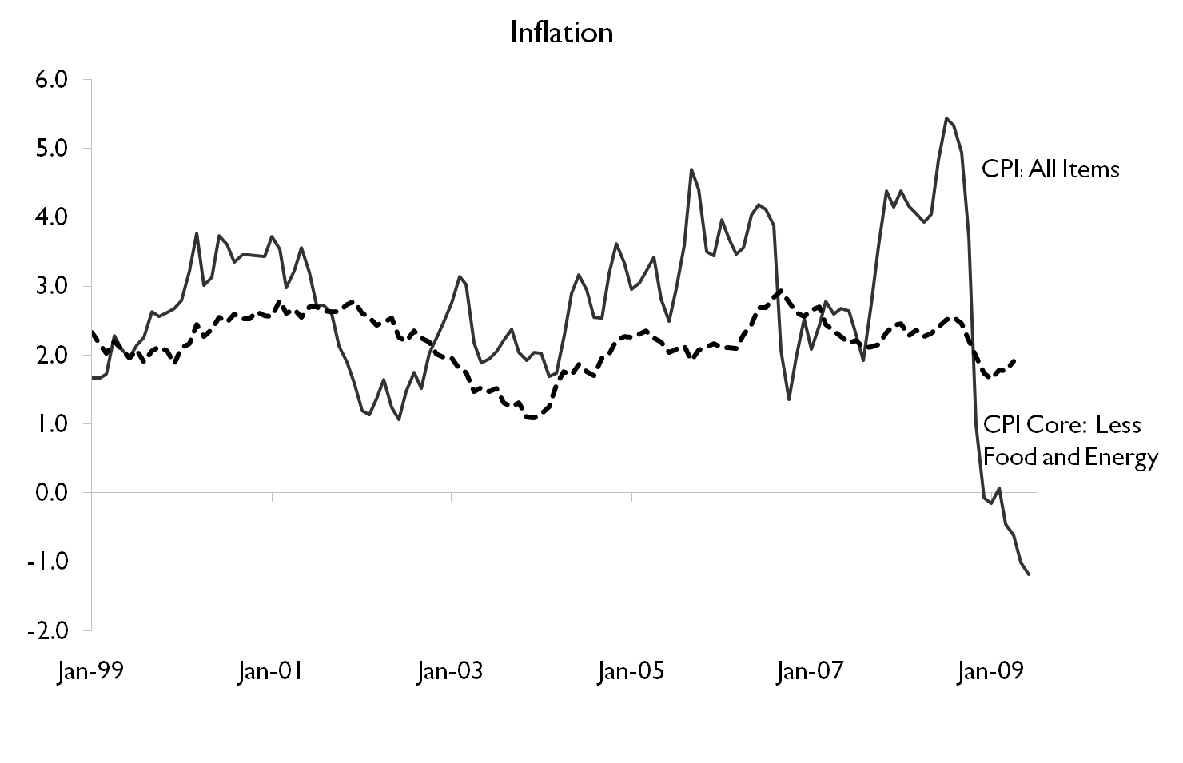

Slide 30
Inflation
Inflation is an increase in the overall price level.
Deflation is a decrease in the overall price level.
Sustained inflation is an increase in the overall price level that continues over a significant period.
Notes:
Inflation is a sustained increase in the average level of prices
Hyperinflation is a very high rate of inflation
Brazil experienced inflation over 1000% during some recent years
Germany between WW1 and WW2
Disinflation is a reduction in the positive inflation rate
Deflation is a sustained decrease in the price level (a negative inflation rate)

Slide 31
Two Serious Inflationary
Periods Since 1970
Inflation Rates, 1974–1976 and 1980–1983
RECESSION BEGINS | INFLATION RATE
1974 | 11.0
1975 | 9.1
1976 | 5.8
1980 | 13.5
1981 | 10.3
1982 | 6.2
1983 | 3.2
Source: See Table 19.8.

Slide 32
Inflation and the Business Cycle
Inflation During Three Expansions
 | INFLATION RATE
1972 | 3.2
1973 | 6.2
1974 | 11.0
1976 | 5.8
1977 | 6.5
1978 | 7.6
1979 | 11.3
1980 | 13.5
1984 | 4.3
1985 | 3.6
1986 | 1.9
1987 | 3.6
1988 | 4.1
1989 | 4.8
Source: See Table 19.8.

Slide 33
The Benefits of Recessions
Recessions may help to reduce inflation.
Some argue that recessions may increase efficiency by driving the least efficient firms out of business and by forcing surviving firms to trim waste and manage their resources better.
Also, a recession leads to a decrease in the demand for imports, which improves a nation’s balance of payments.

Slide 34
Cost of Living
If you were offered a job in Minneapolis making $50,000 a year, and your boss here what to match the offer by providing you the same purchasing power here. What would you want to know about La Crosse and Minneapolis?
If you were to guess how much less would your boss have to pay you to live here?
Notes:
http://www.homefair.com/homefair/calc/salcalc.html
50K-41,729

Slide 35
How do we Measure Inflation?
Consumer Price Index
  Bureau of Labor and Statistics (BLS)
    http://www.bls.gov
    conduct surveys
Producer Price Index
GDP Deflator

Slide 36
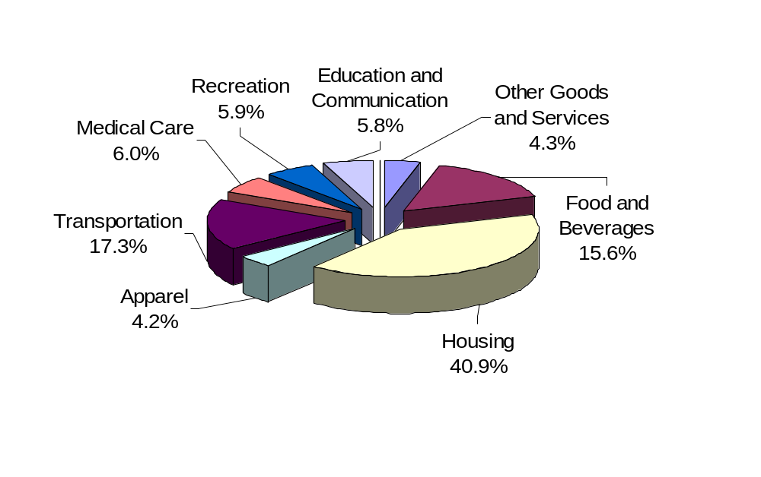
Price Indexes
http://www.nytimes.com/interactive/2008/05/03/business/20080403_SPENDING_GRAPHIC.html?scp=1&s
Notes:
The CPI market basket shows how a typical consumer divides his or her money among various goods and services.

Slide 37
Sample CPI-H (for all Hockey players)
Good Base Year(04) Current(05)
1 gross of twinkies 10.00 11.00
1 Hockey Stick 25.00 24.50
1 Skate Sharpening 2.00 3.00
Total 37.00 38.50
CPI 100 104.1
CPI in 05=(Total for Basket in 05 *100
total for basket in base year)
CPI in base year always equals 100, by definition

Slide 38
Current Data
U.S.
  http://stats.bls.gov/news.release/cpi.nr0.htm
Other Countries
  http://www.stls.frb.org/publications/iet/
Historical
  http://www.orst.edu/Dept/pol_sci/fac/sahr/sahr.htm
  http://data.bls.gov/cgi-bin/cpicalc.pl

Slide 39
Problems with Official Inflation Stats (CPI)
Sources of Understatement
  Health insurance costs
  quality of life factors
Sources of Overstatement
  Substitution bias
  Quality changes
On Net the Boskin commission believes the CPI overstates inflation by 1.1%
Notes:
http://www.marginalrevolution.com/marginalrevolution/2005/12/claims_my_russi.html
I do, it seems. Don't tell my suppliers, but I am a big fan of zero price search. Mark Aguiar and Erik Hurst write:
Using scanner data and time diaries, we document how households substitute time for money through shopping and home production. We find evidence that there is substantial heterogeneity in prices paid across households for identical consumption goods in the same metro area at any given point in time. For identical goods, prices paid are highest for middleaged, rich, and large households, consistent with the hypothesis that shopping intensity is low when the cost of time is high. The data suggest that a doubling of shopping frequency lowers the price paid for a given good by approximately 10 percent. [TC: is that all????] From this elasticity and observed shopping intensity, we impute the shopper’s opportunity cost of time, which peaks in middle age at a level roughly 40 percent higher than that of retirees [emphasis added]. Using this measure of the price of time and observed time spent in home production, we estimate the parameters of a home production function. We find an elasticity of substitution between time and market goods in home production of close to 2. Finally, we use the estimated elasticities for shopping and home production to calibrate an augmented lifecycle consumption model. The augmented model predicts the observed empirical patterns quite well. Taken together, our results highlight the danger of interpreting lifecycle expenditure without acknowledging the changing demands on time and the available margins of substituting time for money.
Here is the paper, and thanks to Bruce Bartlett for the pointer. We also learn that people with children pay higher prices (presumably they have less time to search) and people in their forties with children pay the highest prices of all, six to eight percent more than people in their twenties or sixties.
I also take these results to imply that poor households, which shop more frequently and pay lower prices, are better off in material terms than CPI-based measures of real income will imply. That being said, they also have less time. Fans of the "happiness literature," which suggests more money above a certain level doesn't make you better off, should favor less search. After all, we are told that people enjoy time spent with friends more than either money or sex. So does this view (not mine) suggest that we shut down discount outlets and induce more consumption of time? Are single price monopolies better than price discrimination? Is Marshall's the true enemy of the middle class?

Slide 40
Why is Inflation So Unpopular?
As an economic problem, inflation is widespread since it affects everyone
Workers’ wages may not keep up with inflation
Those on fixed incomes are seriously affected
Long-term contracts are difficult to negotiate
Menu Costs

Slide 41
Inflation Costs
Inflation redistributes income and wealth
Inflation increases transactions costs
  (shoe leather costs)
Inflation increases uncertainty
  Hard to distinguish between relative price changes
Notes:
People’s income increases during inflations, when most prices, including input prices, tend to rise together.
Inflation changes the distribution of income. People living on fixed incomes are particularly hurt by inflation.
The benefits received by many retired workers, including social security, are fully indexed to inflation. When prices rise, benefits rise.
The poor have not fared so well. Welfare benefits are not indexed and have not kept pace with inflation.
Inflation creates administrative costs and inefficiencies. Without inflation, time could be used more efficiently.
The opportunity cost of holding cash is high during inflations. People therefore hold less cash and need to stop at the bank more often.
People are not fully informed about price changes and may make mistakes that lead to a misallocation of resources.
Some people consider inflation to be our public enemy number one. Elected leaders have vigorously pursued policies designed to stop inflation.
The recessions of 1974 to 1975 and 1980 to 1982 were the price we had to pay to stop inflation. Stopping inflation is costly.

Slide 42
The Costs of Inflation
Unanticipated inflation—an inflation that takes people by surprise—can hurt creditors.
Inflation that is higher than expected benefits debtors; inflation that is lower than expected benefits creditors.
The real interest rate is the difference between the interest rate on a loan and the inflation rate.
Notes:
A major issue is whether workers can accurately anticipate changes in the price level
Workers seek to anticipate inflation so that the purchasing power of wage contracts is maintained
The extent to which workers can anticipate inflation determines the effects of inflation on those in the economy

Slide 43
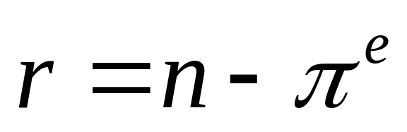
Inflation and Interest Rates
Inflation creates a difference between real and nominal interest rates
Real rate = nominal rate - inflation rate
Inflation risk makes some lenders offer adjustable-rate home loans

Slide 44
Example
You buy a bike for $100 by borrowing money from a lender to whom you agree to pay $110 next year. We expect that the bike will cost $103 next year.
The nominal interest rate is 10%, since the expected inflation rate is 3% the real rate of return is 7%.
What if the bike costs $110 next year?
There are two reason you pay someone interest
  1. To compensate them for the loss in purchasing power (inflation)
  2. To compensate them for forgoing consumption (Real rate)

Slide 45
What is the optimal inflation rate?
Low vs. high inflation
Stable vs. variable inflation

Slide 46
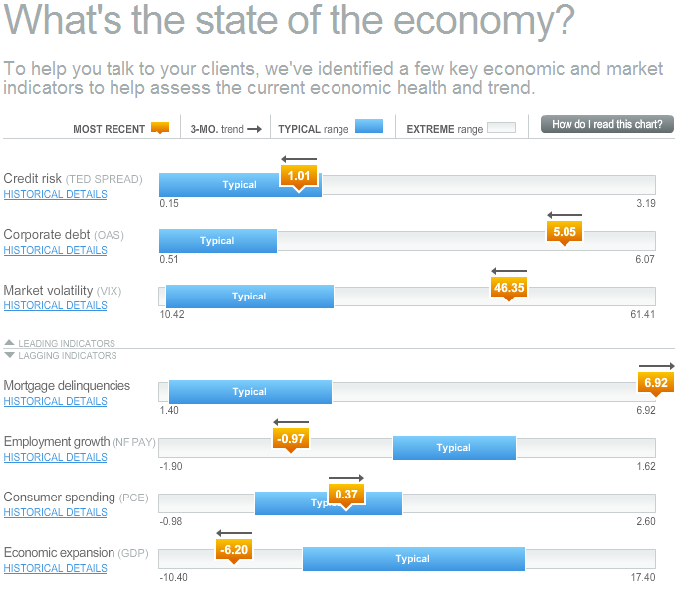
http://www.russell.com/Helping-Advisors/Markets/EconomicRecoveryDashboard.asp
Notes:
http://www.russell.com/Helping-Advisors/Markets/EconomicRecoveryDashboard.asp

Slide 47

http://www.google.com/finance/domestic_trends
Notes:
http://www.google.com/finance/domestic_trends

Slide 48
Appendix
Slides after this point will most likely not be covered in class. However they may contain useful definitions, or further elaborate on important concepts, particularly materials covered in the text book.
They may contain examples I’ve used in the past, or slides I just don’t want to delete as I may use them in the future.

Slide 49
Review Terms and Concepts
consumer price index (CPI)
cyclical unemployment
deflation
depression
discouraged-worker effect
employed
frictional unemployment
inflation
labor force
labor-force participation rate
natural rate of unemployment
not in the labor force
producer price indexes (PPIs)
real interest rate
recession
structural unemployment
sustained inflation
unemployed
unemployment rate

Slide 50

The Labor Force Participation Rate
The proportion of adults who are in the labor force
The civilian unemployment rate is the unemployment rate calculated excluding the military from the labor force

Slide 51

Some Employment Facts
Today 60% of working-age women are in the work force, compared to 40% three decades ago
Unemployment rates are significantly higher among blacks and teenagers
Recent employment statistics place unemployment duration at an average of 19.0 weeks with a median of 9.4

Slide 52
Some UR Correlations
Each one-point increase in the u-rate is associated with:
  920 more suicides
  650 more homicides
  4000 more people admitted to state mental institutions
  3300 more people sent to state prisons
  37,000 more deaths
  increases in domestic violence and homelessness
Notes:
Source: Barry Bluestone and Bennett Harrison, The Deindustrialization of America (New York: Basic Books, 1982), Chapter 3, cited in Robert J. Gordon, Macroeconomics, 4th edition (Boston: Little, Brown and Company), p.334. If you know of more recent estimates, please email me so I can update this slide!!! Thanks!

Slide 53
Price Indexes
The consumer price index (CPI) is the most popular fixed-weight price index.
One version of the CPI is the “Chained Consumer Price Index,” which uses changing weights.
The CPI differs from the GDP deflator in important ways.

Slide 54
The Consumer Price Index (CPI)
The CPI, 1950–2002
YEAR | PERCENTAGE CHANGE IN CPI | CPI | YEAR | PERCENTAGE CHANGE IN CPI | CPI | YEAR | PERCENTAGE CHANGE IN CPI | CPI
1950 | 1.3 | 24.1 | 1968 | 4.2 | 34.8 | 1986 | 1.9 | 109.6
1951 | 7.9 | 26.0 | 1969 | 5.5 | 36.7 | 1987 | 3.6 | 113.6
1952 | 1.9 | 26.5 | 1970 | 5.7 | 38.8 | 1988 | 4.1 | 118.3
1953 | 0.8 | 26.7 | 1971 | 4.4 | 40.5 | 1989 | 4.8 | 124.0
1954 | 0.7 | 26.9 | 1972 | 3.2 | 41.8 | 1990 | 5.4 | 130.7
1955 | −0.4 | 26.8 | 1973 | 6.2 | 44.4 | 1991 | 4.2 | 136.2
1956 | 1.5 | 27.2 | 1974 | 11.0 | 49.3 | 1992 | 3.0 | 140.3
1957 | 3.3 | 28.1 | 1975 | 9.1 | 53.8 | 1993 | 3.0 | 144.5
1958 | 2.8 | 28.9 | 1976 | 5.8 | 56.9 | 1994 | 2.6 | 148.2
1959 | 0.7 | 29.1 | 1977 | 6.5 | 60.6 | 1995 | 2.8 | 152.4
1960 | 1.7 | 29.6 | 1978 | 7.6 | 65.2 | 1996 | 3.0 | 156.9
1961 | 1.0 | 29.9 | 1979 | 11.3 | 72.6 | 1997 | 2.3 | 160.5
1962 | 1.0 | 30.2 | 1980 | 13.5 | 82.4 | 1998 | 1.6 | 163.0
1963 | 1.3 | 30.6 | 1981 | 10.3 | 90.9 | 1999 | 2.2 | 166.6
1964 | 1.3 | 31.0 | 1982 | 6.2 | 96.5 | 2000 | 3.4 | 172.2
1965 | 1.6 | 31.5 | 1983 | 3.2 | 99.6 | 2001 | 2.8 | 177.1
1966 | 2.9 | 32.4 | 1984 | 4.3 | 103.9 | 2002
1967 | 3.1 | 33.4 | 1985 | 3.6 | 107.6
Sources: Bureau of Labor Statistics, U.S. Department of Labor.

Slide 55
Recessions, Depressions, and Unemployment
The business cycle describes the periodic ups and downs in the economy, or deviations of output and employment away from the long-run trend.
A recession is roughly a period in which real GDP declines for at least two consecutive quarters. It is marked by falling output and rising unemployment.

Slide 56
Recessions, Depressions, and Unemployment
A depression is a prolonged and deep recession. The precise definitions of prolonged and deep are debatable.
Capacity utilization rates, which show the percentage of factory capacity being used in production, are one indicator of a recession.

Slide 57
Price Indexes
Price indexes are used to measure overall price levels. The price index that pertains to all goods and services in the economy is the GDP deflator.
The consumer price index (CPI) is a price index computed each month by the Bureau of Labor Statistics using a bundle that is meant to represent the “market basket” purchased monthly by the typical urban consumer.

Slide 58
Price Indexes
Other popular price indexes are producer price indexes (PPIs), which measure price changes for products at all stages in the production process.
The three main categories are:
  finished goods,
  intermediate materials, and
  crude materials.

Slide 59
Long-Run and Short-Run Concerns
Growth, Productivity, Unemployment, and Inflation
Notes:
Growth and Productivity are more long run concerns and inflation and unemployment tend to be more short run concerns.
These slides will be covered in the last third of the semester.

Slide 60
Long-Run Output and Productivity Growth
An ideal economy is one in which there is:
  rapid growth of output per worker,
  low unemployment, and
  low inflation.

Slide 61
Long-Run Output and Productivity Growth
The average growth rate of output in the economy since 1900 has been about 3.4 percent per year.
An area of economics called “growth theory” is concerned with the question of what determines this rate.

Slide 62
Long-Run Output and Productivity Growth
There are a number of ways to increase output. An economy can:
  Add more workers
  Add more machines
  Increase the length of the workweek
  Increase the quality of the workers
  Increase the quality of the machines

Slide 63
Long-Run Output and Productivity Growth
Output per worker hour is called “labor productivity.”
For the 1952-2000 period, labor productivity exhibits:
  an upward trend, and
  fairly sizable fluctuations around that trend.
The growth rate was much higher in the 1950s and 1960s than it has been since the early 1970s.

Slide 64
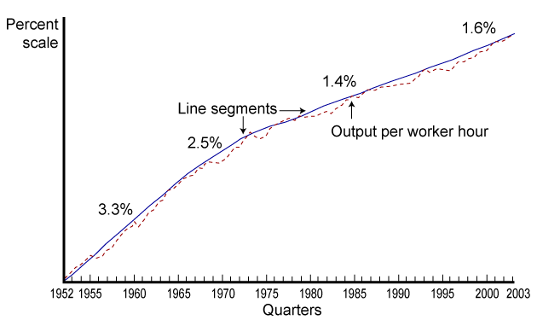
Output per Worker Hour
(Productivity), 1952-2003

Slide 65
Long-Run Output and Productivity Growth
Part of the reason for the upward trend in productivity is an increase in the amount of capital per worker. With more capital per worker, more output can be produced per year.
The other reason productivity has increased is that the quality of labor and capital has been increasing.

Slide 66
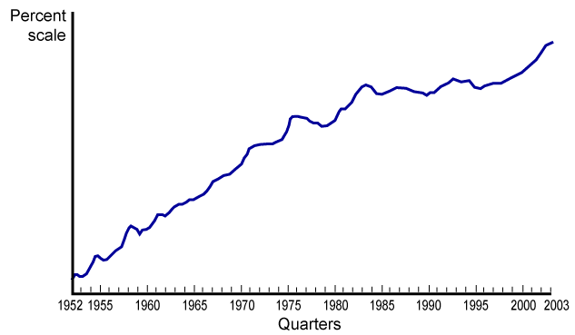
Capital per Worker, 1952-2003
Capital per worker grew until about 1980 and then leveled off.

Slide 67
Long-Run Output and Productivity Growth
A harder question to answer is why has productivity grown more slowly since the early 1970s.
The growth of the Internet, which brings about an increase in the quality of capital, should lead to a “new age” of productivity growth.

Slide 68
Real GDP and Unemployment Rates,
1929-1933 and 1980-1982
THE EARLY PART OF THE GREAT DEPRESSION, 1929–1933
YEAR | PERCENTAGE CHANGE IN REAL GDP |  | UNEMPLOYMENT RATE |  |  |  | NUMBER OF UNEMPLOYED (MILLIONS)
1929 |  |  | 3.2 |  |  |  | 1.5
1930 | −8.6 |  | 8.9 |  |  |  | 4.3
1931 | −6.4 |  | 16.3 |  |  |  | 8.0
1932 | −13.0 |  | 24.1 |  |  |  | 12.1
1933 | −1.4 |  | 25.2 |  |  |  | 12.8
Note: Percentage fall in real GDP between 1929 and 1933 was 26.6 percent.
THE RECESSION OF 1980–1982
YEAR | PERCENTAGE CHANGE IN REAL GDP |  | UNEMPLOYMENT RATE |  | NUMBER OF UNEMPLOYED (MILLIONS) |  | CAPACITY UTILIZATION (PERCENTAGE)
1979 |  |  | 5.8 |  | 6.1 |  | 85.2
1980 | −0.2 |  | 7.1 |  | 7.6 |  | 80.9
1981 | 2.5 |  | 7.6 |  | 8.3 |  | 79.9
1982 | −2.0 |  | 9.7 |  | 10.7 |  | 72.1
Note: Percentage increase in real GDP between 1979 and 1982 was 0.1 percent. Sources: Historical Statistics of the United States and U.S. Department of Commerce, Bureau of Economic Analysis.

