Slide 1
Co-Routines
By Dr. Bradford A. Towle Jr.

Slide 2
Objectives
How to use Co-Routines
Different forms of Waiting
Why Co-Routines are important
Examples
Waiting on your own Co-Routine
Avoiding the dangers of the Co-Routine

Slide 3
What is a Co-Routine
A Co-routine is a function that can temporarily surrender control.
When it wishes to surrender control it must use a yield statement and then it will “return” temporarily until a condition is met.

Slide 4


How to Start a Co-Routine
Method 1
Method 2
I can also pass parameters in here!

Slide 5
What Can We Wait For?
We can wait for:
Time
Bool variables
Other co-routines.

Slide 6
Why is This Important
This will be very useful for you in making:
Timers
An easy method for creating a thread
An easy way to run something after an event has occurred

Slide 7
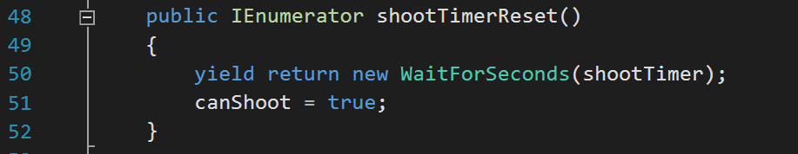
Shoot Timer
You would start this co-routine when after you fired a bullet and set canShoot to false.

Slide 8
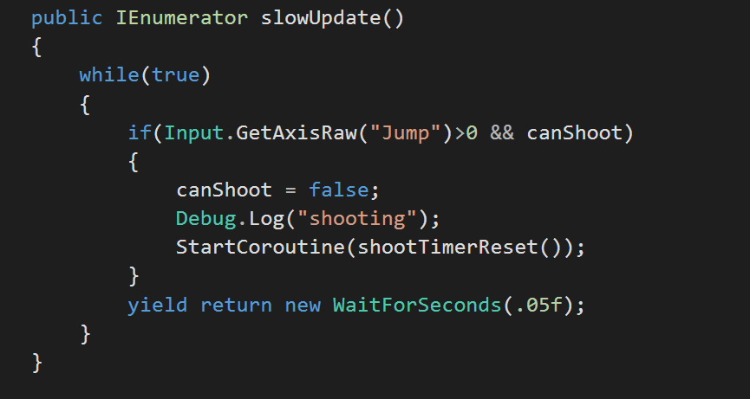
Reduced Computation with Slow Update
Running this co-routine, will act like update but it will only happen every 50 ms. (Instead of 60 to 120 times a second)

Slide 9
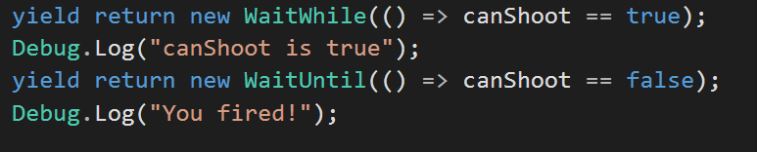
Waiting for A Boolean
We can wait until something is true or wait while something is true.

Slide 10

Waiting on Your Own Co-Routine
We can also wait for our own co-routines to finish before continuing execution.
Our custom co-routine

Slide 11
Dangers of Co-Routines
We do NOT want to do any of these with co-routines
Have an uncontrolled spawning of them.
There is a limit to how many your system can effectively have, if start a co-routine in you update MAKE SURE it doesn’t happen every frame
You want to be frugal with how many co-routines you have active at once.
This is especially true for scripts that are going to be on objects which are used in many different instances
Beware of shared data and race-conditions
If you use the co-routine as a thread, you will have the same pitfalls that threading introduces.
Luckily, the need for two co-routines to be accessing the same data the same time is pretty rare.

