Slide 1
Using AJAX to Consume a JSON Web Service
CS 261
Presented by Amy Cook

Slide 2
AJAX = Asychronous JavaScript And XML
A browser built-in object called XMLHttpRequest (to request data)
JavaScript and HTML DOM (to display or use the data)
Not just XML data; also uses plain text or JSON
Web pages can be updated asynchronously

Slide 3
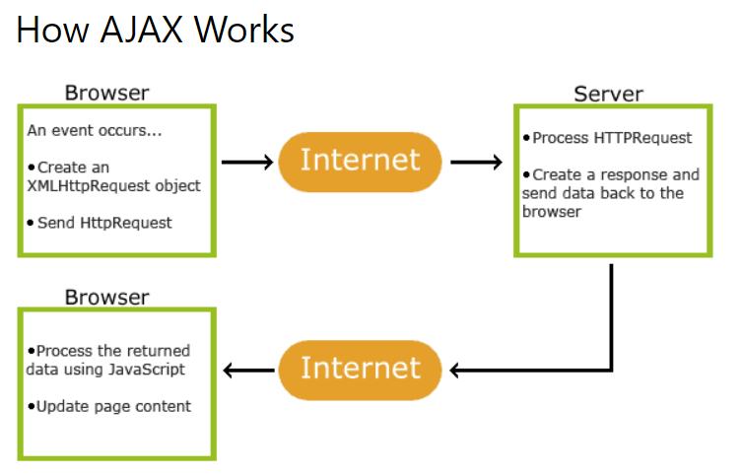

Slide 4
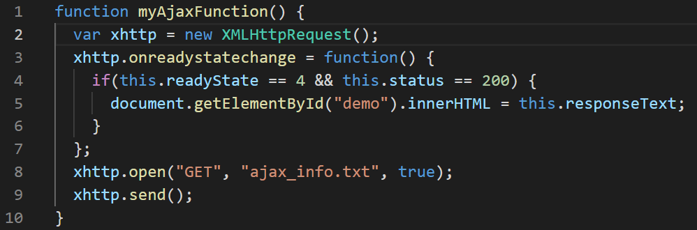

Slide 6
Creates a new built-in object
Variable name can be anything
httpRequest
jsonRequest
myRequest

Slide 7
onreadystatechange => object property
Defines a function
What will happen when something changes from the request

Slide 8
readyState => object property
Status of the request
0: request not initialized
1: server connection established
2: request received
3: processing request
4: request finished and response is ready

Slide 9
status => object property
Returns the status number of a request
200: “OK”
403: “Forbidden”
404: “Not Found”
More numbers defined at
https://www.w3schools.com/tags/ref_httpmessages.asp

Slide 10
What do you want to do with the response?
responseText => object property
Returns the response data as a string
responseXML => object property
Returns the response as XML data
Use a function call for more than a few lines.

Slide 11
open( ) => object method
Specifies the request
open(method, url, async, user, pwd)
method: GET or POST
url: file location
async: true(asynchronous) or false(synchronous)
user: optional user name
pwd: optional password

Slide 12
GET vs POST
GET
Used in most cases
Faster and simpler
POST
A cached file is not an option (update a file or DB on the server)
Sending large amounts of data (POST has no size limits)
Sending user input or sensitive information
Asynchronous – true or false
true
Recommended
Other scripts can execute while waiting for a response
Deal with the response after its ready
false
Quick testing
Older code
Don’t need onreadystatechange function
Your application will pause or stop until the response is ready

Slide 13
Send => object method
Sends the request to the server
Send(string) – used for POST requests

Slide 15
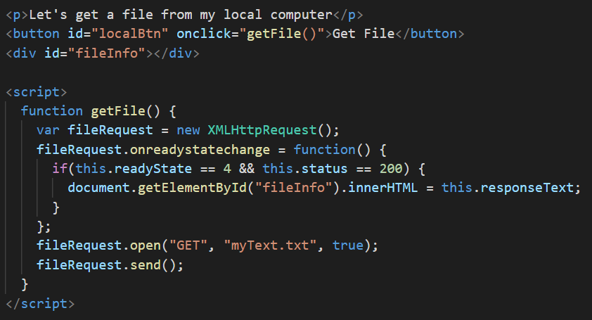
Example 1

Slide 16
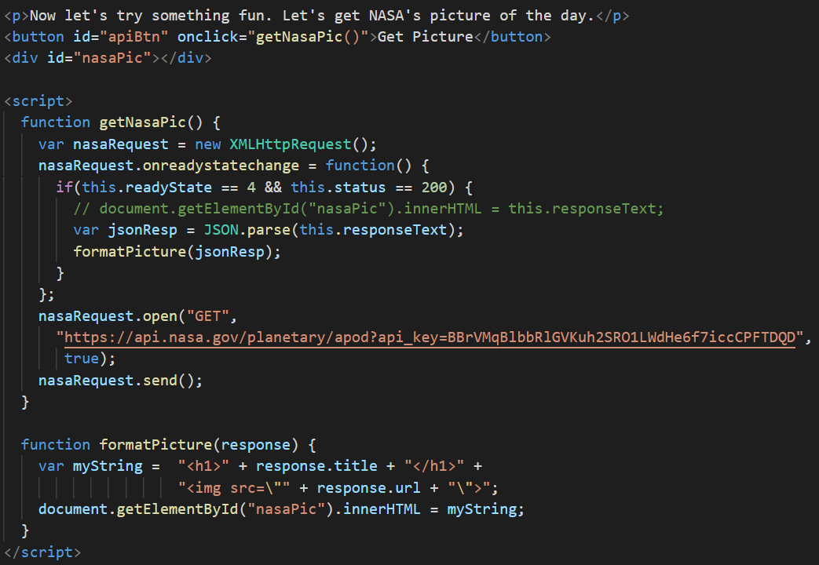
Example 2

