Slide 1
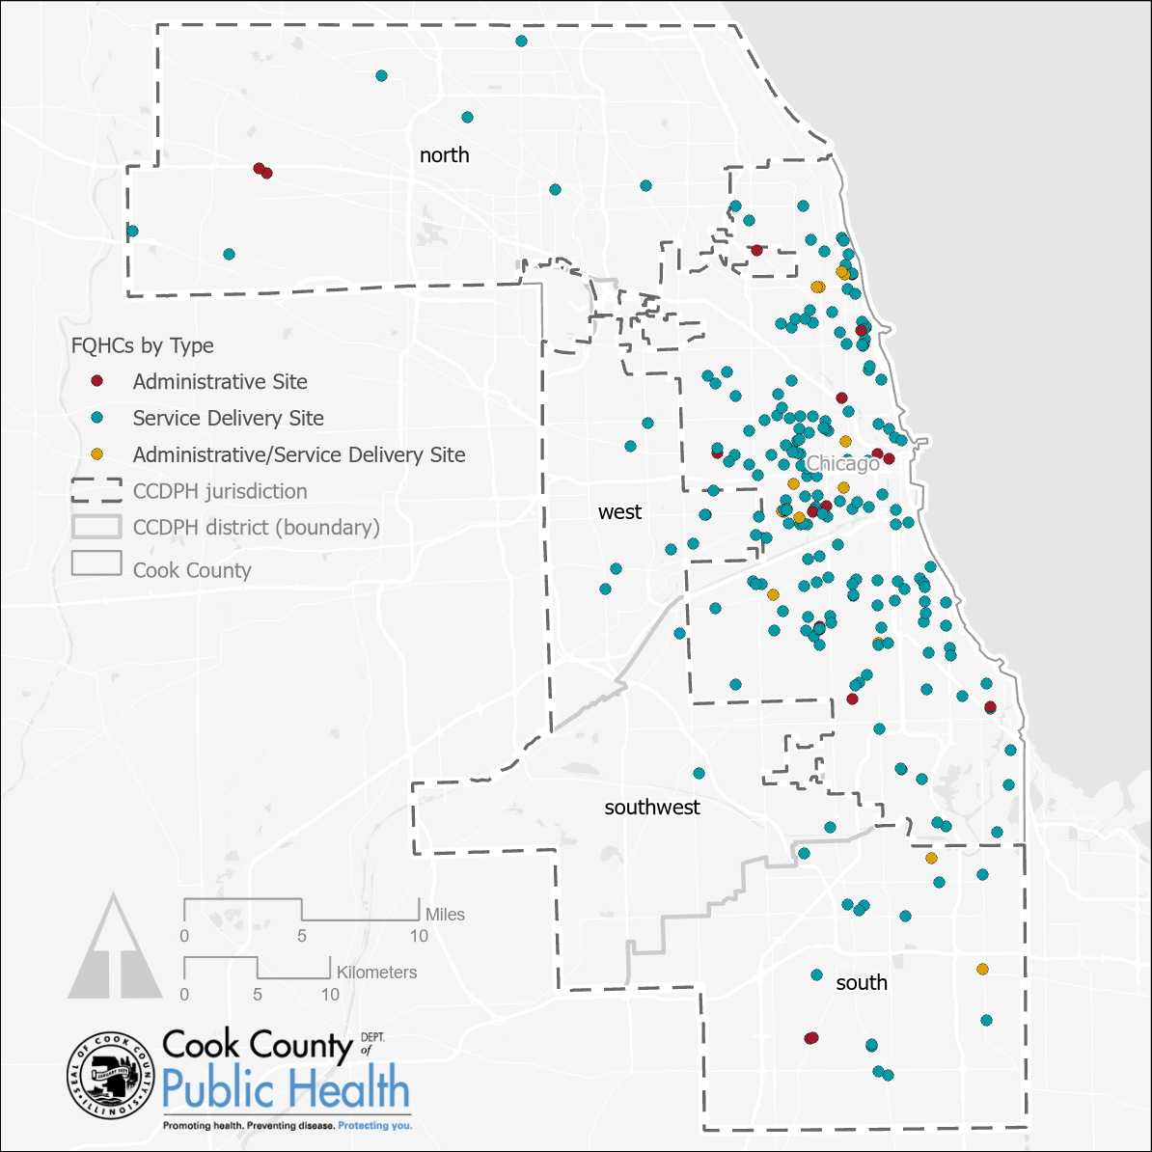
Federally Qualified Health Centers
Federally Qualified Health Centers are community-based health care providers that receive funds from the HRSA Health Center Program to provide primary care services in underserved areas.
There are 266 unique FQHC sites in Cook County, 200 (75%) of which are in the city of Chicago and 48 (18%) located within CCDPH’s jurisdiction.
Data source: FQHC data adapted, geocoded by CCDPH's Epi Unit from table downloaded from the US Health Resources and Services Administration (HRSA). Data current as of 6/13/2022.
https://data.hrsa.gov/data/reports/datagrid?gridName=FQHCs
Notes:
Federally Qualified Health Centers are community-based health care providers that receive funds from the HRSA Health Center Program to provide primary care services in underserved areas. They must meet a stringent set of requirements, including providing care on a sliding fee scale based on ability to pay and operating under a governing board that includes patients. Federally Qualified Health Centers may be Community Health Centers, Migrant Health Centers, Health Care for the Homeless, and Health Centers for Residents of Public Housing. The defining legislation for Federally Qualified Health Centers (under the Consolidated Health Center Program) is Section 1905(l)(2)(B) of the Social Security Act.

Slide 2
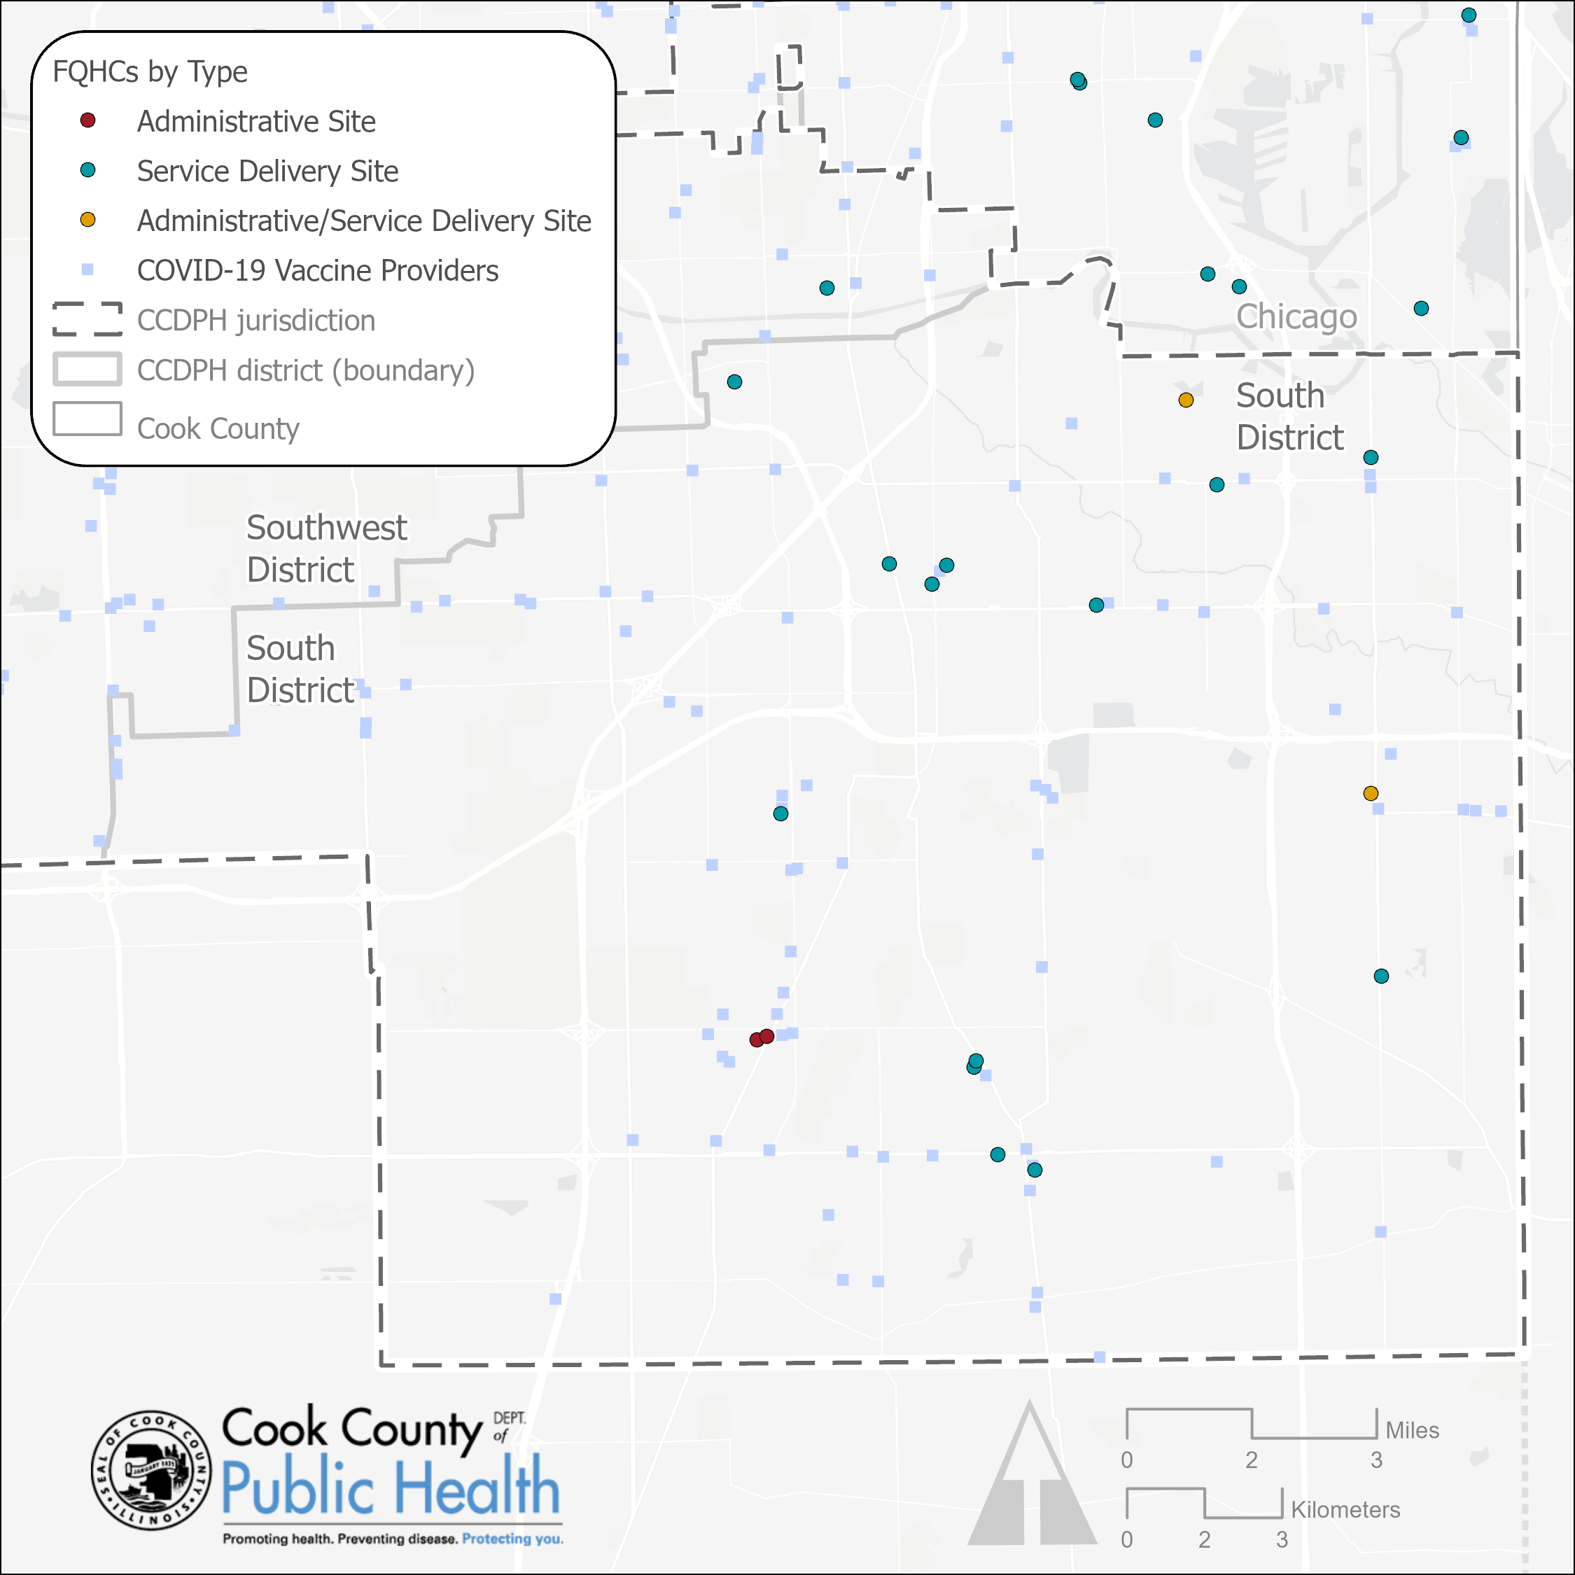
Federally Qualified Health Centers and
COVID-19 Vaccine Providers Located in
CCDPH’s South District
A total of 1,381 health providers in Cook County have administered COVID-19 vaccines, 590 (43%) of which are in CCDPH’s jurisdiction. These providers include pharmacies, hospitals, clinics, government facilities and FQHCs. 93 of the 590 (15.8%) providers are within the South District.
19 of the 48 (40%) FQHCs located within CCDPH’s jurisdiction are within the South District.
Data sources: FQHC data adapted, geocoded by CCDPH's Epi Unit from table downloaded from the US Health Resources and Services Administration (HRSA). Data current as of 6/13/2022.
https://data.hrsa.gov/data/reports/datagrid?gridName=FQHCs; COVID-19 Vaccine Providers adapted by CCDPH’s Epi Unit from daily I-CARE COVID-19 provider reports. Data current through 10/31/2021
Notes:
Federally Qualified Health Centers are community-based health care providers that receive funds from the HRSA Health Center Program to provide primary care services in underserved areas. They must meet a stringent set of requirements, including providing care on a sliding fee scale based on ability to pay and operating under a governing board that includes patients. Federally Qualified Health Centers may be Community Health Centers, Migrant Health Centers, Health Care for the Homeless, and Health Centers for Residents of Public Housing. The defining legislation for Federally Qualified Health Centers (under the Consolidated Health Center Program) is Section 1905(l)(2)(B) of the Social Security Act.

Slide 3
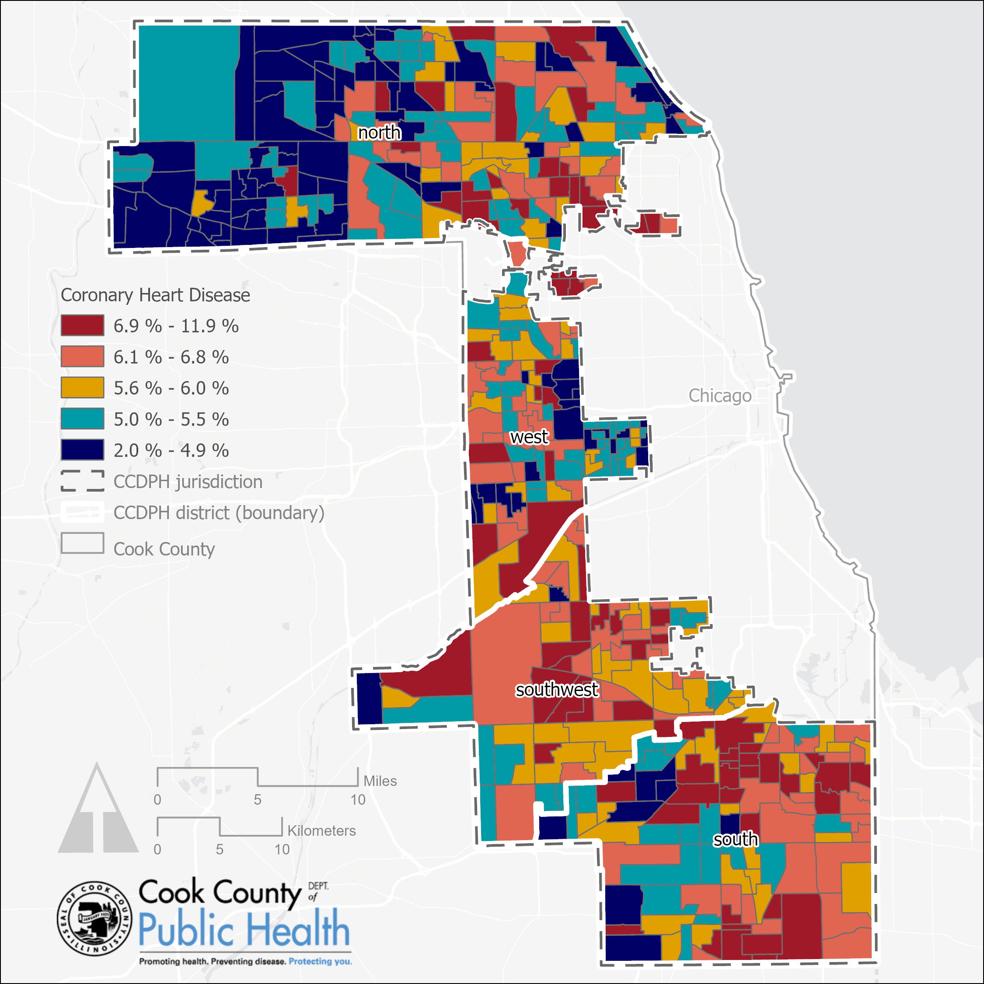
Coronary Heart Disease
Among Adults Aged ≥ 18 Years
This map shows the prevalence of respondents aged ≥18 years who report ever having been told by a doctor, nurse, or other health professional that they had angina or coronary heart disease.
Prevalence data from Behavioral Risk Factor Surveillance System (BRFSS) (numerator) and population estimates from the U.S. Census Bureau (denominator).
Data source: CDC PLACES (2021); US Census Bureau TIGER/Line shapefiles (2019); CCDPH

Slide 4
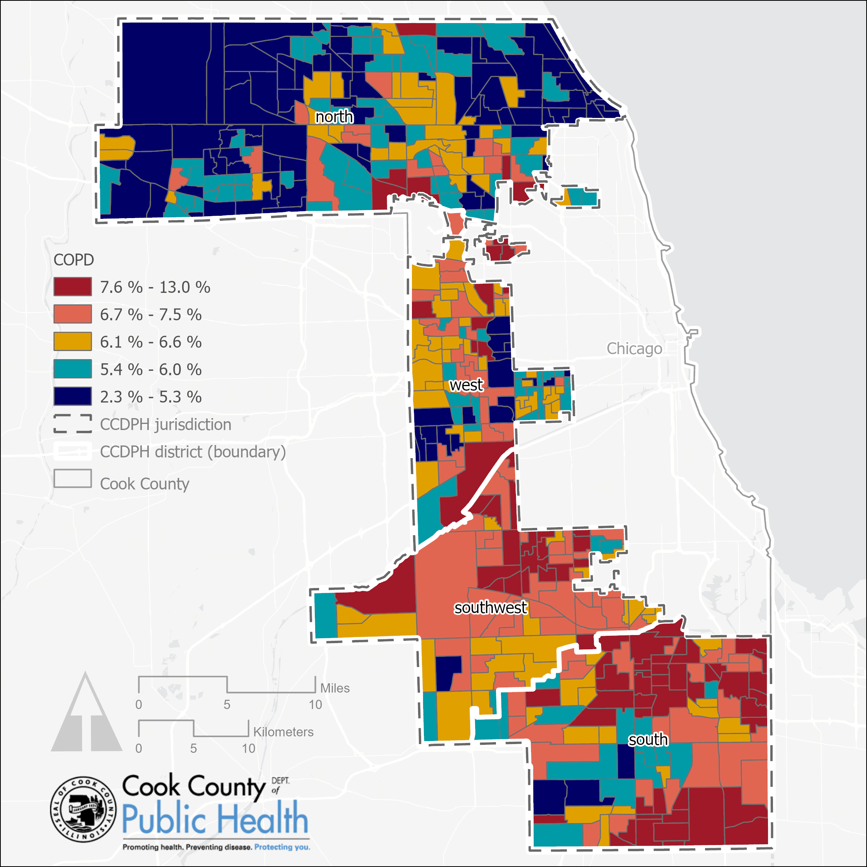
Chronic Obstructive Pulmonary Disease (COPD)
Among Adults Aged ≥ 18 Years
This map shows the prevalence of respondents aged ≥18 years who report ever having been told by a doctor, nurse, or other health professional that they had chronic obstructive pulmonary disease (COPD), emphysema, or chronic bronchitis.
Prevalence data from Behavioral Risk Factor Surveillance System (BRFSS) (numerator) and population estimates from the U.S. Census Bureau (denominator).
Data source: CDC PLACES (2021); US Census Bureau TIGER/Line shapefiles (2019); CCDPH

