Slide 1
Best Practices for Managing Reproducible Workflows: CCDPH’s Epi Handbook case study
C. Scott Smith, PhD AICP
Notes:
Session topic: Best Practices for Managing Reproducible Workflows (CCDPH’s Epi Handbook case study)

Slide 2
Outline
REPRODUCIBLE workflows
Ccdph workflow infrastructure
EPI HANDBOOK Examples
Q & a discussion
Notes:
The value of documenting standard epidemiological practices
Data and document management using GitHub, Quarto, and SQL Server
Example 1: Geographies and populations Example 2: Mortality indicators
Example 3: Data briefs and reports
Resources and discussion

Slide 3
DATA SOURCES
Secondary data from IDPH
updated annually
Secondary data from IDPH
updated annually
Secondary data from IDPH
updated quarterly
Inpatient and outpatient hospital discharge records of CCDPH residents
Line level mortality and natality records of residents within CCDPH’s jurisdiction
Prevalence rates of select health outcomes calculated using clinical health records
Primary data contingent on funding
Secondary data update schedules vary
Surveys of SCC youths and adults concerning their health status, access and behaviors
Socioeconomic, environmental, other data used to evaluate neighborhood context
HOSPITAL-IZATION
VITAL STATISTICS
ELECTRONIC HEALTH RECORDS
Data are used to create indicators to evaluate rates across: (1) population groups; (2) places; and (3) time periods
HEALTH SURVEYS
SOCIAL ECOLOGICAL

Slide 4


DATA DISSEMINATION
CCDPH STORYMAPS, DASHBOARDS AND REPORTS
SUBURBAN COOK COUNTY HEALTH ATLAS
Online health indicator data exploration, visualization, and sharing platform designed for the broadest range of users
Immersive, topic-specific public health information presented using a combination of multimedia content including text and interactive maps
CCDPH GITHUB REPOSITORIES
CCDPH DATA REQUESTS
Delimited datasets, geographic feature layers and associated programming code made available for expert users
Online forms for partner agencies, researchers, community groups and the general public to request custom CCDPH datasets.

Slide 5
REPRODUCIBLE WORKFLOWS
Enhance the quality of epidemiological data
Consistency
Efficiency
Training and onboarding
Reliability
Reproducible workflows offer several advantages over ad hoc approaches to epidemiological data management…
Transparency
Quality control
Scalability; Adaptability
Collaboration
Regulatory compliance
Coordinate work across multiple authors and audiences
Accelerate the development of epidemiological data

Slide 6




WORKFLOW INFRASTRUCTURE
01
03
02
04
An integrated development environment (IDE) for R (and Python), designed to streamline data analysis, visualization, and statistical computing.
Platform for version control and collaboration, enables epidemiologists to manage and share code, track changes, and collaborate via private, project-specific repositories.
Relational database management system that stores, retrieves, and manages raw, formatted, and other epidemiological data.
Publishing system that enables the creation of dynamic documents, reports, presentations, and websites, integrating code, text, and visualizations across programming languages.

Slide 7
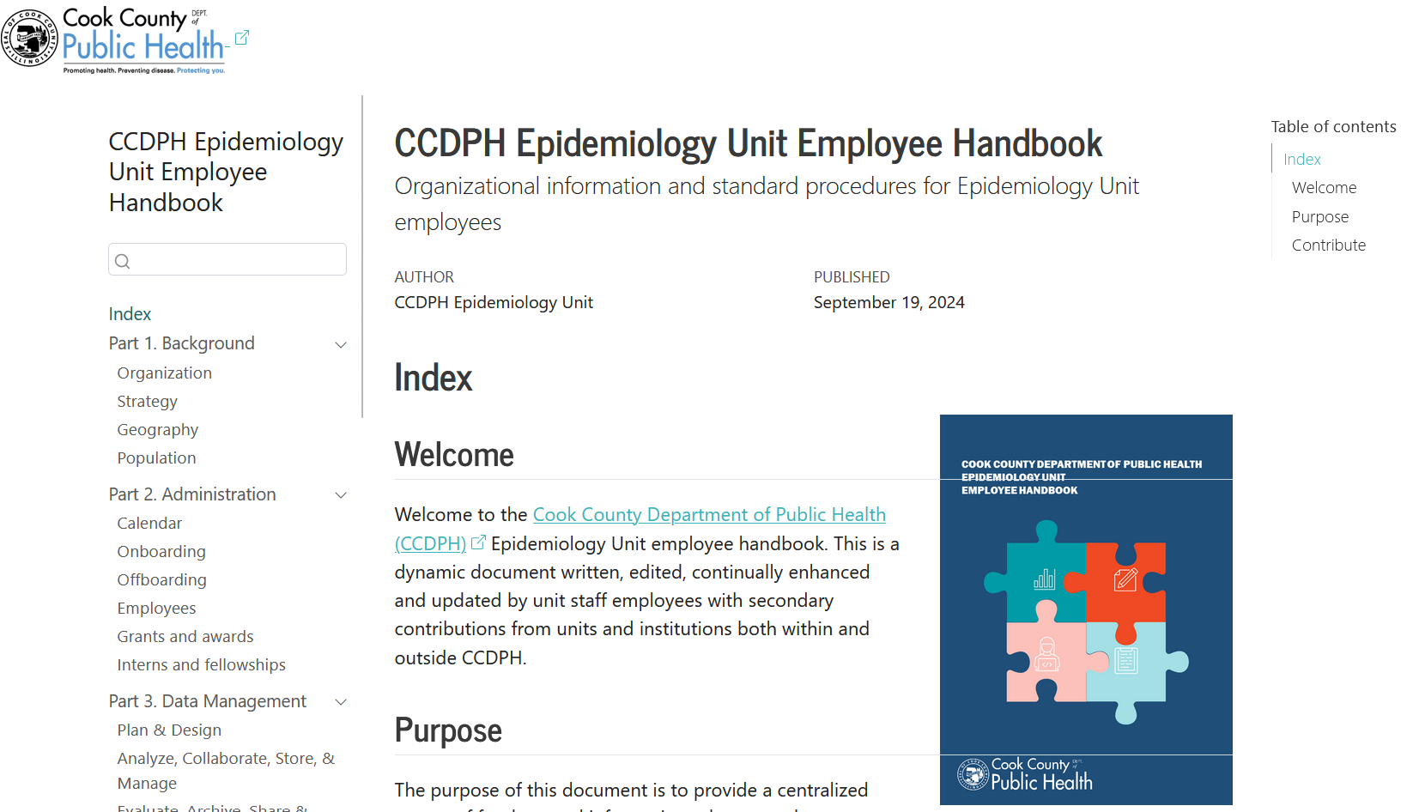
CCDPH EPI HANDBOOK
Notes:
https://justenvirons.org/epihandbook/

Slide 8



WORKFLOW EXAMPLES
…
DATA PROCESSING
DATA BRIEF DEVELOPMENT
NEXT STEPS
ONBOARDING

Slide 9
THANK YOU! QUESTIONS?
C. Scott Smith, PhD AICP
Program Coordinator
Epidemiology Unit
Cook County Department of Public Health
christopher.smith@cookcountyhealth.org

