Slide 1
ELEC 3050 Lab Project
Ethan Cook

Slide 2
Overview
Keypad
Micro-
controller
Motor drive
Motor
Tachometer
AND Gates
Signal Conditioning

Slide 3
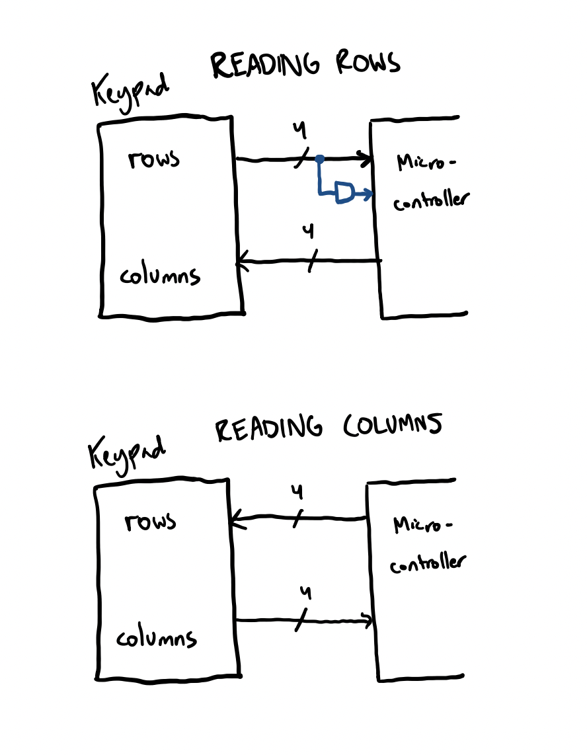
Keypad (Requirement A)
AND the row signals to generate a keypad interrupt signal
Reads rows then columns
Inputs are configured with pull-up resistors

Slide 4
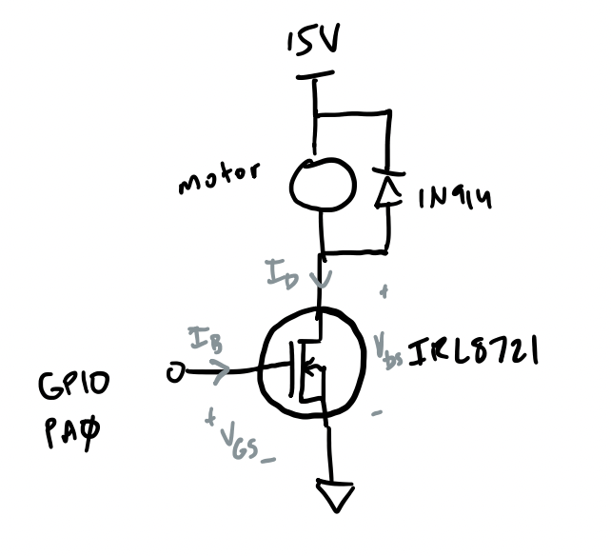
Motor Drive (Requirement C)
Motor can receive 15V
GPIO PA0 outputs PWM signal
Flyback diode needed to protect circuit
MOSFET transistor is used

Slide 5
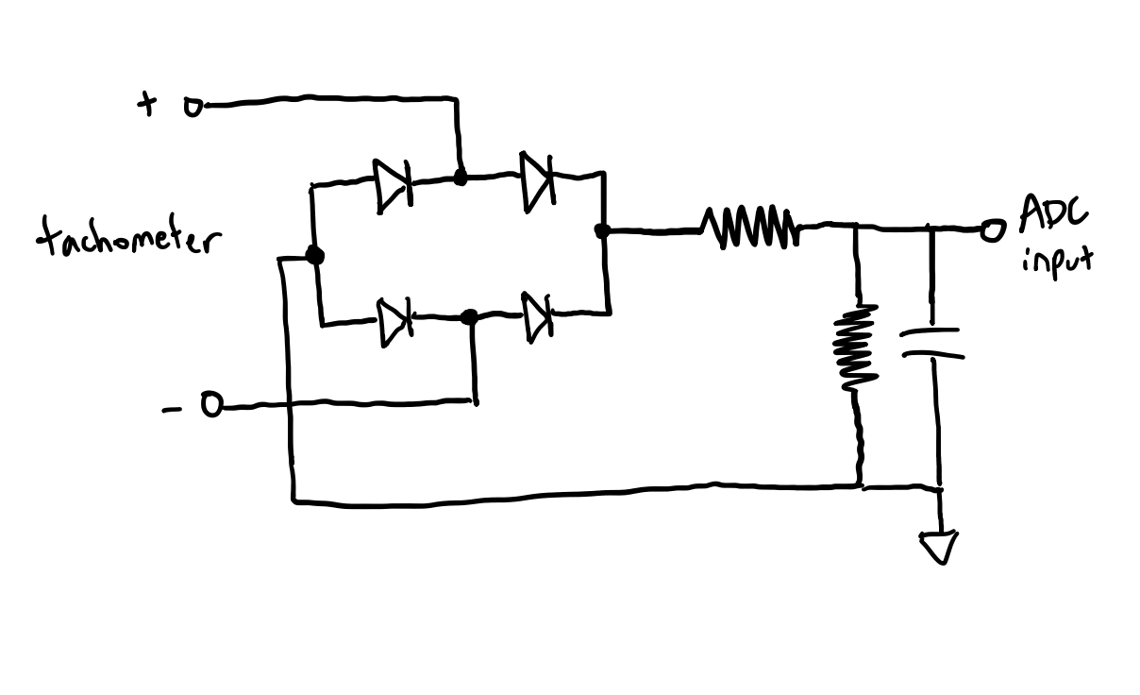
Signal Conditioning
Need to convert max 20V AC signal to max 3.3V DC signal
Uses a bridge rectifier, attenuator, and lowpass filter

Slide 6
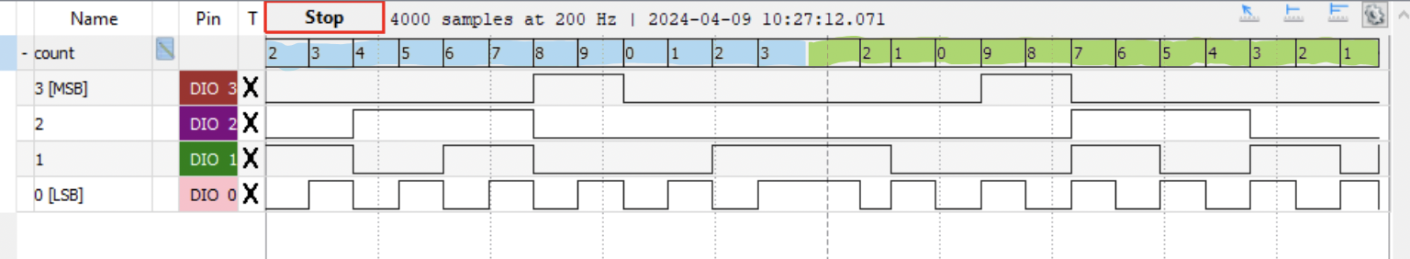
Counter (Requirement D)
Counter period is in the range of 792 ms to 808 ms
Counter starts/stops (*) and counts up/down (#)
Counter value rolls over

Slide 7
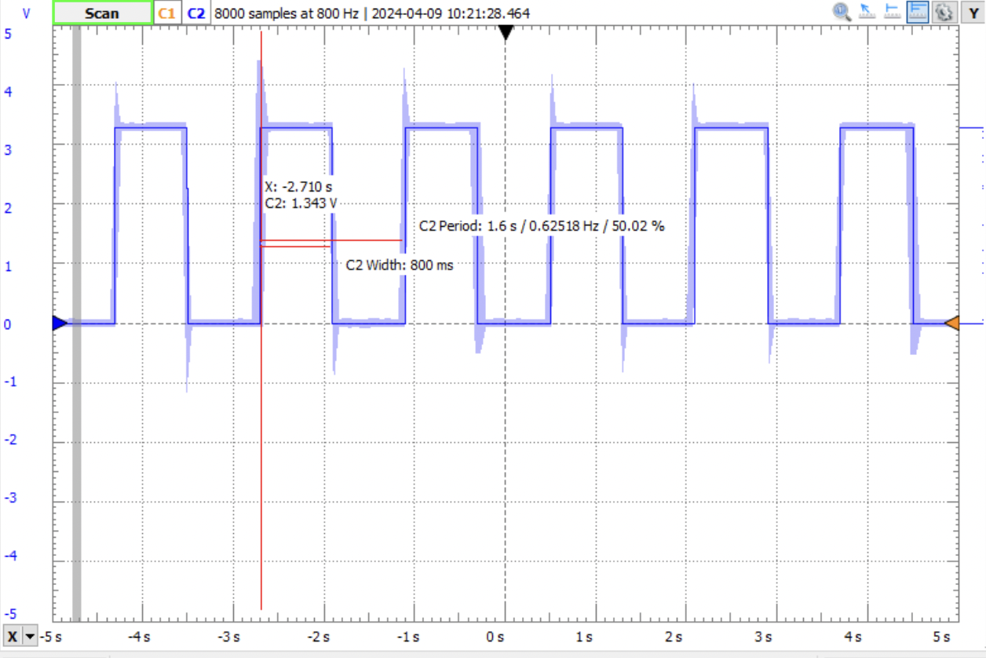

Slide 8

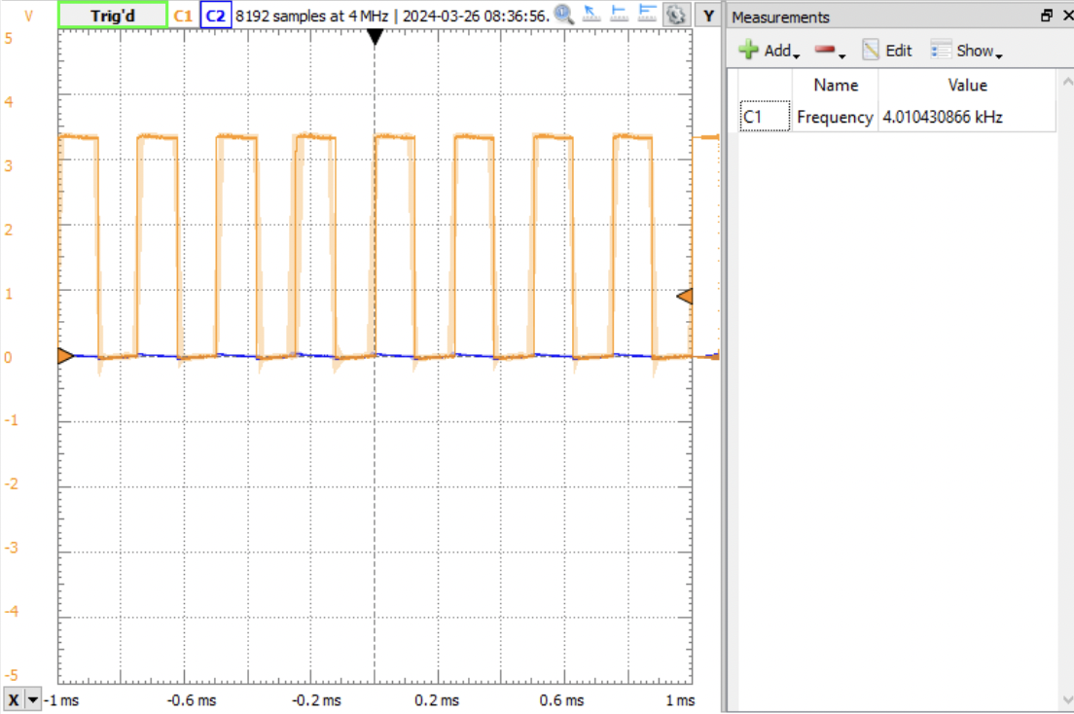
PWM Signal (Requirement B)
Produces 4 kHz PWM signal
10 different duty cycles to choose from
Duty cycles selected by keypad (0-A)

Slide 9
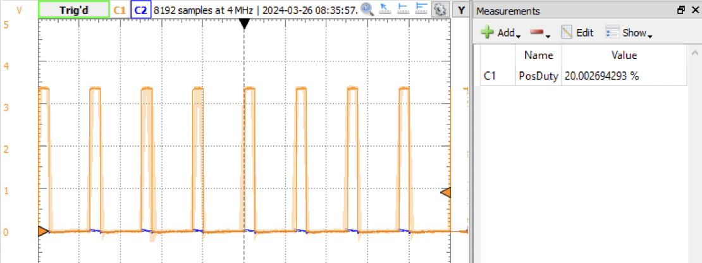
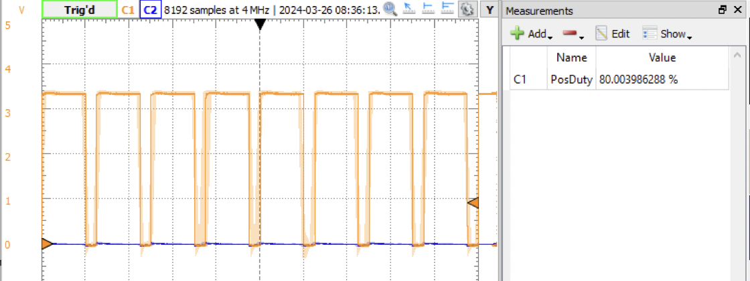

Slide 10
Feedback Control (Requirement E)
ADC read values range between 0x000 and 0xE00
Desired speeds set at 0x300, 0x600, 0x900, and 0xC00
Keypad “D” used to cycle between desired speeds
Sampling every 12.5 ms
Speed 1
Speed 2
Speed 3
Speed 4
Off

Slide 11
PID Controller
Proportional
Integral
Derivative
Control output is proportional to the current error
Proportional term alone results in a residual error
Control output is a function of current error and past error
Integral term eliminates residual error
Control output is a prediction of future error
Derivative term estimates future trends of error
P
+
∑
I
+
∑
Process
Desired
Actual
+
-
+
D

Slide 12
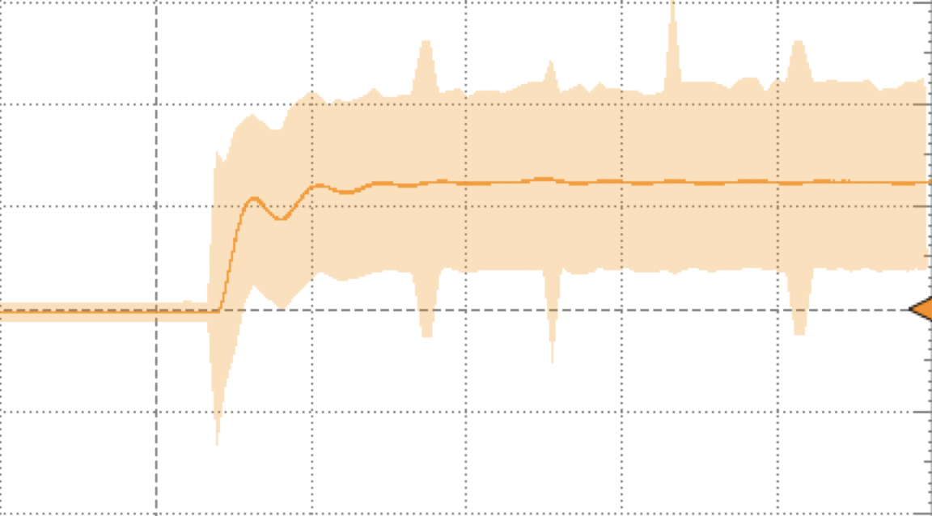
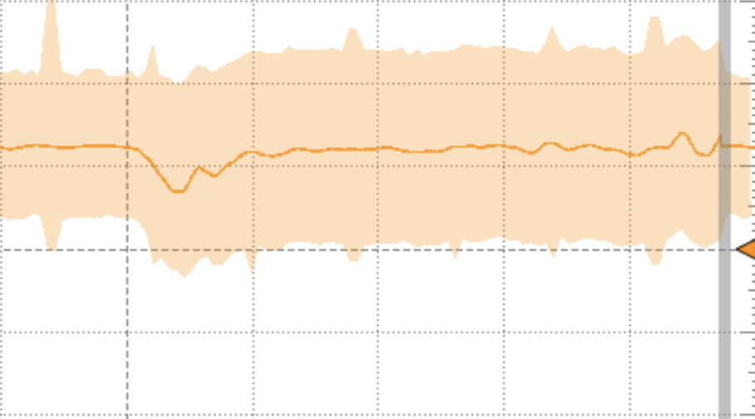
Feedback Control: Off to Speed 1
Feedback Control: Finger pressure

Slide 13
Issues During the Project
ADC input errors
Keypad Debounce
Inputs would jump around 0x400
Feedback control wouldn’t work
Troubleshot
Fixed configuration
Buttons are double pressed with an interval of around 60 ms
Swapped keypads
Added delay in code

Slide 14
Thank you
Ethan Cook
efc0009@auburn.edu

