Slide 1
Energy Management

Slide 2
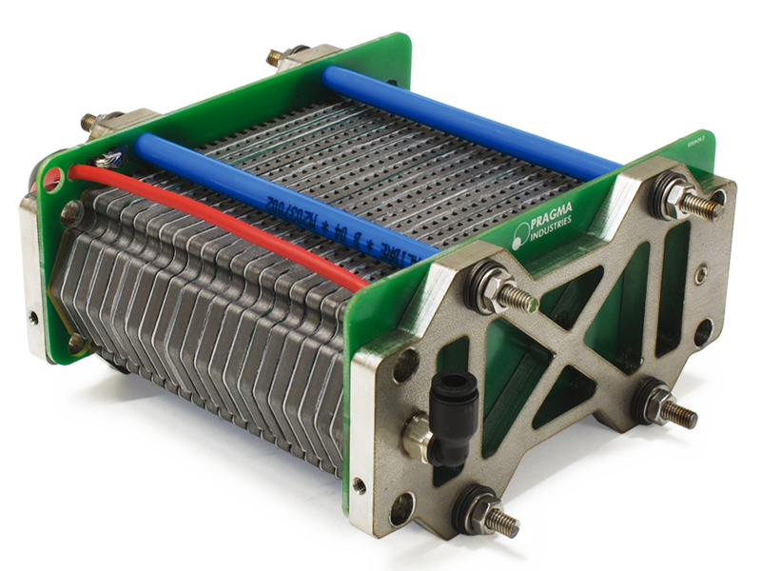
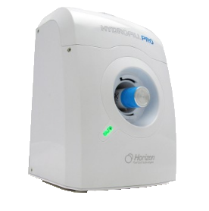




Slide 3
Optimization

Slide 4

Load Profile
Power Profile

Slide 6

POWER > LOAD

Slide 7
Tank
Stability
Feasibility

Slide 8
POWER > LOAD

Slide 9
Fuel Cell
120 kw
60 kw

Slide 10
Fuel Cell
120 kw
60 kw
+
Battery

Slide 11
Electrolyzer
500 lit/min

