Slide 1
ASP.NET Core Blazor Presentation
ZeLing Chen

Slide 2
Today’s topic
Data binding in ASP.NET Core Blazor
ASP.NET Core Blazor component parameter
ASP.NET Core Blazor cascading parameter and values

Slide 3
Data binding in Blazor

Slide 4
What is data binding?
A general technique that connects data sources to UI elements
Allows the separation of concerns
Simpler and more maintainable apps

Slide 5
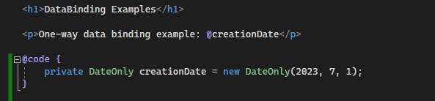
One-way data binding

Slide 6
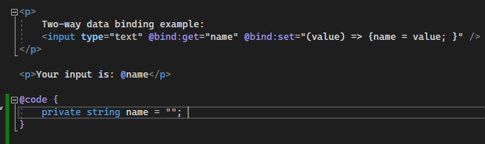
Two-way data binding

Slide 7
Unparsable value
By default, the value will be reverted after the user changes the focus
If specified “oninput”, user will not be able to type illegal characters into the input textbox.

Slide 8
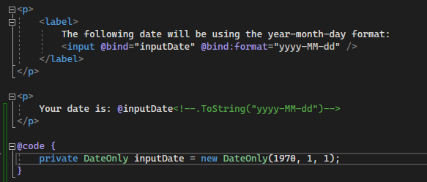
Format String
Only DateTime data type accepts format string in Blazor as of right now
For other datatype, use a custom get and set accessor

Slide 9
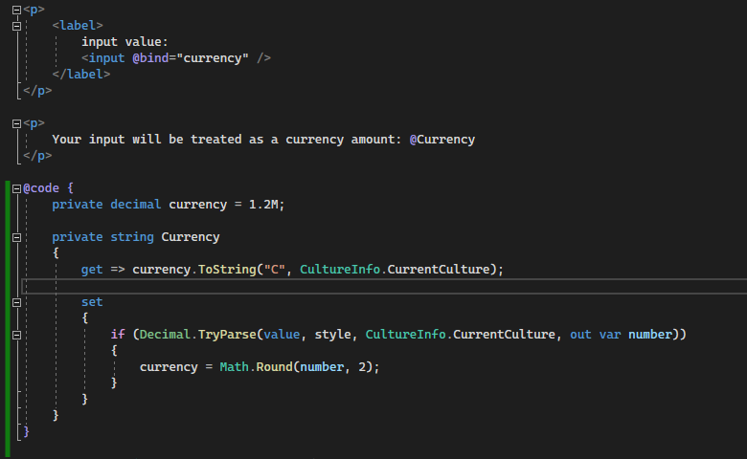
Sample custom accessor

Slide 10
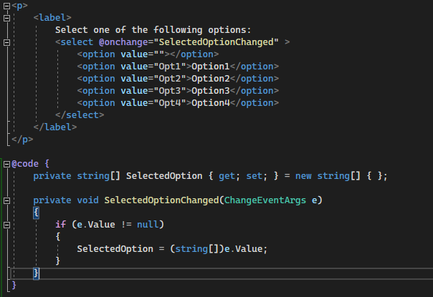
Bind to <select> element

Slide 11
Limitation of Binding to <select> element
The data in question must be an array.
There is no meaningful representation of null.
If the user select the option with no value, Blazor will treat it as an empty string value.

Slide 12
Binding with component parameter
Also know as chained bind
There is no number limitation to the number of nested components you can bind through, but you must respect the one-way flow of data:
Change notifications flow up the hierarchy
New parameter values flow down the hierarchy

Slide 13
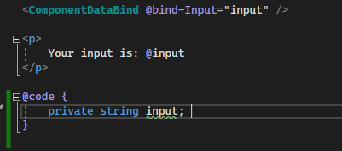
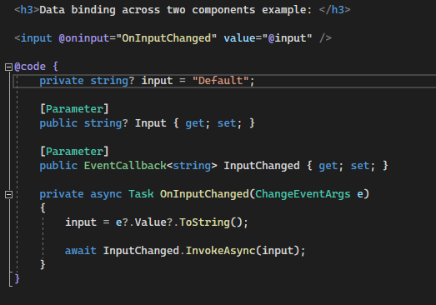
Bind to component parameter sample
Parent component
Child Component

Slide 14
Component parameter

Slide 15
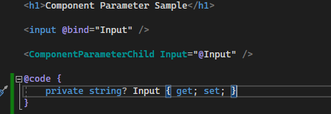
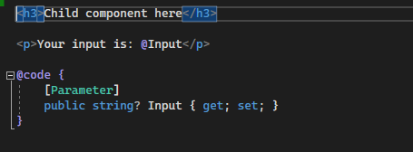
What is a component parameter?
One of the ways of passing data between components
Parent component
Child component

Slide 16
Accidental overwrite
These actions may result in the child component parameter being overwritten:
Allowing the child component to write to the parameter directly
The child component in question has one or more data-bound parameters
Re-rendering the parent component
Avoid creating components that directly write to its own parameter after the initial rendition.

Slide 17
Cascading values and parameters

Slide 18
What is cascading values and parameters?
A way to flow data down a component hierarchy
Similar to component parameter

Slide 19
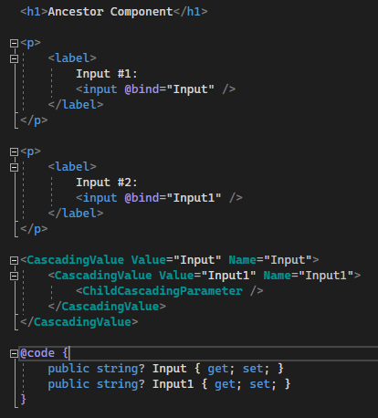
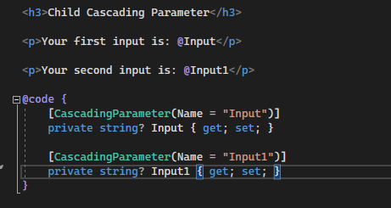
Sample Cascading parameter and value
Parent component
Child component

Slide 20
Demo

Slide 21
The End

