Slide 1
TETRIS Văn Hoàng Quế Anh – ITITIU19003 Trần Thành Công – ITITIU19089 Lương Phúc Điền – ITITIU19010 Dương Minh Lộc – ITITIU19024

Slide 2
OUTLINE
An overview about the game
UML
Diagram
Future features
?
?
?

Slide 3
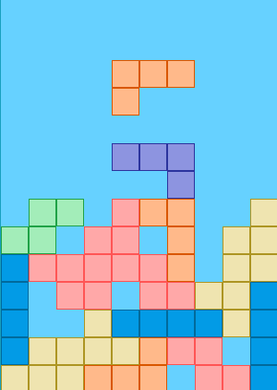
OVERVIEW
BUTTONS
FEATURERS

Slide 4
UML DIAGRAM

Slide 5
FUTURE FEATURES
Game over screen
Change background
Bomb

Slide 6
SUMMARY
1
2
3
OVERVIEW
UML DIAGRAM
Buttons
Features
Closer look into the game
FUTURE FEATURES
Game over screen
Change background
Bomb

Slide 7
THANK YOU

Slide 8
QUESTIONS

