Slide 1

P.E.S Modern College Of Engineering
Department of Artificial Intelligence & Data Science
Project Title : Food-Share
Project By :
Shloka Nanna(32541)
Sayali Navale(32542)
Gunjan Rane(32553)
Yash Savdekar(32554)
Saksham Sharma(32557)

Slide 2
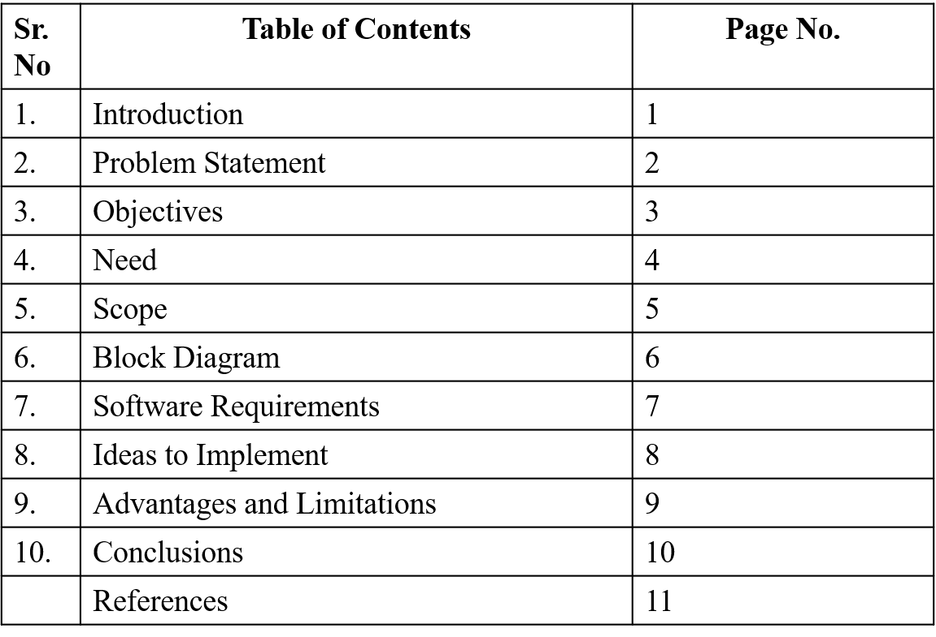
Index

Slide 3
Introduction
This platform aims to connect hotels with surplus food to NGOs that need food donations. By acting as an intermediary, it facilitates seamless communication between hotels and NGOs to ensure food that would otherwise go to waste is donated to those in need.

Slide 4
Problem Statement
Food waste in hotels is a significant issue, with tons of food being discarded daily. At the same time, NGOs are constantly seeking food donations to serve those in need. There is no efficient system to bridge the gap between food waste and the requirements of NGOs. This platform offers a solution by connecting hotels with excess food directly to NGOs.

Slide 5
Objectives
To reduce food wastage by connecting hotels with surplus food to NGOs.
To streamline the process of food donation, making it quick and easy for hotels to contribute.
To ensure NGOs have real-time access to food donations based on their needs.
To facilitate communication and coordination between hotels and NGOs.

Slide 6
Need
Minimizing Food Waste: Reduce the amount of food wasted in hotels by redirecting surplus to NGOs.
Support for NGOs: Provide NGOs with easy access to food donations.
Efficient Coordination: Enable a structured process for food donation and distribution.
Awareness Creation: Encourage sustainable food practices within the hospitality industry.

Slide 7
Scope
Hotel and NGO Registration: A platform where hotels and NGOs can register and manage their profiles.
Food Donation Management: Hotels can notify NGOs when surplus food is available.
Contact and Coordination: Secure communication channels between hotels and NGOs for donation logistics.
Tracking Donations: A system to keep track of donations and ensure transparency.

Slide 8
Software Requirement
Front-End:
HTML, CSS (Bootstrap), JavaScript
Back-End:
NodeJS, SQL for database and server management
Editor:
VS Code, WebStorm

Slide 9
Ideas to Implement
Real-time Notifications: Notify NGOs when hotels have surplus food available.
Food Collection Scheduling: Allow NGOs to schedule pickups based on availability.
Food Expiry Monitoring: Implement a system to ensure only safe and fresh food is donated.
Impact Metrics: Track and display the amount of food saved from wastage and the number of people helped.
Partnerships: Collaborate with logistics companies to ease food transportation.

Slide 10
Advantages And Limitations
Advantages:
Reduces food wastage significantly in the hospitality sector.
Helps NGOs access food quickly and efficiently.
Encourages sustainable and responsible food practices.
Limitations:
The platform may initially be limited to certain regions.
Challenges related to food safety and transportation logistics.

Slide 11
Conclusion
This food donation platform creates a bridge between hotels with surplus food and NGOs that need donations. It not only helps reduce food waste but also serves as a vital resource for NGOs working to support those in need, ensuring a win-win situation for both sectors.

