Slide 1
實作課程 Lesson 04
蔡秉文
Cookie Tsai

Slide 2
You Will Learn
認識 HBase
認識 Hive
Hive MetaStore
Hive Server 2
如何使用 HBase Shell
如何使用 Beeline 和 Hive Shell
Notes:
* 如果這些問題 任何其中一個造成排程延遲或需要進一步討論，請將細節放入下一張投影片。

Slide 3
Big Data 的起源 Google 三篇論文
The Google File System http://research.google.com/archive/gfs.html
MapReduce: Simplified Data Processing on Large Clusters http://research.google.com/archive/mapreduce.html
Bigtable: A Distributed Storage System for Structured Data http://research.google.com/archive/bigtable.html

Slide 4
What is HBase
A kind of NoSQL
Manipulation in HDFS
Using column family qualifier
Each Row-Key is also a indexed column
Row-Key | Column |  | Timestamp | Value
 | Family | Qualifier
row1 | cf | name | 1442053885486 | Tom
row2 | cf | name | 1442053885487 | Mary
row2 | cf | phone | 1442053885487 | 0999XXXXXX
row3 | cf | name | 1442053885486 | John

Slide 5
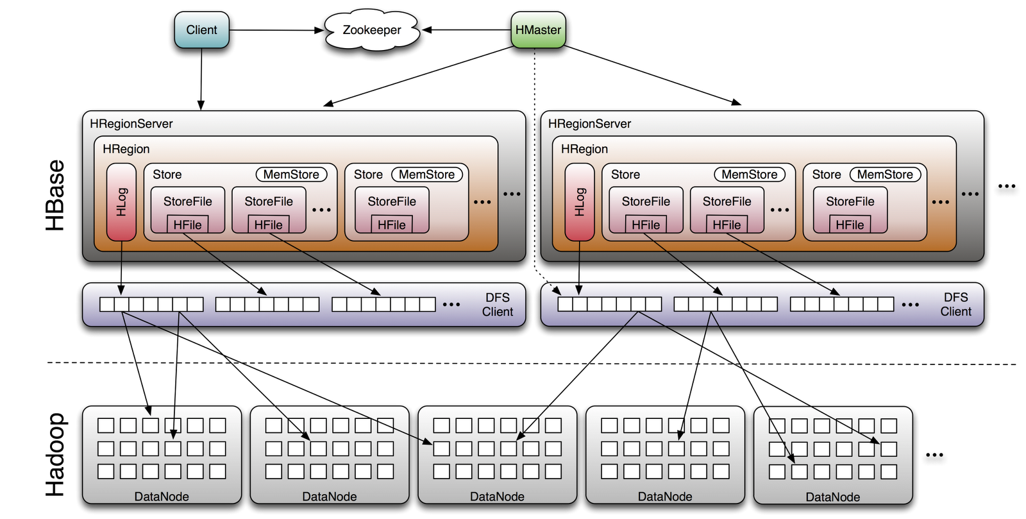
HBase Architecture

Slide 6
What is Hive
Data warehouse software facilitates querying and managing large datasets residing in distributed storage.
SQL-like language called HiveQL
At the same time this language also allows traditional map/reduce

Slide 7
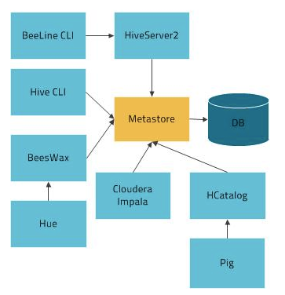
Hive Metastore Architecture

Slide 8
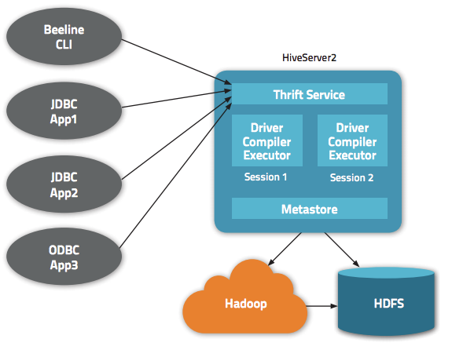
Hiveserver2

Slide 9
Reference
HBase Getting Started
https://hbase.apache.org/book.html#quickstart
Hive Getting Started
https://cwiki.apache.org/confluence/display/Hive/GettingStarted

Slide 10
Thank you for your listening

