Slide 1
實作課程 Lesson 02
蔡秉文
Cookie Tsai

Slide 2
Big Data 的起源 Google 三篇論文
The Google File System http://research.google.com/archive/gfs.html
MapReduce: Simplified Data Processing on Large Clusters http://research.google.com/archive/mapreduce.html
Bigtable: A Distributed Storage System for Structured Data http://research.google.com/archive/bigtable.html

Slide 3
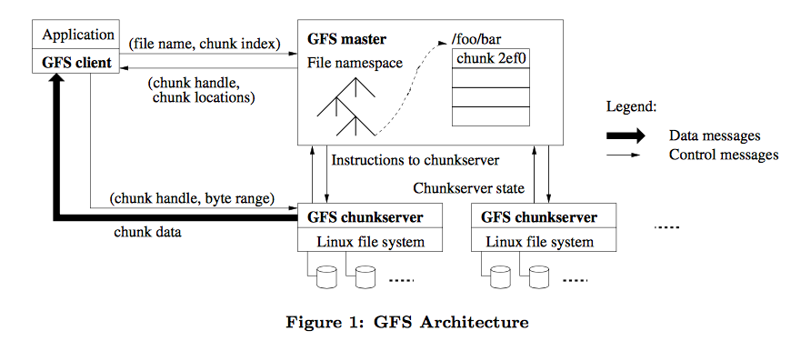
The Google File System Architecture
Notes:
* 如果這些問題 任何其中一個造成排程延遲或需要進一步討論，請將細節放入下一張投影片。

Slide 4
What is Apache Hadoop
Hadoop Common
The common utilities that support the other Hadoop modules.
Hadoop Distributed File System (HDFS™)
A distributed file system that provides high-throughput access to application data.
Hadoop YARN
A framework for job scheduling and cluster resource management.
Hadoop MapReduce
A YARN-based system for parallel processing of large data sets.

Slide 5
HDFS Overview
HDFS is the primary distributed storage used by Hadoop applications.
A HDFS cluster primarily consists of a NameNode that manages the file system metadata and DataNodes that store the actual data. The HDFS Architecture Guide describes HDFS in detail.
This user guide primarily deals with the interaction of users and administrators with HDFS clusters.
The HDFS architecture diagram depicts basic interactions among NameNode, the DataNodes, and the clients.
Clients contact NameNode for file metadata or file modifications and perform actual file I/O directly with the DataNodes.

Slide 6
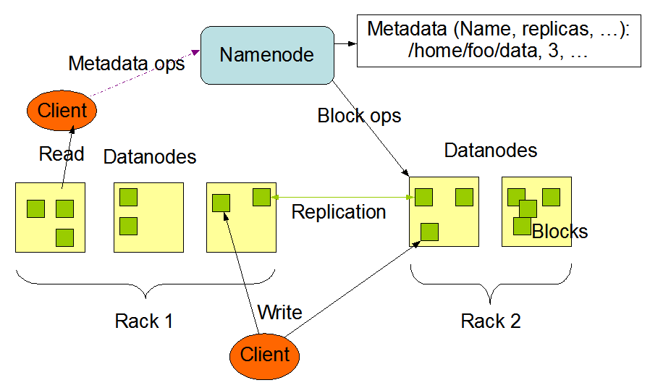
HDFS Architecture

Slide 7
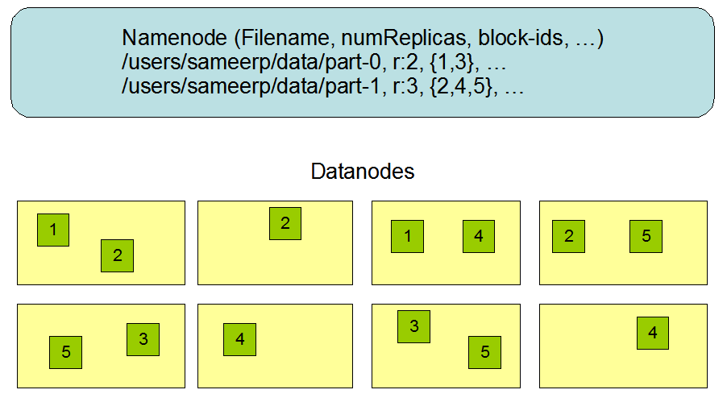
Block Replication

Slide 8
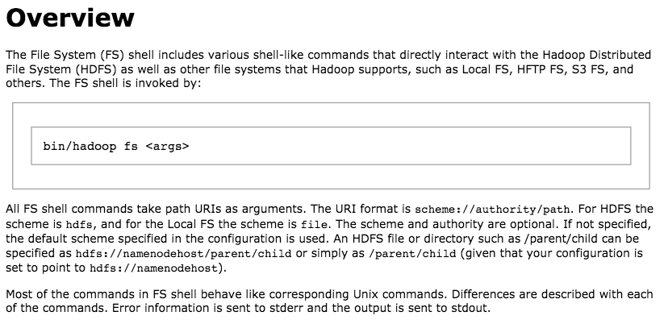
HDFS Shell Commands

Slide 9
Reference
HDFS Users Guide
http://hadoop.apache.org/docs/current/hadoop-project-dist/hadoop-hdfs/HdfsUserGuide.html
File System Shell Guide
http://hadoop.apache.org/docs/current/hadoop-project-dist/hadoop-common/FileSystemShell.html
HDFS Architecture
http://hadoop.apache.org/docs/current/hadoop-project-dist/hadoop-hdfs/HdfsDesign.html

Slide 10
Thank you for your listening

