Slide 1
Hadoop技術工程師 – 實作Lab
2015-XX-XX
蔡秉文
Cookie Tsai

Slide 2
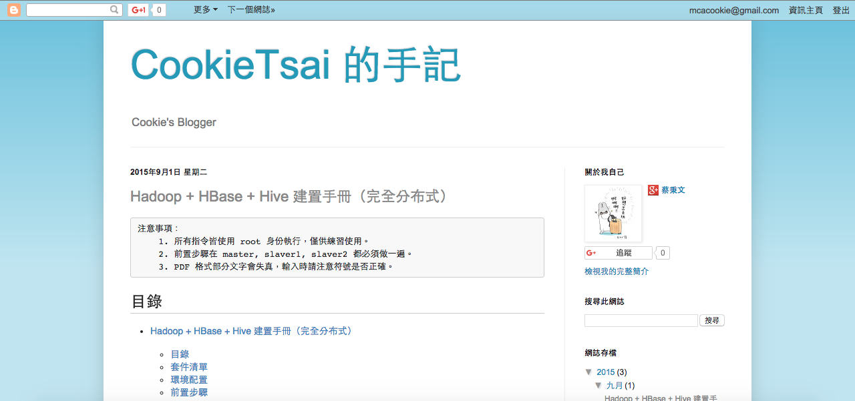
Resources
CookeTsai 的手記
http://tsai-cookie.blogspot.tw/

Slide 3

About Me
Education
III
NUTC
Experience
Mitake
JC Software Services
Honors & Awards
The Winner of Etu Hadoop Competition 2015
2011 電信創新應用大賽 智慧家庭組 優選
2010 電信奧斯卡 MOD應用組 佳作

Slide 4

Lab deploment
Zookeeper
Client
Web Service
Analysis
&
Prediction
Hive
HBase
HBase
MapReduce
Beeline
HDFS

Slide 5
System architecture
Virtual Box
Packages
Host Name | IP | OS
master | 192.168.60.100 | CentOS 6.7
slaver1 | 192.168.60.101 | CentOS 6.7
slaver2 | 192.168.60.102 | CentOS 6.7
Package | Package Name | Version
Apache Hadoop | hadoop-2.4.1.tar.gz | 2.4.1
Apache HBase | hbase-0.98.13-hadoop2-bin.tar.gz | 0.98.13
Apache Hive | apache-hive-1.2.1.tar.gz | 1.2.1
Apache Zookeeper | zookeeper-3.4.6.tar.gz | 3.4.6

Slide 6
Setup for testing hosts (3 VMs)
Install Virtual Box
Import Virtual Box VM
Modify to the static IP and try a test

Slide 7
You will learn
Basic hadoop
HDFS, MapReduce, HBase(NoSQL)
Basic hadoop ecosystem
Hive, R
Back end
Web Service, Shell Script
Front end
HTML, CSS and JQuery

Slide 8
What is hadoop
A big-data platform for data manipulation
Store data in distributed repositories
Distributed job process to deal with big-data
Dig out the data insight and data analytics
High availability and stabilized
Many ecosystems supports

Slide 9
Install Hadoop

Slide 10
What is Zookeeper
Used for message management in distributed system, such like naming, synchronization service, clustering management
Considering to HA, ZK also provides clustering mode
In Hadoop, it manages Namenode, HBase... for message passing and sync

Slide 11
Install Zookeeper

Slide 12
What is HBase
A kind of NoSQL
Manipulation in HDFS
Using column family qualifier
Each Row-Key is also a indexed column
Row-Key | Column |  | Timestamp | Value
 | Family | Qualifier
row1 | cf | name | 1442053885486 | Tom
row2 | cf | name | 1442053885487 | Mary
row2 | cf | phone | 1442053885487 | 0999XXXXXX
row3 | cf | name | 1442053885486 | John

Slide 13
Install HBase

Slide 14
What is Hive
Data warehouse software facilitates querying and managing large datasets residing in distributed storage.
SQL-like language called HiveQL
At the same time this language also allows traditional map/reduce

Slide 15
Install Hive

Slide 16
What is R
R is a free software environment for statistical computing and graphics.
It compiles and runs on a wide variety of UNIX platforms, Windows and MacOS.
It provides an unparalleled platform for programming new statistical methods in an easy and straightforward manner.

Slide 17
Install R Lib & RStudio

Slide 18
Web Service
What is myApp
It’s a Simple Java Project
It’s a RESTful Service
Using Jersey
Install myApp
$ tar -zxvf /tmp/myApp.tar.gz
$ java -jar myApp/application-1.0-SNAPSHOT.jar

Slide 19
What WampServer
WampServer is a Windows web development environment.
It allows you to create web applications with Apache2, PHP and a MySQL database. Alongside, PhpMyAdmin allows you to manage easily your databases.

Slide 20
Install WampServer

Slide 21
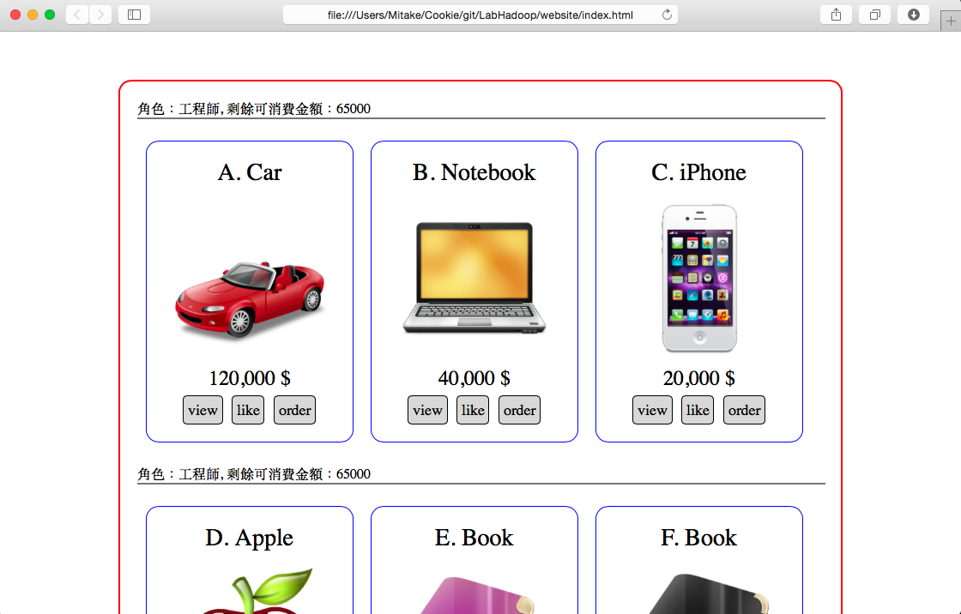
Using Web Client

Slide 22
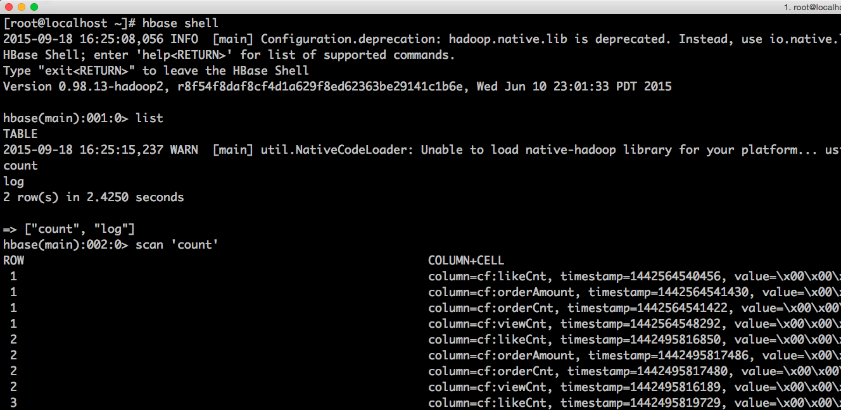
Using HBase Shell

Slide 23
Learning HBase Shell

Slide 24
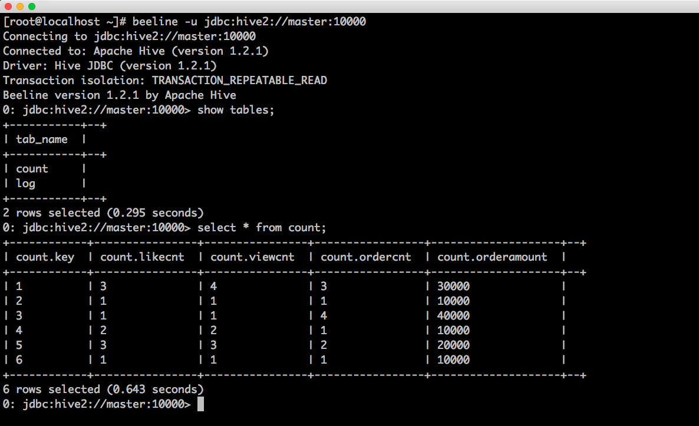
Using Beeline

Slide 25
Learning HiveQL

Slide 26
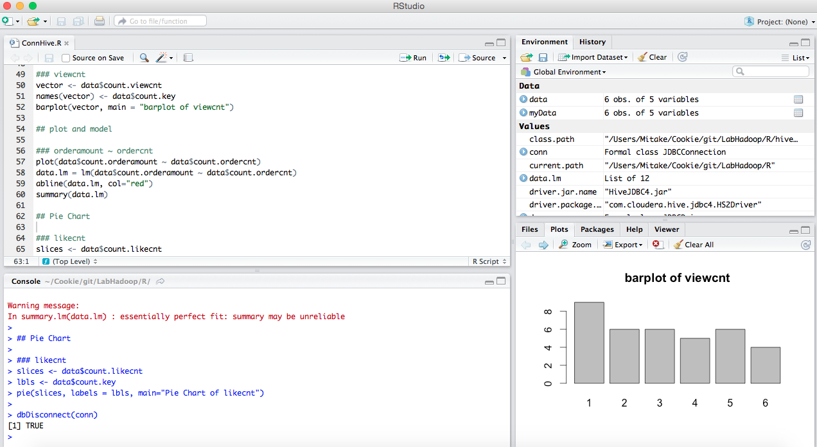
Using RStudio

Slide 27
Learning R

Slide 28
Download
Hadoop-2.5.2
http://apache.stu.edu.tw/hadoop/common/hadoop-2.5.2/hadoop-2.5.2.tar.gz
Zookeeper-3.4.6
http://apache.stu.edu.tw/zookeeper/zookeeper-3.4.6/zookeeper-3.4.6.tar.gz
HBase-0.98.13
http://ftp.tc.edu.tw/pub/Apache/hbase/0.98.13/hbase-0.98.13-hadoop2-bin.tar.gz
Hive-1.2.1
http://apache.stu.edu.tw/hive/hive-1.2.1/apache-hive-1.2.1-bin.tar.gz
R-3.1.3
http://cran.r-project.org/src/base/R-3/R-3.1.3.tar.gz

Slide 29
Thank you for your listening

Slide 30
【實作主題】
本次實作Lab主題:「大型分散式系統-使用者資料分析」。
實作 Lab 主題：『』
日期 | 第一天 | 第二天
上午 09:30 ~ 12:30 | 認識 Hadoop
 | 建置 Hadoop 環境
下午 13:30 ~ 16:30

