Slide 1
Outline
Introduction
Motivation & Background
Challenge and Approach
System Model
MAC System Level
Message Sequence Chart (MSC)
Timing Diagram
Proposed approach
The design of NPDCCH period and search space
DCI field determination
Evaluation
Conclusion & Future Works
Notes:
But if DL or UL transmission are too long will have a gap duration to avoid DL/UL packet be blocked itself by UL/DL packet.

Slide 2
Outline
Introduction
Motivation & Background
Challenge and Approach
System Model
MAC System Level
Message Sequence Chart (MSC)
Timing Diagram
Proposed approach
The design of NPDCCH period and search space
DCI field determination
Evaluation
Conclusion & Future Works
Notes:
But if DL or UL transmission are too long will have a gap duration to avoid DL/UL packet be blocked itself by UL/DL packet.

Slide 3
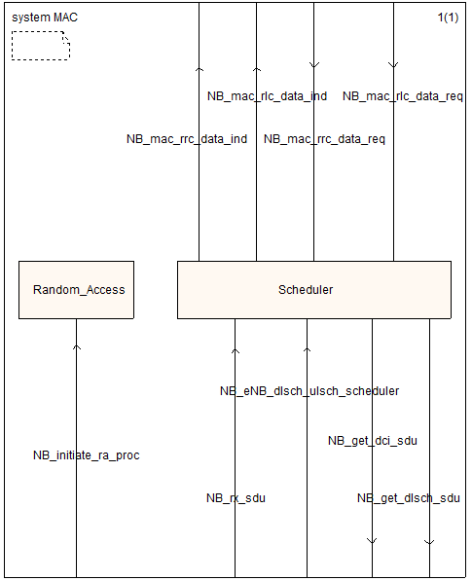
NB MAC System Level

Slide 4
NB MAC System Level
MAC block
Interface
Random Access
Scheduler
NB_initiate_ra_proc
NB_eNB_dlsch_ulsch_scheduler
NB_get_dlsch_sdu
NB_rx_sdu
NB_get_dci_sdu
DLSCH SDU
DCI SDU(N0/N1/N2)
( rnti + data )
ULSCH SDU
ACK/NACK
Preamble(List)
Time tick : 1ms
NB_phy_procedures_uespec_RX
NB_phy_procedures_TX
PHY

Slide 5
NB MAC System Level
MAC block
Interface
Scheduler
Function
NB_rx_sdu
NB_schedule_ue_spec
Modify Parts
NB_schedule_ulsch
NB_schedule_SI
Random Access
NB_schedule_RA
NB_schedule_MIB
NB_initiate_ra_proc
NB_eNB_dlsch_ulsch_scheduler
NB_get_dlsch_sdu
NB_rx_sdu
NB_get_dci_sdu
Preamble(List)
DLSCH SDU
DCI SDU(N0/N1/N2)
( rnti + data )
ULSCH SDU
ACK/NACK
Time tick : 1ms
NB_phy_procedures_uespec_RX
NB_phy_procedures_TX
PHY

Slide 6
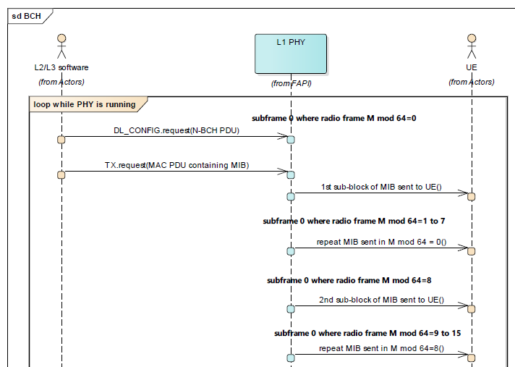
NB_schedule_MIB
MIB Transmission only in anchor carrier in SF #0:
SFN mod 64 = 0 → Update MIB transmitted (every 640 ms)
→ L2/L3 provide a BCH PDU to PHY
SFN mod 8 = 0 → new MIB sub-block
SFN mod 8 ≠ 0 → MIB repeated
L2/L3 software provide the following information:
DL_CONFIG.request → N-BCH PDU to the PHY in subframe #0
for each radio frame SFN mod 64 = 0 (every 640 ms)
TX.request→ MAC-PDU containing the MIB (every 640 ms)
*If PHY not receive a N-BCH PDU→ no BCH will be transmitted

Slide 7
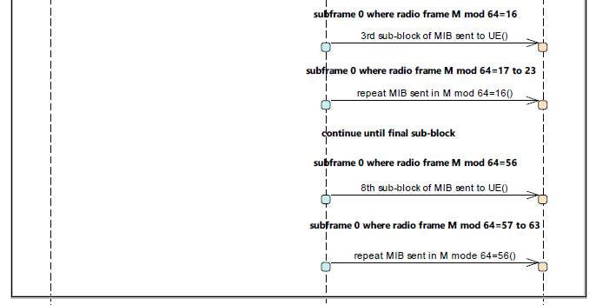
NB_schedule_MIB
MIB Transmission only in anchor carrier in SF #0:
SFN mod 64 = 0 → Update MIB transmitted (every 640 ms)
→ L2/L3 provide a BCH PDU to PHY
SFN mod 8 = 0 → new MIB sub-block
SFN mod 8 ≠ 0 → MIB repeated
L2/L3 software provide the following information:
DL_CONFIG.request → N-BCH PDU to the PHY in subframe #0
for each radio frame SFN mod 64 = 0 (every 640 ms)
TX.request→ MAC-PDU containing the MIB (every 640 ms)
*If PHY not receive a N-BCH PDU→ no BCH will be transmitted

Slide 8
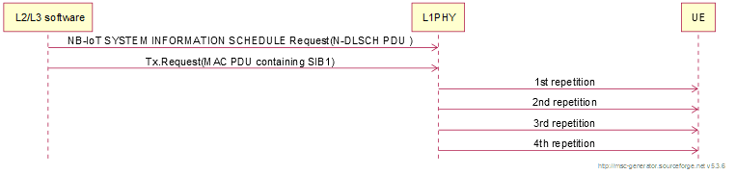
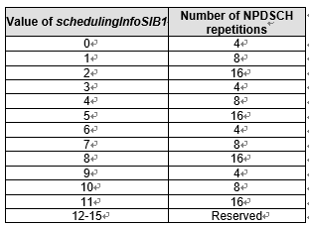
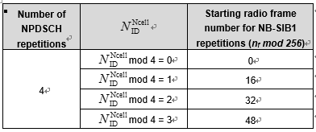
NB_schedule_SI-SIB1
SIB1 Transmission only in anchor carrier in SF #4:
SFN mod 256 = 0 → Update SIB1 transmitted (every 2560 ms)
→ L2/L3 provide a N-DSLCH PDU to PHY
L2/L3 software provide the following information:
NB-IoT SYSTEM INFORMATION SCHEDULE Request→ N-DLSCH PDU to the PHY for each radio frame SFN mod 256 = 0 (every 2560 ms)
TX.request→ MAC-PDU containing the SIB1 (every 2560 ms)
Transmit at starting frame (0 RF) and repetition (4) base on SchedulingInfoSIB1-NB (0) and Cell Id (0)in subframe #4 of every other frame in 16 continuous frames.
*If PHY not receive a N-DLSCH PDU→ no SIB1 will be transmitted
Subframe 4 where radio frame Mod 256=0
Subframe 4 where radio frame Mod 256=0-15
Subframe 4 where radio frame Mod 256=64-79
Subframe 4 where radio frame Mod 256=128-143
Subframe 4 where radio frame Mod 256=192-207

Slide 9
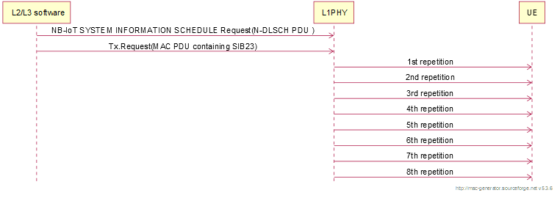
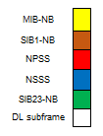
NB_schedule_SI-SIB23
SIB23 Transmission in anchor carrier in Consecutive 8 DL subframe base on radio-frame offset and repetition-pattern within SI window:
SFN mod 64 = 0 → Update SIB23 transmitted (every 640 ms)
→ L2/L3 provide a N-DSLCH PDU to PHY
L2/L3 software provide the following information:
NB-IoT SYSTEM INFORMATION SCHEDULE Request→ N-DLSCH PDU to the PHY for each radio frame SFN mod 64 = 0 (every 640 ms)
TX.request→ MAC-PDU containing the SIB23 (every 640 ms)
Transmit at starting subframe and repetition base on radio-frame offset and repetition-pattern in consective 8 DL subframe of every other frame in 16 continuous frames.
*If PHY not receive a N-DLSCH PDU→ no SIB23 will be transmitted
DL subframe where radio frame Mod 64=0
Consecutive 8 DL subframe of every other frame
in 16 continuous frames Where
(radio frame-radio-frame offset) Mod 2=0
which base on radio-frame offset (1) and
repetition-pattern(Every2ndRF)
SI window=160ms
…..
RF
0
1
2
3
4
5
14
15

Slide 10
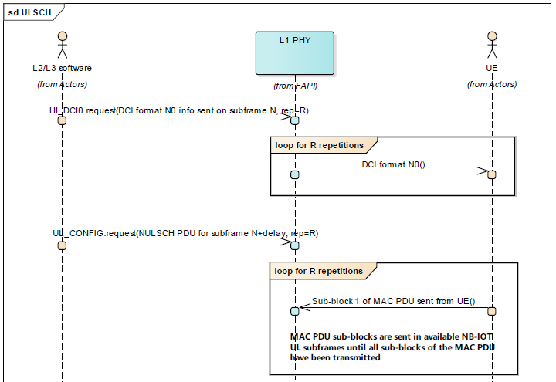


ULSCH HARQ Cycle
If pp start at subfram N
Scheduling Timing: Subframe N-1
subframe N-1
NB_eNB_dlsch_ulsch_scheduer
subframe N
subframe N+R
subframe N+R+k0-1
subframe N+R+k0
$N_{RU} ∗$ $N_{Rep}∗$ $N_{slots}^{UL}$
subframe N+R+k0+$N_{RU} ∗$ $N_{Rep}∗$ $N_{slots}^{UL}$
Notes:
根據不同上限設計不同pp
如果設計不同pp實際上會有甚麼問題? At P.17
如果Nrep跟CE關係如下:
Nrep=4 for CE 0
Nrep=8 for CE 1
Nrep=16 for CE 2
對CE0來說一段UL資料區間(Nru Nulsots Nrep )的範圍就是
(1 8 4)~(10 8 4)→ 32 ~ 320 ms→pp=384
CE1
(1 8 8)~(10 8 8)→ 64 ~ 640 ms→pp=768
CE2
(1 8 16)~(10 8 16)→ 128 ~ 1280 ms→pp=1536

Slide 11
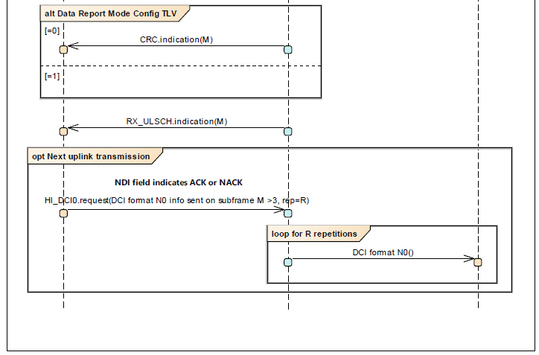

ULSCH HARQ Cycle
Successful
subframe M = N+R+k0+$N_{RU} ∗$ $N_{Rep}∗$ $N_{slots}^{UL}$
fail
subframe M
(UE_Info)
NB_rx_sdu
Scheduling Timing at
previous SF of next pp
NB_eNB_dlsch_ulsch_scheduler

Slide 12
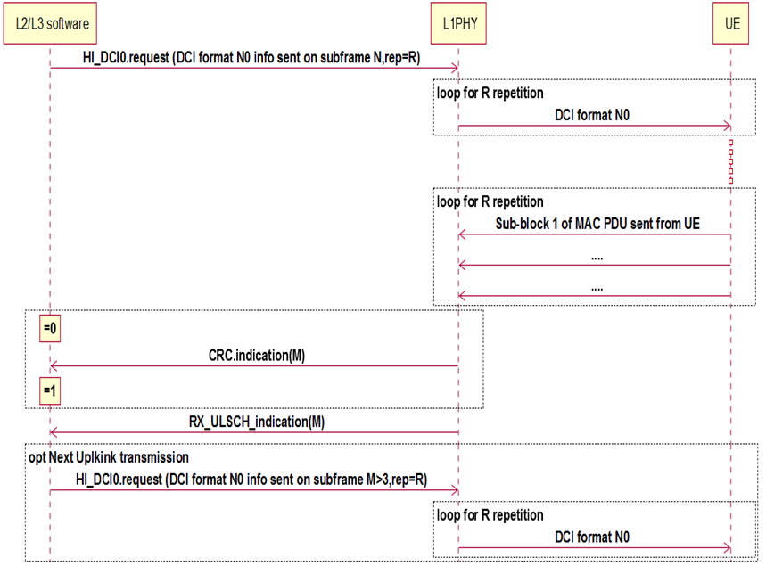
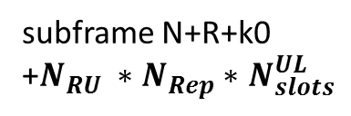
ULSCH HARQ Cycle
subframe N-1
NB_eNB_dlsch_ulsch_scheduler
subframe N
If pp start at subfram N
Scheduling Timing: Subframe N-1
subframe N+R
subframe N+R+k0
UL duration
subframe N+R+k0+UL duration
subframe N+R+k0
+$N_{RU} ∗$ $N_{Rep}∗$ $N_{slots}^{UL}$
NB_rx_sdu
Notes:
根據不同上限設計不同pp
如果設計不同pp實際上會有甚麼問題? At P.17
如果Nrep跟CE關係如下:
Nrep=4 for CE 0
Nrep=8 for CE 1
Nrep=16 for CE 2
對CE0來說一段UL資料區間(Nru Nulsots Nrep )的範圍就是
(1 8 4)~(10 8 4)→ 32 ~ 320 ms→pp=384
CE1
(1 8 8)~(10 8 8)→ 64 ~ 640 ms→pp=768
CE2
(1 8 16)~(10 8 16)→ 128 ~ 1280 ms→pp=1536

Slide 13

subframe N-1
subframe N
subframe N+R
subframe N+R+k0
UL duration
subframe N+R+k0+UL duration
subframe N+R+k0
+$N_{RU} ∗$ $N_{Rep}∗$ $N_{slots}^{UL}$
Notes:
根據不同上限設計不同pp
如果設計不同pp實際上會有甚麼問題? At P.17
如果Nrep跟CE關係如下:
Nrep=4 for CE 0
Nrep=8 for CE 1
Nrep=16 for CE 2
對CE0來說一段UL資料區間(Nru Nulsots Nrep )的範圍就是
(1 8 4)~(10 8 4)→ 32 ~ 320 ms→pp=384
CE1
(1 8 8)~(10 8 8)→ 64 ~ 640 ms→pp=768
CE2
(1 8 16)~(10 8 16)→ 128 ~ 1280 ms→pp=1536

Slide 14
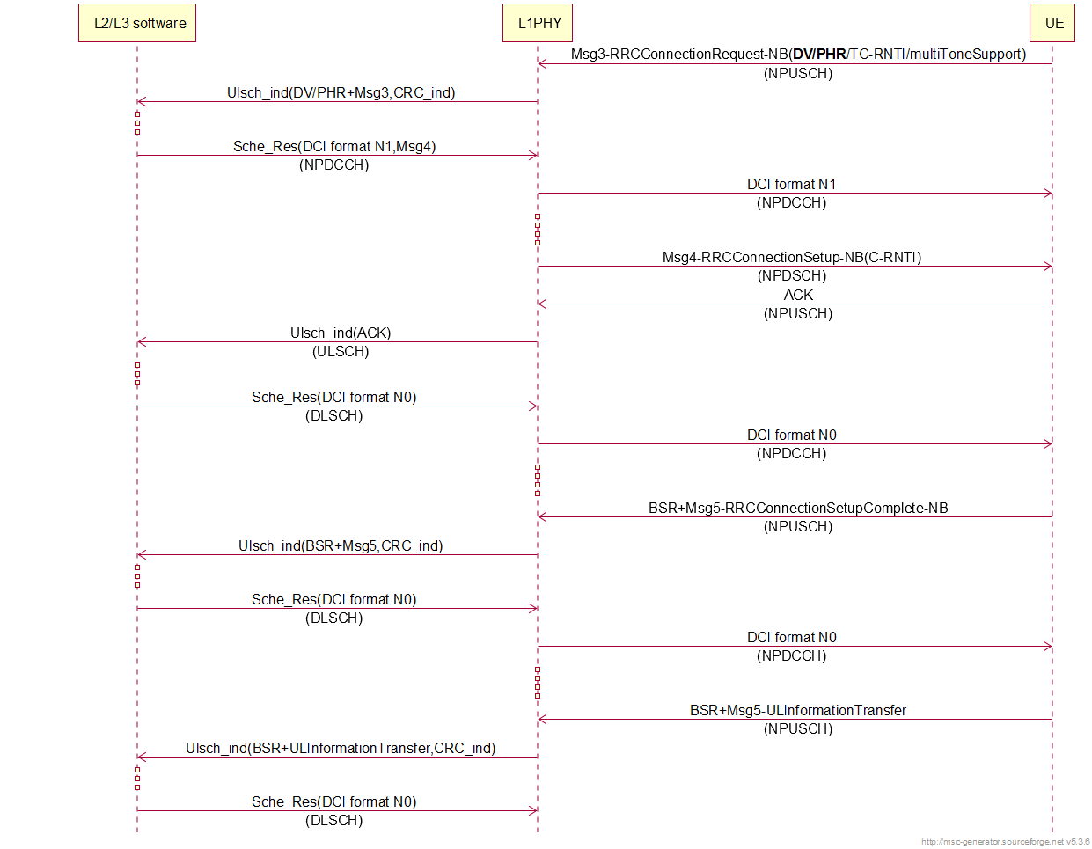
Packet scheduler MSC in NB-IoT
Schedule
Msg5
Schedule
ULInformationTransfer

Slide 15
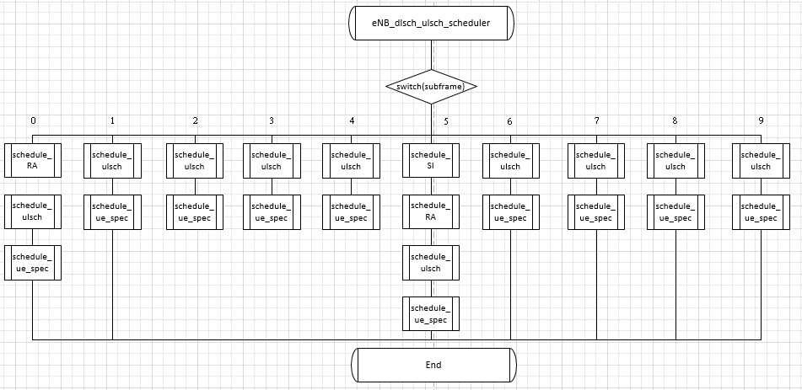
LTE MAC scheduling block
Scheduling at each subframe

Slide 16
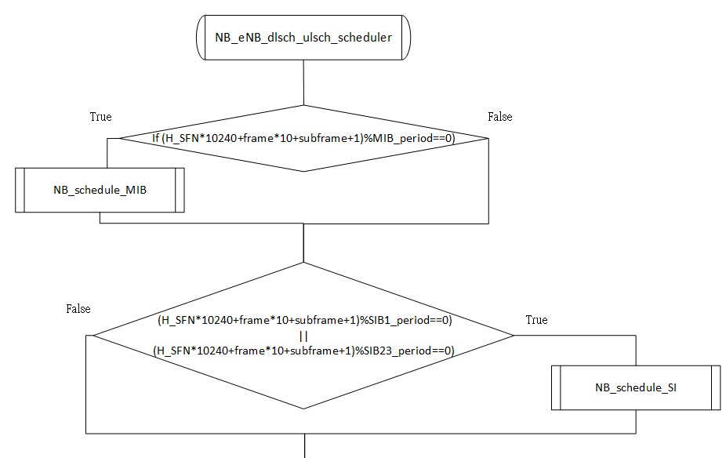
NB MAC scheduling block
MIB/SIBs scheduling base on their period.

Slide 17
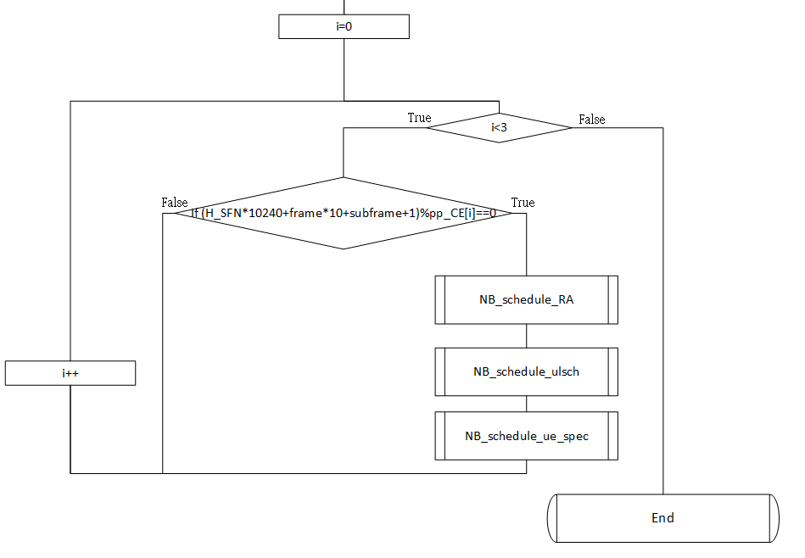
NB MAC scheduling block
Scheduling at previous subframe of NPDCCH period (pp_CE[i]) for CE level i.

Slide 18

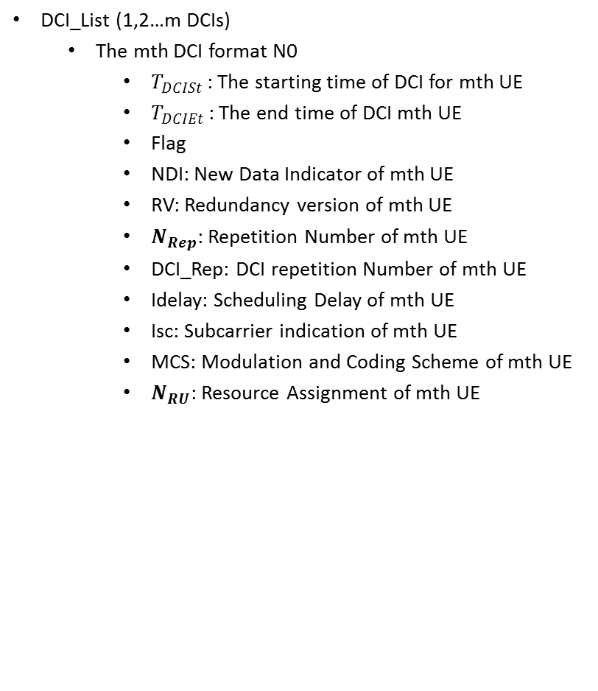
Simulation Parameter definition
NPDCCH configuration
R[i]: The DCI length of CE level i
Rmax[i]: The search space length of CE level i
G[i]: The offset of NPDCCH period of CE level i
T[i]: NPDCCH period (pp) of CE level i
αoffset[i]: Start search space offset of CE level i
u[i]: 0,1,….Rmax/R-1
bi[n]: DCI possible starting time of CE level i
UE_List (UE_list1,UE_list2,UE_list3)
UE_list1/2/3 (CE0/1/2)
(1,2..m UE_Info)
CE level
Multi_toneSupport
UL_Buffer_Size (DV/BSR)
PHR
CRC
Round
DCI_List (1,2…m DCIs)
The mth DCI format N0
$T_{DCISt }$: The starting time of DCI for mth UE
$T_{DCIEt }$: The end time of DCI mth UE
Flag
NDI: New Data Indicator of mth UE
RV: Redundancy version of mth UE
$N_{Rep}$: Repetition Number of mth UE
DCI_Rep: DCI repetition Number of mth UE
Idelay: Scheduling Delay of mth UE
Isc: Subcarrier indication of mth UE
MCS: Modulation and Coding Scheme of mth UE
$N_{RU}$: Resource Assignment of mth UE
NPRACH Configuration
CE[i]: CE levels i
Np[i]: NPRACH period of CE level i
St[i]: Starting time of CE level i
So[i]: Subcarrier offset of CE level i
Ns[i]: # of subcarrier of CE level i
Pr[i]: preamble repetition of CE level i
CE level i $∈$ {0,1,2}
Notes:
DCI_Rep[i]
Rmax/8=R (00)
Rmax/4=R (01)
Rmax/2=R (10)

Slide 19
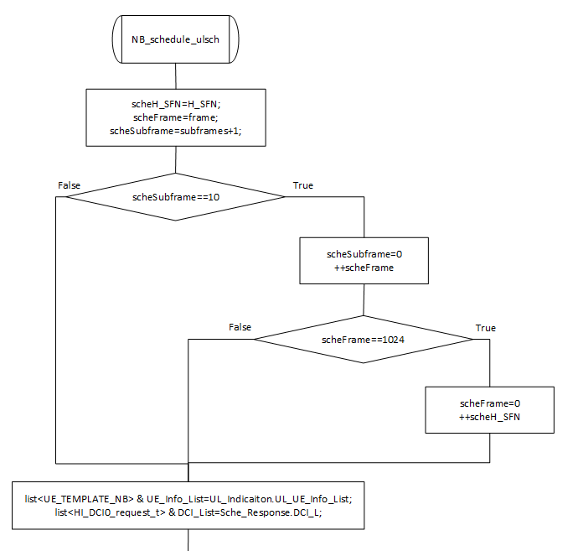
NB_schedule_ulsch(1/3)
Move to outside
Separate UE list base on CE level.

Slide 20
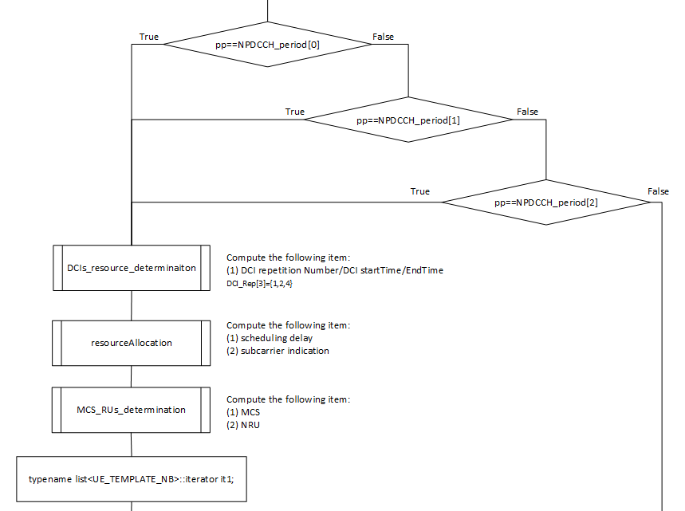
NB_schedule_ulsch(2/3)
Modify to CE level i
Loop UE_List

Slide 21
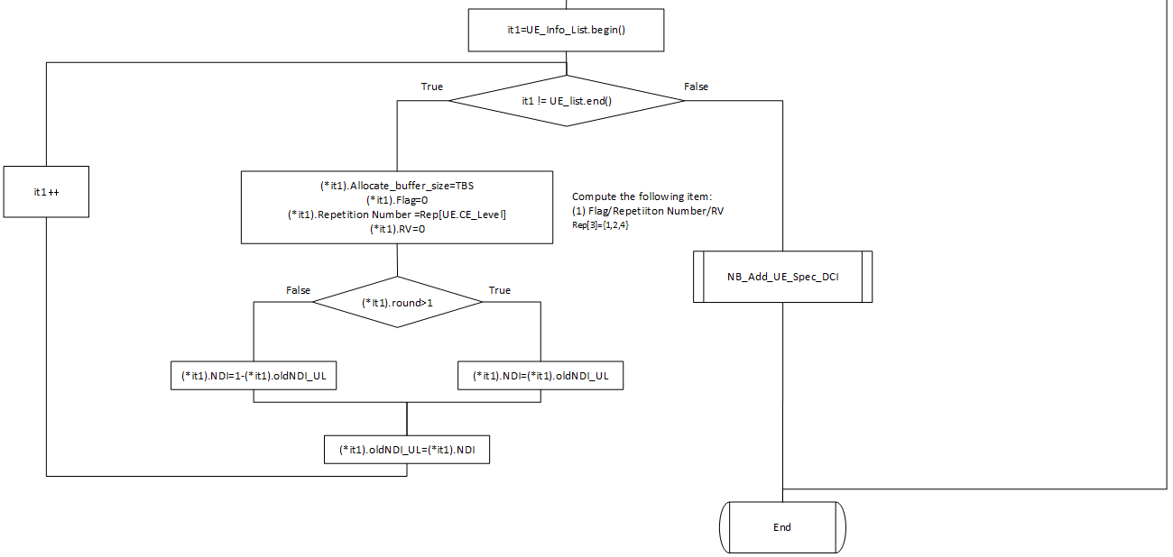
NB_schedule_ulsch(3/3)

Slide 22
System Model Assumption
All UE-specific NPDCCH period (pp) is the same as common pp for each CE level.
Common configuration is set in SIB2-NB
UE-specific configuration is set in Msg4
Search space configuration of UE-specific is the same as that of common for each CE level.
Starting search space of common pp is set in SIB2-NB
Starting search space of UE-specific pp is set in Msg4
Evaluation Case
All UE only support single-tone transmission in 3 CE levels. → Case 1
Compare resource utilization (U) with different Rmax (Max # of supported DCIs) for all devices in same CE level.
A UE could support multi-tone or single-tone transmission in 3 CE levels. → Case 2
Compare resource utilization (U) with different pattern-base resource allocation.
Notes:
UL HARQ RTT timer=4+deltaPDCCH, which is the interval from the last subframe of
the PUSCH transmission plus 4 subframes to the first subframe of the next PDCCH occasion
Define a Capacity (C) to limit the time duration of each UL transmissions in a pp, the HARQ
RTT timer of each UL transmissions is shorter than no C.

Slide 23



System Parameter definition
R[i]: The DCI length of CE level i
Rmax[i]: The search space length of CE level i
G[i]: The offset of NPDCCH period of CE level i
T[i]: NPDCCH period (pp) of CE level i
α_{offset[i]:} Start search space offset of CE level i
u[i]: 0,1,….Rmax/R-1
bi[n]: DCI possible starting time of CE level i
Ulsch_ind(1,2…m): UE_List(1,2..m UE_Info )
$T_{Ind}j$: The jth arrival of m Ulsch_PDU include UE_List(1,2..m UE_Info).
$S_{Request}$: Scheduling action.
$T_{S_{Request}}$: $S_{Request}$ at previous subframe of each pp
$T_{DCISt [m]}$: The starting time of DCI for mth UE
$T_{DCIEt [m]}$: The end time of DCI mth UE
${Start}_{SearchSpace}$: Starting time of seacch space for CE level i
${End}_{SearchSpace}$: End time of seacch space for CE level i
NPRACH Configuration
CE[i]: CE levels i
Np[i]: NPRACH period of CE level i
St[i]: Starting time of CE level i
So[i]: Subcarrier offset of CE level i
Ns[i]: # of subcarrier of CE level i
Pr[i]: preamble repetition of CE level i
UE_list (1,2..m UE_Info)
CE_Level[m]
Multi_toneSupport[m] = 0
DV[m]/BSR[m]→ UL_Buffer_Size[m]
PHR[m] (power header room)
CRC[m]
Round[m]
DCI format N0
Flag
NDI[m]: New Data Indicator of mth UE
RV[m]: Redundancy version of mth UE
$N_{Rep[m]}$: Repetition Number of mth UE
DCI_Rep[m]: DCI repetition Number of mth UE
Idelay[m]: Scheduling Delay of mth UE
Isc[m]: Subcarrier indication of mth UE
MCS[m]: Modulation and Coding Scheme of mth UE
$N_{RU[m]}$: Resource Assignment of mth UE
UE list 要分成3個CE level
CE level i $∈$ {0,1,2}
Notes:
DCI_Rep[i]
Rmax/8=R (00)
Rmax/4=R (01)
Rmax/2=R (10)

Slide 24
System Parameter definition
NPDCCH configuration
R[i]: The DCI length of CE level i
Rmax[i]: The search space length of CE level i
G[i]: The offset of NPDCCH period of CE level i
T[i]: NPDCCH period (pp) of CE level i
αoffset[i]: Start search space offset of CE level i
u[i]: 0,1,….Rmax/R-1
bi[n]: DCI possible starting time of CE level i
UE_List (UE_list1,UE_list2,UE_list3)
UE_list1/2/3 (CE0/1/2)
(1,2..m UE_Info)
CE level
Multi_toneSupport
UL_Buffer_Size (DV/BSR)
PHR
CRC
Round
DCI_List (1,2…m DCIs)
The mth DCI format N0
$T_{DCISt }$: The starting time of DCI for mth UE
$T_{DCIEt }$: The end time of DCI mth UE
Flag
NDI: New Data Indicator of mth UE
RV: Redundancy version of mth UE
$N_{Rep}$: Repetition Number of mth UE
DCI_Rep: DCI repetition Number of mth UE
Idelay: Scheduling Delay of mth UE
Isc: Subcarrier indication of mth UE
MCS: Modulation and Coding Scheme of mth UE
$N_{RU}$: Resource Assignment of mth UE
NPRACH Configuration
CE[i]: CE levels i
Np[i]: NPRACH period of CE level i
St[i]: Starting time of CE level i
So[i]: Subcarrier offset of CE level i
Ns[i]: # of subcarrier of CE level i
Pr[i]: preamble repetition of CE level i
CE level i $∈$ {0,1,2}
Notes:
DCI_Rep[i]
Rmax/8=R (00)
Rmax/4=R (01)
Rmax/2=R (10)

Slide 25































Timing diagram for NPDCCH period
$S_{Request}:$Scheduling action at $T_{S_{Request}}$
DL
Ulsch_indication(1,2…m): Get UE scheduling Info. from Ulsch_indication
$T_{Ind}j$: The jth arrival of m Ulsch_PDU include UE scheduling Info.
$${Start}_{SearchSpace}$$
$$R_{max}[i]$$
$${End}_{SearchSpace}$$
$$S_{Request}$$
NPDCCH period (pp)
$$S_{Request}$$
$$\text{R}\text{[}\text{i}\text{]}$$
$$\text{R}\text{[}\text{i}\text{]}$$
$$\text{R}\text{[}\text{i}\text{]}$$
…
Ulsch_ind(1,2…m)
NPDCCH search space for CE level i
Ulsch_ind(2)
Ulsch_ind(m)
Ulsch_ind(1)
Time
$$T_{Ind}1$$
$$T_{Ind}2$$
$$T_{Ind}3$$
$$T_{Ind}j$$
${Start}_{SearchSpace}+$pp
$$T_{DCISt [1]}$$
$$T_{DCIEt [1]}$$
$$T_{DCISt [2]}$$
$$T_{DCIEt [2]}$$
$$T_{DCISt [m]}$$
$$T_{DCIEt [m]}$$
>=3ms
>=3ms
UL
$$T_{S_{Request}}$$
$$I_{Delay[1]}$$
$$T_{S_{Request}}$$
$$I_{Delay[2]}$$
$$I_{Delay[m]}$$
11
10
9
8
UL Transmission-
${dT}_{m}$ ($N_{RU[m]}$, $N_{Rep[m]}$, $N_{slots[m]}^{UL}$)
7
6
UL Transmission-
${dT}_{2}$ ($N_{RU[m]}$, $N_{Rep[m]}$, $N_{slots[m]}^{UL}$)
5
4
3
$$I_{sc[m]}$$
2
$$I_{sc[2]}$$
1
$$I_{sc[1]}$$
Time
0
UL Transmission-
${dT}_{1}$ ($N_{RU[m]}$, $N_{Rep[m]}$, $N_{slots[m]}^{UL}$)
${Start}_{SearchSpace}+$pp
Notes:
The timing diagram shown in Fig. 2 shows the behavior of UL scheduler in NB-IoT. Let Ulsch_ind(1,2..m) be the indication of UL transmissions for m devices; $T_{Rep}i$ is the time of ith UL indication for m devices. The data type of each UL transmission in Ulsch_ind could be UL data or any kind of UL RRC message include Msg3, Msg5, and ULinformationTranfer [2], etc; A UL transmission will carry device’s scheduling information, such as DV/PHR or BSR..,etc. These scheduling information will input to the scheduler when triggering the scheduler at $T_{S_{Request}}$; $S_{Request}$ is an trigger action starts at $T_{S_{Request}}$, it will starts the scheduler at previous subframe of next pp according to the received scheduling information in Ulsch_ind. The $T_{SearchSpace}$ is the duration of search space for three CE levels in pp; ${Start}_{SearchSpace}$ is the starting time of search space in pp; ${End}_{SearchSpace}$ is the end time of search space in pp. The $T_{DCISt[m]}$ is the starting time of mth DCI; $T_{DCIEt[m]}$ is the end time of mth DCI; $T_{DCIRep[m]}$ is the mth DCI repetiiton number. The relation among $T_{DCISt[m]}$, $T_{DCIEt[m]}$, $T_{DCIRep[m]}$, $T_{SearchSpace}$, ${Start}_{SearchSpace}$, ${End}_{SearchSpace}$ and pp is illustrated in DL in Fig. 2.
The $F_{m}$ is frequency split unit base on different tone support in UL resource alocation; $F_{m}∈\{1, 3, 6, 12\}$ in Table I. m is the number of element in resource allocaiton pattern $S_{Freq}\left[m\right]$; $S_{Freq}\left[m\right]$ is the starting frequency position of each element, this will be described in III. proposed approach. The $I_{Delay[m]}$ is the shceduling delay after $T_{DCIEt[m]}$; $I_{sc[m]}$ is the subcarrier indication to point out the location of mth UL transmission in frequency domain; $N_{RU[m]}$ is the number of resource unit uesd for mth UL transmission; $N_{Rep[m]}$ is the number of repetiiton used for mth UL transmission; $N_{slots[m]}^{UL}$ is the number of UL slots used for mth UL transmission; ${dT}_{m}$ is the duration of mth UL transmission in time domain; The ${dT}_{m}$ is equal to $N_{RU[m]}∗N_{Rep[m]}∗N_{slots[m]}^{UL}$. The relation among $F_{m}$, $S_{Freq}\left[m\right]$, $I_{Delay}$[m], $N_{RU[m]}$, $N_{Rep[m]}$, $N_{slots[m]}^{UL}$ is illustrated in UL in Fig. 2. The proposed system model describe general concept of UL traffic scheduler in NB-IoT. The details of shceduling procedure and design concept will be described in III. proposed approach.

Slide 26
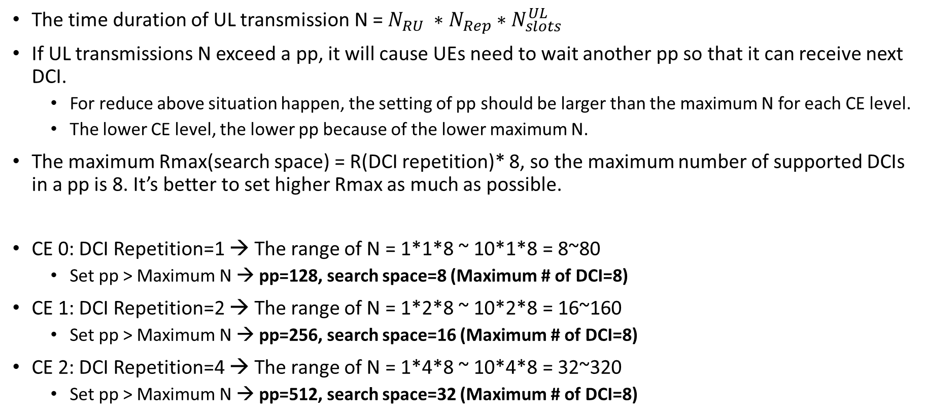
The design of NPDCCH period and search space
The time duration of UL transmission N = $N_{RU} ∗$ $N_{Rep}∗$ $N_{slots}^{UL}$
If UL transmissions N exceed a pp, it will cause UEs need to wait another pp so that it can receive next DCI.
For reduce above situation happen, the setting of pp should be larger than the maximum N for each CE level.
The lower CE level, the lower pp because of the lower maximum N.
The maximum Rmax(search space) = R(DCI repetition)* 8, so the maximum number of supported DCIs in a pp is 8. It’s better to set higher Rmax as much as possible.
CE 0: DCI Repetition=1 → The range of N = 1*1*8 ~ 10*1*8 = 8~80
Set pp > Maximum N → pp=128, search space=8 (Maximum # of DCI=8)
CE 1: DCI Repetition=2 → The range of N = 1*2*8 ~ 10*2*8 = 16~160
Set pp > Maximum N → pp=256, search space=16 (Maximum # of DCI=8)
CE 2: DCI Repetition=4 → The range of N = 1*4*8 ~ 10*4*8 = 32~320
Set pp > Maximum N → pp=512, search space=32 (Maximum # of DCI=8)

Slide 27
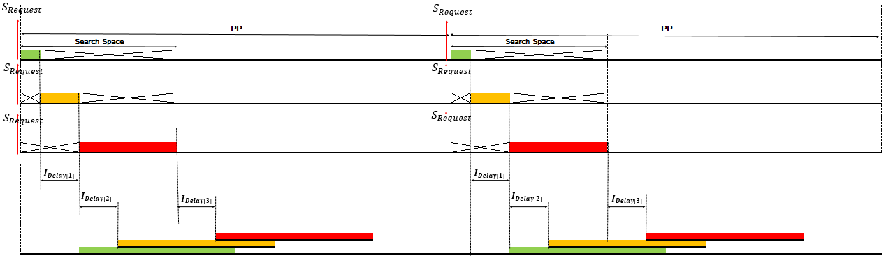
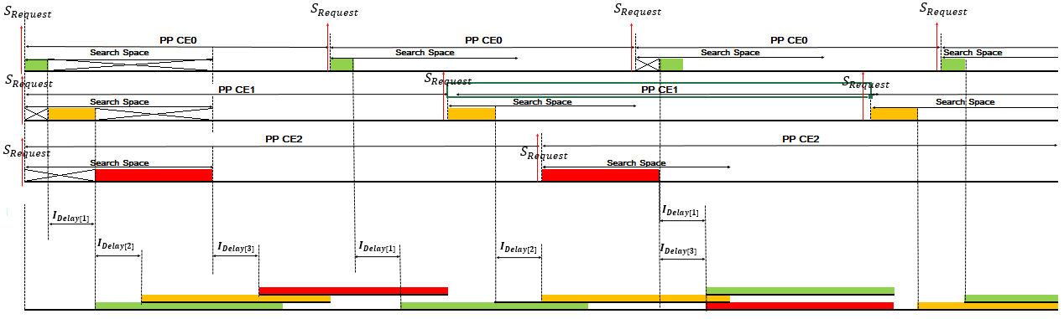
Design consideration of NPDCCH period (pp) (1/4)
Case1
DL
UL
Case2
DL
UL

Slide 28
Design consideration of NPDCCH period (pp) (2/4)
Case1: pp are the same for three CE levels.
DL
CE0
subframe
CE1
subframe
CE2
subframe
UL

Slide 29
Design consideration of NPDCCH period (pp) (3/4)
Case 2: pp are the different for three CE levels, the lower CE level, the lower pp.
DL
CE0
subframe
CE1
subframe
CE2
subframe
UL
Notes:
CE 0: Rep: 1→$N_{RU} ∗$ $N_{Rep}∗$ $N_{slots}^{UL}$=1*1*8~10*1*8=8~80→pp=128
CE1: Rep: 2→1*2*8~10*2*8=16~160→pp=256
CE 2: Rep: 4→1*4*8~10*4*8=32~320→pp=384

Slide 30
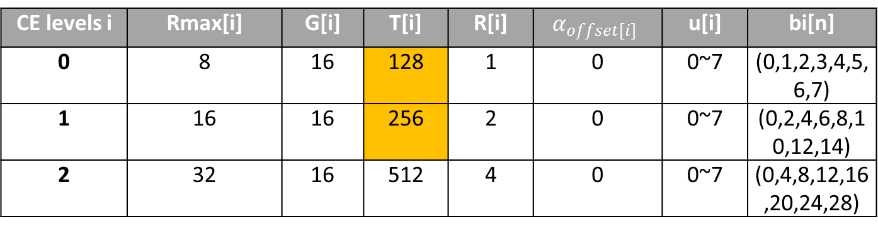

Design consideration of NPDCCH period (pp) (4/4)
Case1
CE levels i | Rmax[i] | G[i] | T[i] | R[i] | $$α_{offset[i]}$$ | u[i] | bi[n]
0 | 8 | 16 | 128 | 1 | 0 | 0~7 | (0,1,2,3,4,5,6,7)
1 | 16 | 16 | 256 | 2 | 0 | 0~7 | (0,2,4,6,8,10,12,14)
2 | 32 | 16 | 512 | 4 | 0 | 0~7 | (0,4,8,12,16,20,24,28)
R[i]: The DCI length of CE level i
Rmax[i]: The search space length of CE level i
G[i]: The offset of NPDCCH period of CE level i
T[i]: NPDCCH period of CE level i
α_{offset[i]:} Start search space offset of CE level i
u[i]: 0,1,….Rmax/R-1
bi[n]: DCI possible starting time of CE level i
DCI_Rep[i]: DCI repetition of CE level i
Case2
CE levels i | Rmax[i] | G[i] | T[i] | R[i] | $$α_{offset[i]}$$ | u[i] | bi[n]
0 | 8 | 64 | 512 | 1 | 0 | 0~7 | (0,1,2,3,4,5,6,7)
1 | 16 | 32 | 512 | 2 | 0 | 0~7 | (0,2,4,6,8,10,12,14)
2 | 32 | 16 | 512 | 4 | 0 | 0~7 | (0,4,8,12,16,20,24,28)
Actually, Case 1 has better performance, lower average delay for each UE in CE level 0 and 1,
and higher UL resource utilization for eNB.

Slide 31
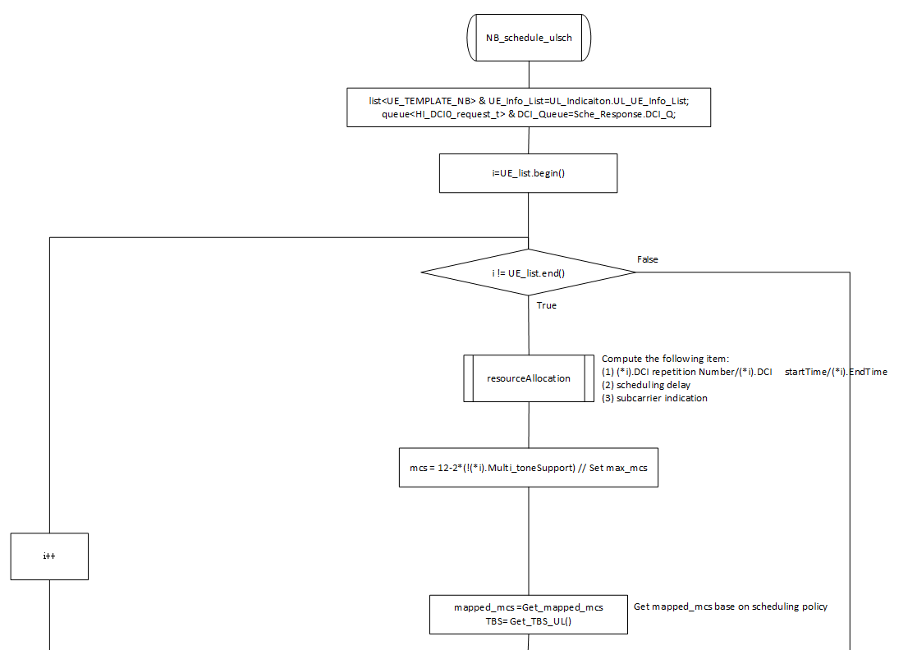
NB_schedule_ulsch(1/2)
Modify schedule base on NPDCCH period of each CE level.

Slide 32
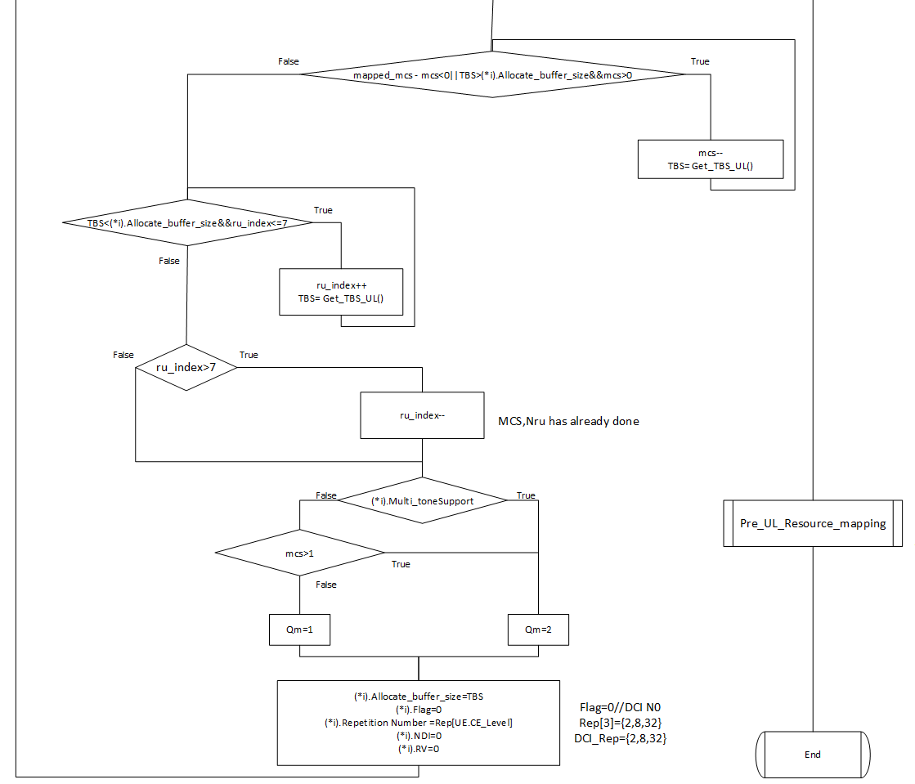
NB_schedule_ulsch(2/2)
Modify schedule base on NPDCCH period of each CE level.

Slide 33
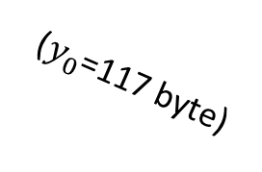

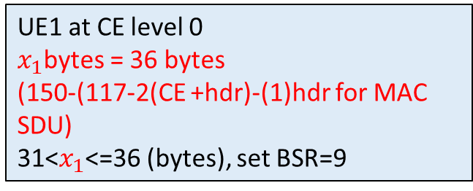

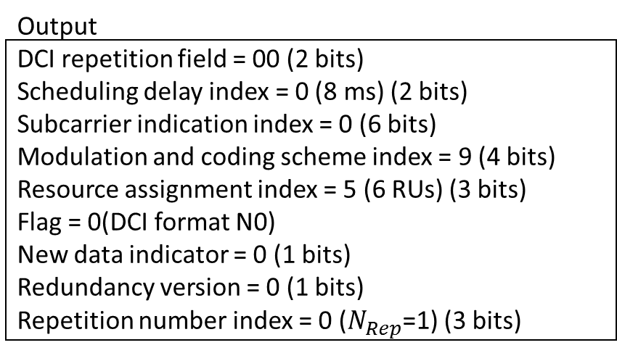
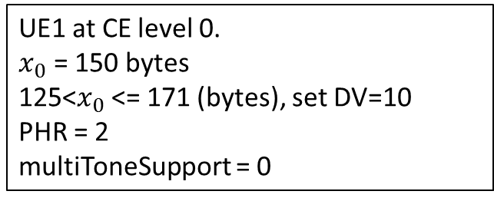
DCI field determination example
Store UE information
CE levels=0
PHR=2
DV=10
multiToneSupport=0
UE1
UL Buffer Size
MAC
UL Scheduler
Msg3(DV=10/PHR=2/multiToneSupport=0)
DCI determination sequence
BSR+Msg5
Output
DCI repetition field = 00 (2 bits)
Scheduling delay index = 0 (8 ms) (2 bits)
Subcarrier indication index = 0 (6 bits)
Modulation and coding scheme index = 9 (4 bits)
Resource assignment index = 5 (6 RUs) (3 bits)
Flag = 0(DCI format N0)
New data indicator = 0 (1 bits)
Redundancy version = 0 (1 bits)
Repetition number index = 0 ($N_{Rep}$=1) (3 bits)
$x_{0}$ bytes
MAC SDU
DCI N0(UL grant)
($y_{0}$=117 byte)
$x_{1}$bytes
UE1 at CE level 0
$x_{1}$bytes = 36 bytes
(150-(117-2(CE +hdr)-(1)hdr for MAC SDU)
31<$x_{1}$<=36 (bytes), set BSR=9
UE1 at CE level 0.
$x_{0}$ = 150 bytes
125<$x_{0}$<= 171 (bytes), set DV=10
PHR = 2
multiToneSupport = 0
$x_{m}$ is UL buffer size only include MAC SDU, not include MAC header and control element.
$y_{m}$ is Transport block size (TBS) allocated by scheduler.
Notes:
P.2的部分可以再加強一點，將 “假設” (e.g. x_0=150), 規格 (e.g., 125<x_0<171, set DV=10), 用到的參數要先定義(WHAT are x_1, Y_0?)
BSR=8 (26<BS<=31) 這裡也錯誤百出

Slide 34
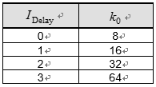
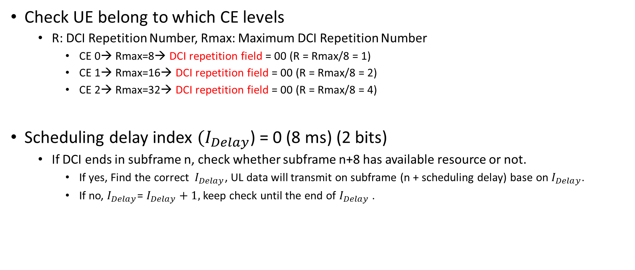
DCI Format N0-DCI repetition & Scheduling delay
(TS 36.213 Table 16.6-3)
Check UE belong to which CE levels
R: DCI Repetition Number, Rmax: Maximum DCI Repetition Number
CE 0→ Rmax=8→ DCI repetition field = 00 (R = Rmax/8 = 1)
CE 1→ Rmax=16→ DCI repetition field = 00 (R = Rmax/8 = 2)
CE 2→ Rmax=32→ DCI repetition field = 00 (R = Rmax/8 = 4)
Scheduling delay index $(I_{Delay}$) = 0 (8 ms) (2 bits)
If DCI ends in subframe n, check whether subframe n+8 has available resource or not.
If yes, Find the correct $I_{Delay}$, UL data will transmit on subframe (n + scheduling delay) base on $I_{Delay}$.
If no, $I_{Delay}$= $I_{Delay}+1,$keep check until the end of $I_{Delay}$ .

Slide 35
Scheduling Delay Index-Idelay[m]
$S_{Request}:$Scheduling action at $T_{S_{Request}}$
DL
Ulsch_indication(1,2…m): Get UE scheduling Info. from Ulsch_indication
$T_{Ind}j$: The jth arrival of m Ulsch_PDU include UE scheduling Info.
$${Start}_{SearchSpace}$$
$$R_{max}[i]$$
$${End}_{SearchSpace}$$
$$S_{Request}$$
NPDCCH period (pp)
$$S_{Request}$$
$$\text{R}\text{[}\text{i}\text{]}$$
$$\text{R}\text{[}\text{i}\text{]}$$
$$\text{R}\text{[}\text{i}\text{]}$$
…
Ulsch_ind(1,2…m)
NPDCCH search space for CE level i
Ulsch_ind(2)
Ulsch_ind(m)
Ulsch_ind(1)
Time
$$T_{Ind}1$$
$$T_{Ind}2$$
$$T_{Ind}3$$
$$T_{Ind}j$$
${Start}_{SearchSpace}+$pp
$$T_{DCISt [1]}$$
$$T_{DCIEt [1]}$$
$$T_{DCISt [2]}$$
$$T_{DCIEt [2]}$$
$$T_{DCISt [m]}$$
$$T_{DCIEt [m]}$$
>=3ms
>=3ms
UL
$$T_{S_{Request}}$$
$$I_{Delay[1]}$$
$$T_{S_{Request}}$$
$$I_{Delay[2]}$$
$$I_{Delay[m]}$$
Sort UE base on the following rule:
The bigger round, the higher priority.
If round2>round1, swap UEs
11
10
9
8
UL Transmission-
${dT}_{m}$ ($N_{RU[m]}$, $N_{Rep[m]}$, $N_{slots[m]}^{UL}$)
7
6
UL Transmission-
${dT}_{2}$ ($N_{RU[m]}$, $N_{Rep[m]}$, $N_{slots[m]}^{UL}$)
5
4
3
$$I_{sc[m]}$$
2
$$I_{sc[2]}$$
1
$$I_{sc[1]}$$
Time
0
UL Transmission-
${dT}_{1}$ ($N_{RU[m]}$, $N_{Rep[m]}$, $N_{slots[m]}^{UL}$)
${Start}_{SearchSpace}+$pp
Notes:
The timing diagram shown in Fig. 2 shows the behavior of UL scheduler in NB-IoT. Let Ulsch_ind(1,2..m) be the indication of UL transmissions for m devices; $T_{Rep}i$ is the time of ith UL indication for m devices. The data type of each UL transmission in Ulsch_ind could be UL data or any kind of UL RRC message include Msg3, Msg5, and ULinformationTranfer [2], etc; A UL transmission will carry device’s scheduling information, such as DV/PHR or BSR..,etc. These scheduling information will input to the scheduler when triggering the scheduler at $T_{S_{Request}}$; $S_{Request}$ is an trigger action starts at $T_{S_{Request}}$, it will starts the scheduler at previous subframe of next pp according to the received scheduling information in Ulsch_ind. The $T_{SearchSpace}$ is the duration of search space for three CE levels in pp; ${Start}_{SearchSpace}$ is the starting time of search space in pp; ${End}_{SearchSpace}$ is the end time of search space in pp. The $T_{DCISt[m]}$ is the starting time of mth DCI; $T_{DCIEt[m]}$ is the end time of mth DCI; $T_{DCIRep[m]}$ is the mth DCI repetiiton number. The relation among $T_{DCISt[m]}$, $T_{DCIEt[m]}$, $T_{DCIRep[m]}$, $T_{SearchSpace}$, ${Start}_{SearchSpace}$, ${End}_{SearchSpace}$ and pp is illustrated in DL in Fig. 2.
The $F_{m}$ is frequency split unit base on different tone support in UL resource alocation; $F_{m}∈\{1, 3, 6, 12\}$ in Table I. m is the number of element in resource allocaiton pattern $S_{Freq}\left[m\right]$; $S_{Freq}\left[m\right]$ is the starting frequency position of each element, this will be described in III. proposed approach. The $I_{Delay[m]}$ is the shceduling delay after $T_{DCIEt[m]}$; $I_{sc[m]}$ is the subcarrier indication to point out the location of mth UL transmission in frequency domain; $N_{RU[m]}$ is the number of resource unit uesd for mth UL transmission; $N_{Rep[m]}$ is the number of repetiiton used for mth UL transmission; $N_{slots[m]}^{UL}$ is the number of UL slots used for mth UL transmission; ${dT}_{m}$ is the duration of mth UL transmission in time domain; The ${dT}_{m}$ is equal to $N_{RU[m]}∗N_{Rep[m]}∗N_{slots[m]}^{UL}$. The relation among $F_{m}$, $S_{Freq}\left[m\right]$, $I_{Delay}$[m], $N_{RU[m]}$, $N_{Rep[m]}$, $N_{slots[m]}^{UL}$ is illustrated in UL in Fig. 2. The proposed system model describe general concept of UL traffic scheduler in NB-IoT. The details of shceduling procedure and design concept will be described in III. proposed approach.

Slide 36
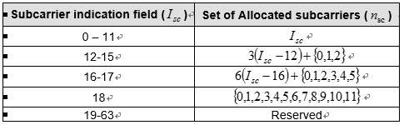
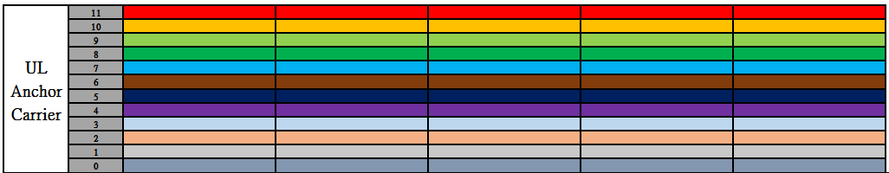
DCI Format N0-Subcarrier indication index
UE1 multiToneSupport=0 → eNB will find available resource form the bottom to up in frequency domain.
so it firstly find single-tone resource region not be used, subcarrier indication=0 and $N_{SC}^{RU}$ will be set to 1.
Subcarrier indication
index

Slide 37
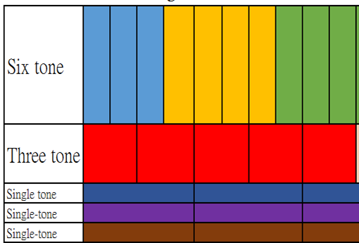
Specific PHR base on CE levels & UE capability
If a device is in higher CE level, it means the channel quality is worse, set to lower PHR to map lower MCS in order to do a reliable transmission.
If devices support multi-tone transmission, it has more capability to increase data rate than those devices only support single-tone transmission.
CE level | Multi-tone support | Specific PHR
0 | 1 | 3
 | 0 | 2
1 | 1 | 2
 | 0 | 1
2 | 1 | 1
 | 0 | 0
The higher tone transmission, the earlier end of
resource unit transmission.

Slide 38
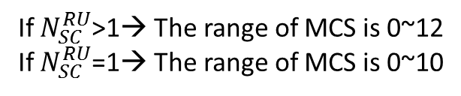
Map PHR to MCS base on scheduling policy.
Scheduling Policy:
(1) If UE had better channel on CE-level (0)
→ greedy choice.
(2) if UE had better channel on CE level (1) AND support multi-tone transmission
→ more capability to support higher data rate → greedy choice.
(3) if UE had better channel on CE level (1) AND only support single-tone transmission
→ less capability to support higher data rate → medium choice.
(4) If UE had worse channel base on CE-level(2)
→ robust choice.
greedy choice
medium choice
robust choice
Highest mcs
Floor((Lowest mcs + Highest mcs)/2)
Lowest mcs
If $N_{SC}^{RU}$>1→ The range of MCS is 0~12
If $N_{SC}^{RU}$=1→ The range of MCS is 0~10
Ref: TS 36.213
Notes:
UE has more capability to support multi-tone, it means it can increase data rate cause multi-tone transmission will end early when consider
the same number of RU.

Slide 39
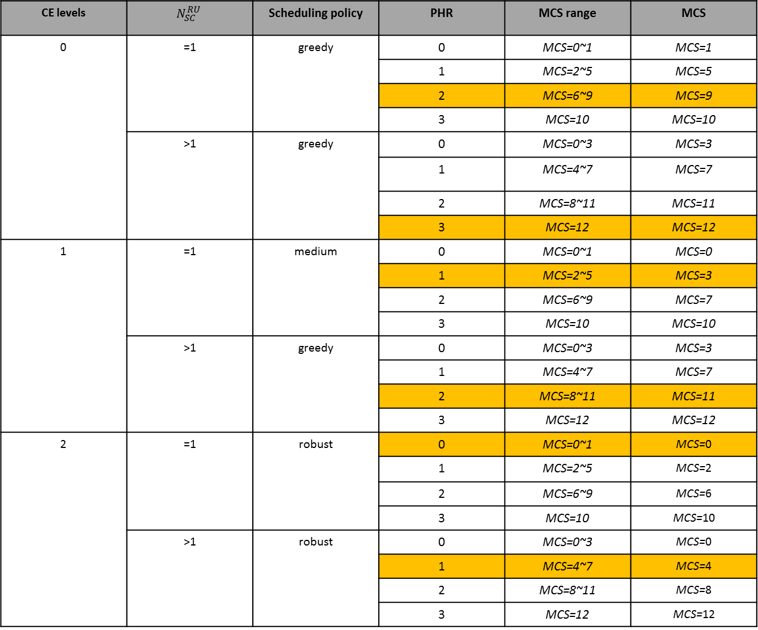
CE levels | $$N_{SC}^{RU}$$ | Scheduling policy | PHR | MCS range | MCS
0 | =1 | greedy | 0 | MCS=0~1 | MCS=1
 |  |  | 1 | MCS=2~5 | MCS=5
 |  |  | 2 | MCS=6~9 | MCS=9
 |  |  | 3 | MCS=10 | MCS=10
 | >1 | greedy | 0 | MCS=0~3 | MCS=3
 |  |  | 1 | MCS=4~7 | MCS=7
 |  |  | 2 | MCS=8~11 | MCS=11
 |  |  | 3 | MCS=12 | MCS=12
1 | =1 | medium | 0 | MCS=0~1 | MCS=0
 |  |  | 1 | MCS=2~5 | MCS=3
 |  |  | 2 | MCS=6~9 | MCS=7
 |  |  | 3 | MCS=10 | MCS=10
 | >1 | greedy | 0 | MCS=0~3 | MCS=3
 |  |  | 1 | MCS=4~7 | MCS=7
 |  |  | 2 | MCS=8~11 | MCS=11
 |  |  | 3 | MCS=12 | MCS=12
2 | =1 | robust | 0 | MCS=0~1 | MCS=0
 |  |  | 1 | MCS=2~5 | MCS=2
 |  |  | 2 | MCS=6~9 | MCS=6
 |  |  | 3 | MCS=10 | MCS=10
 | >1 | robust | 0 | MCS=0~3 | MCS=0
 |  |  | 1 | MCS=4~7 | MCS=4
 |  |  | 2 | MCS=8~11 | MCS=8
 |  |  | 3 | MCS=12 | MCS=12
CE level | Multi-tone support | Specific PHR
0 | 1 | 3
 | 0 | 2
1 | 1 | 2
 | 0 | 1
2 | 1 | 1
 | 0 | 0
Specific PHR
If $N_{SC}^{RU}$>1→ The range of MCS is 0~12
If $N_{SC}^{RU}$=1→ The range of MCS is 0~10
Ref: TS 36.213
Notes:
以及你的演算法 (e.g., PHR>0, MCS =12)分開列

Slide 40
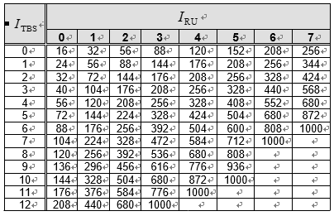
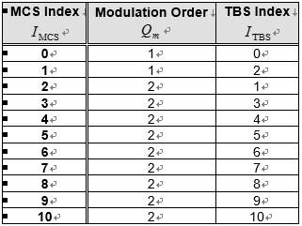
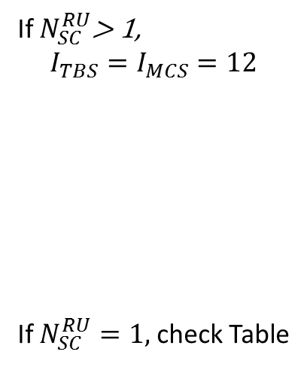
DCI Format N0-Resource Assignment/MCS
Discuss with Navid: PHR → MCS, check OAI LTE
If $N_{SC}^{RU}$> 1,
$$I_{TBS}=I_{MCS}=12$$
If $N_{SC}^{RU}=1,$ check Table
Resource Assignment index= 5
Modulation and Coding Scheme index = 9

Slide 41
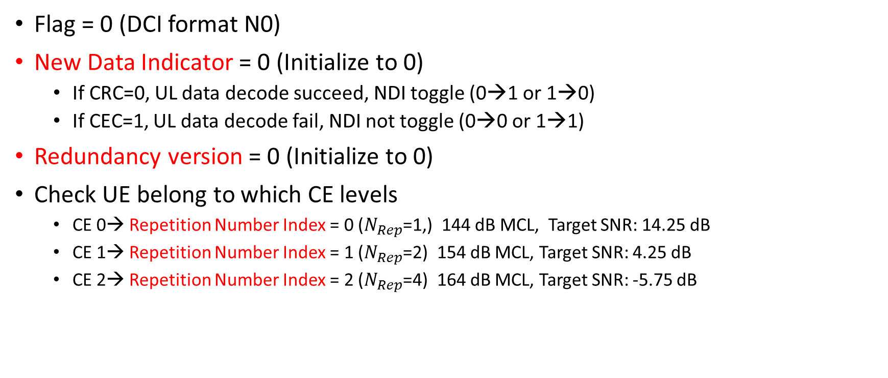
DCI Format N0-the other field
Flag = 0 (DCI format N0)
New Data Indicator = 0 (Initialize to 0)
If CRC=0, UL data decode succeed, NDI toggle (0→1 or 1→0)
If CEC=1, UL data decode fail, NDI not toggle (0→0 or 1→1)
Redundancy version = 0 (Initialize to 0)
Check UE belong to which CE levels
CE 0→ Repetition Number Index = 0 ($N_{Rep}$=1,) 144 dB MCL, Target SNR: 14.25 dB
CE 1→ Repetition Number Index = 1 ($N_{Rep}$=2) 154 dB MCL, Target SNR: 4.25 dB
CE 2→ Repetition Number Index = 2 ($N_{Rep}$=4) 164 dB MCL, Target SNR: -5.75 dB

Slide 42
Timing diagram for NPDCCH period
$S_{Request}:$Scheduling action at $T_{S_{Request}}$
DL
Ulsch_indication(1,2…m): Get UE scheduling Info. from Ulsch_indication
$T_{Ind}j$: The jth arrival of m Ulsch_PDU include UE scheduling Info.
$${Start}_{SearchSpace}$$
$$R_{max}[i]$$
$${End}_{SearchSpace}$$
$$S_{Request}$$
NPDCCH period (pp)
$$S_{Request}$$
$$\text{R}\text{[}\text{i}\text{]}$$
$$\text{R}\text{[}\text{i}\text{]}$$
$$\text{R}\text{[}\text{i}\text{]}$$
…
Ulsch_ind(1,2…m)
NPDCCH search space for CE level i
Ulsch_ind(2)
Ulsch_ind(m)
Ulsch_ind(1)
Time
$$T_{Ind}1$$
$$T_{Ind}2$$
$$T_{Ind}3$$
$$T_{Ind}j$$
${Start}_{SearchSpace}+$pp
$$T_{DCISt [1]}$$
$$T_{DCIEt [1]}$$
$$T_{DCISt [2]}$$
$$T_{DCIEt [2]}$$
$$T_{DCISt [m]}$$
$$T_{DCIEt [m]}$$
>=3ms
>=3ms
UL
$$T_{S_{Request}}$$
$$I_{Delay[1]}$$
$$T_{S_{Request}}$$
$$I_{Delay[2]}$$
$$I_{Delay[m]}$$
Sort UE base on the following rule:
The bigger round, the higher priority.
If round2>round1, swap UEs
11
10
9
8
UL Transmission-
${dT}_{m}$ ($N_{RU[m]}$, $N_{Rep[m]}$, $N_{slots[m]}^{UL}$)
7
6
UL Transmission-
${dT}_{2}$ ($N_{RU[m]}$, $N_{Rep[m]}$, $N_{slots[m]}^{UL}$)
5
4
3
$$I_{sc[m]}$$
2
$$I_{sc[2]}$$
1
$$I_{sc[1]}$$
Time
0
UL Transmission-
${dT}_{1}$ ($N_{RU[m]}$, $N_{Rep[m]}$, $N_{slots[m]}^{UL}$)
${Start}_{SearchSpace}+$pp
Notes:
The timing diagram shown in Fig. 2 shows the behavior of UL scheduler in NB-IoT. Let Ulsch_ind(1,2..m) be the indication of UL transmissions for m devices; $T_{Rep}i$ is the time of ith UL indication for m devices. The data type of each UL transmission in Ulsch_ind could be UL data or any kind of UL RRC message include Msg3, Msg5, and ULinformationTranfer [2], etc; A UL transmission will carry device’s scheduling information, such as DV/PHR or BSR..,etc. These scheduling information will input to the scheduler when triggering the scheduler at $T_{S_{Request}}$; $S_{Request}$ is an trigger action starts at $T_{S_{Request}}$, it will starts the scheduler at previous subframe of next pp according to the received scheduling information in Ulsch_ind. The $T_{SearchSpace}$ is the duration of search space for three CE levels in pp; ${Start}_{SearchSpace}$ is the starting time of search space in pp; ${End}_{SearchSpace}$ is the end time of search space in pp. The $T_{DCISt[m]}$ is the starting time of mth DCI; $T_{DCIEt[m]}$ is the end time of mth DCI; $T_{DCIRep[m]}$ is the mth DCI repetiiton number. The relation among $T_{DCISt[m]}$, $T_{DCIEt[m]}$, $T_{DCIRep[m]}$, $T_{SearchSpace}$, ${Start}_{SearchSpace}$, ${End}_{SearchSpace}$ and pp is illustrated in DL in Fig. 2.
The $F_{m}$ is frequency split unit base on different tone support in UL resource alocation; $F_{m}∈\{1, 3, 6, 12\}$ in Table I. m is the number of element in resource allocaiton pattern $S_{Freq}\left[m\right]$; $S_{Freq}\left[m\right]$ is the starting frequency position of each element, this will be described in III. proposed approach. The $I_{Delay[m]}$ is the shceduling delay after $T_{DCIEt[m]}$; $I_{sc[m]}$ is the subcarrier indication to point out the location of mth UL transmission in frequency domain; $N_{RU[m]}$ is the number of resource unit uesd for mth UL transmission; $N_{Rep[m]}$ is the number of repetiiton used for mth UL transmission; $N_{slots[m]}^{UL}$ is the number of UL slots used for mth UL transmission; ${dT}_{m}$ is the duration of mth UL transmission in time domain; The ${dT}_{m}$ is equal to $N_{RU[m]}∗N_{Rep[m]}∗N_{slots[m]}^{UL}$. The relation among $F_{m}$, $S_{Freq}\left[m\right]$, $I_{Delay}$[m], $N_{RU[m]}$, $N_{Rep[m]}$, $N_{slots[m]}^{UL}$ is illustrated in UL in Fig. 2. The proposed system model describe general concept of UL traffic scheduler in NB-IoT. The details of shceduling procedure and design concept will be described in III. proposed approach.

Slide 43
Simulation Setting
Number of UE | Average number of UL traffic report per second | success probability for each UL transmission | The ratio number of devices in which CE level in each traffic report | Case 1: pp setting | Case 2: pp setting
12 24 36 | 6/sec | 90% | CE0:70% CE1:20% CE2:10% | CE0:128 CE1:256 CE2:512 | CE0:512 CE1:512 CE2:512
Resource Utilization(U)
Average delay (ms)
2400ms
Case2
0.7
Case1
1600 ms
Case1
0.6
Case2
1200 ms
0.5
0.4
600 ms
0.3
300 ms
Total # of UE
Total # of UE
12
24
36
12
24
36

Slide 44
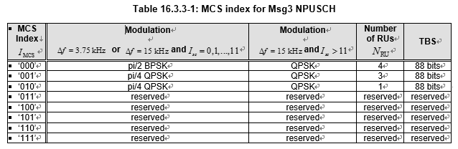
For schedule Msg3 retransmission
Notes:
The redundancy version for the first transmission of Msg3 is 0. [TS.36.213]

