Slide 1

Gym! Latvia Chatbot AI
AI-powered multilingual chatbot for Gym Latvia that answers FAQs and supports customer engagement 24/7 via the website.
GitHub link: https://github.com/Cookkkkie/DIP392-AI_Chatbot_Gym-_Latvia
Date: 26.05.2025

Slide 2
Project Overview and Motivation
Gym! Latvia support team are often busy as according to customer description each around 10k users can attend the website. It leads to delays in answering common questions
Some questions are repetitive across Latvian, English and Russian.
Motivation is to provide instant, human-like support without manual overhead.
Chatbot is a widget and can be applied modularly

Slide 3
SDLC Methodology
We chose Waterfall methodology for this project.
Initially we defined and gathered all requirements, carefully planned the work and split between team members.
This linearity seemed easier as this software is not so big and does not require active collaboration with rapid releases.

Slide 4
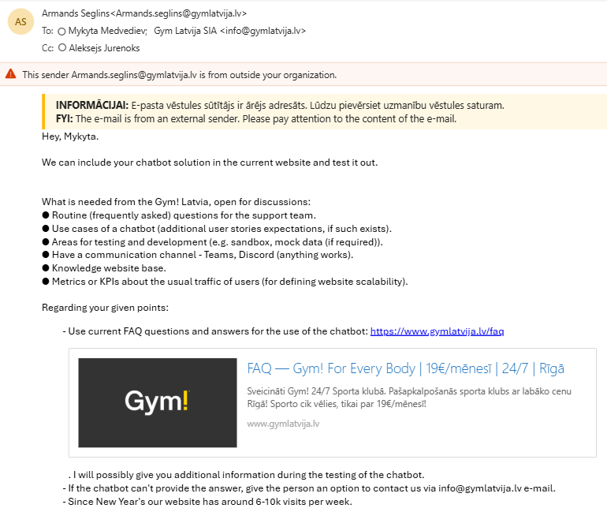
Requirements Gathering & Analysis
Outlook was a main tool in communication between customer and developer team. From given screenshot:
Moreover, Mykyta has met Armands personally in Gym! Latvia and had a very productive talk where the following points has been conducted:

Slide 5
Requirements Gathering & Analysis
FAQ section chatbot answers is what customer expects to see in initial version.
Default answer should give an option to contact support team.
Chatbot must support three languages: Latvian, English and Russian.
Around 6-10k users visit website per week.
Gym Latvia uses Squarespace website constructor instead of standard web development tools.
Gym! Latvia has no access to testing environments as main company location is in Poland and Gym! Latvia as a child company of Perfect Gym S.A.
The history of user conversation with the chatbot should be temporary saved.
Customer is not aware of Gym! Latvia backend hosting. Cloud or On-Premise.

Slide 6
Software Requirements Specification
Functional requirements:
Accept user messages and return AI response in three languages: LV, EN, RU.
Store conversation history temporary.
Default welcome message.
Reference user to support team.
Non-Functional requirements:
Scrape updated FAQs for system context.

Slide 7
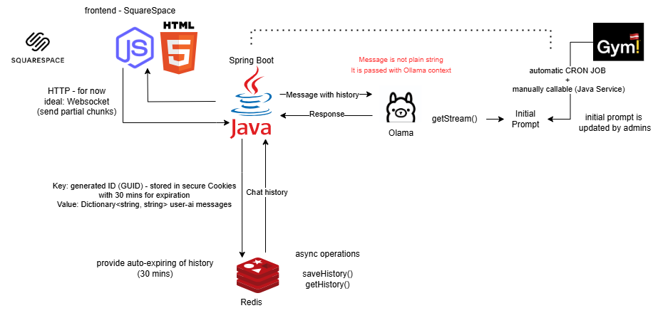
System and Software Design

Slide 8
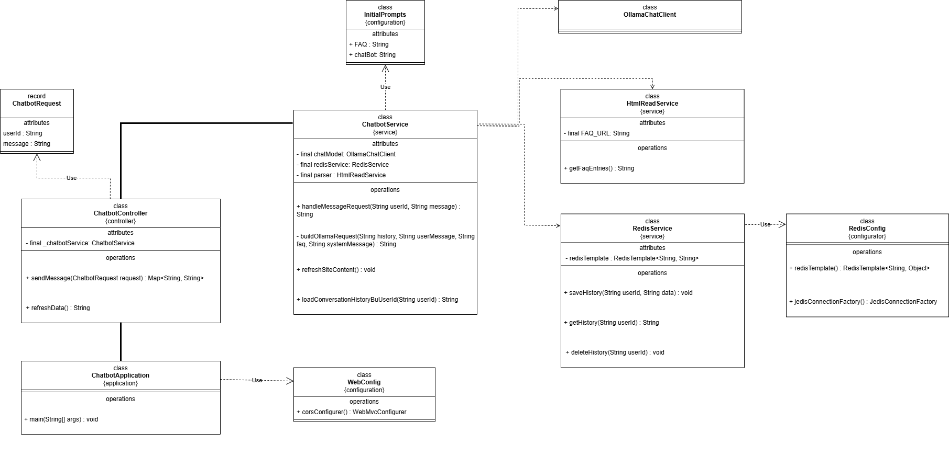
System and Software Design

Slide 9






Implementation Phase
Java 21 + Spring boot 3.
UserId (guid) generation in secure cookies
Ollama integration: system + user prompt chaining
Redis template with Dict<string, string>, userId -> conversation history
Constants used for configurable values such as origins, messages and URLs.
GitHub for version controlling.
Since Squarespace is not free and we have no access, the decision of using standard web development has been chosen.

Slide 10
Testing Strategy
Unit tests with Mockito including Redis and HTML scraper tests.
Using code stubbing.
Integration tests: Simulated chatbot + Redis flow
Manual UI testing

Slide 11
Test Results and Validation
Code coverage: 100% of service and controller layers.
Redis tests confirmed the ability to save, get and auto delete history based on set time
Response validations are referred to Gym! Latvia only avoiding answering not related question
In case of any errors or incomplete reply user is asked to reach support Gym! Latvia team using the email: info@gymlatvia.lv

Slide 12
Process Challenges and Lessons Learned
Squarespace is not ideal for complex interactive apps—early architectural decisions impact future flexibility. Moreover, it is not a free solution.
We should also try to find a balance or a trade off between price and functionality available.
Without a structured SDLC like Agile, it was harder to track progress, assign roles, or maintain a timeline.
Having well-separated services (chat handling, storage, parsing) made debugging and testing manageable.
Proper logging in both backend and frontend is vital for tracing issues quickly.

Slide 13
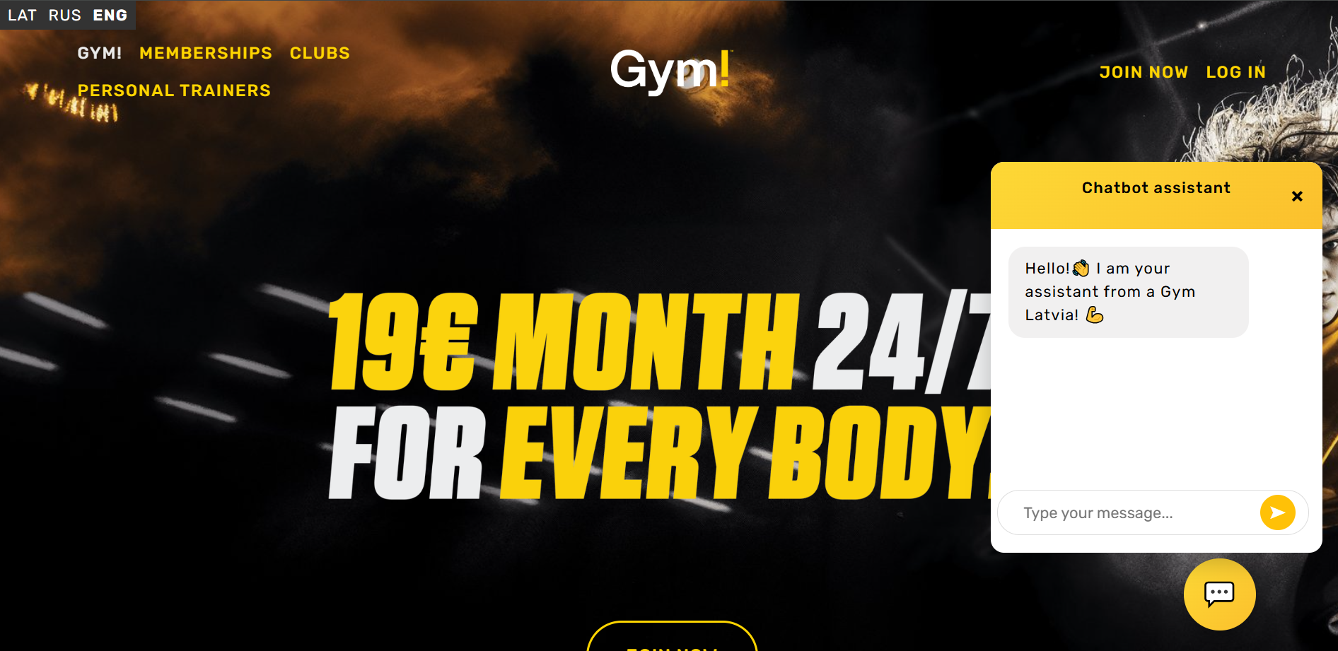
Demo Overview

Slide 14
Conclusion
We successfully developed a functional AI-powered chatbot using:
Java Spring Boot (backend logic)
Ollama (LLM responses)
Redis (for storing chat history)
Modular widget with JavaScript, HTML and CSS that can be integrated to Squarespace.
The chatbot can understand user messages, respond intelligently, and maintain conversation history per user.

Slide 15
Future Work
The expansion of Ollama Gym! Latvia knowledge base will enhance AI replies. FAQ is only initial version
Automated HTML can happen when Gym! Latvia admins change the page. For now, they should manually click the button.
Introducing CI/CD pipelines for enhancing deployments

Slide 16
Q&A / Feedback
Demo recording is done but the customer has not responded yet to our progress.

Slide 17
Thank you for your attention!

