Slide 1
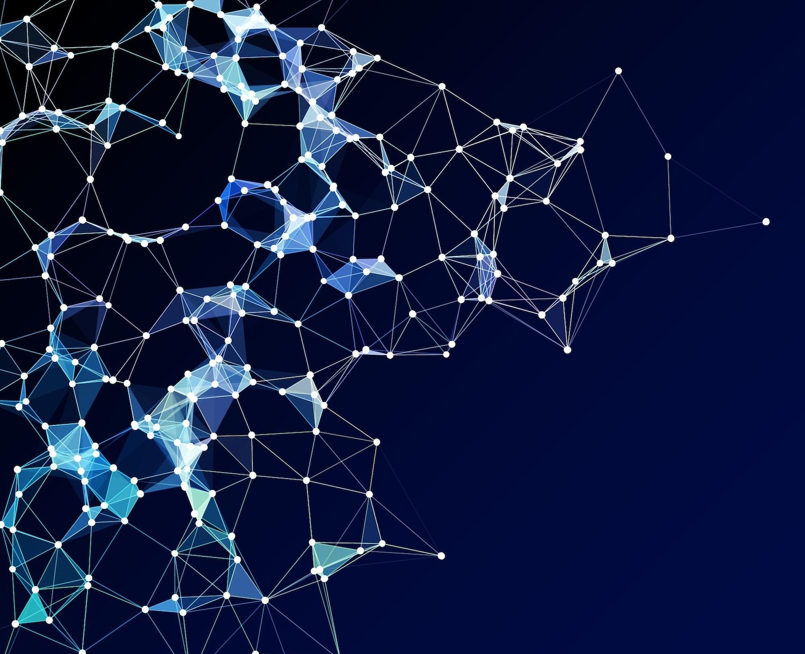
CANCER DETECTION USING CNN

Slide 2
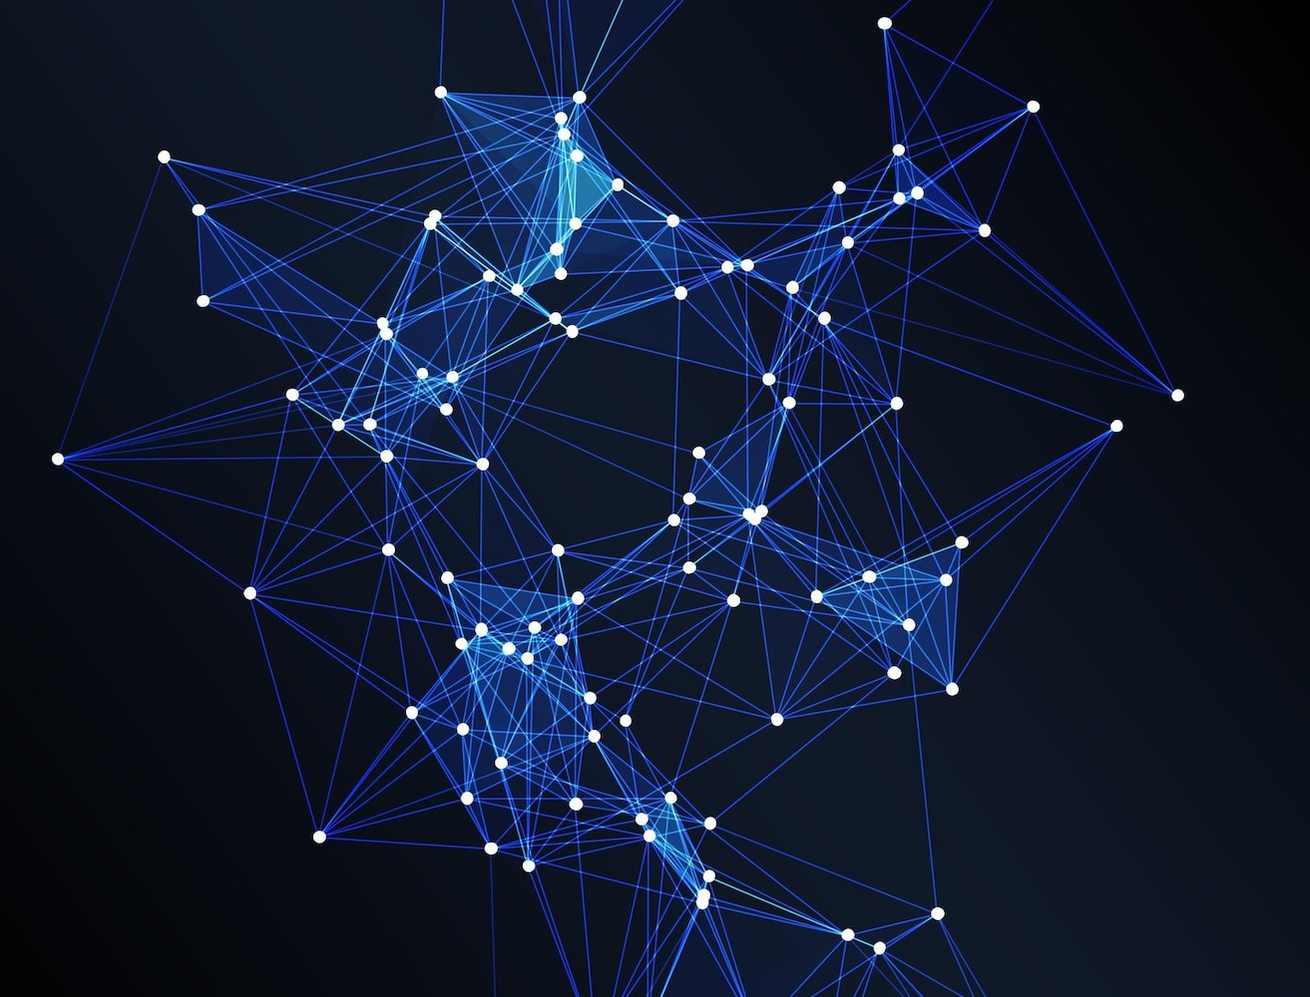
WELCOME TO THE WORLD OF CNN
In this presentation, we'll explore the potential of Convolutional Neural Networks in revolutionizing
. Get ready to uncover the cutting-edge technology that's
reshaping the medical ﬁeld.

Slide 3
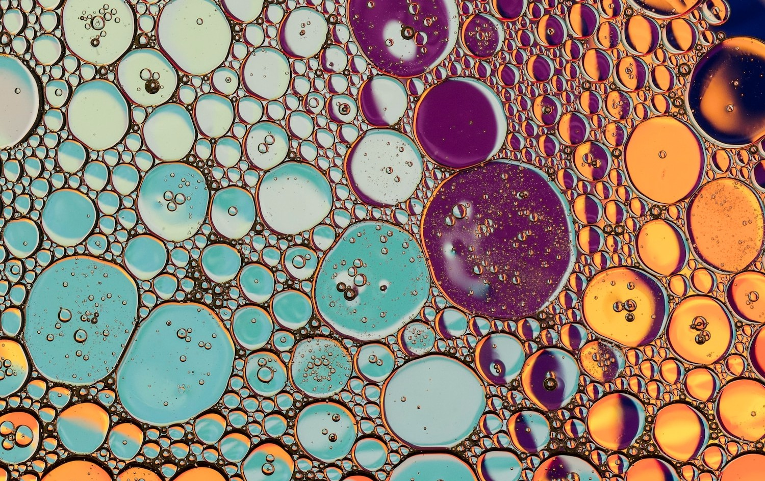
UNDERSTANDING CANCER DETECTION
Let's dive into the complexities of
and how CNN deep learning is enhancing accuracy. We'll unravel the intricacies of tumor identiﬁcation and the role of deep learning in this critical
domain.

Slide 4
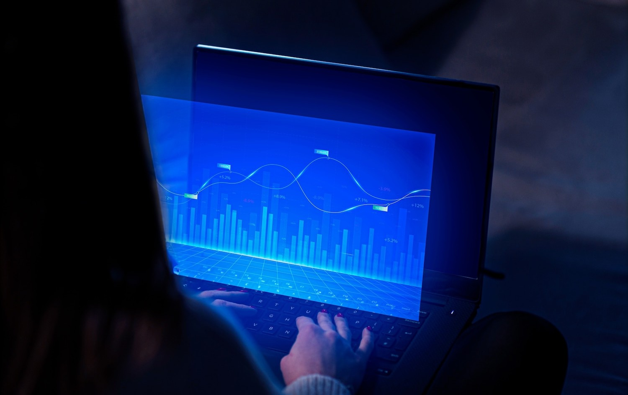
UNLEASHING THE POWER OF CNN
Discover how CNN deep learning is transforming the landscape of
. We'll delve into real-world applications and the potential to
improve early detection rates, ultimately saving lives.

Slide 5
EMBRACING THE FUTURE OF CANCER DETECTION
As we conclude, it's clear that CNN deep learning holds immense promise in the realm of . Let's embrace this innovative technology and work towards a future with enhanced diagnostic capabilities.

Slide 6
Thanks!

