Slide 1
Discovering Threshold-based Frequent Closed Itemsets over Probabilistic Data
Yongxin Tong¹, Lei Chen¹, Bolin Ding²
¹ Department of Computer Science and Engineering
The Hong Kong University of Science and Technology
² Department of Computer Science
University of Illinois at Urbana-Champaign

Slide 2
Outline
Why Data Uncertainty Is Ubiquitous
A Motivation Example
Problem Definitions
MPFCI Algorithm
Experiments
Related Work
Conclusion

Slide 3
Outline
Why Data Uncertainty Is Ubiquitous
A Motivation Example
Problem Definitions
MPFCI Algorithm
Experiments
Related Work
Conclusion

Slide 4











Scenarios 1: Data Integration
the confidence that a document is true
Doc 1
0.2
Doc 2
0.4
…
…
…
…
a document entity
Doc l
0.3
data sources
near duplicate documents
  Unreliability of multiple data sources
Notes:
With the development of Internet, more and more data sources can be found online.
For example, literate data, email data, link data, and so on.
During data integration, for a document entity, instance from multiple data sources might be conflicting.
Thus, data integration leads to the uncertainty in multuple sources data.

Slide 5
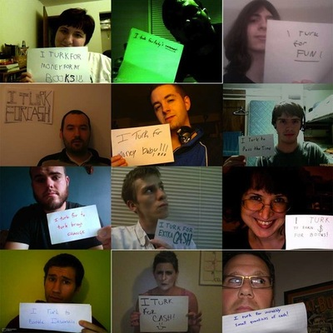
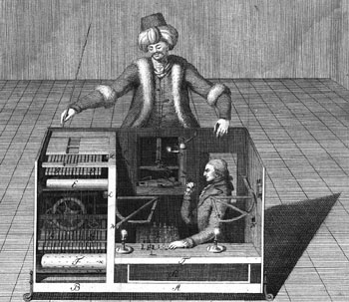

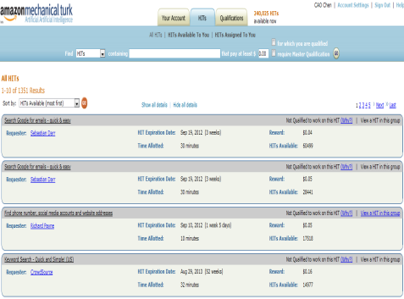
Scenarios 2: Crowdsourcing
AMT
Requesters
MTurk workers
(Photo By Andrian Chen)
Requesters outsourced many tasks to the online crowd workers during the web crowdsourcing platforms (i.e. AMT, oDesk, CrowdFlower, etc.) .
Different workers might provide different answers!
How to aggregating different answers from crowds?
How to distinguish which users are spams?

Slide 6

Scenarios 2: Crowdsourcing
Where to find the best sea food in Hong Kong?
Sai Kung or Hang Kau ?
The correct answer ratio measures the uncertainty of different workers!
Majority voting rule is widely used in crowdsouring, in fact, it is to determine which answer is frequent when min_sup is greater than half of total answers!

Slide 7
Outline
Why Data Uncertainty Is Ubiquitous
A Motivation Example
Problem Definitions
MPFCI Algorithm
Experiments
Related Work
Conclusion

Slide 8
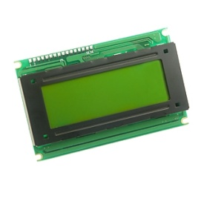

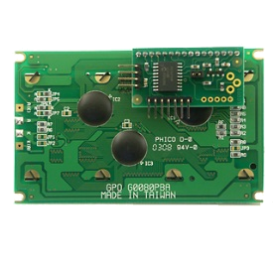
Motivation Example
In an intelligent traffic systems application, many sensors are deployed to collect real-time monitoring data in order to analyze the traffic jams.
TID | Location | Weather | Time | Speed | Probability
T1 | HKUST | Foggy | 8:30-9:00 AM | 90-100 | 0.3
T2 | HKUST | Rainy | 5:30-6:00 PM | 20-30 | 0.9
T3 | HKUST | Sunny | 3:30-4:00 PM | 40-50 | 0.5
T4 | HKUST | Rainy | 5:30-6:00 PM | 30-40 | 0.8

Slide 9
Motivation Example (cont’d)
TID | Location | Weather | Time | Speed | Probability
T1 | HKUST | Foggy | 8:30-9:00 AM | 90-100 | 0.3
T2 | HKUST | Rainy | 5:30-6:00 PM | 20-30 | 0.9
T3 | HKUST | Sunny | 3:30-4:00 PM | 40-50 | 0.5
T4 | HKUST | Rainy | 5:30-6:00 PM | 30-40 | 0.8
According to above data, we analyze the reasons that cause the traffic jams through the viewpoint of uncertain frequent pattern mining.
For example, we find that {Time = 5:30-6:00 PM; Weather = Rainy} is a frequent itemset with a high probability.
Therefore, under the condition of {Time = 5:30-6:00 PM; Weather = Rainy}, it is very likely to cause the traffic jams.

Slide 10
Motivation Example (cont’d)
How to find probabilistic frequent itemsets?
PW | Transactions | Prob.
PW1 | T1 | 0.0108
PW2 | T1, T2 | 0.0162
PW3 | T1, T3 | 0.0252
PW4 | T1, T4 | 0.0972
PW5 | T1, T2, T3 | 0.0378
PW6 | T1, T2, T4 | 0.1458
PW7 | T1, T3, T4 | 0.2268
PW8 | T1, T2, T3, T4 | 0.3402
PW9 | T2 | 0.0018
PW10 | T2, T3 | 0.0042
PW11 | T2, T4 | 0.0162
PW12 | T2, T3, T4 | 0.0378
PW13 | T3 | 0.0028
PW14 | T3, T4 | 0.0252
PW15 | T4 | 0.0108
PW16 | { } | 0.0012
{a}, {b}, {c}
{a, b}, {a, c}, {b, c}
{a, b, c}
TID | Transaction | Prob.
T1 | a b c d | 0.9
T2 | a b c | 0.6
T3 | a b c | 0.7
T4 | a b c d | 0.9
Possible World
Semantics
Freq. Prob. = 0.9726
If min_sup=2, threshold= 0.8
Frequent Probability:
Pr{sup(abcd)≥min_sup} =∑Pr(PWi)=Pr(PW4)+Pr(PW6)+Pr(PW7)+Pr(PW8)=0.81> 0.8
{d}
{a, d}, {b, d}, {c, d}
{a, b, d}, {a, c, d}, {b, c, d}
{a, b, c, d}
Freq. Prob. = 0.81

Slide 11
Motivation Example (cont’d)
How to distinguish the 15 itemsets in two groups in the previous page?
Extend the method of mining frequent closed itemset in certain data to the uncertain environment.
Mining Probabilistic Frequent Closed Itemsets.
PW | Transactions | Prob. | FCI
PW1 | T1 | 0.0108 | { }
PW2 | T1, T2 | 0.0162 | {abc}
PW3 | T1, T3 | 0.0252 | {abc}
PW4 | T1, T4 | 0.0972 | {abcd}
PW5 | T1, T2, T3 | 0.0378 | {abc}
PW6 | T1, T2, T4 | 0.1458 | {abc} {abcd}
PW7 | T1, T3, T4 | 0.2268 | {abc} {abcd}
PW8 | T1, T2, T3, T4 | 0.3402 | {abc} {abcd}
PW9 | T2 | 0.0018 | { }
PW10 | T2, T3 | 0.0042 | {abc}
PW11 | T2, T4 | 0.0162 | {abc}
PW12 | T2, T3, T4 | 0.0378 | {abc}
PW13 | T3 | 0.0028 | { }
PW14 | T3, T4 | 0.0252 | {abc}
PW15 | T4 | 0.0108 | { }
PW16 | { } | 0.0012 | { }
TID | Transaction
T1 | a b c d e
T2 | a b c d
T3 | a b c
T4 | a b c d
In the deterministic data, an itemset is a frequent closed itemset iff:
  It is frequent;
  Its support must be larger than supports of any of its supersets.
For example, if min_sup=2,
  {abc}.support = 4 > 2 (Yes)
  {abcd}.support = 2 (Yes)
  {abcde}.support=1 (No)

Slide 12
Outline
Why Data Uncertainty Is Ubiquitous
A Motivation Example
Problem Definitions
MPFCI Algorithm
Experiments
Related Work
Conclusion

Slide 13
Problem Definitions
Frequent Closed Probability
  Given a minimum support min_sup, and an itemset X, X’s frequent closed probability, denoted as Pr_{FC}(X) is the sum of the probabilities of possible worlds where X is a frequent closed itemset.
Probabilistic Frequent Closed Itemset
  Given a minimum support min_sup, a probabilistic frequent closed threshold pfct, an itemset X, X is a probabilistic frequent closed itemset if
  Pr{X is frequent closed itemset}= Pr_{FC}(X) > pfct

Slide 14
Example of Problem Definitions
If min_sup=2, pfct = 0.8
Frequent Closed Probability: Pr_{FC}(abc)=Pr(PW2)+Pr(PW3)+Pr(PW5)+Pr(PW6)+Pr(PW7)+ Pr(PW8)+Pr(PW10)+Pr(PW11)+Pr(PW12)+Pr(PW14)= 0.8754>0.8
So, {abc} is a probabilistic frequent closed itemset.
PW | Transactions | Prob. | FCI
PW1 | T1 | 0.0108 | { }
PW2 | T1, T2 | 0.0162 | {abc}
PW3 | T1, T3 | 0.0252 | {abc}
PW4 | T1, T4 | 0.0972 | {abcd}
PW5 | T1, T2, T3 | 0.0378 | {abc}
PW6 | T1, T2, T4 | 0.1458 | {abc} {abcd}
PW7 | T1, T3, T4 | 0.2268 | {abc} {abcd}
PW8 | T1, T2, T3, T4 | 0.3402 | {abc} {abcd}
PW9 | T2 | 0.0018 | { }
PW10 | T2, T3 | 0.0042 | {abc}
PW11 | T2, T4 | 0.0162 | {abc}
PW12 | T2, T3, T4 | 0.0378 | {abc}
PW13 | T3 | 0.0028 | { }
PW14 | T3, T4 | 0.0252 | {abc}
PW15 | T4 | 0.0108 | { }
PW16 | { } | 0.0012 | { }

Slide 15
Complexity Analysis
However, it is #P-hard to calculate the frequent closed probability of an itemset when the minimum support is given in an uncertain transaction database.
How to compute this hard problem?

Slide 16
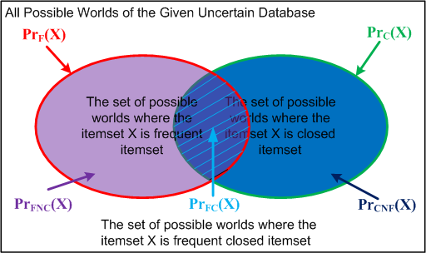


Computing Strategy
O(NlogN)
The relationship of Pr_{F}(X), Pr_{C}(X) and Pr_{FC}(X)
Stragtegy1: Pr_{FC}(X) = Pr_{F}(X) - Pr_{FNC}(X)
Stragtegy2: Pr_{FC}(X) = Pr_{C}(X) - Pr_{CNF}(X)
#P Hard
Notes:
purple
Moreover, the red circle minus the overlapping part represents the set of possible worlds where the itemset X is frequent but not closed; and similarly, the green circle minus the overlapping part represents the set of possible worlds where the itemset X is closed but not frequent.
Obviously, there are two kinds of strategies to compute the frequent closed probability of each itemset. The first method is to subtract the overlapping part from the red circle, the second method is to subtract the overlapping part from the green circle.
So which strategy should we choose? As for the 1st strategy, computing the red circle is easy since its time cost is only O(NlogN), if the red circle can not pass the user’s threshold, it can be safely pruned. As for the 2nd strategy, computing the green circle is a #p hard problem, so it is time-consuming. Therefore, we choose the 1st one.

Slide 17


Computing Strategy (cont’d)
Stragtegy: Pr_{FC}(X) = Pr_{F}(X) - Pr_{FNC}(X)
How to compute the Pr_{FNC}(X) ?
Assume that there are m other items, e₁,e₂,…,e_{m}, besides items of X in UTD.
Pr_{FNC}(X) =
where denotes an event that the superset of X, X+e_{i} , always appears together with X at least min_sup times.
Inclusion-Exclusion principle, a #P-hard problem.

Slide 18
Outline
Why Data Uncertainty Is Ubiquitous
A Motivation Example
Problem Definitions
MPFCI Algorithm
Experiments
Related Work
Conclusion

Slide 19
Outline
Motivation
Problem Definitions
MPFCI Algorithm
Experiments
Related Work
Conclusion

Slide 20
Algorithm Framework
Procedure MPFCI_Framework {
Discover all initial probabilistic frequent single items.
For each item/itemset {
1: Perform pruning and bounding strategies.
2: Calculate the frequent closed probability of itemsets
which cannot be pruned and return as the result set. }
}

Slide 21
Pruning Techniques
  Chernoff-Hoeffding Bound-based Pruning
  Superset Pruning
  Subset Pruning
  Upper Bound and Lower Bound of Frequent Closed Probability-based Pruning

Slide 22

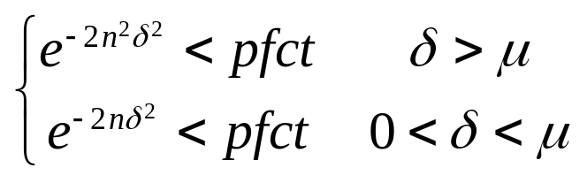

Chernoff-Hoeffding Bound-based Pruning
Given an itemset X, an uncertain transaction database UTD, X’s expected support , a minimum support threshold min_sup, probabilistic frequent closed threshold pfct, an itemset X can be safely filtered out if,
where and n is the number of transactions in UTD.
Fast Bounding Pr_{F}(X)
Stragtegy: Pr_{FC}(X) = Pr_{F}(X) - Pr_{FNC}(X)

Slide 23

Superset Pruning
Given an itemset and X’s superset, X+e, where e is a item, if e is smaller than at least one item in X with respect to a specified order (such as the alphabetic order), and X.count= X+e.count, X and all supersets with X as prefix based on the specified order can be safely pruned.
TID | Transaction | Prob.
T1 | a b c d | 0.9
T2 | a b c | 0.6
T3 | a b c | 0.7
T4 | a b c d | 0.9
{b, c} and all supersets with {b, c} as prefix can be safely pruned.
{b, c} {a,b,c} & a <_{order} b
{b, c}.count = {a,b,c}.count

Slide 24
Subset Pruning
Given an itemset and X’s subset, X-e, where e is the last item in X according to a specified order (such as the alphabetic order), if X.count= X-e.count, we can get the following two results:
  X-e can be safely pruned.
  Beside itemsets of X and X’s superset, itemsets which have the same prefix X-e, and their supersets can be safely pruned.
TID | Transaction | Prob.
T1 | a b c d | 0.9
T2 | a b c | 0.6
T3 | a b c | 0.7
T4 | a b c d | 0.9
{a,b} ,
{a, b, d} and its all supersets can
be safely pruned.
{a, b, c} & {a, b, d} have the same prefix{a, b}
{a, b}.count = {a, b, c}.count

Slide 25
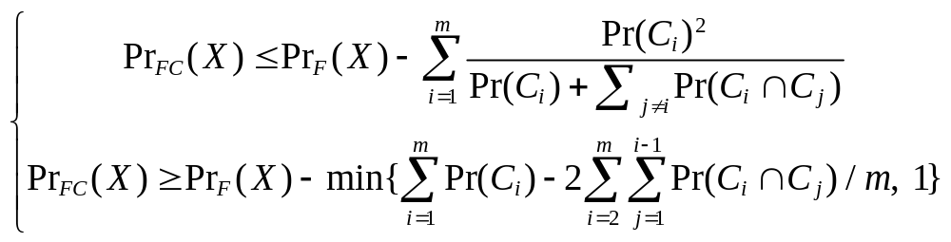
Upper / Lower Bounding Frequent Closed Probability
Given an itemset X, an uncertain transaction database UTD, and min_sup, if there are m other items besides items in X, e₁,e₂,…,e_{m}, the frequent closed probability of X, Pr_{FC} (X), satisfies:
where represents the event that the superset of X, X+e_{i}, always appear together with X at least min_sup times.
Fast Bounding Pr_{FNC}(X)
Stragtegy: Pr_{FC}(X) = Pr_{F}(X) - Pr_{FNC}(X)

Slide 26
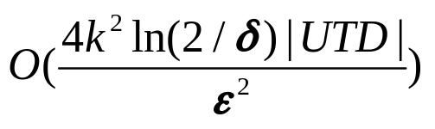
Monte-Carlo Sampling Algorithm
Review the computing strategy of frequent closed probability: Pr_{FC}(X) = Pr_{F}(X) - Pr_{FNC}(X)
The key problem is how to compute Pr_{FNC}(X) efficiently.
Monte-Carlo sampling algorithm to calculate the frequent closed probability approximately.
  This kind of sampling is unbiased
  Time Complexity:

Slide 27
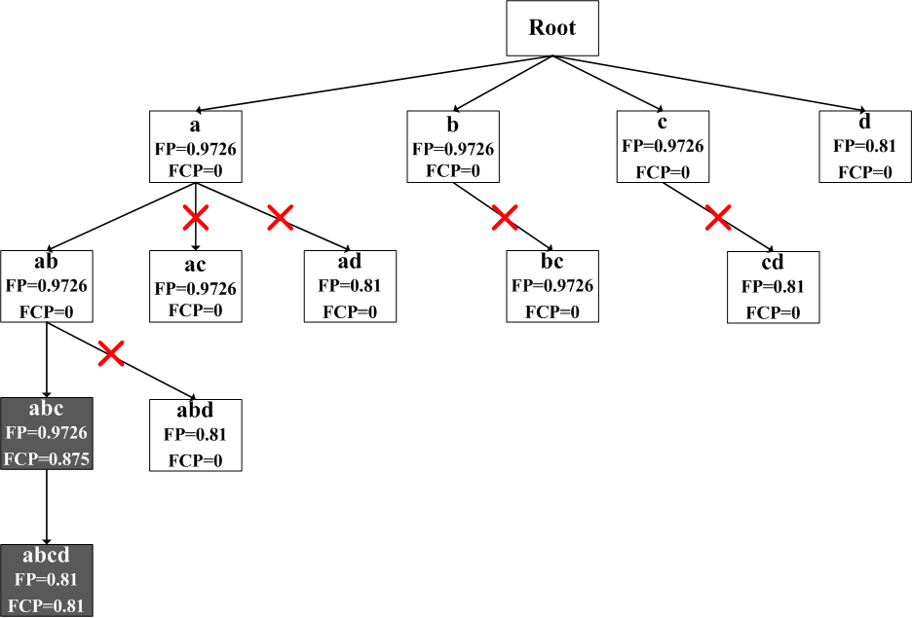
A Running Example
TID | Transaction | Prob.
T1 | a b c d | 0.9
T2 | a b c e | 0.6
T3 | a b c | 0.7
T4 | a b c d | 0.9
Input:
min_sup=2;
pfct = 0.8
Superset Pruning
Subset Pruning

Slide 28
Outline
Why Data Uncertainty Is Ubiquitous
A Motivation Example
Problem Definitions
MPFCI Algorithm
Experiments
Related Work
Conclusion

Slide 29
Experimental Study
Features of Testing Algorithms in Experiments
Algorithm | CH | Super | Sub | PB | Framework
MPFCI | √ | √ | √ | √ | DFS
MPFCI-NoCH |  | √ | √ | √ | DFS
MPFCI-NoBound | √ | √ | √ |  | DFS
MPFCI-NoSuper | √ |  | √ | √ | DFS
MPFCI-NoSub | √ | √ |  | √ | DFS
MPFCI-BFS | √ |  |  | √ | BFS
Characteristics of Datasets
Dataset | Number of Transactions | Number of Items | Average Length | Maximal Length
Mushroom | 8124 | 120 | 23 | 23
T20I10D30KP40 | 30000 | 40 | 20 | 40
Notes:
We have conducted a series of experiments on all variants of algorithms and datasets.
The MPFCI is the algorithm with all bounding techniques. We compare it with other four variants with different pruning power, specifically, MPFCI-NoCH is the algorithm without Chernoff bounding, MPFCI-NoBound is without probabilistic bound of the closed probability pruning, MPFFCI-NoSuper is without superset pruning, MPFCI-NoSub is without subset pruning. Besides, we also implemented a breadth-first search-based algorithm, MPFCI-BFS, which only utilizes the Chernoff-Hoeffding bound-based pruning and the frequent closed probability bound-based pruning.
We test all of these algorithms on two datasets. Mushroom is a real certain dataset containing characteristics of various species of mushrooms. We assign a probability generated from Gaussian distribution to each transaction. The second data set is generated by IBM dataset generator, which also follows normal distribution.

Slide 30
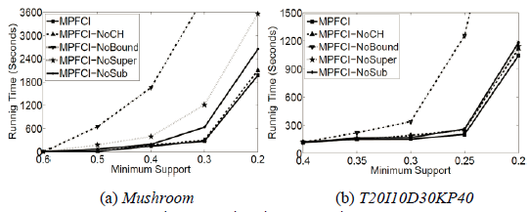
Efficiency Evaluation
Running Time w.r.t min_sup

Slide 31
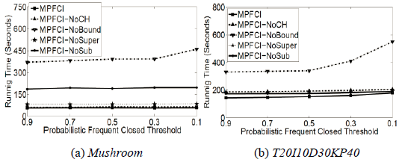
Efficiency Evaluation(cont’d)
Running Time w.r.t pfct

Slide 32
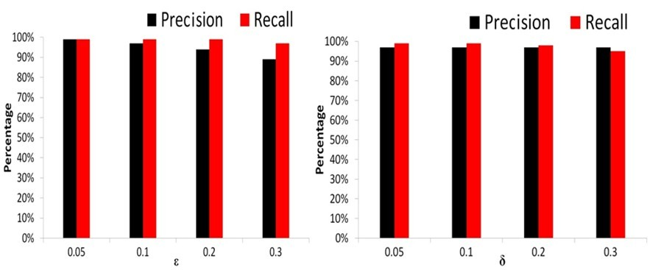
Approximation Quality Evaluation
Varying Epsilon
Varying Delta
Approximation Quality in Mushroom Dataset

Slide 33
Outline
Why Data Uncertainty Is Ubiquitous
A Motivation Example
Problem Definitions
MPFCI Algorithm
Experiments
Related Work
Conclusion

Slide 34
Related Work
  Expected Support-based Frequent Itemset Mining
    Apriori-based Algorithm: UApriori (KDD’09, PAKDD’07, 08)
    Pattern Growth-based Algorithms: UH-Mine (KDD’09)
    UFP-growth (PAKDD’08)
  Probabilistic Frequent Itemset Mining
    Dynamic-Programming-based Algorithms: DP (KDD’09, 10)
    Divide-and-Conquer-based Algorithms: DC (KDD’10)
    Approximation Probabilistic Frequent Algorithms:
      Poisson Distribution-based Approximation (CIKM’10)
      Normal Distribution-based Approximation (ICDM’10)

Slide 35
Outline
Why Data Uncertainty Is Ubiquitous
A Motivation Example
Problem Definitions
MPFCI Algorithm
Experiments
Related Work
Conclusion

Slide 36
Conclusion
  Propose a new problem of mining probabilistic threshold-based frequent closed itemsets in an uncertain transaction database.
  Prove the problem of computing the frequent closed probability of an itemset is #P-Hard.
  Design an efficient mining algorithm, including several effective probabilistic pruning techniques, to find all probabilistic frequent closed itemsets.
  Show the effectiveness and efficiency of the mining algorithm in extensive experimental results.

Slide 37
Thank you

