Slide 1



Online Mobile Micro-Task Allocation in Spatial Crowdsourcing
Yongxin Tong ¹, Jieying She ², Bolin Ding ³, Libin Wang ¹, Lei Chen ² ¹ Beihang University ² The Hong Kong University of Science and Technology ³ Microsoft Research
Notes:
Good morning everyone. I am Yongxin Tong from Beihang University. Today I’ll present our work online mobile micro-task allocation in spatial crowdsourcing. This is a collaborative work with Jieying and Lei from HKUST and Bolin from Microsoft research.

Slide 2
Outline
Background and Motivation
Problem Statement
Our Solutions
Experiments
Conclusion

Slide 3
Outline
Background and Motivation
Problem Statement
Our Solutions
Experiments
Conclusion

Slide 4



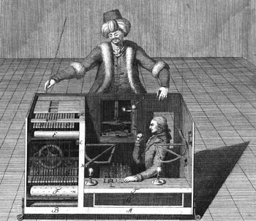


Traditional Crowdsourcing Applications
Question/Answer Type of Crowdsourcing
General Crowdsourcing
AMT
Notes:
I think you have been pretty familiar with crowdsourcing.
Some famous traditional crowdsourcing platforms include Yahoo Answer, AMT, oDesk, etc.

Slide 5
Spatial Crowdsourcing
Spatial Crowdsourcing Platforms
Help assign offline spatial tasks to online crowd workers
e.g. Offline-to-Online (O2O) applications
Notes:
In recent years, spatial crowdsourcing platforms have been more and more popular.
Different with traditional crowdsourcing applications where crowd workers just perform tasks on the platforms, spatial crowdsourcing platforms particularly help assign offline spatial tasks to online workers, such as some offline-to-online applications.

Slide 6
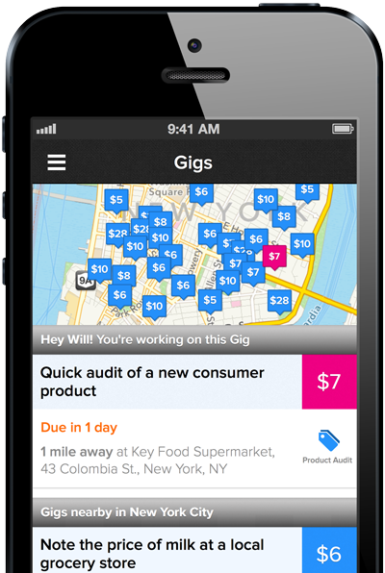







Spatial Crowdsourcing Applications
Notes:
Here are some famous examples of spatial crowdsourcing platforms.
These two are real-time taxi-calling services, uber and the Chinese uber “Shenzhou Taxi”.
This one is gigwalk, where users send out tasks to nearby crowd workers waiting for tasks. We can see on the right that the tasks are tagged at different locations and have different prices. Other similar examples include fieldagent and taskrabbit.
Finally, Openstreemap and Waze encourage people to share nearby map information and live traffic report

Slide 7
Spatial Crowdsourcing
Spatial Crowdsourcing Platforms
Help assign offline spatial tasks to online crowd workers
e.g. Offline-to-Online (O2O) applications
Core Challenges
Task Allocation/Assignment
Quality Control
Privacy Protection
……
Task allocation/assignment is the most important !
Notes:
Particularly, for spatial crowdsourcing platforms, the core challenges include task allocation or assignment, quality control, privacy protection, etc.
Among them, the most important one is task allocation.

Slide 8
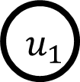
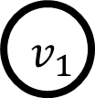
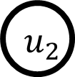
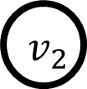
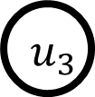

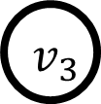
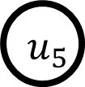
Motivation
Existing research: considered as the classical “maximum weighted bipartite graph matching” problem.
A crowd worker
7
A spatial task
5
3
Weight: the utility score between a task and a worker.
11
9
7
1
6
2
L. Kazemi et al. Geocrowd: enabling query answering with spatial crowdsourcing. In GIS 2012.
H. To et al. A server-assigned spatial crowdsourcing framework. In TASA 2015.
Notes:
Existing works on … usually regard the assignment problem as the classical maximum weighted bipartite graph matching problem.
Here is an example. The nodes on the left…, and the ones on…. Each edge between … has a weight, which is the utility score obtained when the worker successfully completes the task.
The task assignment problem is to find a … so that to maximize the total utility.

Slide 9
Motivation
Most O2O applications need to be addressed in real-time:
Fast Food Delivery
Real-Time Taxi-Calling Service
Restaurant/Supermarket Queue Monitoring
Maximum weighted bipartite graph matching is not suitable for dynamic scenarios
Tasks/workers appear dynamically -- full bipartite graph cannot be known in advance
Once a task/worker appears, it needs to be immediately assigned based on partial information only
Notes:
Note that most … real-time. For example, a food … will appear on the platform dynamically and it needs to be responded immediately so that the customer will not wait too long.
On the other hand, crowd workers, e.g. taxi drivers, may not always wait on the platform and they can also arrive at the platform dynamically.
Therefore, the previous mentioned maximum ...
First, as we mentioned, tasks and workers appear dynamically, and thus the full bipartite graph on all the tasks and workers cannot be known in advance.
Second, tasks and crowd workers cannot wait long time on the platform and their requests must be responded immediately based on the partial information available.

Slide 10
Online Maximum Weighted Bipartite Matching
7
5
3
11
9
7
1
6
2
Offline Scenario
Notes:
We use an example to illustrate the dynamic, or called online scenario.
On the left is our previous maximum weighted bipartite graph matching example.

Slide 11
Online Maximum Weighted Bipartite Matching
7
5
3
11
9
7
1
6
2
The offline optimal total utility is 20
Offline Scenario
Notes:
Here is the optimal solution, where we mark the matched edges in red.
And the total utility is 20.

Slide 12
Online Maximum Weighted Bipartite Matching
7
5
3
11
9
7
1
6
2
The offline optimal cost is 20
(Two-sided)
Online Scenario
Offline Scenario
Notes:
Suppose in the online scenario, a crowd worker u3 arrives first.

Slide 13
Online Maximum Weighted Bipartite Matching
7
5
3
3
11
9
7
1
Full bipartite graph cannot be known.
The new arrival object needs to be immediately assigned based on partial information.
6
2
The offline optimal cost is 20
(Two-sided)
Online Scenario
Offline Scenario
Notes:
Then a task v1 arrives afterwards. Until now, only v1 and u3 are on the platform.
Although we cannot know the full bipartite graph as in the offline scenario on the left, we have to make assignment based on such partial graph.

Slide 14
Online Maximum Weighted Bipartite Matching
7
5
3
3
11
9
7
1
Full bipartite graph cannot be known.
The new arrival object needs to be immediately assigned based on partial information.
6
2
The offline optimal cost is 20
(Two-sided)
Online Scenario
Offline Scenario
Notes:
Therefore, v1 can only be assigned to u3.

Slide 15
Online Maximum Weighted Bipartite Matching
7
5
3
3
11
9
7
1
6
2
The offline optimal cost is 20
(Two-sided)
Online Scenario
Offline Scenario
Notes:
After that, another task v2 appears.
Since there is no edge between v2 and u3, we do nothing.

Slide 16
Online Maximum Weighted Bipartite Matching
7
5
3
3
11
9
9
7
1
1
6
2
The offline optimal cost is 20
(Two-sided)
Online Scenario
Offline Scenario
Notes:
Then u4 arrives afterwards.
Though assigning v1 to u4 will result in larger utility, v1 has been assigned to u3 so we can only assign v2 to u4.

Slide 17
Online Maximum Weighted Bipartite Matching
7
7
5
5
3
3
11
9
9
7
1
1
6
2
The offline optimal cost is 20
(Two-sided)
Online Scenario
Offline Scenario
Notes:
Then workers u1 and u2 arrive, but no task can be assigned to them as v1 has been unavailable.

Slide 18
Online Maximum Weighted Bipartite Matching
7
7
5
5
3
3
11
9
9
7
1
1
6
6
2
The offline optimal cost is 20
(Two-sided)
Online Scenario
Offline Scenario
Notes:
Then v3 arrives and cannot be assigned to u4 since u4 has been allocated to the task v2.

Slide 19
Online Maximum Weighted Bipartite Matching
7
7
5
5
Since both the tasks and workers dynamically appear, the task allocation issue should be modeled as a “Two-Sided online bipartite matching” problem!
3
3
11
11
9
7
1
7
1
6
6
2
The cost of an online greedy algorithm is 6
2
The offline optimal cost is 20
(Two-sided)
Online Scenario
Offline Scenario
Notes:
Finally, worker u5 arrives and is allocated to task v3. As a result, this online matching only has total utility of 6.
Therefore, the online scenario is called a two-sided online bipartite matching, where two-side means that both tasks and workers appear dynamically.

Slide 20
Outline
Background and Motivation
Problem Statement
Our Solutions
Experiments
Conclusion
Notes:
We then formally define our problem.

Slide 21
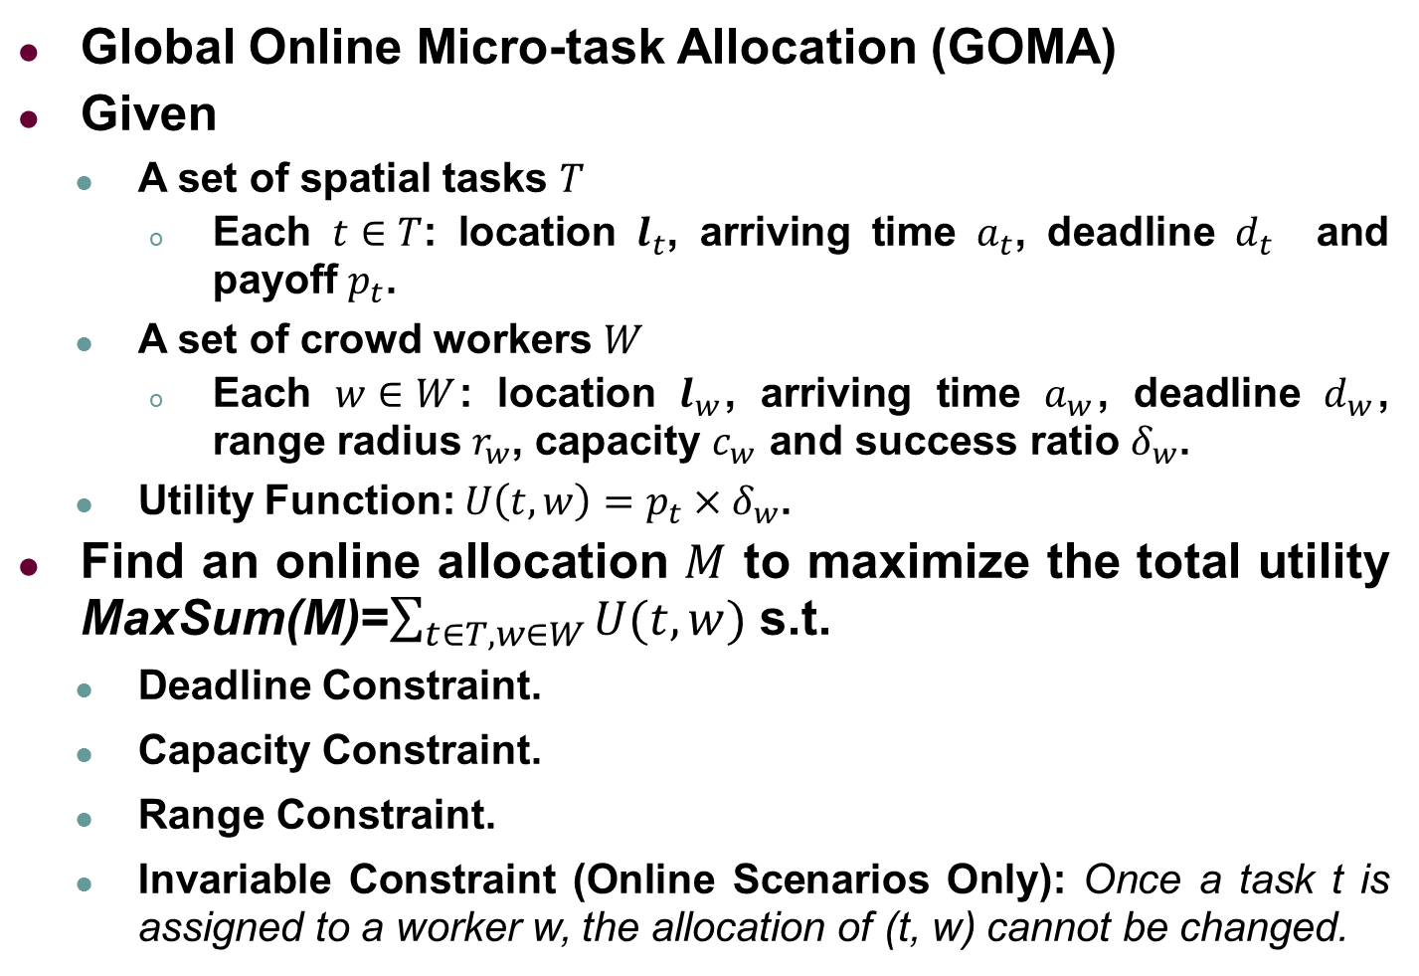
Problem Statement
Global Online Micro-task Allocation (GOMA)
Given
A set of spatial tasks $T$
Each $t∈T$: location $l_{t}$, arriving time $a_{t}$, deadline $d_{t}$ and payoff $p_{t}$.
A set of crowd workers $W$
Each $w∈W$: location $l_{w}$, arriving time $a_{w}$, deadline $d_{w}$, range radius $r_{w}$, capacity $c_{w}$ and success ratio $δ_{w}$.
Utility Function: ${U\left(t,w\right)=p}_{t}×δ_{w}$.
Find an online allocation $M$ to maximize the total utility MaxSum(M)=$\sum_{t∈T, w∈W}{U(t,w)}$ s.t.
Deadline Constraint.
Capacity Constraint.
Range Constraint.
Invariable Constraint (Online Scenarios Only): Once a task t is assigned to a worker w, the allocation of (t, w) cannot be changed.
Notes:
Particularly, we study the global online micro-task allocation problem.
We are given a set of spatial tasks, each with …
We are also given a set of workers, each with ...
Our goal is to find an allocation to maximize....
Particularly, the invariable constraint is only for online scenarios, which means that the allocation between a task and a worker cannot be revoked once it is made.

Slide 22
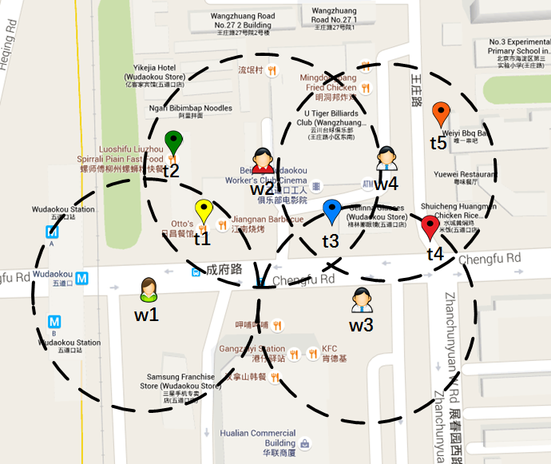
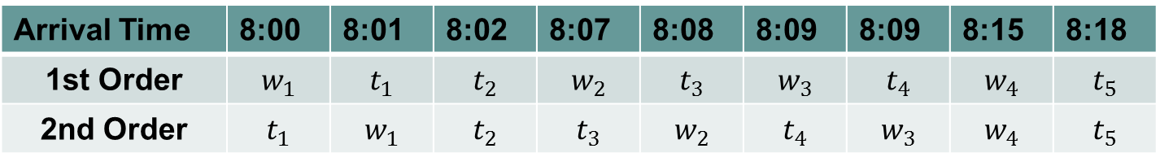
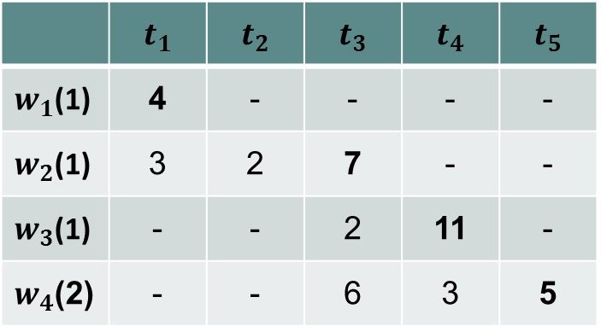
Problem Statement
Offline Optimal Total Utility=27
 | $$t_{1}$$ | $$t_{2}$$ | $$t_{3}$$ | $$t_{4}$$ | $$t_{5}$$
$w_{1}$(1) | 4 | - | - | - | -
$w_{2}$(1) | 3 | 2 | 7 | - | -
$w_{3}$(1) | - | - | 2 | 11 | -
$w_{4}$(2) | - | - | 6 | 3 | 5
The task is out of the range of the crowd worker
Total utility=16
Arrival Time | 8:00 | 8:01 | 8:02 | 8:07 | 8:08 | 8:09 | 8:09 | 8:15 | 8:18
1st Order | $$w_{1}$$ | $$t_{1}$$ | $$t_{2}$$ | $$w_{2}$$ | $$t_{3}$$ | $$w_{3}$$ | $$t_{4}$$ | $$w_{4}$$ | $$t_{5}$$
2nd Order | $$t_{1}$$ | $$w_{1}$$ | $$t_{2}$$ | $$t_{3}$$ | $$w_{2}$$ | $$t_{4}$$ | $$w_{3}$$ | $$w_{4}$$ | $$t_{5}$$
Total utility=27
Notes:
Here is our running example, where we summarize the utility scores and arrival time of tasks and workers in the two tables, and the locations of them are shown on the map.
For each crowd worker, the workload capacity is shown in bracket and the limited range is shown as a dotted circle. This symbol means…
Moreover, the deadlines for both the tasks and the workers are 20min. In other words, we first ignore the influence of deadlines, and it is easy to add in our example.
In this example, the offline optimal matching result is shown in bold, the total utility is 27.
If we perform the simple greedy strategy, the utilities for the two arrival orders are 16 and 27, respectively. Therefore, the total utility for an online algorithm depends on different arrival orders

Slide 23
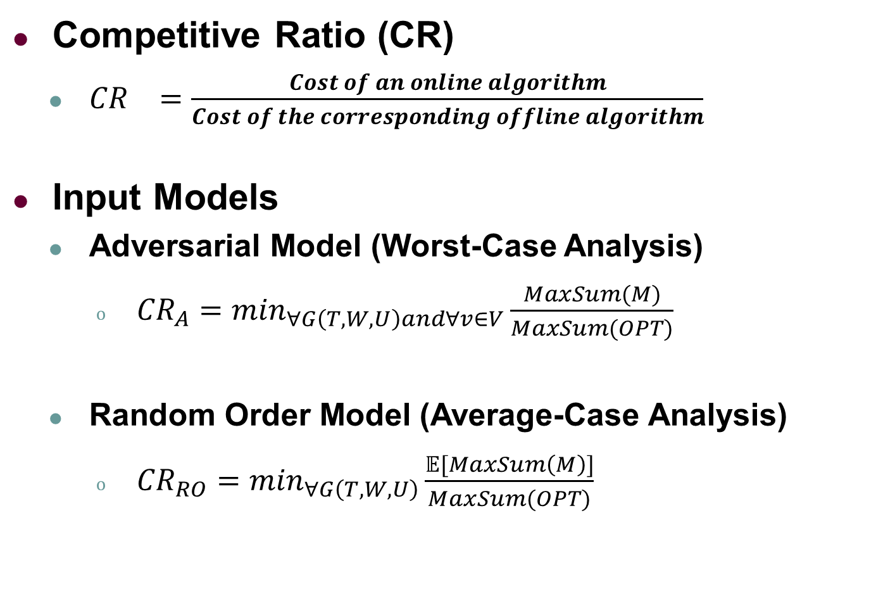
Evaluation for Online Algorithms
Competitive Ratio (CR)
${CR}_{}=\frac{Cost of an online algorithm}{Cost of the corresponding offline algorithm}$
Input Models
Adversarial Model (Worst-Case Analysis)
${CR}_{A}=\min_{∀G\left(T,W,U\right)and∀v∈V}\frac{MaxSum(M)}{MaxSum(OPT)}$
Random Order Model (Average-Case Analysis)
${CR}_{RO}=\min_{∀G\left(T,W,U\right)}\frac{𝔼[MaxSum\left(M\right)]}{MaxSum(OPT)}$
The worst bipartite graph
The worst arrival order
The expectation of the total utility of all possible arrival orders
The worst bipartite graph
Notes:
For online algorithms, competitive ratio is used to evaluate their performance.
And there are two input models for competitive analysis. The first is the adversarial model, which is used to analyze worst case. Particularly, the ratio means the online result over the offline one on the worst bipartite graph with the worst arrival order.
Another is the random order model, which is used to analyze average case. Specifically, the ratio is the expected online result over the offline result on the worst bipartite graph. Note that the expected online result is taken over all possible arrival orders on a specific bipartite graph

Slide 24
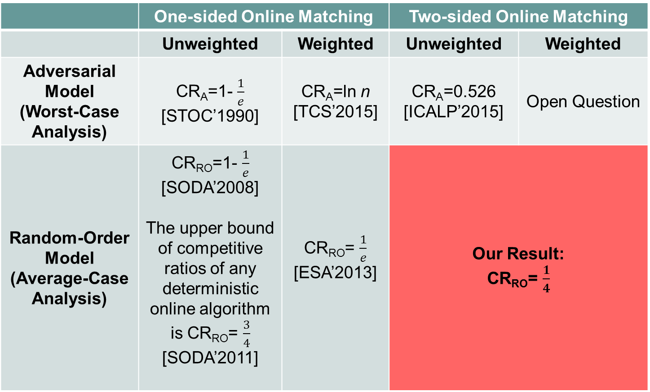
Summary of Online Maximum Weighted Bipartite Matching Algorithms
 | One-sided Online Matching |  | Two-sided Online Matching
 | Unweighted | Weighted | Unweighted | Weighted
Adversarial Model (Worst-Case Analysis) | CR_{A}=1- $\frac{1}{e}$ [STOC’1990] | CR_{A}=ln n [TCS’2015] | CR_{A}=0.526 [ICALP’2015] | Open Question
Random-Order Model (Average-Case Analysis) | CR_{RO}=1- $\frac{1}{e}$ [SODA’2008] The upper bound of competitive ratios of any deterministic online algorithm is CR_{RO}= $\frac{3}{4}$ [SODA’2011] | CR_{RO}= $\frac{1}{e}$ [ESA’2013] | Our Result: CR_{RO}= $\frac{1}{4}$
Notes:
We summarize the theoretical results under different mentioned models of analysis for online matching.
Note that compared to two-sided online matching, only one side of nodes appear dynamically is called one-sided online matching.
Our major contribution in this work is that we provide an algorithm with 1/4 competitive ratio for two-sided online matching under the average-case analysis.

Slide 25
Outline
Background and Motivation
Problem Statement
Our Solutions
Experiments
Conclusion
Notes:
We next present our solutions

Slide 26

Baseline: Extended Greedy-RT Algorithm
Basic idea
Choose an integer k from 0 to $\left\lceil \ln\left(U_{max}+1\right)\right\rceil$randomly.
Filter the edges with weights lower than $e^{k}.$
Use a greedy strategy on the remaining edges.
Notes:
The first is a baseline algorithm, which extends the state-of-the-art algorithm, greedy-rt algorithm.
The basic idea is to first choose an integer k in the range of 0 to the formula randomly.
We then use e^k as a threshold and ignore all the edges with weights lower than e^k.
We finally use a greedy strategy on the remaining edges.

Slide 27
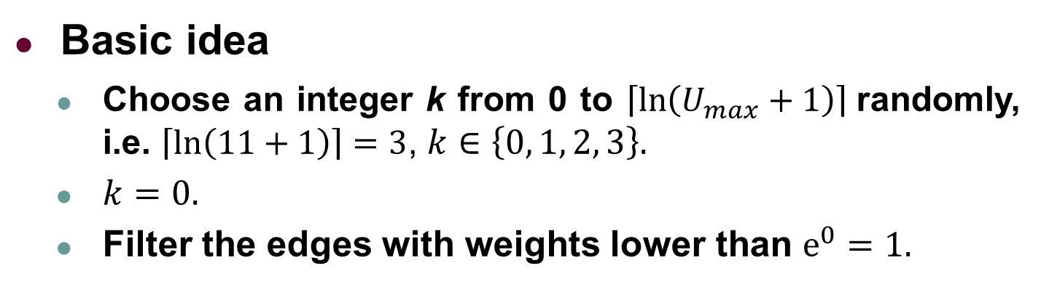
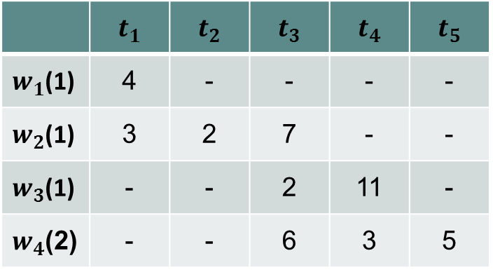
Baseline: Extended Greedy-RT Algorithm
Basic idea
Choose an integer k from 0 to $\left\lceil \ln\left(U_{max}+1\right)\right\rceil$randomly, i.e. $\left\lceil \ln\left(11+1\right)\right\rceil =3$, $k∈\left\{0, 1, 2, 3\right\}.$
$k=0.$
Filter the edges with weights lower than $e^{0}=1.$
 | $$t_{1}$$ | $$t_{2}$$ | $$t_{3}$$ | $$t_{4}$$ | $$t_{5}$$
$w_{1}$(1) | 4 | - | - | - | -
$w_{2}$(1) | 3 | 2 | 7 | - | -
$w_{3}$(1) | - | - | 2 | 11 | -
$w_{4}$(2) | - | - | 6 | 3 | 5
Notes:
Here is a running example. Since the Umax is 11, we first sample the k as 0 and the threshold is 1.

Slide 28


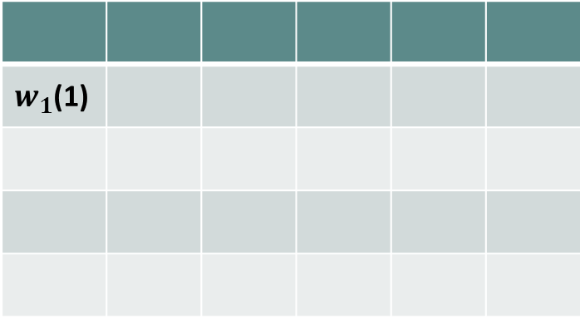
Baseline: Extended Greedy-RT Algorithm
Basic idea
Filter the edges with weights lower than $e^{0}=1.$
For each new arriving object, use a greedy strategy on the remaining edges.
$$w_{1}$$
$w_{1}$(1)
Notes:
We next adopt a greedy strategy to address the filtered edges.

Slide 29
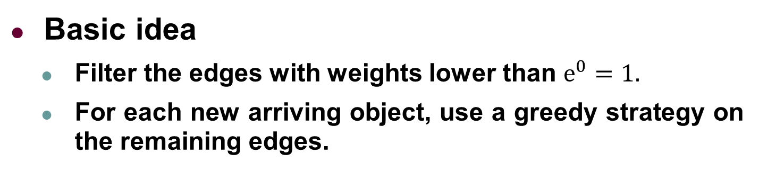

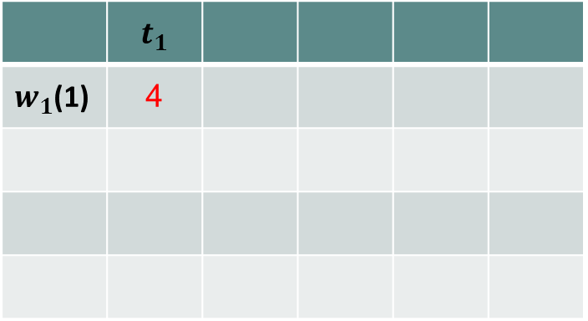
Baseline: Extended Greedy-RT Algorithm
Basic idea
Filter the edges with weights lower than $e^{0}=1.$
For each new arriving object, use a greedy strategy on the remaining edges.
$$w_{1}$$
$$t_{1}$$
 | $$t_{1}$$
$w_{1}$(1) | 4
Notes:
When w1 arrives, t1 is assigned to it.

Slide 30

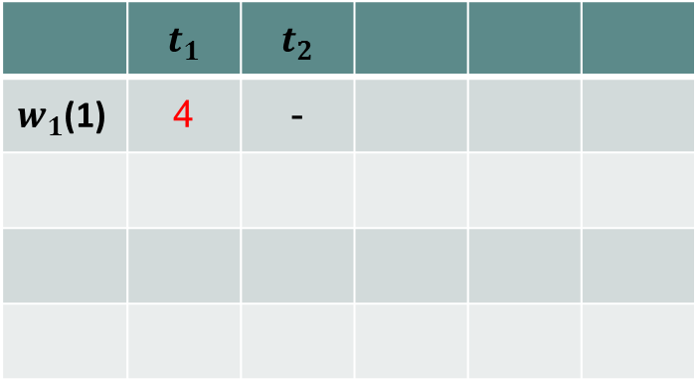
Baseline: Extended Greedy-RT Algorithm
Basic idea
Filter the edges with weights lower than $e^{0}=1.$
For each new arriving object, use a greedy strategy on the remaining edges.
$$w_{1}$$
$$t_{1}$$
 | $$t_{1}$$ | $$t_{2}$$
$w_{1}$(1) | 4 | -
$$t_{2}$$
Notes:
Then t2 arrives.

Slide 31

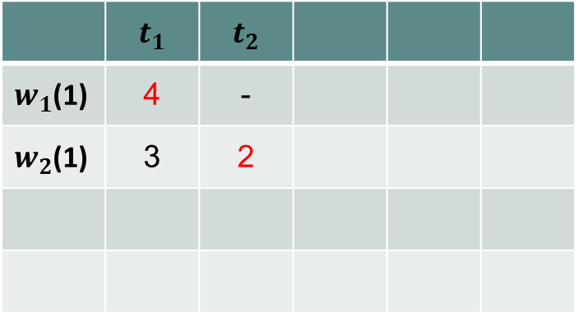
Baseline: Extended Greedy-RT Algorithm
Basic idea
Filter the edges with weights lower than $e^{0}=1.$
For each new arriving object, use a greedy strategy on the remaining edges.
$$w_{1}$$
$$t_{1}$$
 | $$t_{1}$$ | $$t_{2}$$
$w_{1}$(1) | 4 | -
$w_{2}$(1) | 3 | 2
$$w_{2}$$
$$t_{2}$$
Notes:
When w2 arrives it is allocated to t2.
Although (t1, w2) has a higher utility, t1 is unavailable.

Slide 32
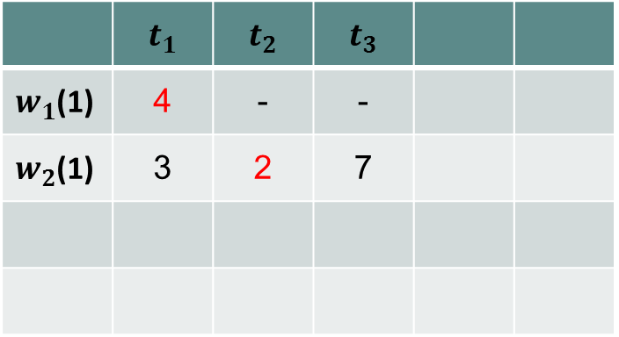

Baseline: Extended Greedy-RT Algorithm
Basic idea
Filter the edges with weights lower than $e^{0}=1.$
For each new arriving object, use a greedy strategy on the remaining edges.
$$w_{1}$$
$$t_{1}$$
 | $$t_{1}$$ | $$t_{2}$$ | $$t_{3}$$
$w_{1}$(1) | 4 | - | -
$w_{2}$(1) | 3 | 2 | 7
$$w_{2}$$
$$t_{2}$$
$$t_{3}$$
Notes:
Then t3 comes. No work is available.

Slide 33

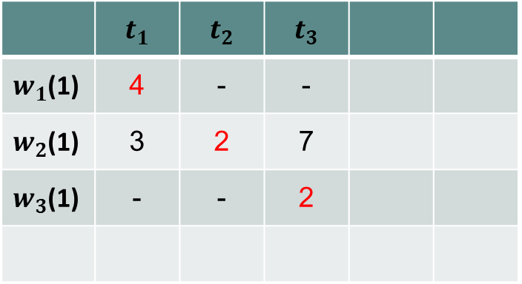
Baseline: Extended Greedy-RT Algorithm
Basic idea
Filter the edges with weights lower than $e^{0}=1.$
For each new arriving object, use a greedy strategy on the remaining edges.
$$w_{1}$$
$$t_{1}$$
 | $$t_{1}$$ | $$t_{2}$$ | $$t_{3}$$
$w_{1}$(1) | 4 | - | -
$w_{2}$(1) | 3 | 2 | 7
$w_{3}$(1) | - | - | 2
$$w_{2}$$
$$t_{2}$$
$$w_{3}$$
$$t_{3}$$
Notes:
And w3 is allocated to t3 when it arrives.

Slide 34

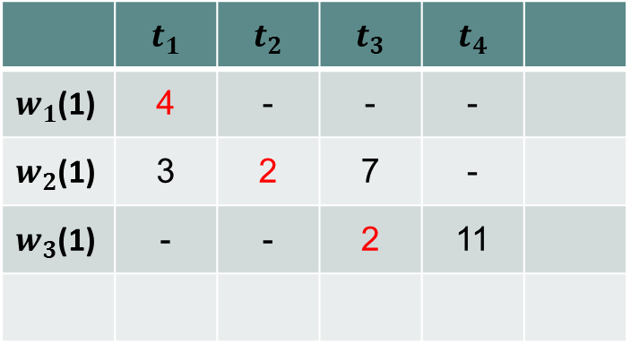
Baseline: Extended Greedy-RT Algorithm
Basic idea
Filter the edges with weights lower than $e^{0}=1.$
For each new arriving object, use a greedy strategy on the remaining edges.
$$w_{1}$$
$$t_{1}$$
 | $$t_{1}$$ | $$t_{2}$$ | $$t_{3}$$ | $$t_{4}$$
$w_{1}$(1) | 4 | - | - | -
$w_{2}$(1) | 3 | 2 | 7 | -
$w_{3}$(1) | - | - | 2 | 11
$$w_{2}$$
$$t_{2}$$
$$w_{3}$$
$$t_{3}$$
$$t_{4}$$

Slide 35

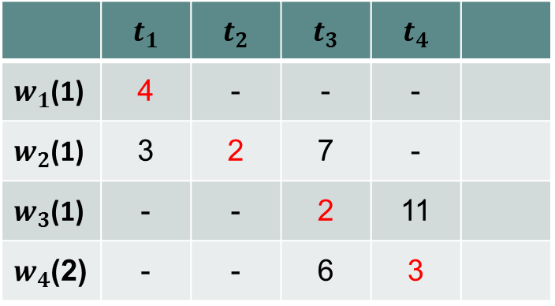
Baseline: Extended Greedy-RT Algorithm
Basic idea
Filter the edges with weights lower than $e^{0}=1.$
For each new arriving object, use a greedy strategy on the remaining edges.
$$w_{1}$$
$$t_{1}$$
 | $$t_{1}$$ | $$t_{2}$$ | $$t_{3}$$ | $$t_{4}$$
$w_{1}$(1) | 4 | - | - | -
$w_{2}$(1) | 3 | 2 | 7 | -
$w_{3}$(1) | - | - | 2 | 11
$w_{4}$(2) | - | - | 6 | 3
$$w_{2}$$
$$t_{2}$$
$$w_{3}$$
$$t_{3}$$
$$w_{4}$$
$$t_{4}$$
Notes:
t4 and w4 are matched.

Slide 36

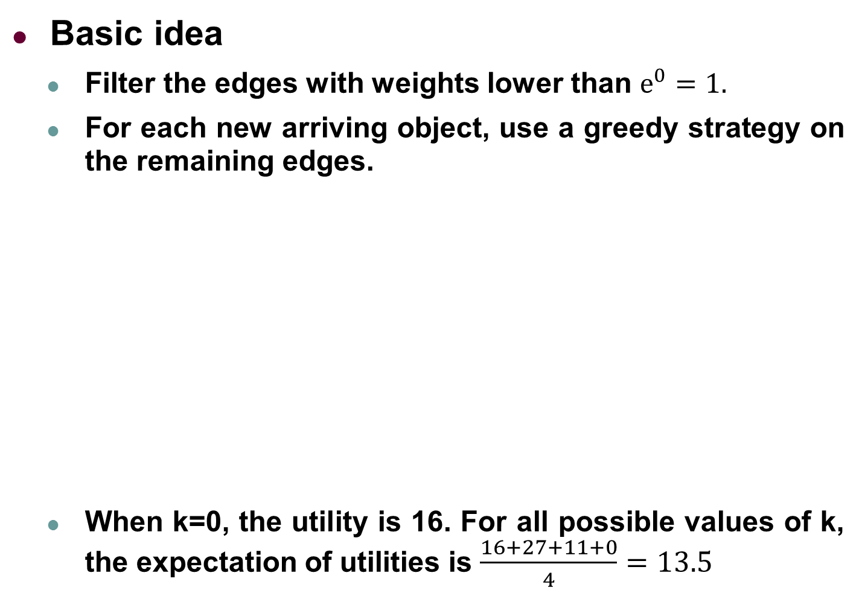
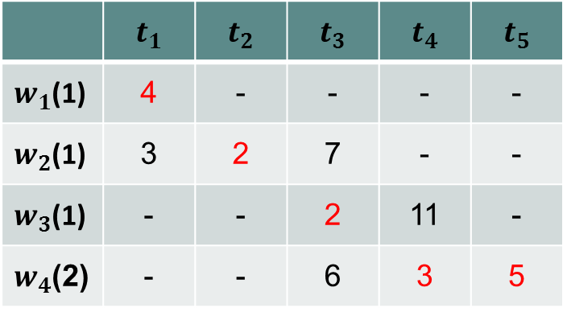

Baseline: Extended Greedy-RT Algorithm
Basic idea
Filter the edges with weights lower than $e^{0}=1.$
For each new arriving object, use a greedy strategy on the remaining edges.
When k=0, the utility is 16. For all possible values of k, the expectation of utilities is $\frac{16+27+11+0}{4}=13.5$
Competitive Ratio CR_{A}=$\frac{1}{2eln(1+U_{max})}$
$$w_{1}$$
$$t_{1}$$
 | $$t_{1}$$ | $$t_{2}$$ | $$t_{3}$$ | $$t_{4}$$ | $$t_{5}$$
$w_{1}$(1) | 4 | - | - | - | -
$w_{2}$(1) | 3 | 2 | 7 | - | -
$w_{3}$(1) | - | - | 2 | 11 | -
$w_{4}$(2) | - | - | 6 | 3 | 5
$$w_{2}$$
$$t_{2}$$
$$w_{3}$$
$$t_{3}$$
$$w_{4}$$
$$t_{4}$$
$$t_{5}$$
Notes:
Finally, t5 is also assigned to w4. Note that the capacity of w4 is 2, w4 can be assigned again.
When k is 0, the total utility 16.
When consider all possible k’s, the expected utility is 13.5.

Slide 37
TGOA Algorithm
Basic idea
Take a fixed fraction of arriving objects as samples and dispose them greedily.
When a new object arrives, compute the optimal matching on the revealed part of the graph.
Match the new object to its adjacent node in the optimal matching if possible.
Notes:
Since the baseline algorithm mainly focuses on avoiding the worst case, its average performance is not good.
To enhance the average performance, we propose the TGOA algorithm.
Our basic idea is to dispose greedily a fixed fraction of arriving objects.
Then when a new object arrives, we compute a temporal offline optimal matching only on the current revealed graph and try to match the new object based on the temporal optimal matching.

Slide 38
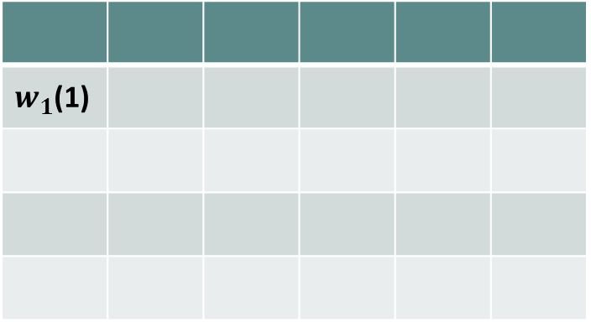
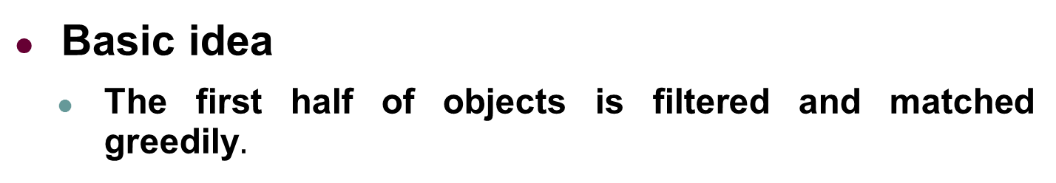

TGOA Algorithm
Basic idea
The first half of objects is filtered and matched greedily$.$
$$w_{1}$$
$w_{1}$(1)
Notes:
Back to our running example. We first filter out the first half of objects, on which we use a greedy strategy. W1 first arrives.

Slide 39
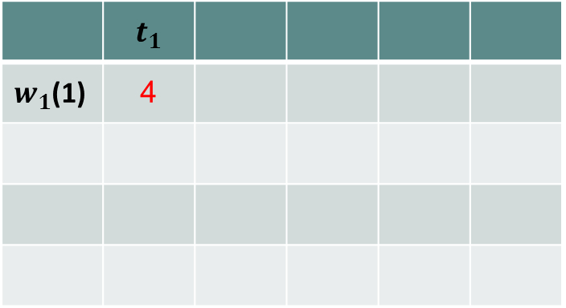
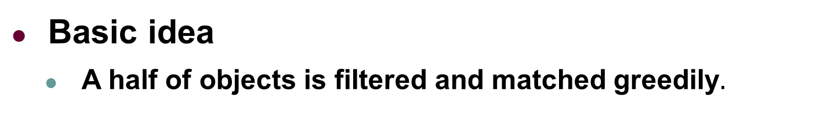

TGOA Algorithm
Basic idea
A half of objects is filtered and matched greedily$.$
$$w_{1}$$
$$t_{1}$$
 | $$t_{1}$$
$w_{1}$(1) | 4
Notes:
Then when t1 arrives, it is greedily matched to w1.

Slide 40

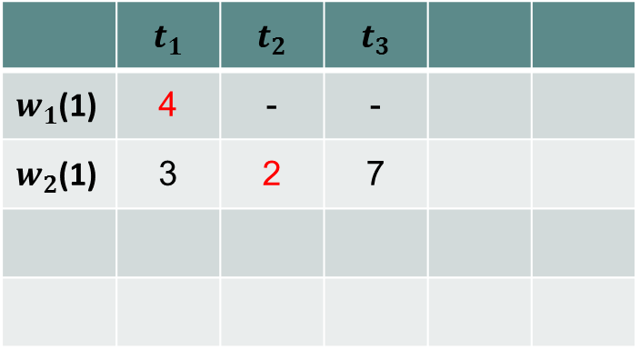

TGOA Algorithm
Basic idea
A half of objects is filtered and matched greedily$.$
$$w_{1}$$
$$t_{1}$$
 | $$t_{1}$$ | $$t_{2}$$ | $$t_{3}$$
$w_{1}$(1) | 4 | - | -
$w_{2}$(1) | 3 | 2 | 7
$$w_{2}$$
$$t_{2}$$
$$t_{3}$$
Notes:
Then w2, t2 and t3 comes with the same order in the example of the baseline algorithm, and we get the same match t2 to w2.

Slide 41

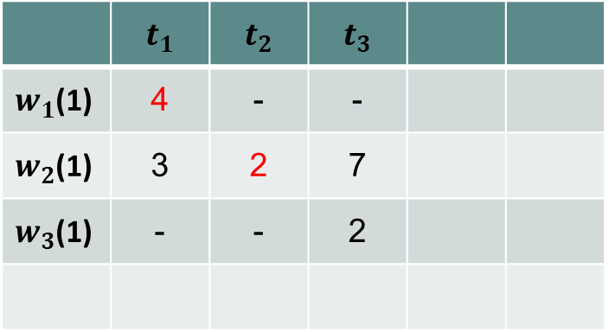






TGOA Algorithm
Basic idea
For the second half of objects, once a new object arrives, compute the optimal matching on the revealed part of the graph.
Match the new object to its adjacent node in the optimal matching if possible.
$$w_{1}$$
$$t_{1}$$
$$w_{1}$$
$$t_{1}$$
 | $$t_{1}$$ | $$t_{2}$$ | $$t_{3}$$
$w_{1}$(1) | 4 | - | -
$w_{2}$(1) | 3 | 2 | 7
$w_{3}$(1) | - | - | 2
$$w_{2}$$
$$t_{2}$$
$$w_{2}$$
$$t_{2}$$
$$w_{3}$$
$$t_{3}$$
$$w_{3}$$
$$t_{3}$$
The optimal matching on the revealed part of graph, so no new edge is inserted.
Notes:
Then for the second half of objects, we try to do temporal offline optimal matching when each new object arrives.
In this example, when w3 arrives, the optimal matching on the revealed graph is show in blue. The current online matching is on the left.
Note that the edge (w2, t3) is not included into the online matching because w2 has been already assigned to t2, and the existing allocation cannot be broken according to the invariable constraint.
Therefore, no new edge is inserted.

Slide 42

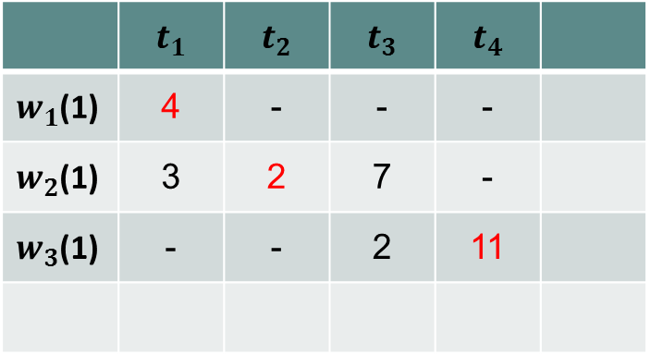





TGOA Algorithm
Basic idea
For the second half of objects, once a new object arrives, compute the optimal matching on the revealed part of the graph.
Match the new object to its adjacent node in the optimal matching if possible.
$$w_{1}$$
$$t_{1}$$
$$w_{1}$$
$$t_{1}$$
 | $$t_{1}$$ | $$t_{2}$$ | $$t_{3}$$ | $$t_{4}$$
$w_{1}$(1) | 4 | - | - | -
$w_{2}$(1) | 3 | 2 | 7 | -
$w_{3}$(1) | - | - | 2 | 11
$$w_{2}$$
$$t_{2}$$
$$w_{2}$$
$$t_{2}$$
$$w_{3}$$
$$t_{3}$$
$$w_{3}$$
$$t_{3}$$
$$t_{4}$$
$$t_{4}$$
The optimal matching on the revealed part of graph, the new edge (w₃, t₄) is inserted
Notes:
Then when t4 arrives, the offline optimal matching is shown on the right in blue.
Note that in this optimal matching, w3 is matched to t4 and they are available in the online matching, so we also assign t4 to w3 in the online matching as on the left.

Slide 43


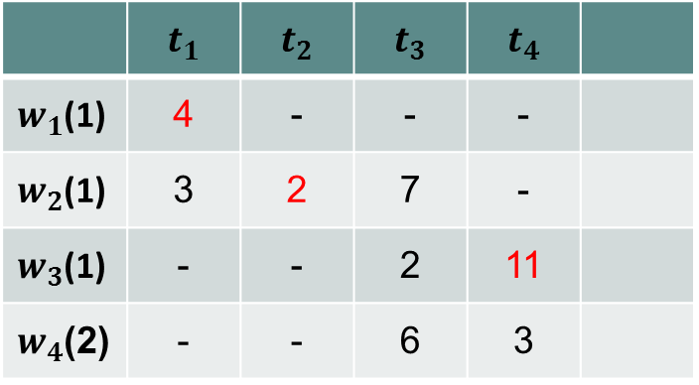








TGOA Algorithm
Basic idea
For the second half of objects, once a new object arrives, compute the optimal matching on the revealed part of the graph.
Match the new object to its adjacent node in the optimal matching if possible.
$$w_{1}$$
$$t_{1}$$
$$w_{1}$$
$$t_{1}$$
 | $$t_{1}$$ | $$t_{2}$$ | $$t_{3}$$ | $$t_{4}$$
$w_{1}$(1) | 4 | - | - | -
$w_{2}$(1) | 3 | 2 | 7 | -
$w_{3}$(1) | - | - | 2 | 11
$w_{4}$(2) | - | - | 6 | 3
$$w_{2}$$
$$t_{2}$$
$$w_{2}$$
$$t_{2}$$
$$w_{3}$$
$$t_{3}$$
$$w_{3}$$
$$t_{3}$$
$$w_{4}$$
$$t_{4}$$
$$w_{4}$$
$$t_{4}$$
The optimal matching on the revealed part of graph, so no new edges is inserted.
Notes:
When w4 arrives, it is not matched in the offline optimal matching on the right, so we do nothing for w4.

Slide 44
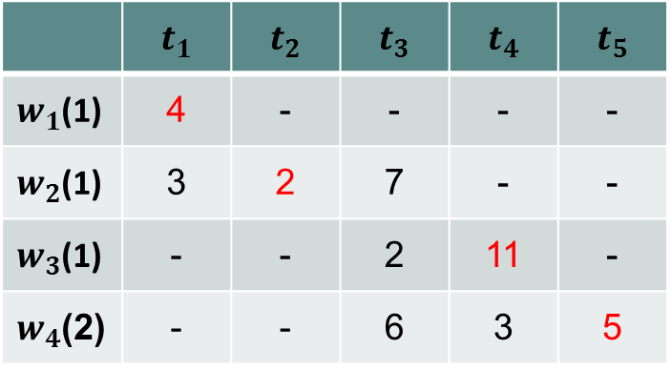



TGOA Algorithm
Basic idea
For the second half of objects, once a new object arrives, compute the optimal matching on the revealed part of the graph.
Match the new object to its adjacent node in the optimal matching if possible.
For the arrival order, the utility of TGOA is 22.
Competitive Ratio CR_{RO}=$\frac{1}{4}$
$$w_{1}$$
$$t_{1}$$
$$w_{1}$$
$$t_{1}$$
 | $$t_{1}$$ | $$t_{2}$$ | $$t_{3}$$ | $$t_{4}$$ | $$t_{5}$$
$w_{1}$(1) | 4 | - | - | - | -
$w_{2}$(1) | 3 | 2 | 7 | - | -
$w_{3}$(1) | - | - | 2 | 11 | -
$w_{4}$(2) | - | - | 6 | 3 | 5
$$w_{2}$$
$$t_{2}$$
$$w_{2}$$
$$t_{2}$$
$$w_{3}$$
$$t_{3}$$
$$w_{3}$$
$$t_{3}$$
$$w_{4}$$
$$t_{4}$$
$$w_{4}$$
$$t_{4}$$
$$t_{5}$$
$$t_{5}$$
Notes:
Finally, when t5 arrives, w4 is assigned to t5 because it is matched to t5 in the offline optimal matching.
And the total utility of TGOA is 22. Particularly, we prove that TGOA has competitive ratio of ¼ under the random order model.

Slide 45

TGOA-Greedy Algorithm
Basic idea
Although TGOA provides a better competitive ratio, it has high computational complexity due to the offline optimal matching algorithm, e.g. Hungary algorithm.
Optimize the efficiency using a greedy solution to get the offline matching instead of the offline optimal matching in the second phase.
Competitive Ratio CR_{RO}=$\frac{1}{8}$
Notes:
Although TGOA has a better competitive ratio, it also has high computation cost since it has to calculate an offline optimal matching whenever an object arrives.
To further enhance the efficiency of TGOA, we propose a greedy optimization technique instead of the offline optimal matching algorithm, i.e. hungary algorithm in each step of the second phase. And we prove that using the greedy strategy in the second phase still guarantees a competitive ratio of 1/8 under the random order model.

Slide 46
Outline
Background and Motivation
Problem Statement
Our Solutions
Experiments
Conclusion
Notes:
We then show some experiment results.

Slide 47
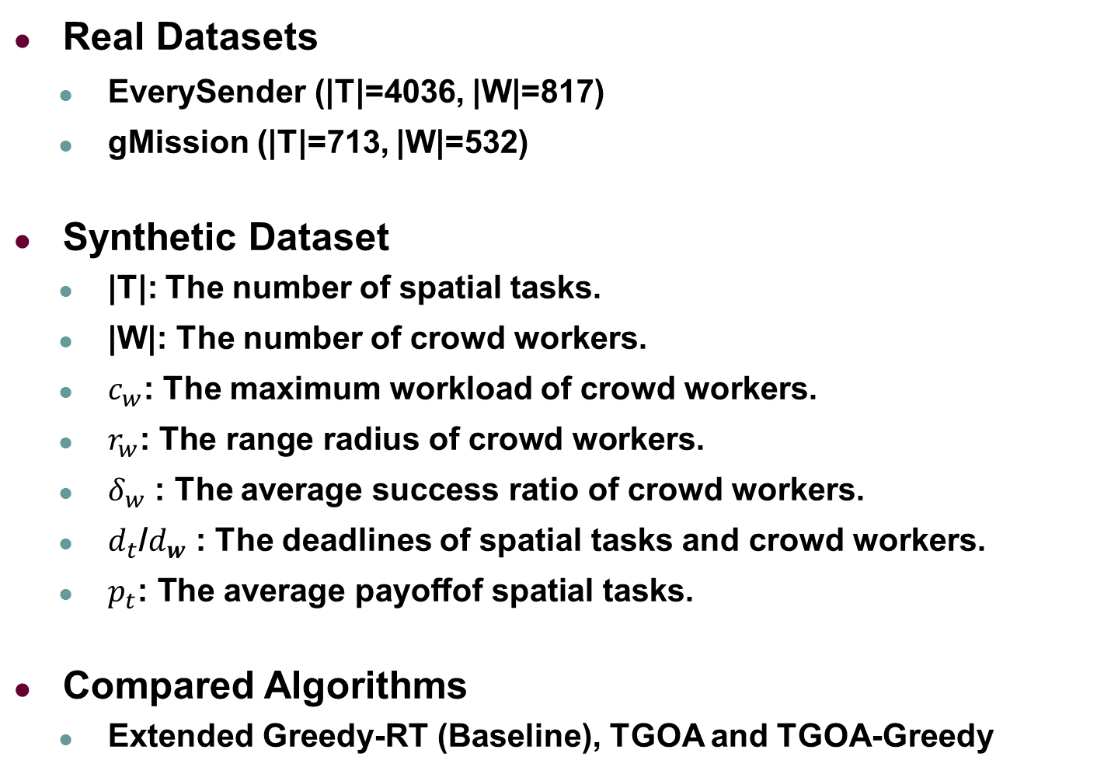
Experimental Setting
Real Datasets
EverySender (|T|=4036, |W|=817)
gMission (|T|=713, |W|=532)
Synthetic Dataset
|T|: The number of spatial tasks.
|W|: The number of crowd workers.
$c_{w}$: The maximum workload of crowd workers.
$r_{w}\text{: }\text{The} \text{range} \text{radius} \text{of} \text{crowd} \text{workers}$.
$δ_{w}$ : The average success ratio of crowd workers.
$d_{t}$/$d_{w}$ : The deadlines of spatial tasks and crowd workers.
$p_{t}\text{: }\text{The} \text{average} \text{payoffof} \text{spatial} \text{tasks}\text{.}$
Compared Algorithms
Extended Greedy-RT (Baseline), TGOA and TGOA-Greedy
Notes:
We use two real datasets and a larger synthetic dataset and compare the three proposed algorithms.

Slide 48
Experiments: Vary |T|
TGOA is the most effective but most inefficient.
TGOA-greedy trades off well between effectiveness and efficiency!
Extended Greedy-RT (Baseline algorithm) is the fastest one, but its effectiveness is the lowest!
Notes:
Here are the results when varying the number of tasks. we compare the utility results of the online algorithms against the offline one.
We can see that TGOA is the most effective but most inefficient.
TGOA-greedy trades off well between effectiveness and efficiency.
Extended Greedy-RT is the fastest one, but its effectiveness is the lowest.

Slide 49
Experiments: Scalability
Different curves mean the different number of crowd workers.
Notes:
Since TGOA is not efficient enough, we only study the scalability of TGOA-Greedy.
With increasing the number of tasks and workers, we can see that TGOA-Greedy are quite scalable.

Slide 50
Experiments: Real Data
The average workload capacity of workers
Notes:
Here are the results on real datasets.
With increasing the average workload capacity of workers, we can again observe that TGOA-greedy is both efficient and effective while TGOA is more effective but less efficient.

Slide 51
Outline
Background and Motivation
Problem Statement
Our Solutions
Experiments
Conclusion
Notes:
We finally conclude our work.

Slide 52
Conclusion
Identify a new two-sided online micro-task allocation problem, called Global Online Micro-task Allocation (GOMA), in spatial crowdsourcing.
Design a two-phase-based framework with a constant competitive ratio under the random order model and a greedy optimization technique.
Extensive experiments on both real and synthetic datasets to verify our solutions.
Notes:
We identify a new two-sided online task allocation problem for crowdsourcing.
We design a framework with a constant competitive ratio under the random order model.
And we run extensive experiments on both real and synthetic datasets to verify our proposed solutions.

Slide 53

Thank You
Q & A

