Slide 1

KDD CUP 2020 LDR
Dispatch Winner Report
Team: Polar Bear
Members: Yansheng Wang
Dingyuan Shi
Yuanfei Luo
Maoxiaomin Peng
Yi Xu
Yongxin Tong
Notes:
Hi, everyone. I’m Yansheng Wang from Beihang University.
Today, I’m very honored to share our work in kdd cup, on behalf of my team.

Slide 2
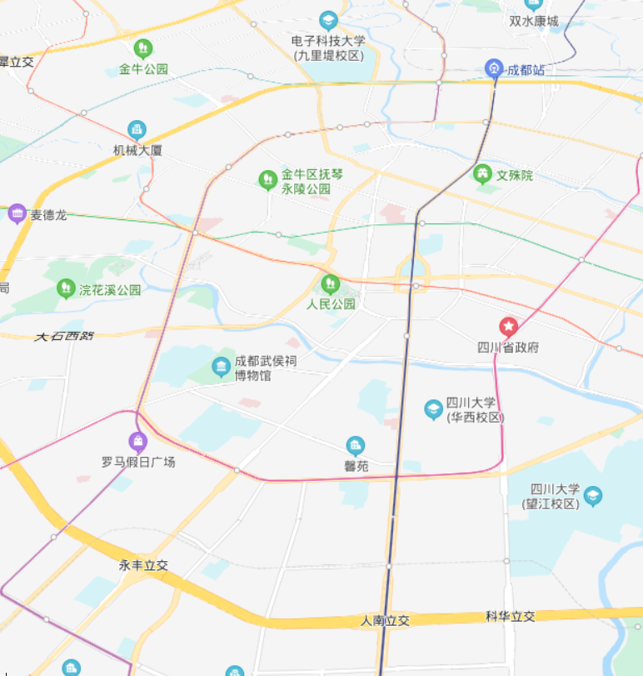



Problem
Pickup commands
Collect data
Platform
Matched pairs
2 s
Pickup &
Delivery
Historical orders and simulated drivers
Order-driver pairs
RL Agent
Objective: Maximize Mean Total Driver Income
Notes:
First, Let me quickly review the problem.
We only participate in the dispatching task.
In this task, the platform collects data from historical orders and simulated drivers, and sends all the order driver pairs to our agent.
The agent then returns a list of matched pairs to the platform and the platform will send pickup and delivery commands to drivers.
This cycle will run for each two seconds.
Our purpose is to design an agent that can maximize mean total driver income.

Slide 3
Solution
Unmatched pairs
Matched pairs
Agent Overview
Early pruning
Calculating edge
weights by values
Matching with KM
Updating values
Notes:
Next, I will present our solution.
Here is an overview of our agent. It has 4 steps.

Slide 4
Solution
Unmatched pairs
Matched pairs
Agent Overview
Top K nearest
drivers
Early pruning
Calculating edge
weights by values
Matching with KM
Updating values
Original Graph
Pruned Graph
Notes:
First, the agent early prunes drivers that are too far away from each order.
After the pruning, only top k nearest drivers of each order are kept.
In our setting, k is set to about 10.

Slide 5
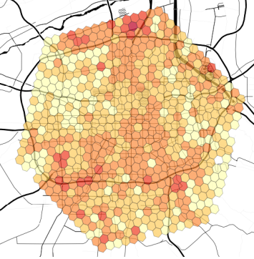
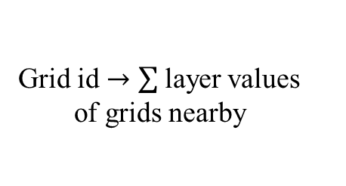

Solution
Unmatched pairs
Matched pairs
Value representation
Source: X. Tang et al. KDD 19
Agent Overview
Early pruning
Calculating edge
weights by values
Grid values
Layer values
Matching with KM
Grid id $→$ value
Grid id $→$ layer values of grids nearby
Updating values
$$Value=Mean(Grid values, Layer values)$$
Notes:
Afterwards, we calculate a new edge weight between each order and driver according to learned values.
The values are represented in two forms.
The first is grid values, which hash a grid id to a numeric value.
The second is layer values, which is the sum of other layer values of a grid’s neighbors.
The final value is the mean of grid values and layer values.

Slide 6

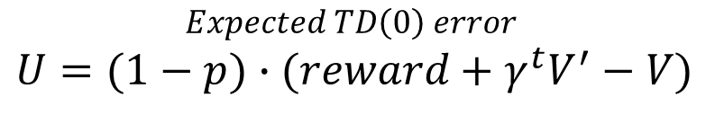
Solution
Unmatched pairs
Matched pairs
Weight Calculation
Agent Overview
Early pruning
Calculating edge
weights by values
Rewards as weights
TD(0) error as weights
$$Expected TD\left(0\right) error$$
$$U=(1−p)∙(reward+γ^{t}V^{′}−V)$$
Matching with KM
Discount factor
Value of driver position
Cancel Probability
Value of order destination
Updating values
$$p=0.01exp⁡(\frac{ln20}{2000}d)$$
Order driver distance
Notes:
According to the values, we can calculate the TD(0) error between a source grid and a target grid.
The TD error is then considered as the new weight of the bipartite graph.
The formulation is as below.
Here p is the cancel probability, which is fit by an exponential function.
Gamma is the discount factor and t is discretized time of a trip.
V’ and V are values of the order’s destination and the driver’s position respectively.

Slide 7
Solution
Unmatched pairs
Matched pairs
On-policy Decision making
Agent Overview
KM algorithm
Early pruning
Calculating edge
weights by values
TD(0) error as weights
Matching results
Python implementation: Exceeds runtime limits
Matching with KM
Implementation of KM for imbalanced graphs with C++
Updating values
Observation:
Imbalanced graph
Notes:
After rebuilding the graph with TD errors, we can match the nodes with KM algorithm.
However, we found that the python implementation runs too slow.
So we use a special implementation for imbalanced graphs with C++.

Slide 8


Solution
Unmatched pairs
Matched pairs
Agent Overview
Matched drivers
Early pruning
$$V←V+α∙U$$
Calculating edge
weights by values
Unmatched drivers
Matching results
$$V←V+α∙(γV−V)$$
Matching with KM
Updating values
Notes:
Finally, the values are updated both for matched drivers and unmatched drivers.

Slide 9

Solution
Agent Overview
Early pruning
Historical Orders
Calculating edge
weights by values
Parameter
Tuning
Matching with KM
Updating values
Driver Simulator
Notes:
We have also built a driver simulator with trajectory data and tuned the hyperparameters with the simulator.

Slide 10
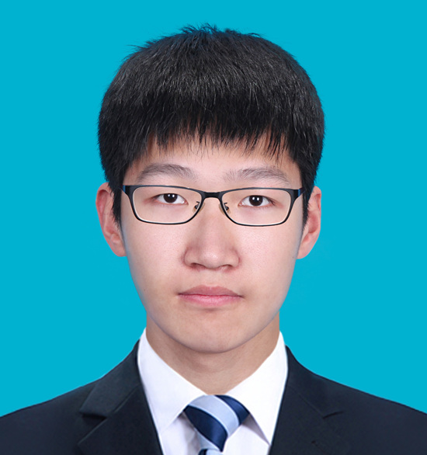
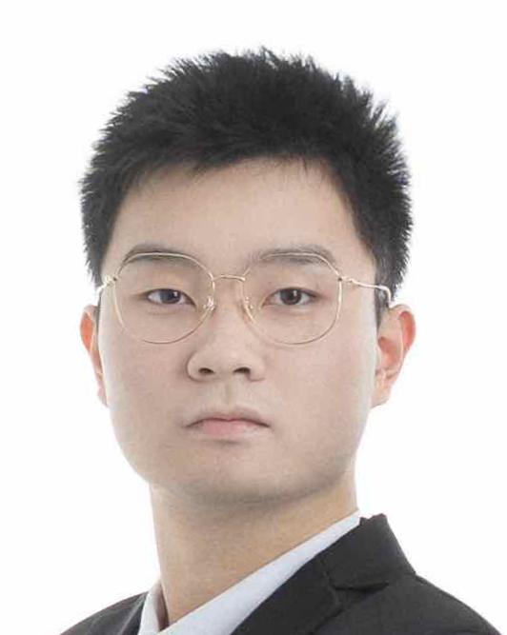
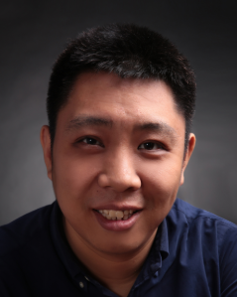
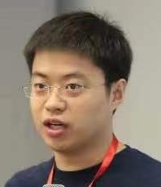
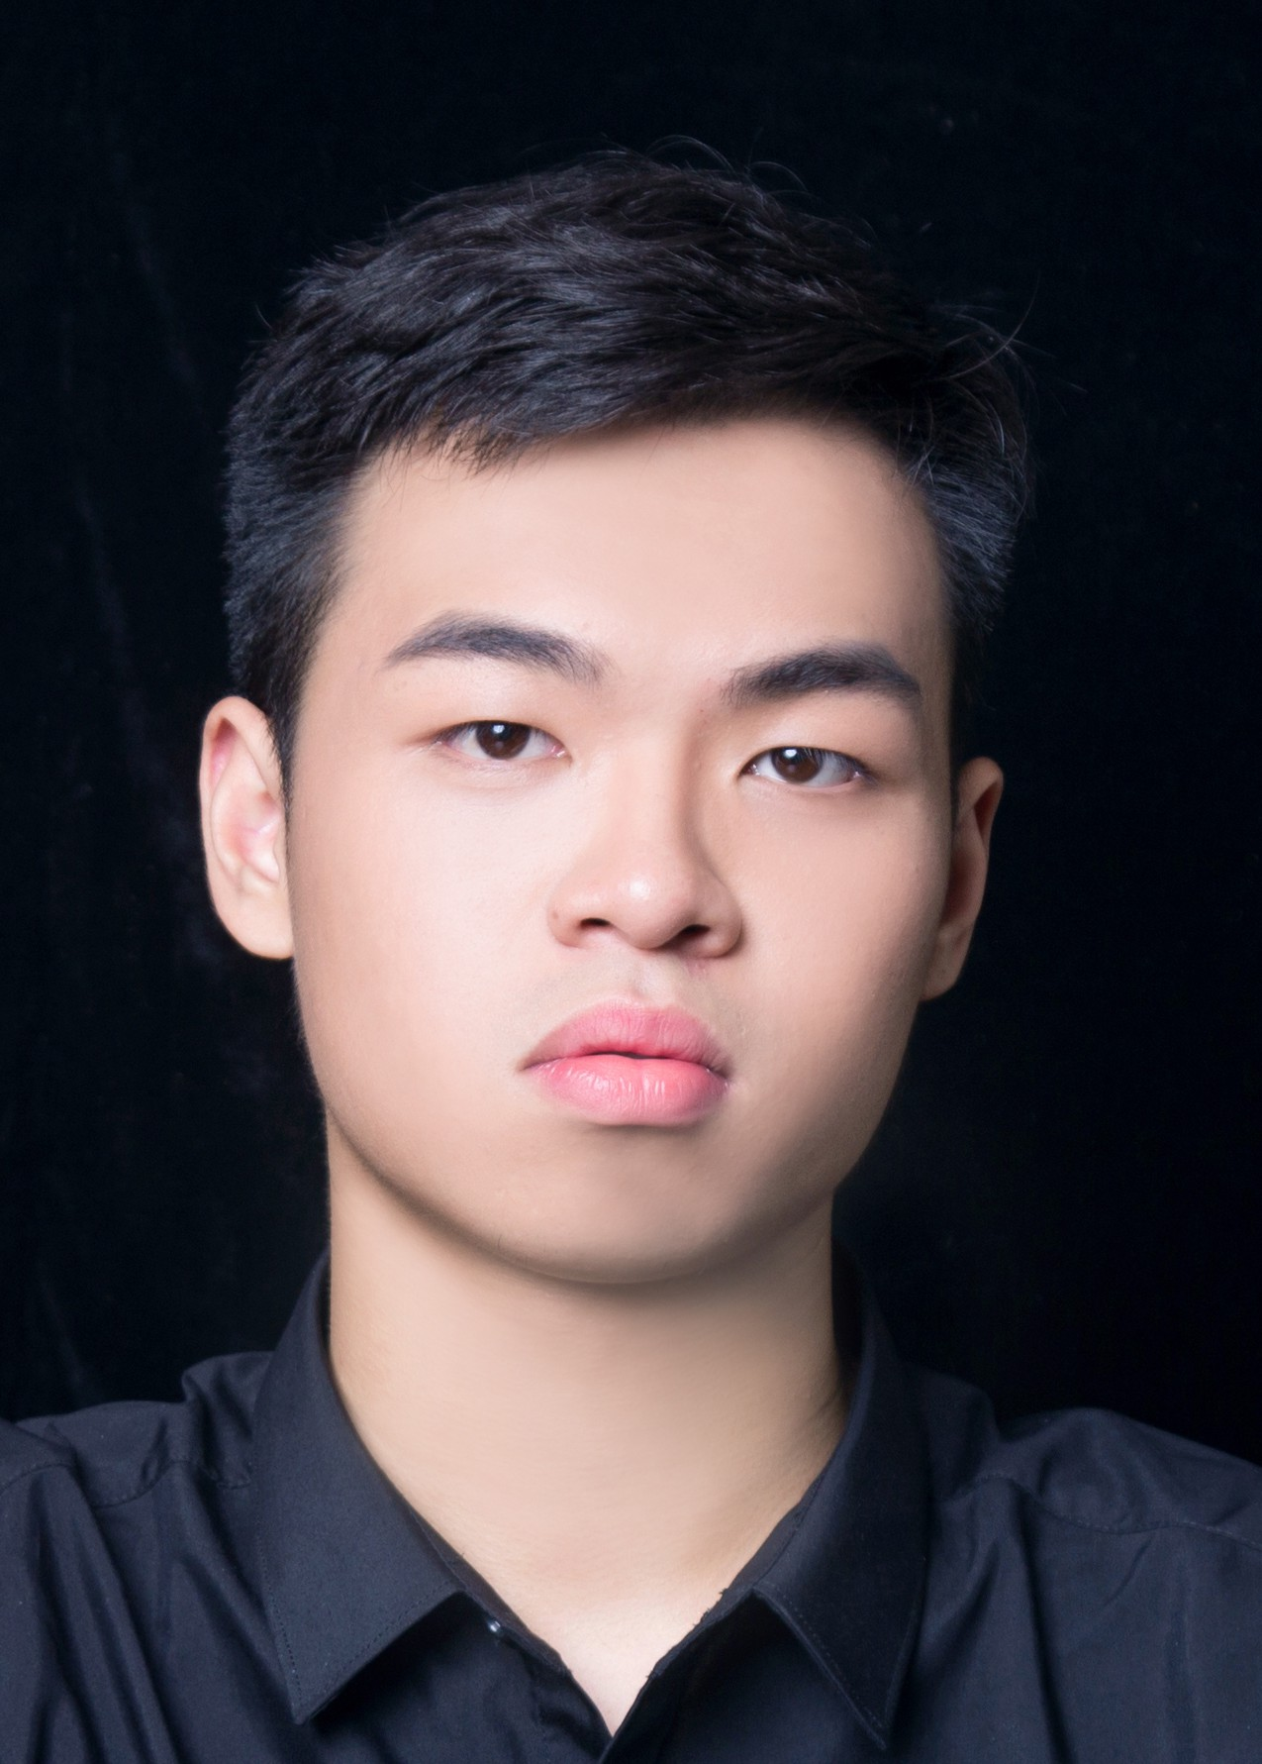
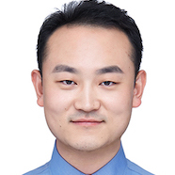
Our Team
Team Leader
Team Coach
Yansheng Wang
Beihang University
Dingyuan Shi
Beihang University
Yongxin Tong
Professor
Beihang University
Yuanfei Luo
4Paradigm Inc.
Maoxiaomin Peng
Beihang University
Yi Xu
Beihang University

Slide 11
Thanks!

